Slide 1
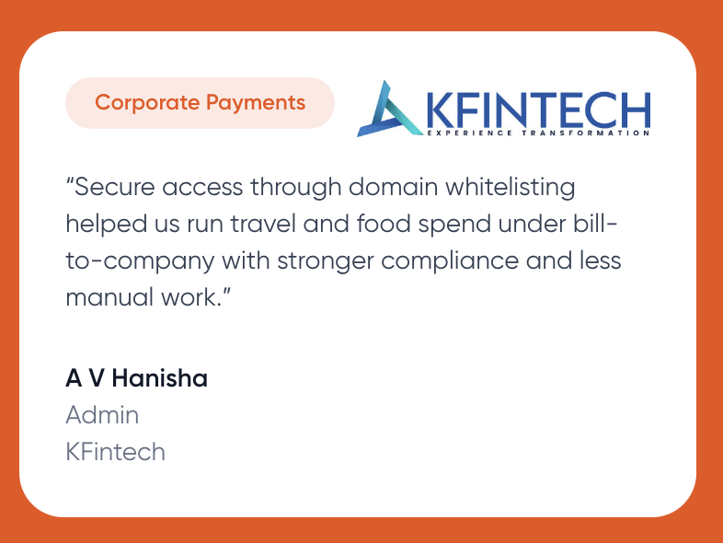

Earlier, meal reimbursements meant chasing employees for receipts, handling paperwork, and managing multiple approval layers—costing us time and productivity. With Swiggy for Work, the process is completely seamless, eliminating administrative overhead. It has streamlined our workflows and saved valuable hours for our team.
A V Hanisha
Facility Manager
KFintech, Hyderabad
Facility Manager
KFintech, Hyderabad

Slide 2


Swiggy Corporate Payments has brought unmatched transparency and control to our meal benefits program. We can now track expenses in real-time, stay fully aligned with company budgets, and still give our employees the freedom to choose their meals. The shift has not only simplified administration but also improved employee satisfaction.
Maria Sneha
Administrator
Wework, Hyderabad

Slide 3

XX
Maria Sneha
Administrator
Wework, Hyderabad

