Slide 1
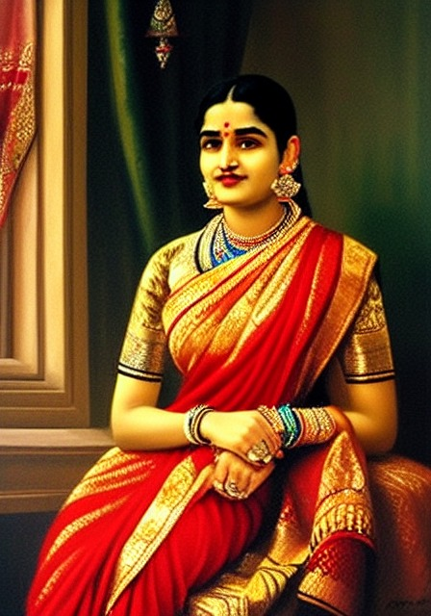
The Next Ravi Varma
Ravi Varma-inspired image generation with Stable Diffusion 1.5 + LoRA
Milestone review: Milestones 1-2 complete (~50% of the proposal)
Generated by our v2 LoRA
Shashwat Sahu | BITS Pilani, K K Birla Goa Campus | October 2026
Notes:
Introduce the project: adapting the 'Next Rembrandt' idea to Raja Ravi Varma using a modern diffusion model plus parameter-efficient fine-tuning. The image on the right was generated by the model we trained this milestone. Today: what is done (dataset + LoRA training), the real results, honest problems, and what remains.

Slide 2
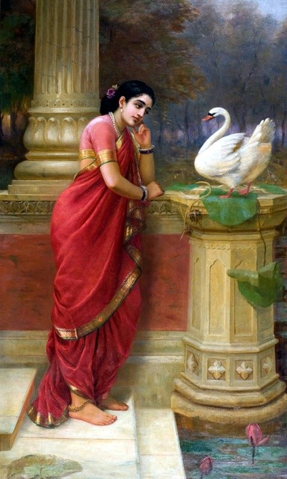
Can a diffusion model learn Ravi Varma's visual language?
MOTIVATION
Raja Ravi Varma (1848-1906): fused European academic oil realism with Indian epics, attire and iconography.
Inspiration: The Next Rembrandt (2016) - learn a painter's style from his corpus and create new works.
Our approach: Stable Diffusion 1.5 stays frozen; a small LoRA adapter (3.2M parameters, 0.37% of the UNet) learns the style behind a trigger token <rvvarma>.
End goal (4 milestones): epic scene text -> prompt expansion -> style LoRA + pose ControlNet -> evaluated image in a web panel.
Hamsa Damayanti - Raja Ravi Varma (training image)
Notes:
Frame the question. Ravi Varma's style is a specific blend: academic oil technique, soft modelling of skin and drapery, theatrical staging, Indian subjects. We use LoRA so we never retrain the whole 860M-parameter UNet: only 3.2M parameters learn the style, attached to a trigger word.

Slide 3


Progress against the proposal
STATUS
Milestone 1
Corpus curation & multimodal captioning
Complete
~50%
Milestone 2
Style-injected LoRA fine-tuning
Complete - trained & evaluated
of the proposal delivered
2 of 4 milestones complete, with a trained model, generated images and a paired evaluation
Milestone 3
Text parsing & semantic scene generation
Not started
Milestone 4
ControlNet, evaluation framework, web panel
Not started
Notes:
Where we are: Milestones 1 and 2 are complete and verified end to end - dataset, captions, training on a GPU, generation and evaluation. Milestones 3 and 4 are not started; some early prototype code exists but I am not counting it.

Slide 4





What has been built: the end-to-end pipeline
ARCHITECTURE
Wikimedia
download
→
Validate &
curate
→
VLM
captions
→
Prepare
→
LoRA
training
→
Generate &
evaluate
200 images,
provenance
134 accepted
BLIP + BLIP-VQA
template
aspect buckets,
12 held out
SD1.5, Colab T4
1500 steps
paired vs base
model
Milestone 1: first four stages (local machine, Apple M-series)
Milestone 2: LoRA training on a Colab T4 GPU, generation + evaluation; weights load back on the Mac
Engineering: YAML configs, reproducible CLI scripts, Colab notebook, 101 automated tests (99 pass, 2 run only without CLIP)
Notes:
Walk the pipeline left to right. Green stages are Milestone 1, red are Milestone 2. Everything is driven by YAML configs and scripts, so another person can reproduce it; the README lists the exact commands.

Slide 5
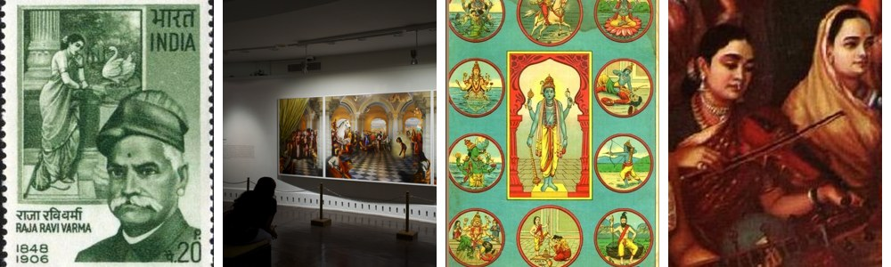
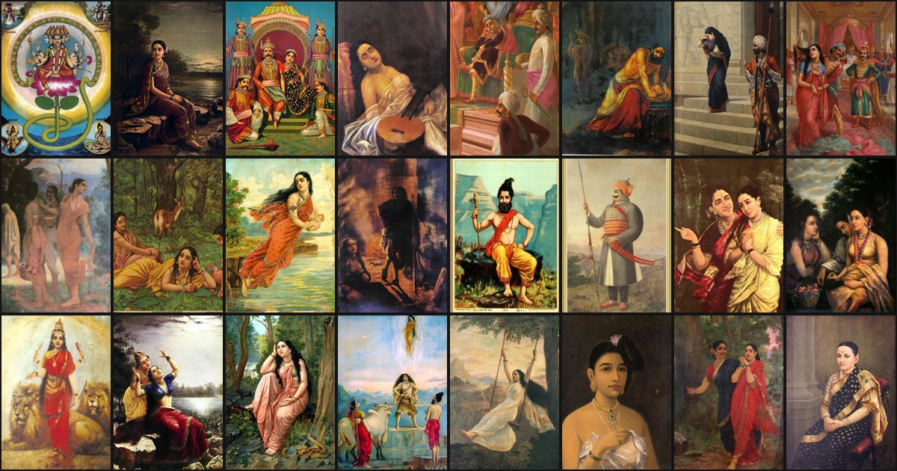
Curating 200 downloads into a clean training set
MILESTONE 1 - DATASET
200
downloaded from Wikimedia Commons
(193 public domain, provenance kept)
66 excluded, each with a recorded reason
26 upscaled copies - originals as small as 200 px (checked against Commons)
33 duplicates - same artwork as prints/crops/re-scans; best copy kept
7 non-paintings - stamps, gallery photos, panel grids, text labels
134
accepted after validation
& curation
122 + 12
training images +
held-out evaluation set
Excluded: postage stamp | gallery photo | multi-panel grid | 200 px original upscaled
Aspect-ratio buckets (e.g. 448x640) instead of square crops: heads and feet are no longer cut off.
Notes:
Quality over quantity. Of 200 downloads only 134 are distinct, real, high-enough-resolution paintings. Key finding: 26 local files had been upscaled to just pass the 384 px minimum - I fetched the true original sizes from Wikimedia to catch that. 12 accepted paintings are held out and never trained on, so evaluation is fair. Images keep their aspect ratio.

Slide 6
Structured captions from a vision-language model
MILESTONE 1 - CAPTIONS
Training caption (real, from the manifest)
<rvvarma>, Hamsa Damayanti, a woman in a red sari feeding a white swan, wearing red dress, necklace jewelry, sitting, calm expression, in park, single-figure composition, vertical format, mid-tone lighting, warm red and ochre palette
BLIP-large writes the scene sentence; BLIP-VQA answers a fixed template: people, clothing, colour, jewelry, pose, action, expression, objects, setting, day/night.
Grounded, not guessed: follow-ups are gated ("what jewelry?" only if "wearing jewelry?" = yes); non-answers and anachronisms ("phone", "smoking") are filtered; all Q&A saved for audit.
Style left to the trigger token: captions describe content, so <rvvarma> absorbs the painterly style; frames are named so they are not learned.
Fits CLIP's 77-token limit; 134 images captioned in 29 min on a laptop.
Notes:
Before: an earlier run had trained on placeholder captions like 'unknown (no VLM available)'. Now every caption is grounded in model answers to fixed questions. The VQA model still makes small mistakes - here 'red dress' for a sari and 'park' for a palace garden - which is why every answer is stored and can be corrected.

Slide 7
LoRA fine-tuning on a Colab T4 GPU
MILESTONE 2 - TRAINING
1500
58 min
3.2M
12.8 MB
optimizer steps
(~49 epochs)
on one Tesla T4
(fp16)
trainable params
(0.37% of UNet)
final LoRA
weights file
Setting | Value
Base model | Stable Diffusion 1.5 (frozen)
LoRA rank / alpha / dropout | 16 / 16 / 0.05
Target modules | to_q, to_k, to_v, to_out.0
Learning rate | 1e-4, 100 warm-up steps
Batch x grad. accumulation | 1 x 4, seed 42
Fixed along the way
LR warm-up was silently 4x too long - fixed
Base-model repo removed from Hugging Face - moved to the official mirror
Colab package conflicts (xformers, bitsandbytes) - removed, documented
Every checkpoint now exports loadable weights; 20-step smoke test before the full run
Notes:
The configuration is the one from the plan, unchanged except it now actually behaves as specified. The smoke test paid off: it caught a GPU library incompatibility in the first minute instead of after an hour. Total training time was 58 minutes on a free-tier T4.

Slide 8
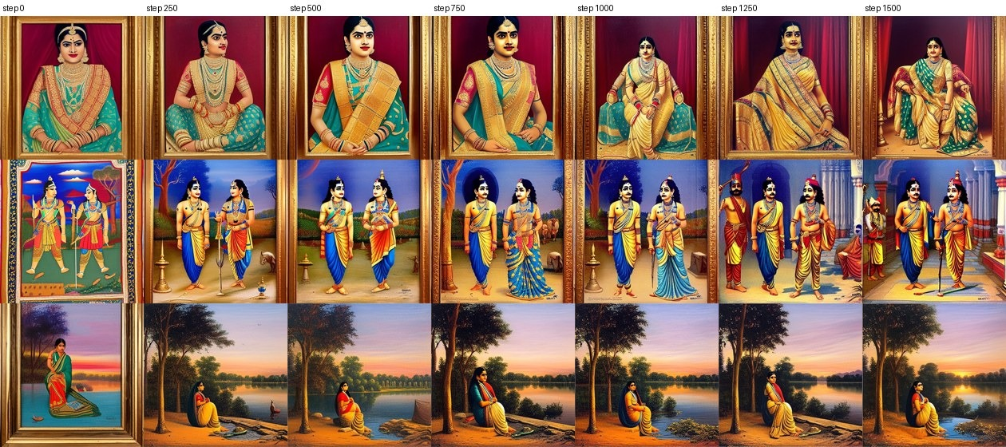
The style emerges during training
MILESTONE 2 - WHAT THE MODEL LEARNED
Same 3 prompts and seeds at every checkpoint. Step 0 = untrained adapter. Frames disappear, a seated maharani pose and a pillared court appear after step 1000.
Notes:
Read left to right: step 0 is the base model behaviour - framed, flat, folk-art. By step 250 the rendering becomes painted oil; the lake scene turns into a soft dusk landscape. After step 1000 the compositions become Varma-like: full-figure seated royal woman with red curtains, Krishna and Arjuna in a pillared court. The training loss stays flat (~0.17-0.18), which is normal for diffusion; these images are the real signal.

Slide 9
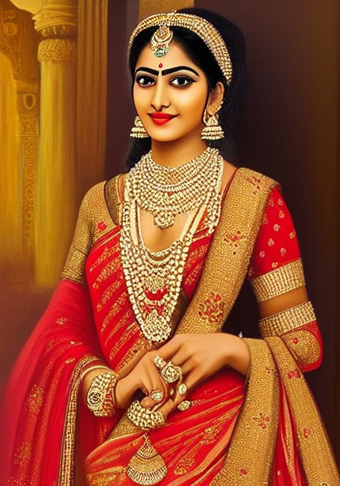
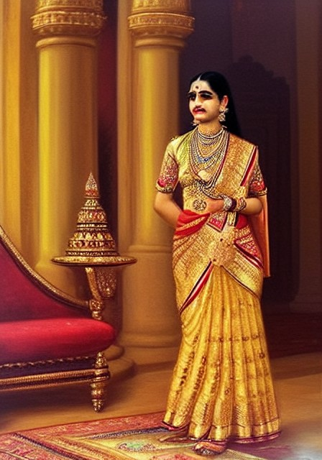
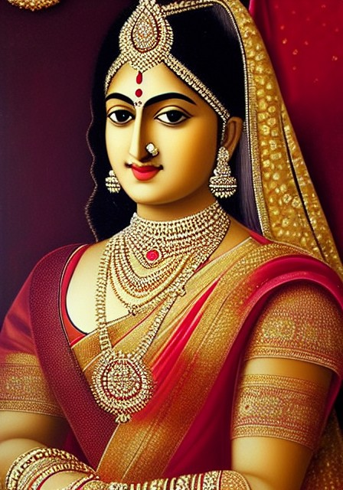
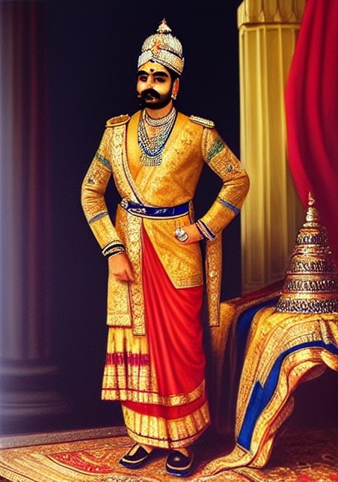
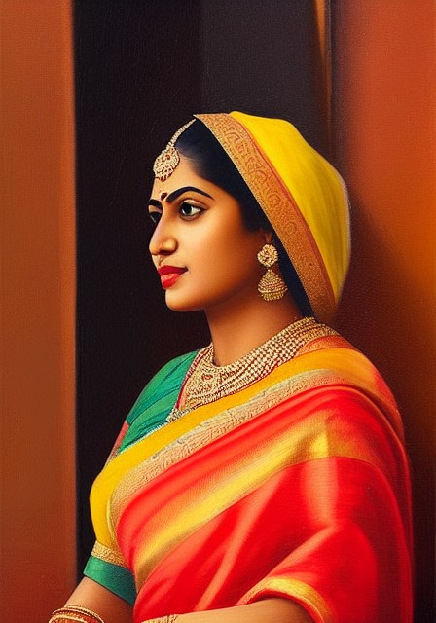
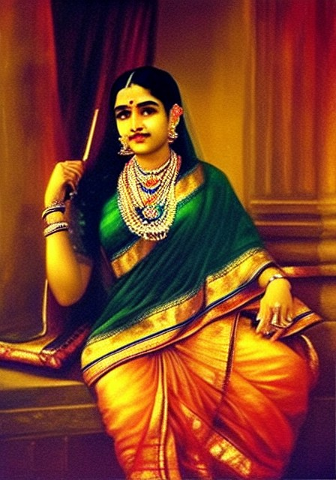
Base model vs our LoRA
RESULTS - SAME PROMPT, SAME SEED
BASE SD1.5
+ LoRA
BASE SD1.5
+ LoRA
BASE SD1.5
+ LoRA
"royal Indian woman ... palace interior"
"royal Indian portrait ... jewelry"
"woman seated beside a window ..."
Staging moves toward Varma: full-length figures with pillars, carpets and lamp stands; maharaja-style court portraits; seated poses with draped saris.
No gilt frames: 0 of 15 LoRA images vs 5 of 15 base images (same negative prompt).
Rendering: warmer, darker painted backgrounds instead of glossy digital 'calendar art'.
Notes:
Each pair uses the identical prompt and random seed - the only difference is the LoRA. Point at the palace pair: the base model gives a glossy bridal close-up; the LoRA gives a full-length figure staged with pillars and props like Varma's portraits. The portrait prompt becomes a maharaja-style commission. And none of the 15 LoRA images has a frame, while a third of the base images do.

Slide 10

What works, and what the LoRA gets wrong
RESULTS - HONEST ASSESSMENT
Works
Varma-like staging, palette and soft painted lighting on single figures
Generalises to unseen prompts and seeds; no memorised copies (max similarity to any training image 0.88)
Weights trained on Colab load and run on a laptop
Problems found
Moustache-like shadow on some women's upper lips (not in the base model)
Signature-like scribbles in corners - learned from printed signatures on oleographs
Crowded mythological scenes stay saturated 'poster art'; hands remain weak
Generated locally on a MacBook with the trained weights (seed 7)
Notes:
This image is the strongest single result: dark green background, soft side light, seated pose, detailed sari - close to Varma's portraits of women. But I want to be clear about the defects: an upper-lip shadow on some women, small signature-like marks in corners because many training prints carry signatures, and group scenes still look like posters. These are the first things to fix next.

Slide 11
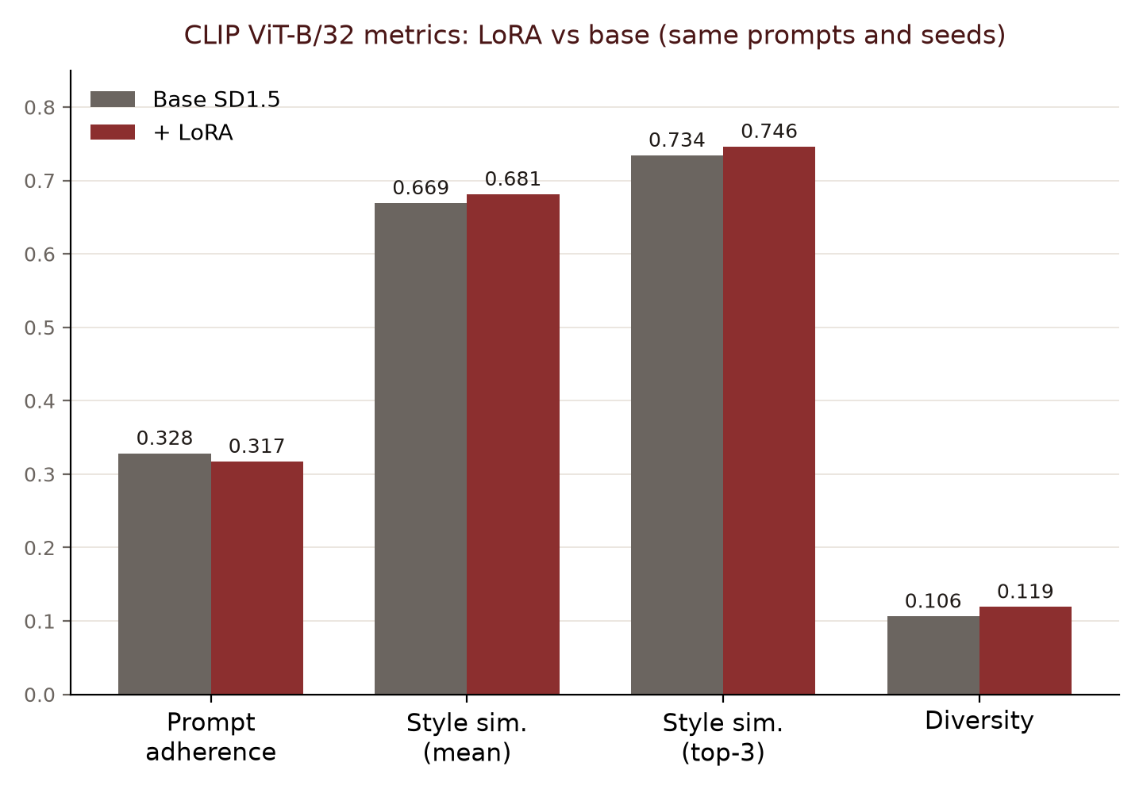
Automatic metrics: a small, inconsistent shift
EVALUATION - 15 PAIRED IMAGES
Style similarity to 12 held-out paintings: +0.012 (LoRA higher in 7 of 15 pairs).
Prompt adherence -0.011, within noise for 15 pairs.
No memorisation: no output is a near-copy of a training image.
Takeaway: CLIP barely sees the composition and framing changes that are obvious to a viewer - it is a weak judge of painting style. A human rubric (quality, anatomy, style, prompt) is prepared for the next stage.
Base SD1.5 vs + LoRA: prompt adherence 0.328 vs 0.317; style similarity mean 0.669 vs 0.681, top-3 0.734 vs 0.746; diversity 0.106 vs 0.119.
Notes:
I did not want to over-claim, so the metrics are reported as they are. On paper the change is small. Looking at the images, the change is clear but not in the dimensions CLIP measures well. This is exactly why Milestone 4 plans a stronger evaluation; the human rating sheet is already generated.

Slide 12

Next steps
REMAINING ~50%
Fix LoRA artifacts
Name or crop printed signatures in captions; find the portraits behind the upper-lip shadow; pick the best checkpoint with the human rubric.
Milestone 3: scene parser
LLM prompt expansion: epic narrative -> attribute-rich prompt with the trigger token (e.g. "Yudhishthira weeping over Karna at Kurukshetra").
Milestone 4: control & UI
OpenPose / Canny ControlNet for balanced, dignified poses; Gradio panel (text + pose -> image); fuller evaluation and checkpoint hub.
Notes:
Immediate next step is fixing the two artifacts, which is a data/caption fix rather than a model change. Then the remaining milestones: the text-to-prompt scene parser and pose control with ControlNet, ending in the web panel.

Slide 13
Summary
A curated, provenance-tracked 134-image Ravi Varma corpus with grounded VLM captions
A LoRA trained on a T4 that visibly moves SD1.5 toward Varma's staging and rendering
Honest evaluation: clear visual gains, small CLIP gains, two artifacts to fix
Code, data list, results and docs: github.com/f20240684-cmd/the-next-ravi-varma-v2
Thank you - questions?
Notes:
Close with the three claims: a clean dataset, a working style model with visible effect, and an honest evaluation. Everything is public in the repository. Then take questions.

