Slide 1
ChaturangZero
R
A
G
M
K
G
A
R
Learning Chaturanga by self-play, AlphaZero style
CS F407 course project
R
A
G
M
K
G
A
R
Notes:
We built an AlphaZero-style agent for Chaturanga, the Indian ancestor of chess. It knows only the rules and learns entirely by playing against itself. The board on the right is the uncheckered Ashtapada in its starting position.

Slide 2
Chaturanga: the ancestor of chess
Piece | How it moves
Raja (king) | One square in any direction
Mantri (minister) | One square diagonally
Gaja (elephant) | Jumps exactly two squares diagonally
Ashva (horse) | Like a knight
Ratha (chariot) | Like a rook
Padati (soldier) | One step forward, no double step; becomes a Mantri on the last rank
Why it is hard to learn
Weak, short-range pieces make attacks slow
Checkmate = win, stalemate = draw
Draws by 100 moves without progress or threefold repetition
So most games between beginners end in a draw
Notes:
Same 8x8 board as chess but uncheckered. The pieces are much weaker than in chess: the minister moves only one square diagonally and the elephant jumps two squares diagonally. That makes attacks slow and draws very common, which turns out to matter a lot for learning.

Slide 3
The course rules we worked within
0
50
4×64
4096
domain knowledge
simulations per move
residual network
possible moves
Only the rules of the game. No piece values, no opening books, no human games
In training (the limit is 30 to 50). Play time may use more
4 blocks of 64 filters (limit 4 to 6 blocks, 64 to 128 filters), 836k parameters
Every from-square × to-square pair, illegal moves masked before the softmax
Notes:
These are the constraints from the project proposal. Everything in the final model follows them. A couple of short exploratory runs used piece values to test a hypothesis; they are clearly labelled and are not part of the final model.

Slide 4
How it learns: the AlphaZero loop
1
Self-play
2
Replay buffer
3
Training
4
New network
The agent plays itself. Each move: 50 steps of tree search guided by the network
Every position is stored with the search's move preferences and the final result
The network learns to predict both: policy (cross-entropy) + value (MSE) + L2
The improved network plays the next round of games
Search: PUCT selection, the network's move priors to expand, its value to judge leaves (no random playouts). Exploration: Dirichlet noise at the root in self-play.
Notes:
One loop, repeated. The network has two heads: a policy over 4096 moves and a value between minus one and one. The tree search uses the policy to decide what to look at and the value instead of random playouts. The search's visit counts and the final game result become the training targets.

Slide 5
What we built
1
Rules engine
Board, legal moves, check, game end; 13-plane 8×8 encoding
Student 1
164
2
Network
Residual net, policy + value heads, training loop, replay buffer
Student 2
automated tests
3
Search + evaluation
MCTS with PUCT, benchmarks, matches, human-game logging, plots
36 for the rules alone; the fast engine is checked against the original on thousands of positions
Student 3
4
Browser game
Play the final model with clickable moves and a view of what it thinks
Shared
Notes:
Work was split by the proposal's roles. Milestone 1 asked for a fully tested rules engine: there are 36 rules tests, plus tests that compare the optimised engine with the original move for move.

Slide 6
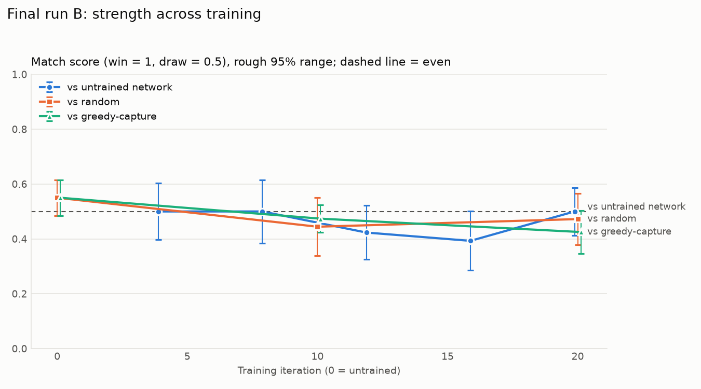
First runs: no measurable improvement
400 games per run
Scores stayed near 0.5 against random, greedy-capture and untrained players
About 80% of self-play games were draws
About 7 hours per run on one CPU core
A team member new to chess beat it: 3 wins, 3 draws
Notes:
Milestone 3 and 4 runs. Two runs of 20 iterations with 20 games each. The curves stay flat around an even score. Instead of stopping there, we measured why.

Slide 7
Why, and what we changed
259 → 19 ms
Diagnosis
per move: faster rules engine and a folded network
Draws give the value head a target of 0: almost nothing to learn
400 games is tiny: AlphaZero used about 44 million
So the problem was data, and data was limited by speed
6
games in parallel, one per core
2.2–2.4×
faster again with self-play on the laptop GPU
Notes:
We made self-play about 11 times faster without changing any result: tests check the fast engine against the original. Later we batched positions from many games onto the GPU for another 2.2 to 2.4 times.

Slide 8
The long run: training finally helps
54,000
self-play games
144 h
on one laptop
27–0
round 560 vs its starting point (59 draws)
Notes:
Same method, 135 times more games. Every checkpoint beats the starting model. Most of the gain came in the first 140 iterations; lowering the learning rate at the end gave the last clear step. Iteration 560 was the final model of this run; Gumbel self-play later replaced it.

Slide 9
Final model (round 1220) vs fixed opponents
What it learned
It almost never loses: 3 losses in 400 games
It checkmates: 22 of 30 games vs greedy, 16 of 30 vs random
Greedy capture: round 560 drew 99 of 100, round 1220 wins 70
Notes:
The first chart bar is round 1220 against round 560 at the browser setting, 1600 simulations each. Round 560 rarely checkmated and drew almost every game against greedy capture; Gumbel self-play fixed most of that. Round 1220 also beat 560 by 128 wins to 3 at 50 simulations.

Slide 10
Trying to go further: one idea beat round 560
Idea (all within the rules) | Result | Score vs 560
Bigger network (6×128), twice | Caught up with round 560, never passed it | 0.495
Counting draws as slightly bad | More decisive games, but riskier and weaker | 0.454
Even smaller learning steps | No change | 0.515
Learning from the search's own values | No change | 0.518
Shorter practice games (300 plies) | 2.4× more decisive games per hour, no gain | 0.500
Averaging 7 trained versions | No change | 0.515
Resigning hopeless games | Unsafe: the model does not see losses coming | –
Gumbel self-play | The one gain: kept improving to round 1220 | 0.814
Notes:
A score of 0.5 means even with round 560. Every margin is about plus or minus 0.03 to 0.05, so none of the first seven is a real gain. Their common thread: the value head cannot tell a won position from a lost one, because about 85% of self-play games are draws. Gumbel self-play trains on a better move target than visit counts, made 44% of practice games decisive, and kept improving for 660 rounds.

Slide 11
Thinking longer helps, up to a point
Search steps per move
The 30–50 limit is for training only
800 beat 50 by 23 wins to 0
1600 beat 800 by 15 to 3
3200 vs 1600: even (7 to 6)
The browser game uses 1600, about 0.5 s per move
Notes:
The clearest gain after training came from search at play time. Each doubling helps less, and past 1600 nothing: more search cannot make up for a weak value head. These numbers are for round 560.

Slide 12
Against people
An experienced player (FIDE blitz 1641) vs round 560
The same player vs round 1220 (final)
10 games, 800 simulations
14 games, 800 simulations
2
3
5
0
1
13
AI wins
draws
human wins
AI wins
draw
human wins
AI score 0.350. It kept more material and won one game by checkmate.
AI score 0.036. Far stronger against programs, but not against a person.
Notes:
The same experienced player played both sets at 800 simulations per move. The 1220 games were played from another city on a standalone browser version, checked to give the same moves as the Python code. Round 1220 beats round 560 by 83 wins to 1, yet scored 0.036 against this player, against 0.350 for 560. Part of that is the player knowing the agent by then, but mainly it never meets a direct attack on its king in self-play. Ten of the thirteen losses took under 110 plies. Earlier, a beginner played six games against the first-run model: 3 human wins and 3 draws.

Slide 13
Why it does not master the game
 | AlphaZero (chess) | ChaturangZero
Self-play games | about 44 million | about 120,000
Search steps per move in training | 800 | 50
Network | about 20 blocks × 256 | 4 blocks × 64
Hardware | thousands of TPUs | one laptop
370×
fewer games
At our speed, 44 million games would take about 8 years of nonstop running on this laptop
Notes:
The method is the same as AlphaZero's; the scale is not. The gap to mastery is one of compute, which we measured rather than guessed.

Slide 14
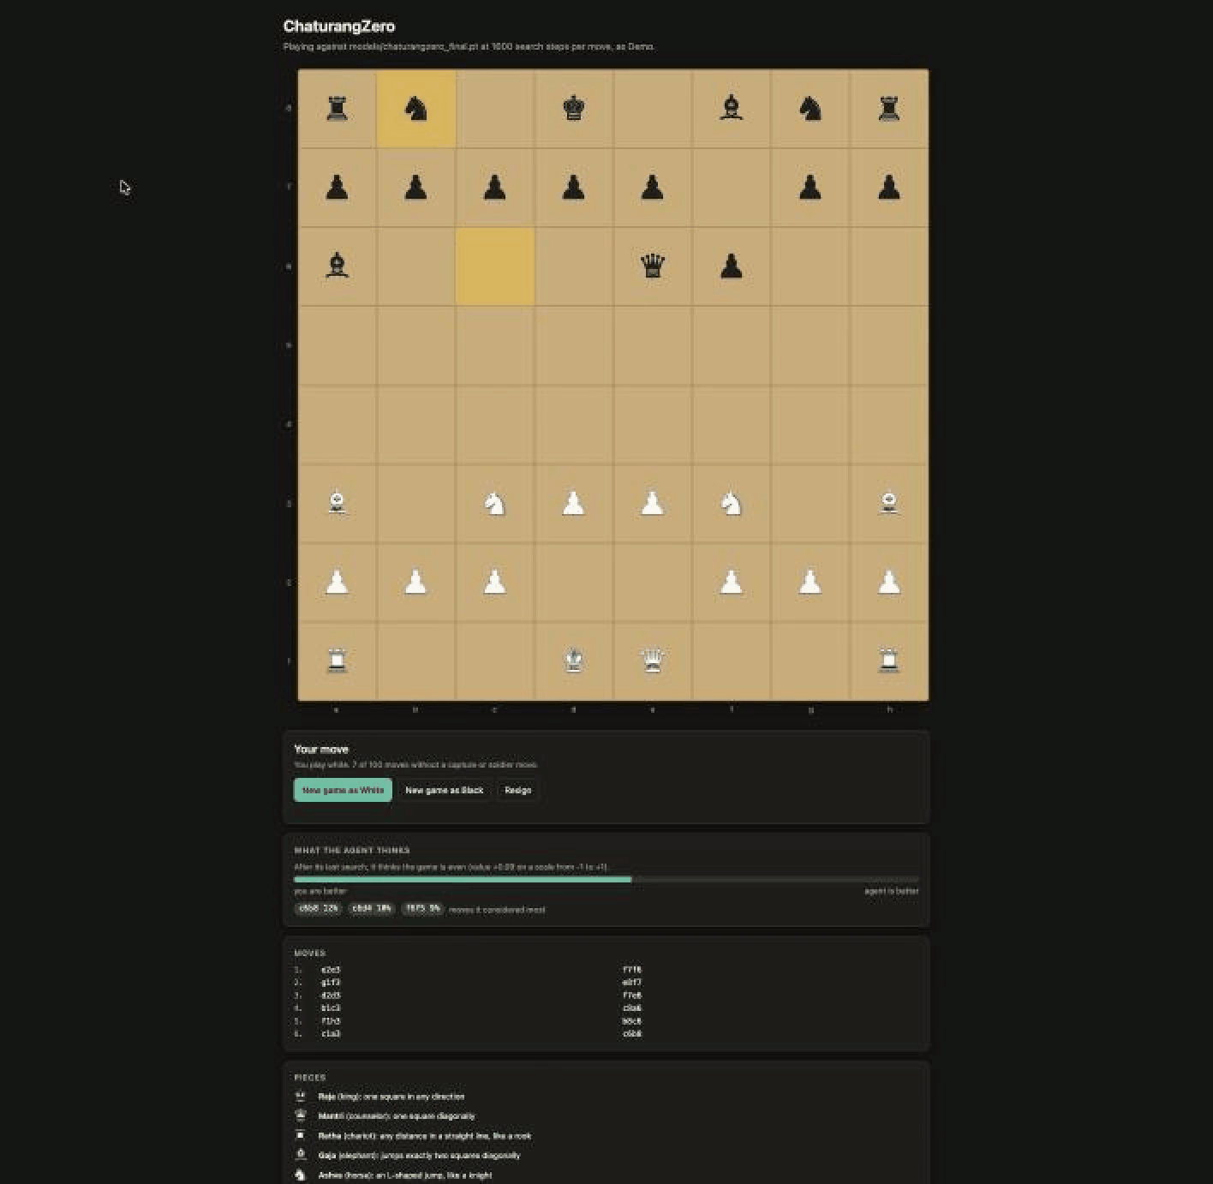
Live demo: play the final model
1
python play_web.py --player Demo --no_log
Opens the board in the browser; no internet needed
2
Click a piece, then a square
Legal moves are highlighted; the AI answers in about half a second
3
Watch "What the agent thinks"
Its evaluation and the three moves it searched most
Backup recording: click to play
Notes:
Start the server before the talk. If port 8000 is busy, add --port 8001. If the live demo fails, play the recording on this slide instead. Point out the legal-move highlights and the agent's evaluation panel.

Slide 15
What we learned
The full AlphaZero method works on one laptop, within the rules
A failed first result, measured and explained, led to the fix: more data
Gumbel self-play (round 1220) taught it to finish games; mastery still needs far more games
Notes:
Gumbel self-play was the one training change that helped, and it produced the final model. It did not make the agent harder for a strong human to beat (13 of 14 human wins). Future work: many more games, for example with the larger network, which would need several days of dedicated GPU time.

