Slide 1
Digital Design
Prof. GSS Chalapathi,
Prof. Saurabh Gandhi,
Prof. Ramesh Sambangi

Slide 2
Review questions
Final expression after simplification with k-maps must include what terms?
While applying k-maps, don’t cares should be treated as?

Slide 3
A circuit to turn on the right LED
Turn on exactly 1 of 8 LEDs, depending on a certain stored value.
How many bits do we need to store the value of the LED to be turned on?
How many output wires does the circuit need to turn on the correct LED?
LED0
LED1
1
LED2
3-to-8
DECODER
LED3
0
LED4
1
LED5
◀ only this one is ON
101₂ = 5
LED6
LED7
A decoder expands a compact 3-bit code back into 8 individual output lines — exactly one active at a time.

Slide 4
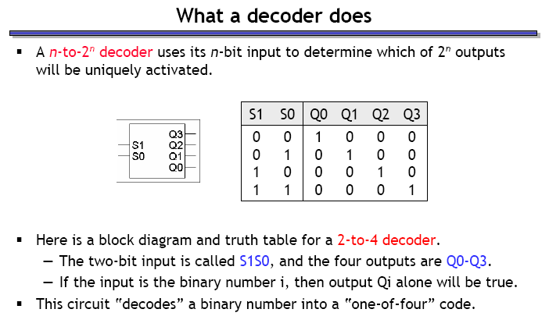
Decoders

Slide 5
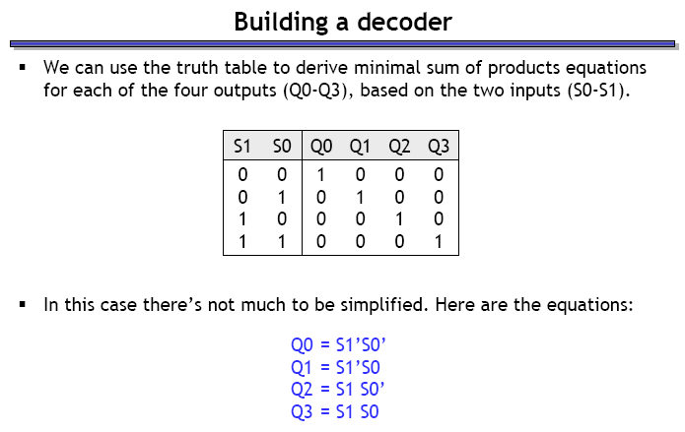
Building a decoder

Slide 6
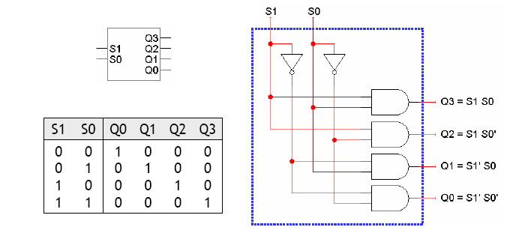
Building a decoder – the circuit

Slide 7
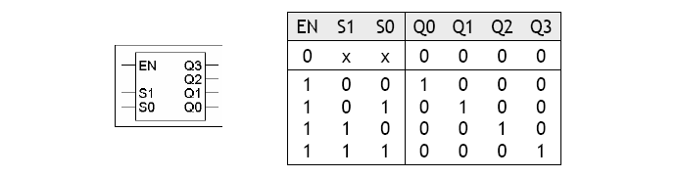
Decoders with ‘enable’ inputs
Decoders can include an enable input (EN)
EN = 0 disables the decoder (all outputs are 0)
EN = 1 enables the decoder (exactly 1 output is 1 depending on the input)

Slide 8
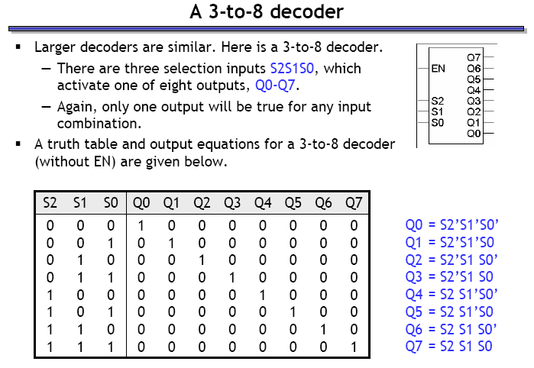
3 – to – 8 decoder

Slide 9
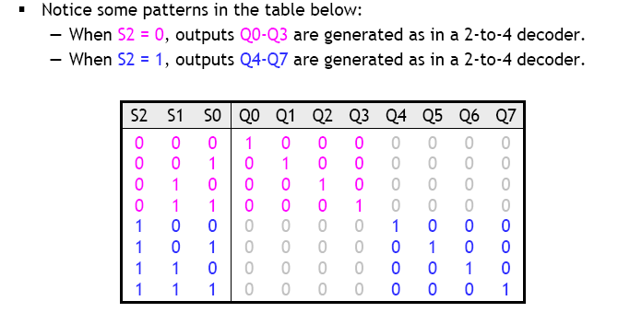
Building a 3 - to - 8 decoder
Can you think of a ‘hierarchical’ design for this decoder, like we did with half and full adders?

Slide 10
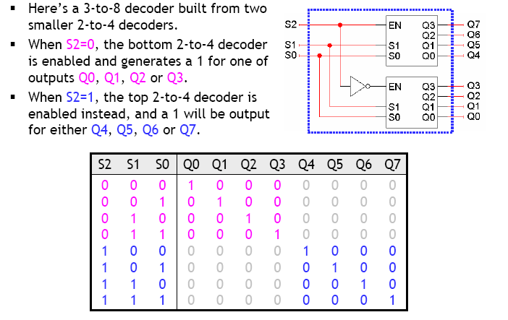
Hierarchical decoder design
Verify this circuit: use equations for the 2-to-4 decoder to derive equations for 3-to-8 decoder!

Slide 11
Notice anything special about the 3-to-8 decoder output expressions?

Slide 12
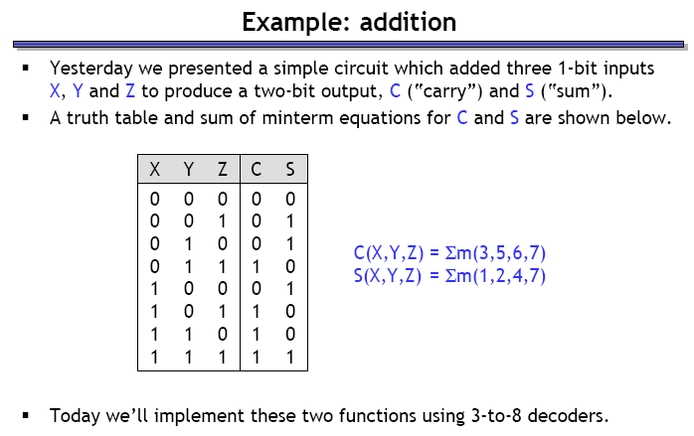
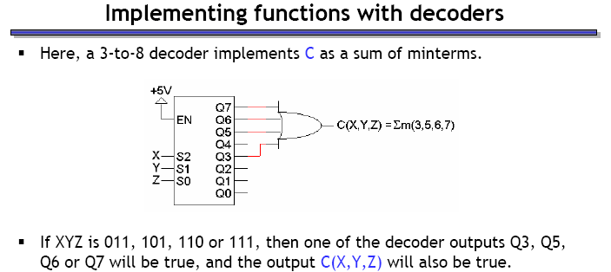
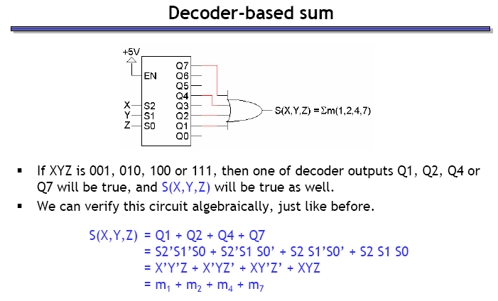
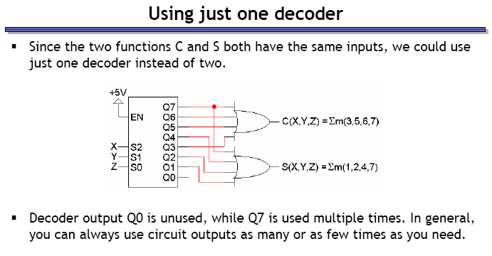
Example: building an adder with decoder(s)
Verify:
Reuse the same decoder for both outputs:
(Dis)advantages of this approach?

Slide 13
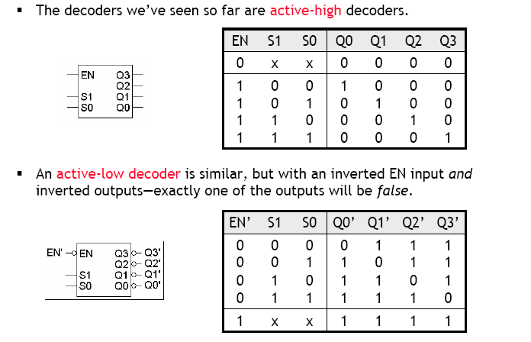
Active-high and active-low decoders

Slide 14
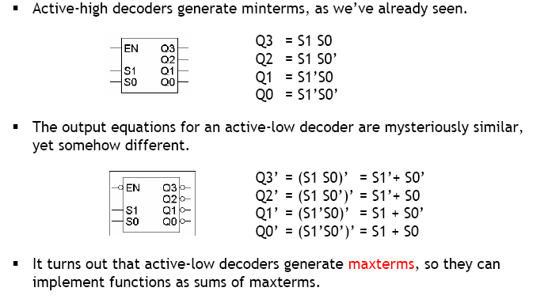
Active-low decoders are maxterm generators!

Slide 15
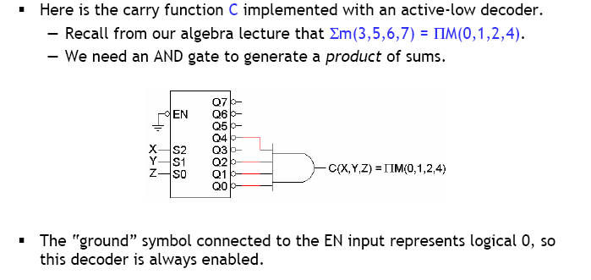
Active-low decoder example

Slide 16
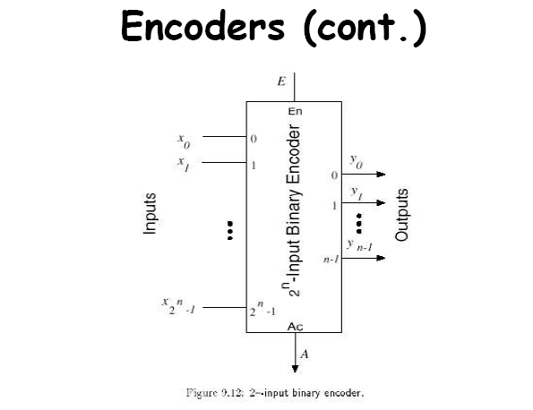
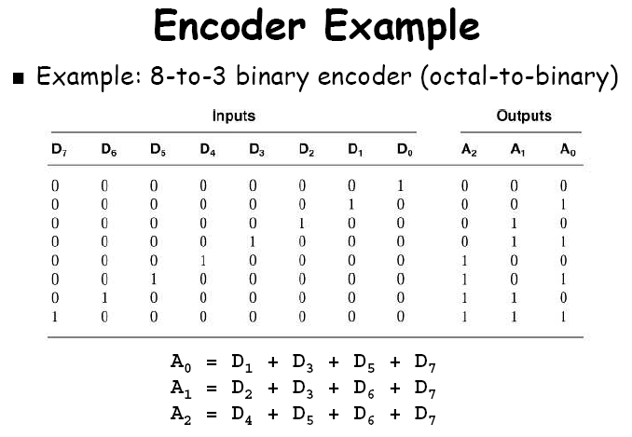
Encoders
Opposite function as that of a decoder
Takes 2^{n} inputs, and generates the binary equivalent of the input rank as output

Slide 17
Encoder design issues
Two ambiguities associated with the design of the simple encoder shown previously:
It assumes only one input to be active. If two inputs are simultaneously active, output becomes invalid.
D₀ = 1 or all Ds = 0 will both generate an output of 0
Solution: Priority encoders
Multiple asserted inputs allowed; one has priority over others
Separate indication of no-asserted-inputs

Slide 18
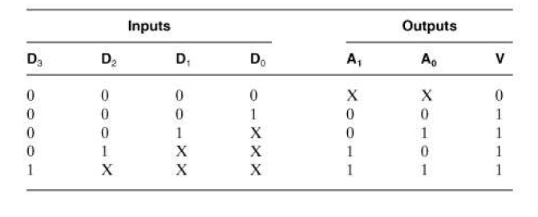
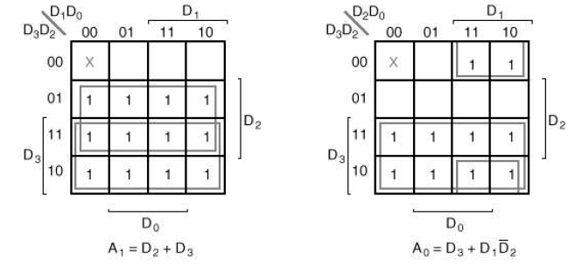
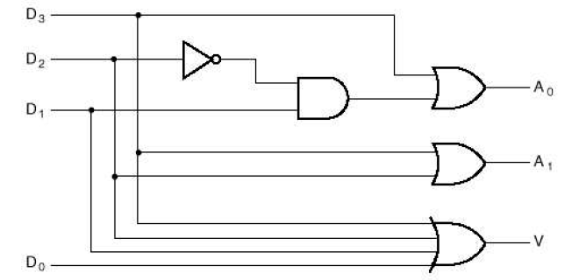
Example: 4-to-2 priority encoder
If two or more inputs are simultaneously 1, output will correspond to the rank of the highest priority input
‘Valid’ output indicator, set to 1 only if at least one of the inputs is 1

Slide 19
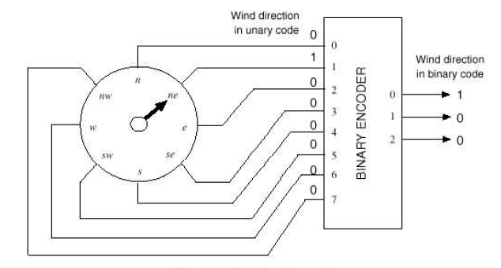
Use of binary encoder (example)

Slide 20
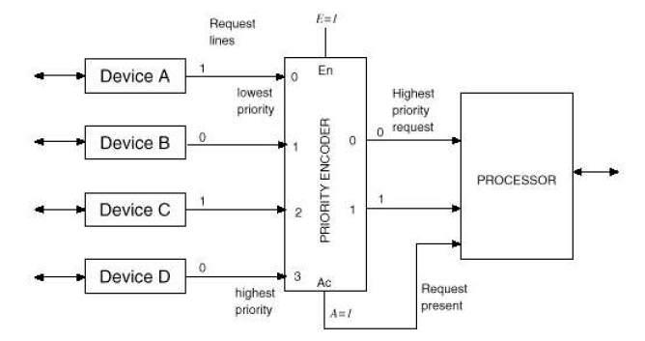
Uses of priority encoders (example)

