Slide 1
Digital Design
Prof. GSS Chalapathi,
Prof. Saurabh Gandhi,
Prof. Ramesh Sambangi

Slide 2
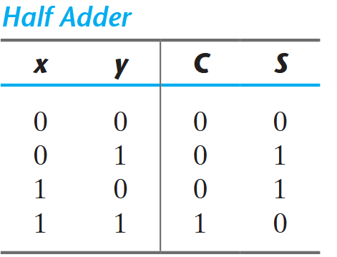
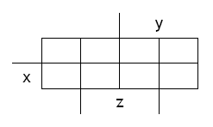
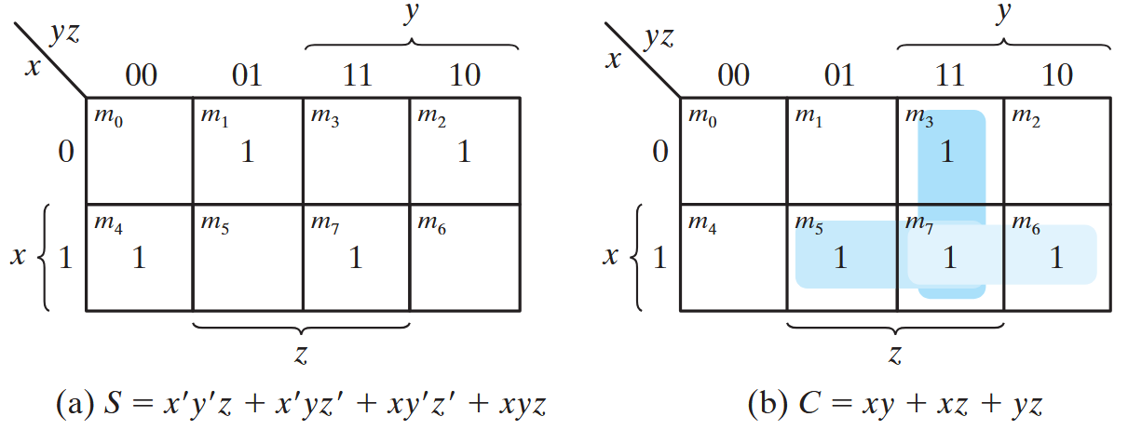
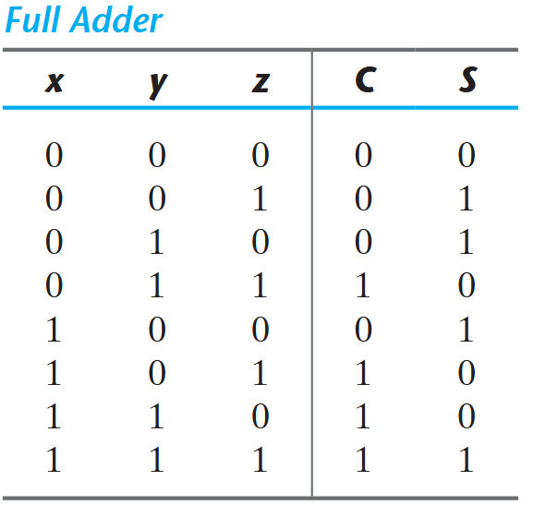
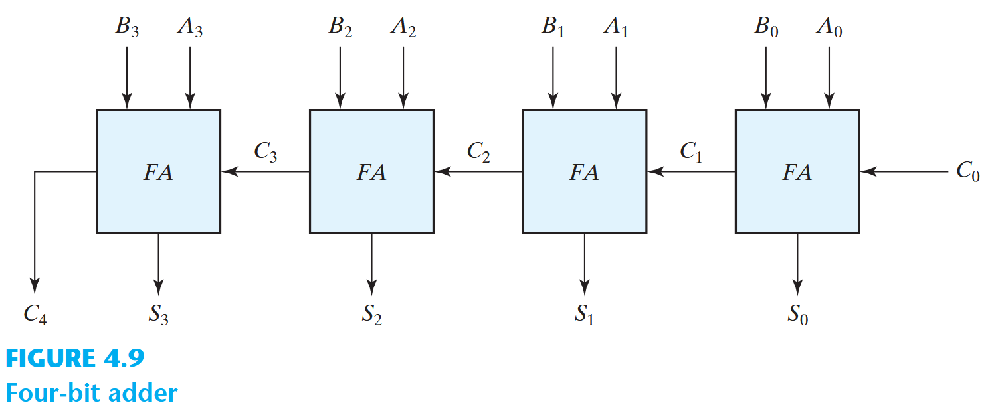
Using K-maps to build binary adders
K-map for S
K-map for C

Slide 3
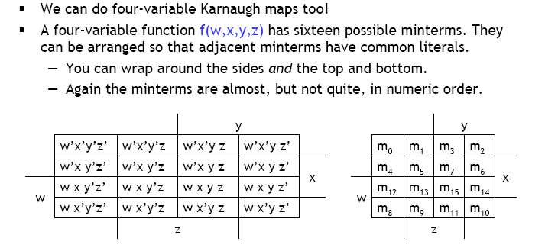
Four variable K-maps

Slide 4
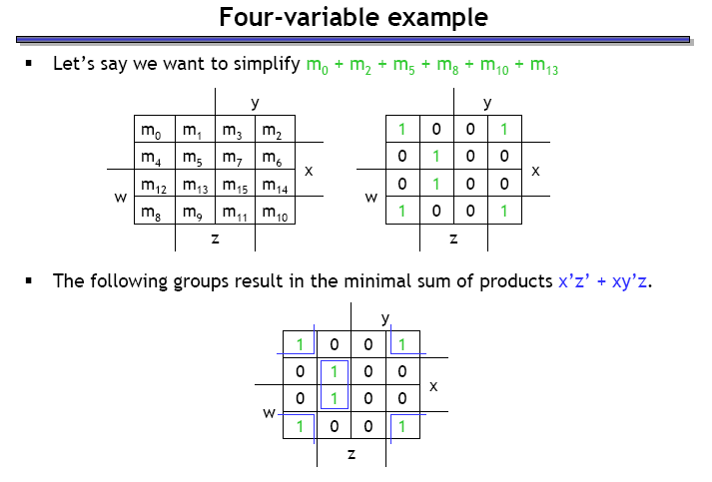
Four variable example

Slide 5
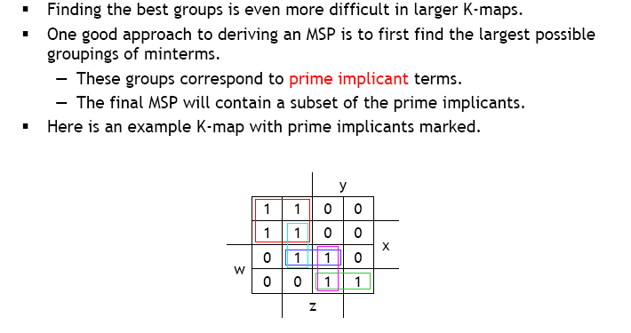
Prime implicants

Slide 6
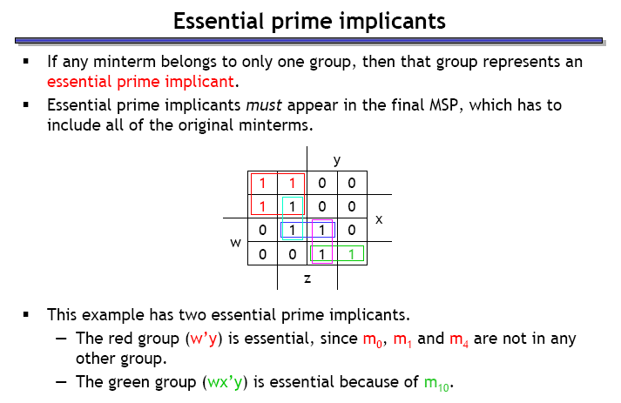
Essential prime implicants

Slide 7
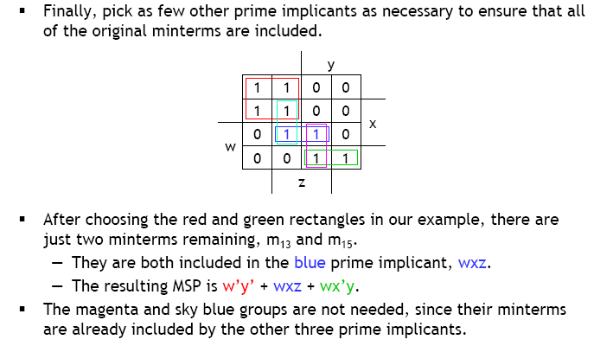
Covering the remaining minterms

Slide 8
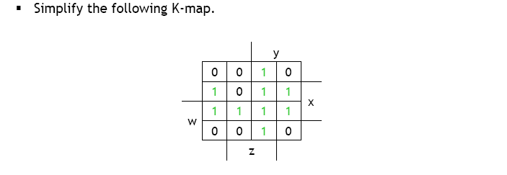
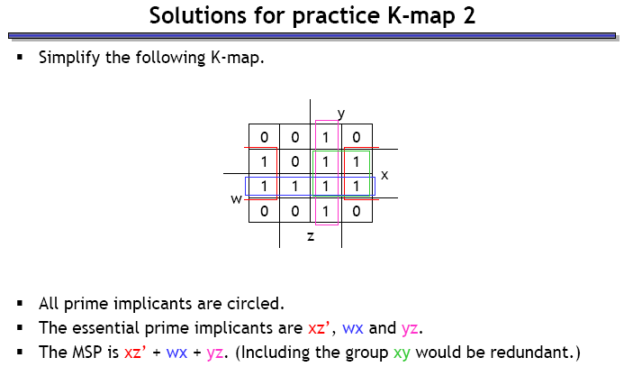
Example 2

Slide 9
Don’t Care Conditions
Unspecified outputs for certain inputs
Used in Map to provide further simplification
X is marked inside the square for don’t care input
Choose to include each don’t care minterm as either 1 or 0

Slide 10
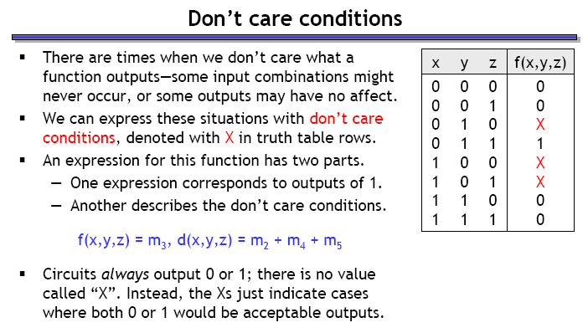
Don’t care conditions

Slide 11
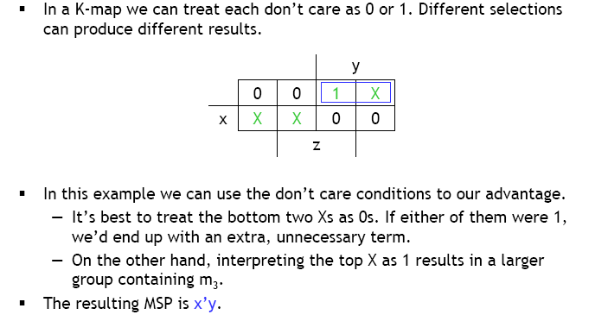
Don’t care simplifications

Slide 12
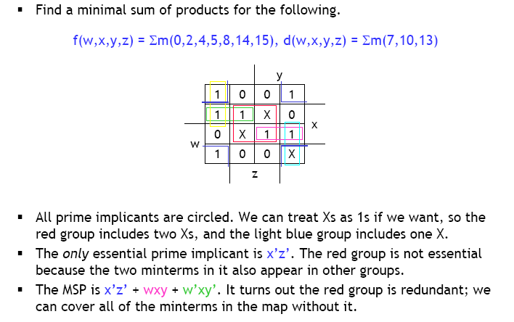
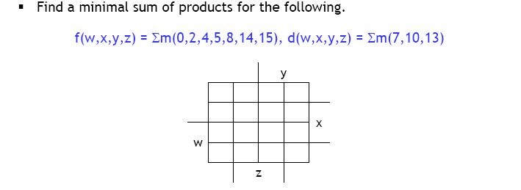
Example 3

Slide 13
POS Simplification
Combine valid adjacent squares containing 0’s
Obtain simplified expression of the complement in SOP form
Compliment further to get function in POS form
F(A,B,C,D) = Σ(0,1,2,5,8,9,10)
1 | 1 | 0 | 1
0 | 1 | 0 | 0
0 | 0 | 0 | 0
1 | 1 | 0 | 1
F’ = AB + CD + BD’
By De Morgan’s:
F = (A’+B’) (C’+D’)(B’+D)

Slide 14
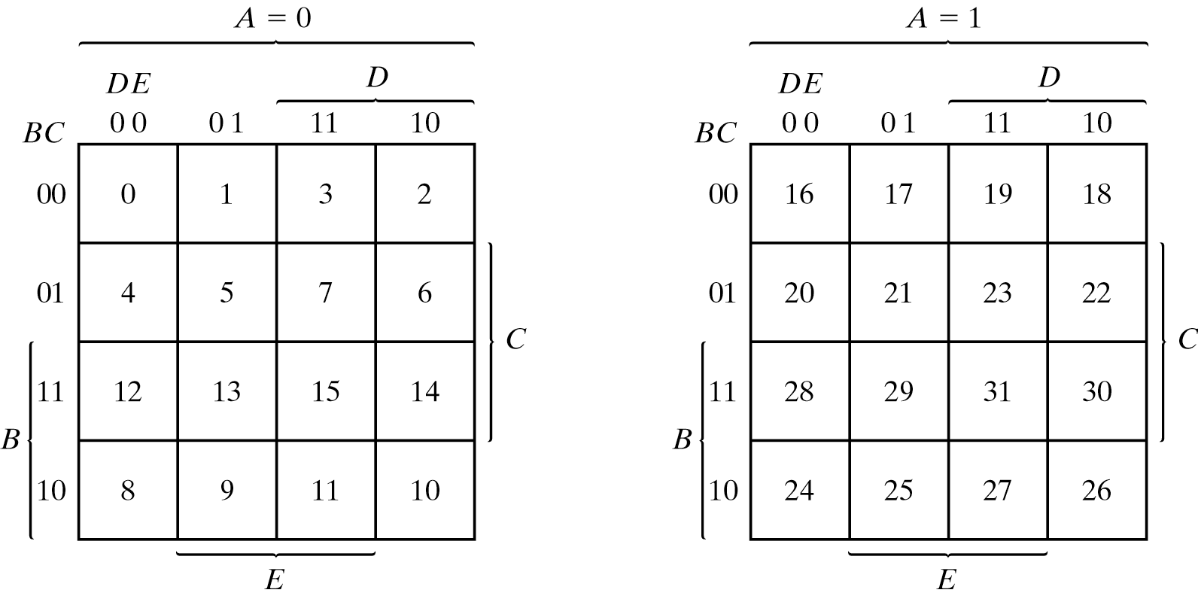
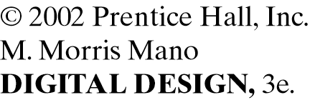
Five variable K-map

