Slide 1
Verilog Introduction
Prof. GSS Chalapathi,
Prof. Saurabh Gandhi,
Prof. Ramesh Sambangi

Slide 2
Why Do We Need HDL?
Traditional digital design
Specification Circuit Logic Design Gates
For a small circuit, this is manageable.
But modern systems contain:
Millions/billions of transistors
Complex datapaths
Memories and processors
High-speed communication interfaces
Problem: Manually designing and connecting gates becomes impractical.
Solution: Hardware Description Languages (HDLs)

Slide 3
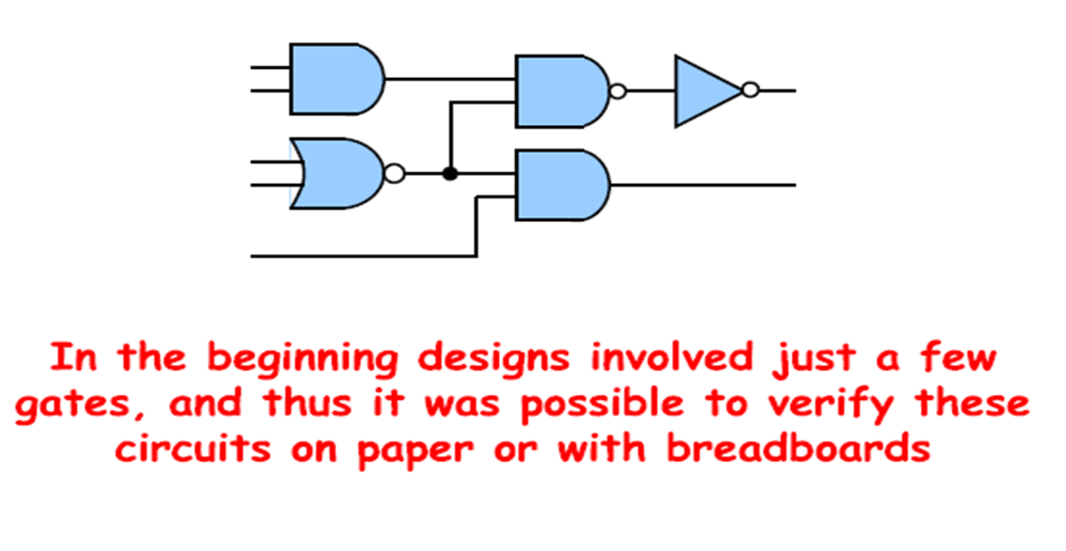
Why HDLs Contd…

Slide 4
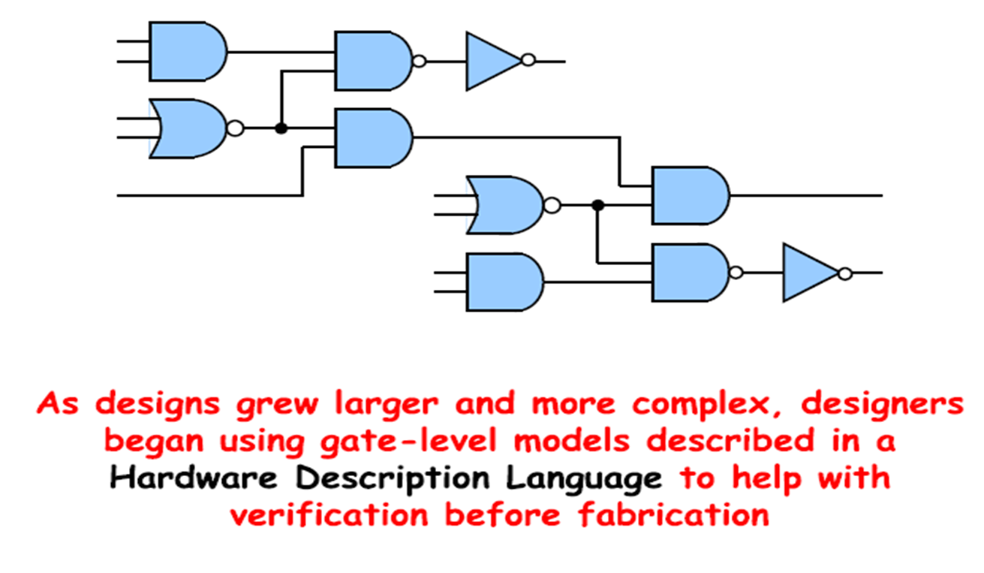
Why HDLs Contd…

Slide 5
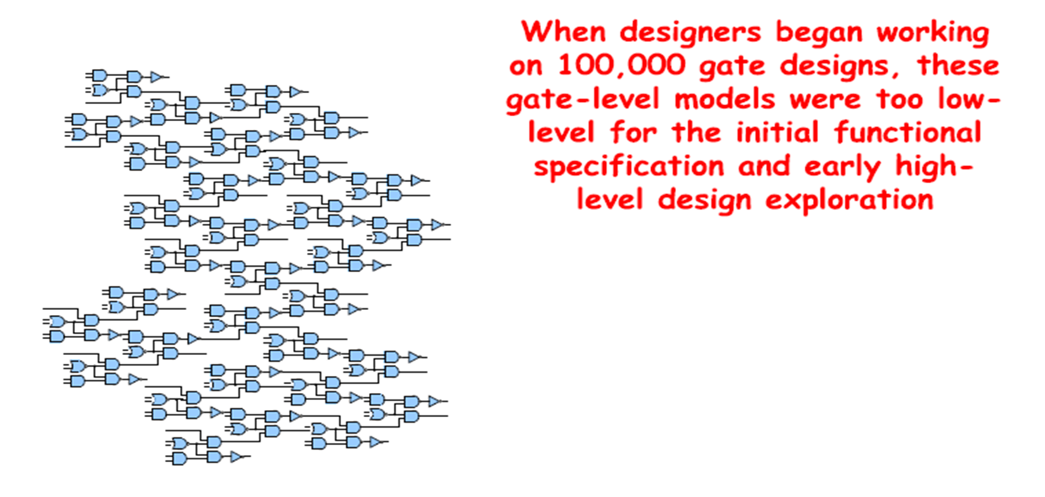
Why HDLs Contd…

Slide 6
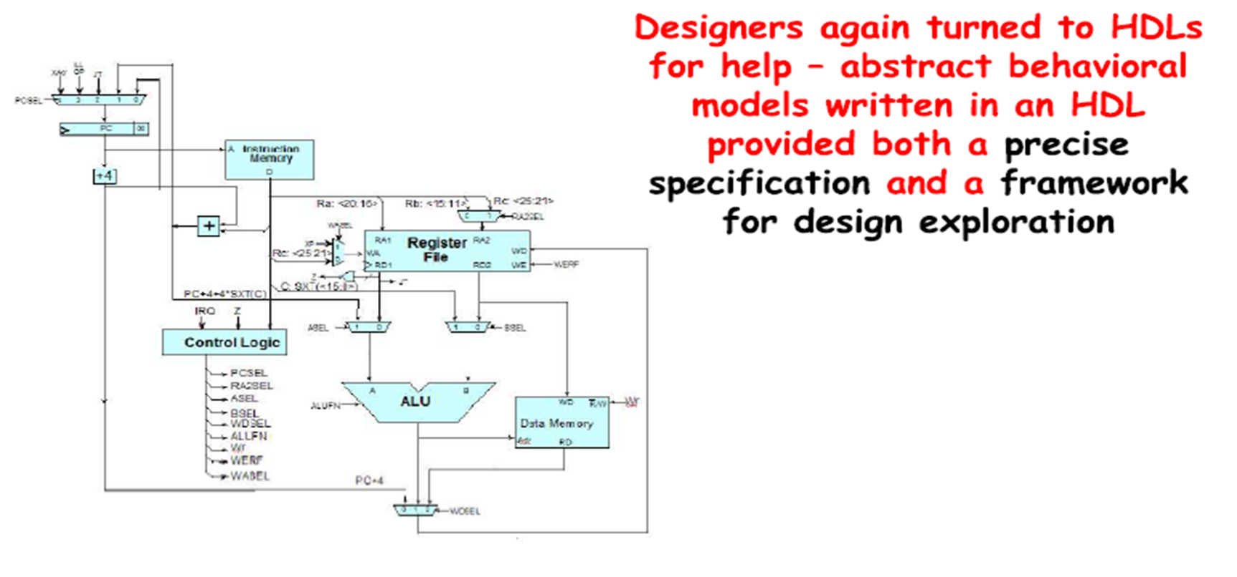
Why HDLs Contd…

Slide 7
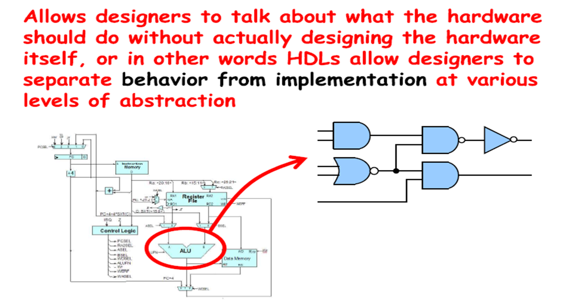
Advantages of HDLs

Slide 8
Types of HDL
There are three standard HDL’s that are supported by IEEE.
VHDL (Very-High-Speed Integrated Circuits Hardware Description Language). Sometimes referred to as VHSIC HDL, this was developed from an initiative by US. Dept. of Defense. (IEEE 1076)
Verilog HDL – developed by Cadence Data systems and later transferred to a consortium called Open Verilog International (OVI). (IEEE 1364)
SystemVerilog - SystemVerilog is essentially an extension of Verilog. Useful for Hardware design + advanced verification IEEE 1800

Slide 9
Verilog HDL
HDL is NOT a software programming language.
Textual representation of Hardware constructs.
All statements in HDL code are executed in parallel.
Originally a modeling language for a very efficient event-driven digital logic simulator
Later pushed into use as a specification language for logic synthesis
Virtually every chip (FPGA, ASIC, etc.) is designed in part using Verilog.

Slide 10
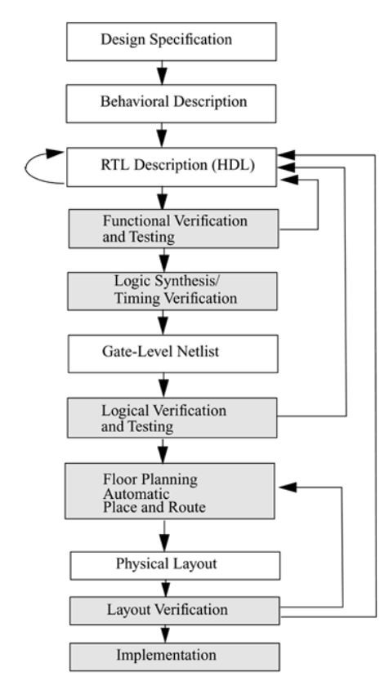
ASIC Design Flow
Specification
Define functionality, performance, power, area, technology, and interface requirements.
RTL Design
Describe the hardware using Verilog/SystemVerilog/ VHDL.
Functional Verification
Check whether the RTL correctly implements the specification using simulation.
Logic Synthesis
Convert RTL into a gate-level netlist using standard-cell libraries.
Floorplanning & Placement
Decide the physical locations of major blocks, memories, and I/O cells on the chip.
Place individual standard cells in their physical locations.

Slide 11
ASIC Design Flow
Layout & GDSII Generation
Generate the final physical layout database used for manufacturing.
Layout verification
It is the process of checking whether the physical layout is correct, manufacturable, and electrically equivalent to the intended circuit before fabrication.
Implementation
Semiconductor foundry manufactures the chip on silicon wafers.
Package the die and perform electrical/functional testing before deployment.

Slide 12
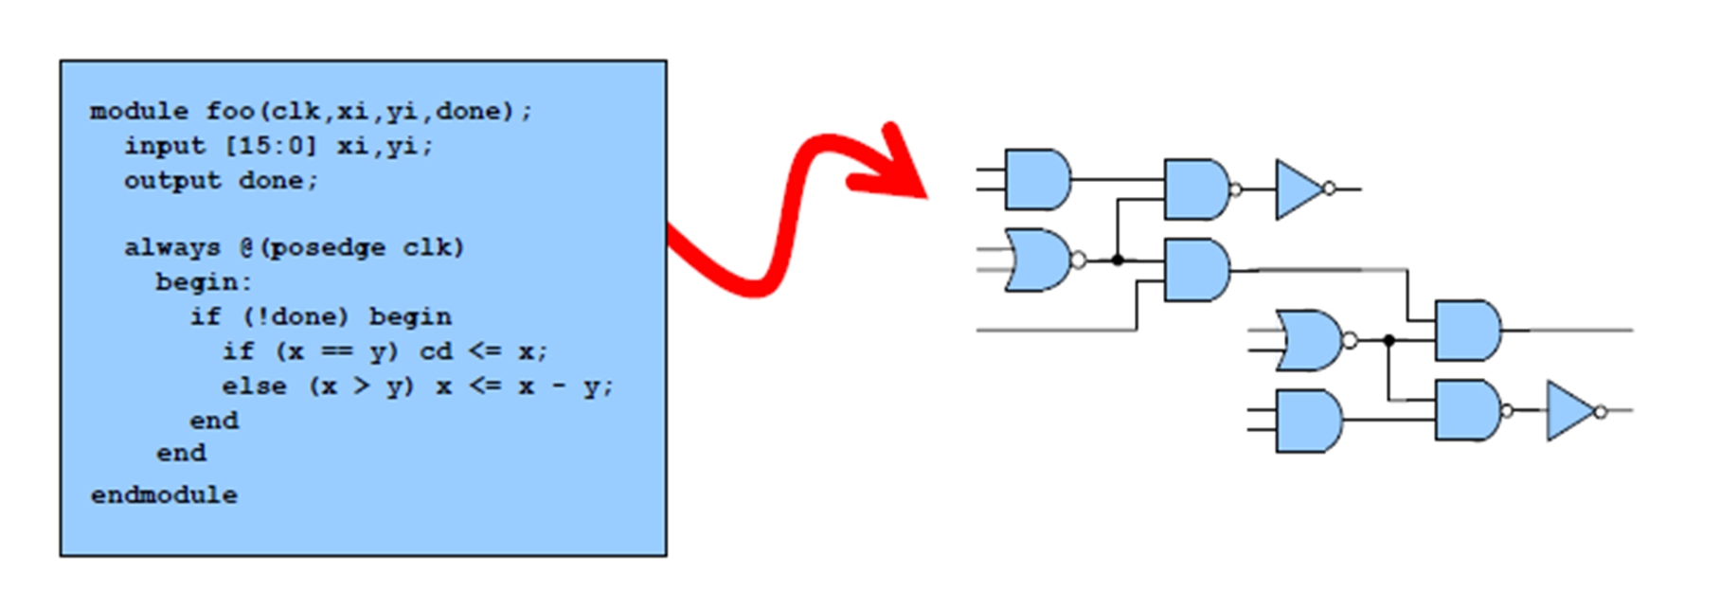
Logic Synthesis?
The process of automatically generating a gate-level model from either a dataflow or a behavioral model is called Logic Synthesis

Slide 13

Modules
A module is basic building block in Verilog
It describes a piece of hardware from a simple AND gate to a full CPU.
It tells the EDA tools what pins exist, what logic to build, and how to connect it

Slide 14
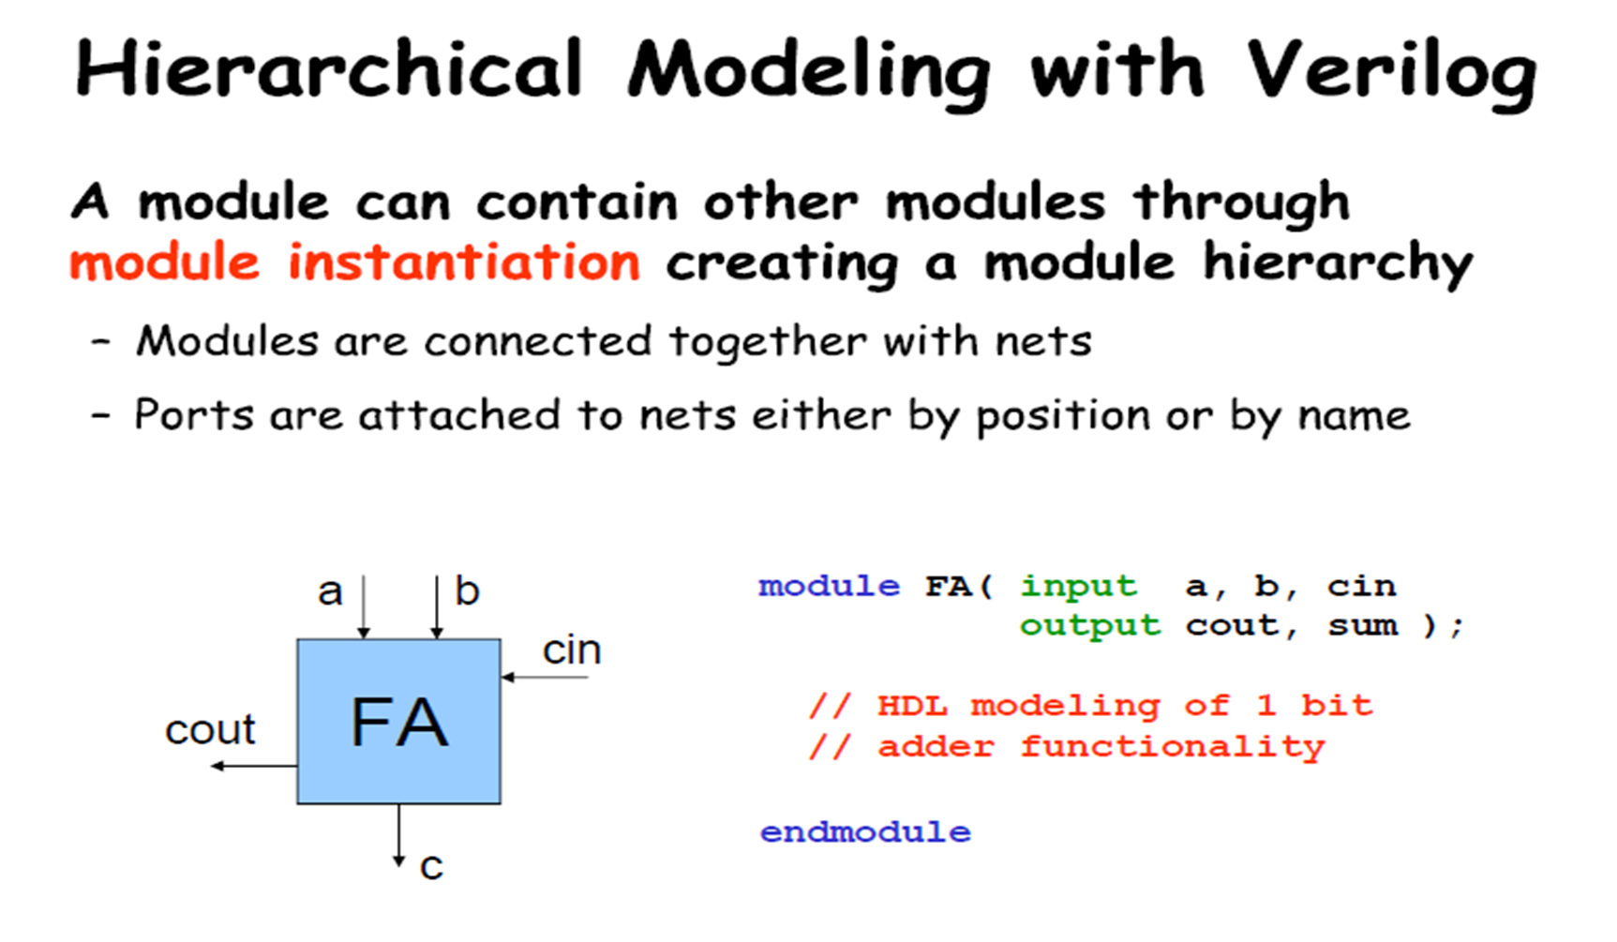
Ports
Port list defines how the module communicates with the outside world.
Ports can be declared as input, output and inout.
input : Signal flows into the module.
Read-only inside the module. Cannot be written to.
output : Signal flows out of the module.
Written inside the module, read by the parent.
inout : Bi-directional signal (e.g., data buses).
Can be both read and written.

Slide 15
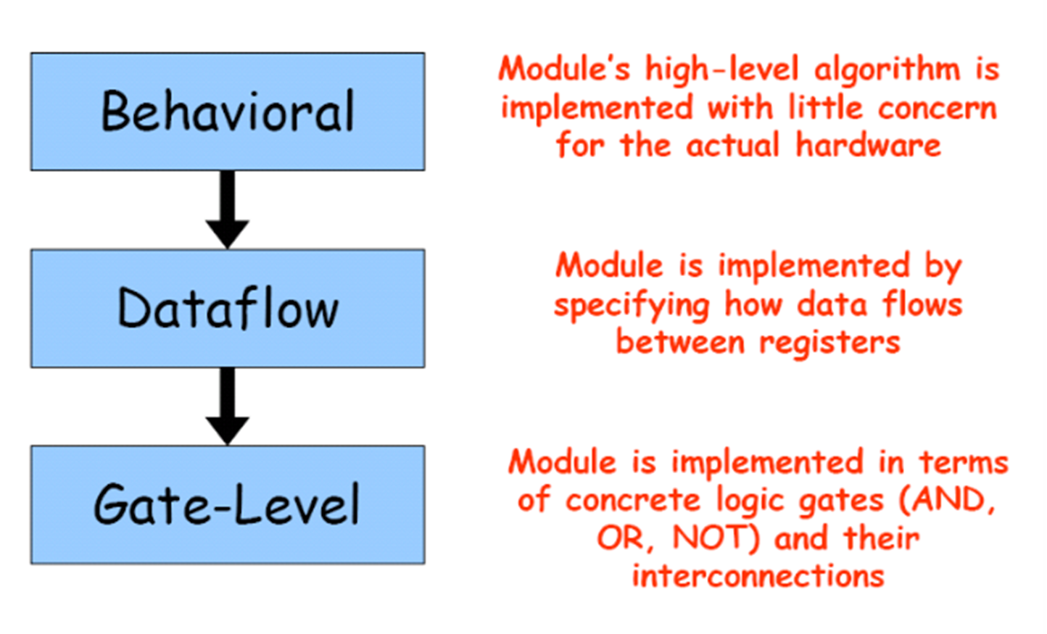
HDL Abstraction Levels

Slide 16
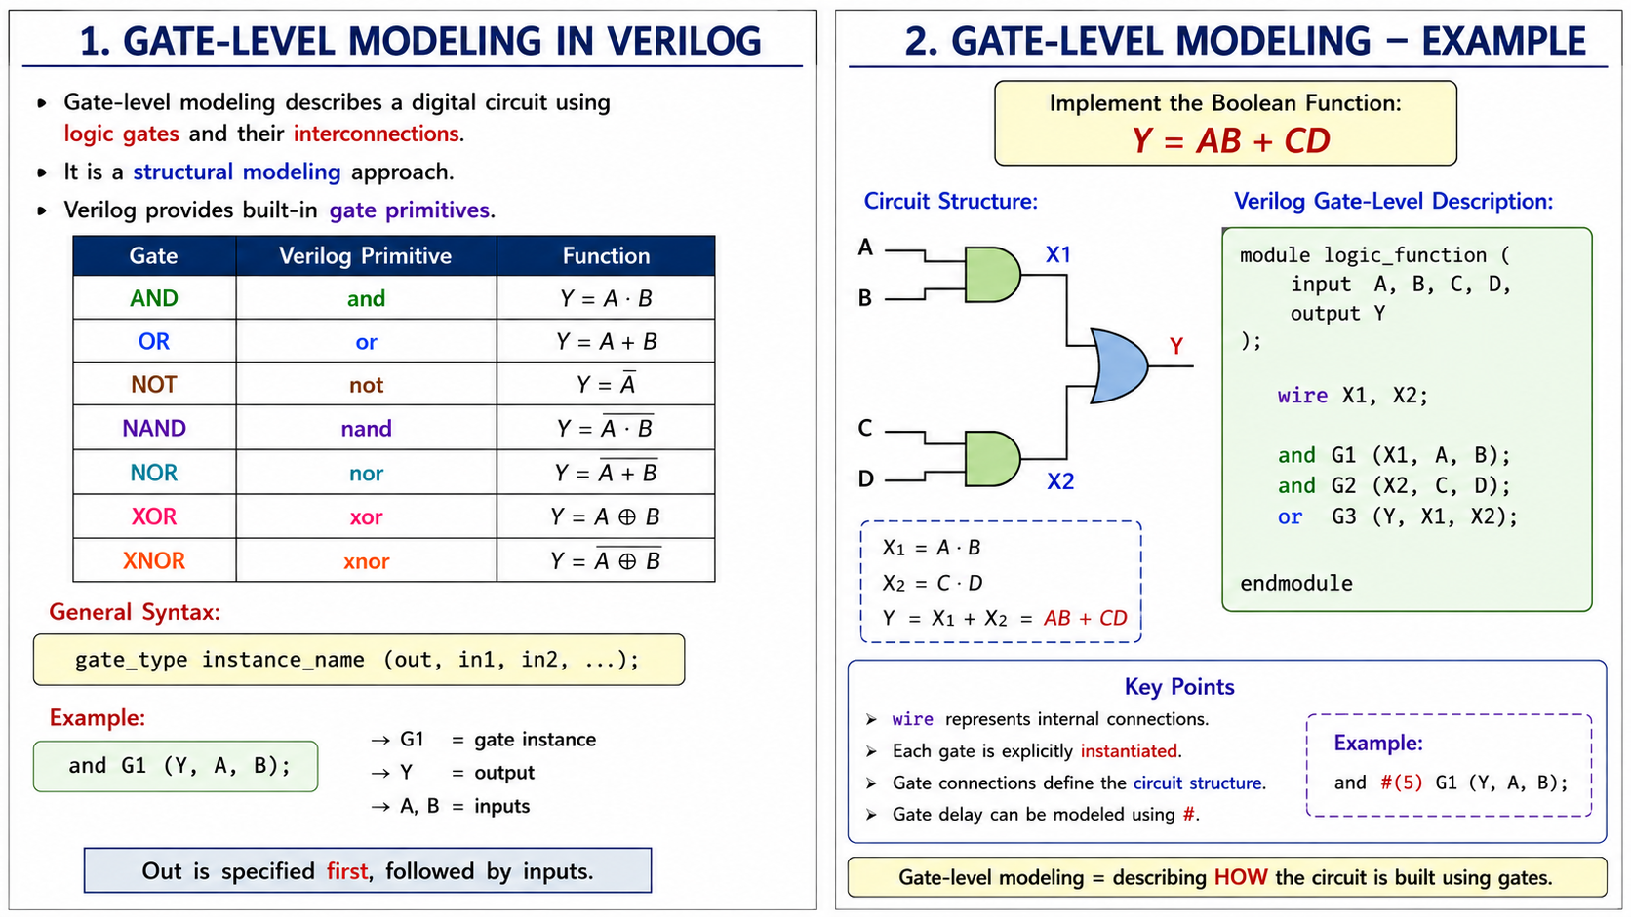
Gate Level Modeling

Slide 17
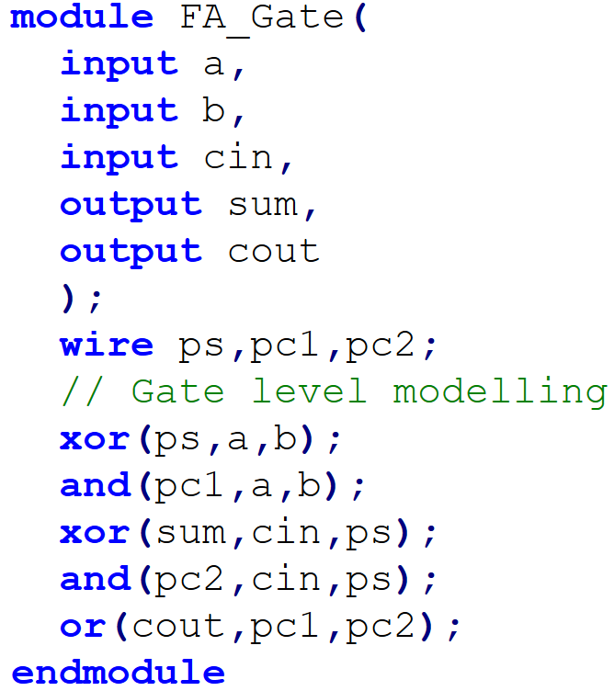
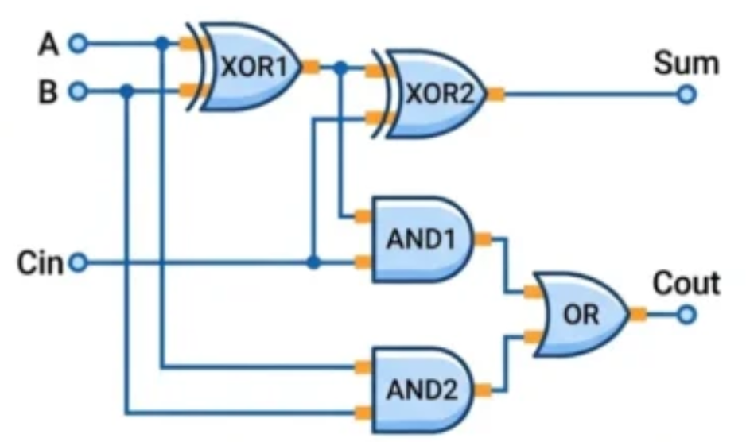
Gate Level Abstraction

Slide 18
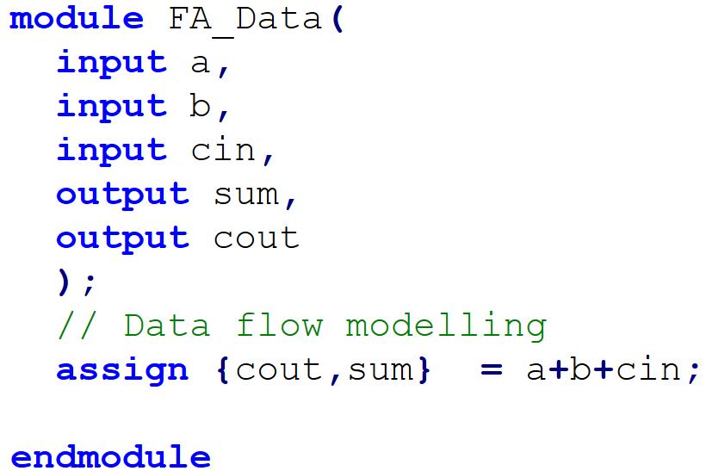
Dataflow Level

Slide 19
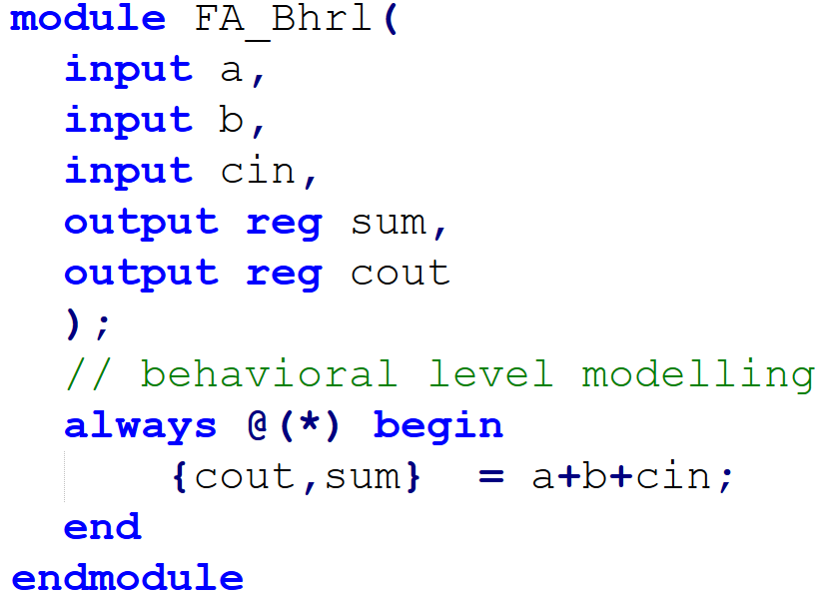
Behavioral Level

Slide 20
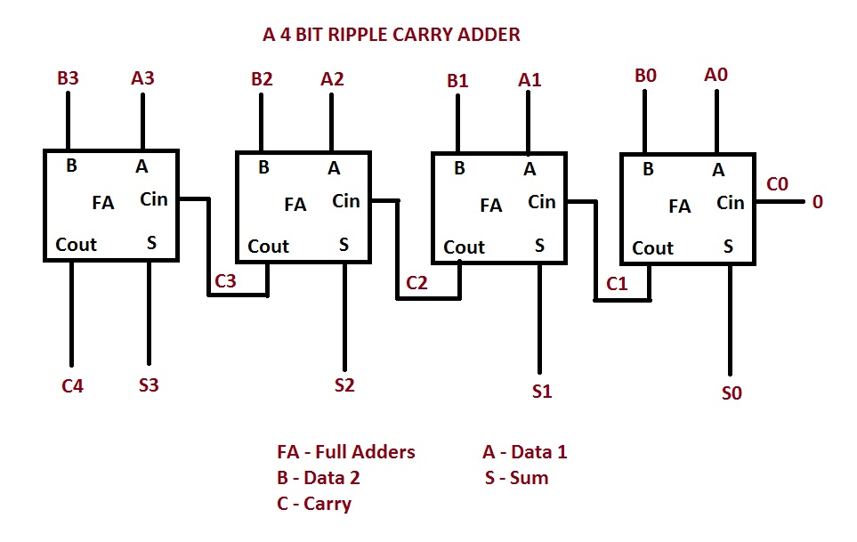
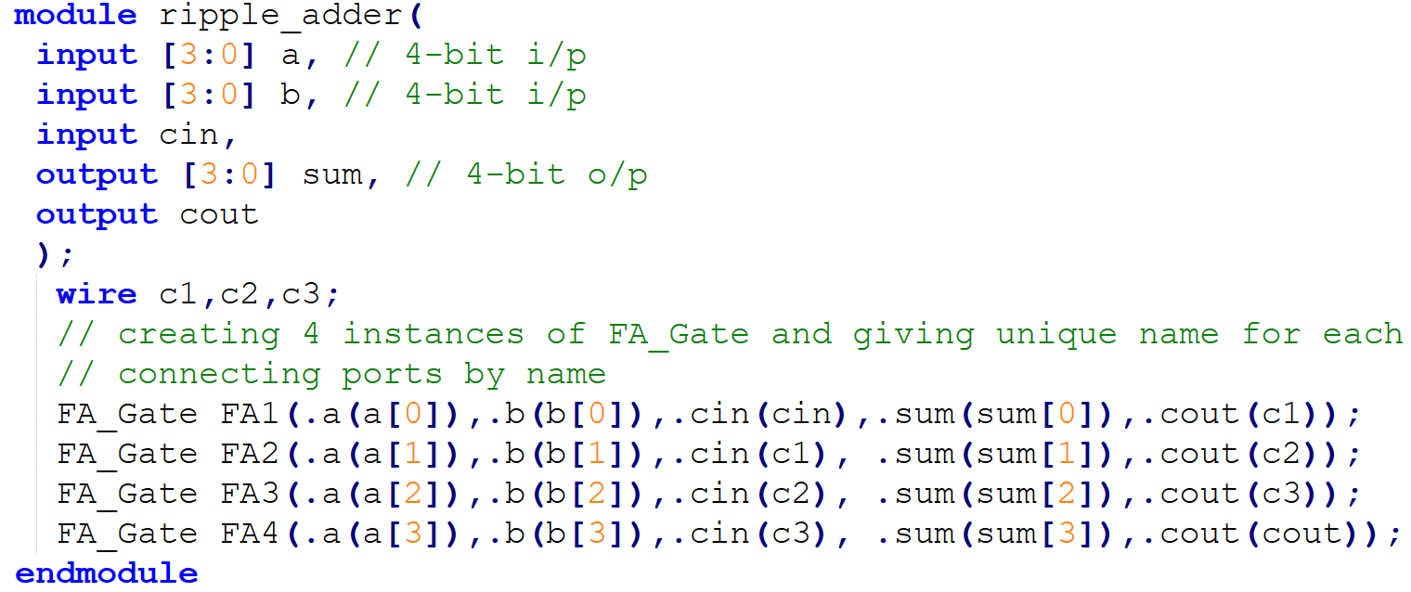
Module Instantiation
The process of creating objects from a module template is called instantiation.
The objects are called instances.
It is illegal to nest modules.

Slide 21
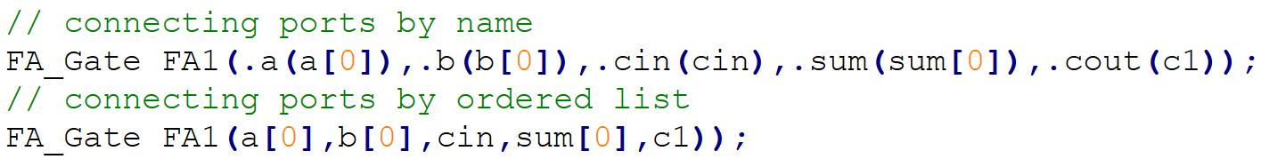
Connecting Ports to External Signals
Connection by Ordered List (Positional) : This method maps your external signals to the module ports based strictly on the order they appear in the original module declaration.
Connection by Name (Named Association): This method explicitly links the sub-module’s internal port name to your external signal. The syntax uses a dot (.) followed by the internal port name, with the external signal inside parentheses.

Slide 22
Module Instantiation contd..
A module defines a reusable block of logic (like a function in C).
The process of creating objects from a module template is called instantiation.
The objects are called instances.
.a(a[0]) → Port connection

Slide 23
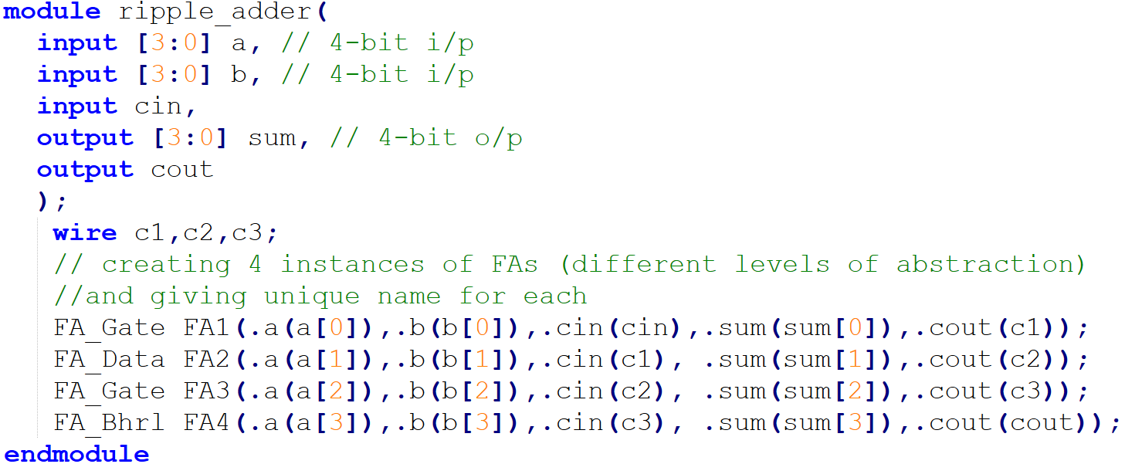
Module Instantiation contd..
The instances can have different levels of abstraction
It is illegal to nest modules.
Helps in building complex designs from simpler, reusable modules

Slide 24
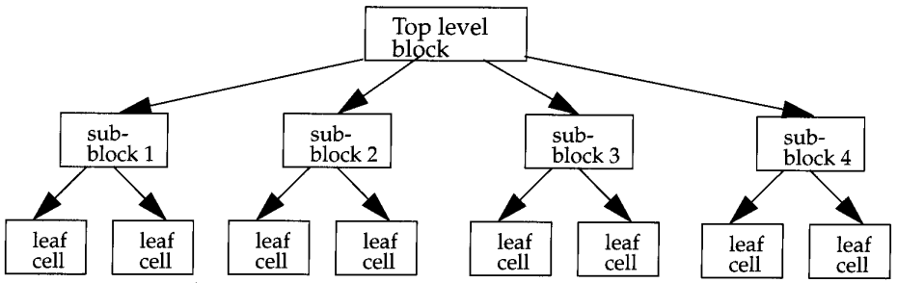
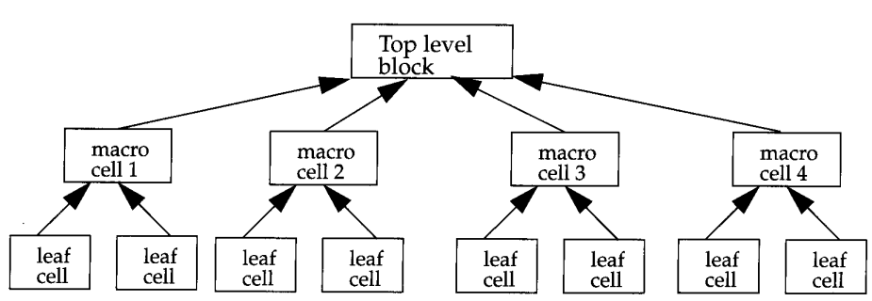
Design Methodology
Top-down
Bottom-up

Slide 25
Components of a Simulation
Stimulus or testbench is used to test the functionality of the design block.
The DUT cannot run by itself.
Stimulus generates the necessary clock signals and input data sequences to exercise every feature of your design.
Test bench
t_a
t_b
t_cin
DUT
(Ex: Full adder)
t_sum
t_cout

Slide 26
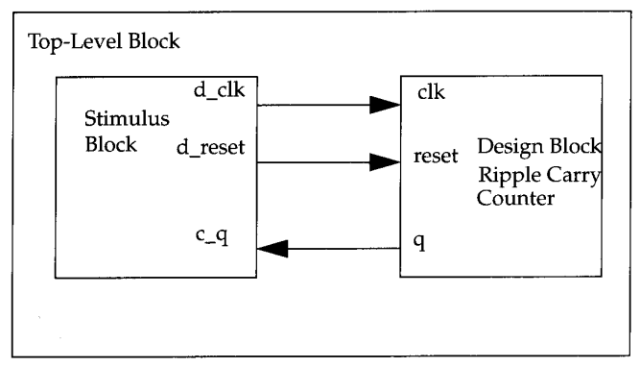
Simulation contd..
Best practice is instantiate both testbench and DUT in a dummy Top-level module

Slide 27
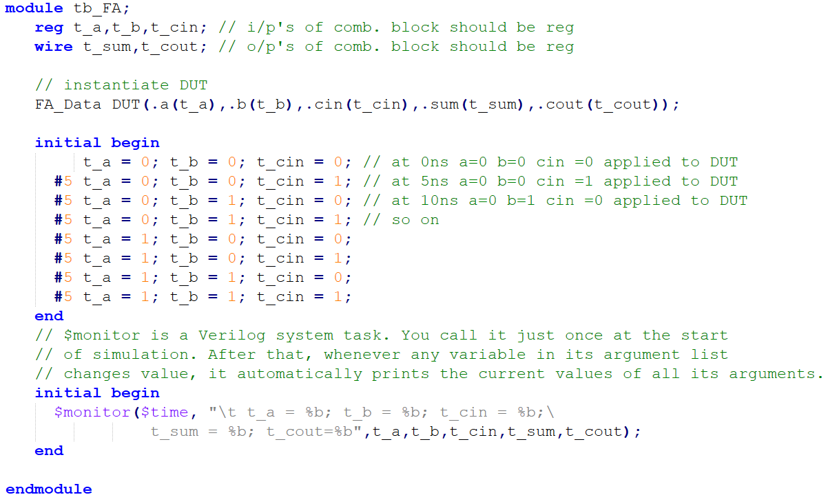
Simulation contd..
Why should testbench input values declared as reg type? Data items for the inputs will be written by the testbench and should hold their values between assignments.
In contrast, the outputs will simply derive their values from the module outputs and thus require wire nets.

Slide 28
Stimulus example
Test bench
t_a
t_b
t_cin
DUT
(Ex: Full adder)
t_sum
t_cout

Slide 29
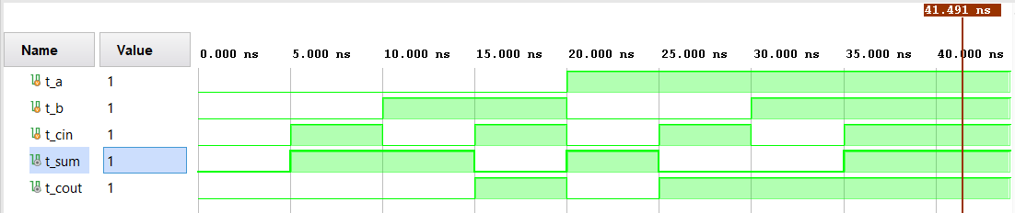
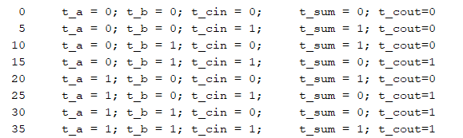
Simulation output
Output of Simulation
Result of $monitor

Slide 30
Gate Level Modeling

Slide 31
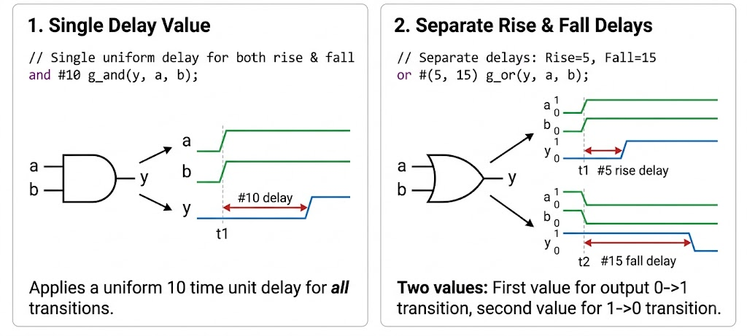
Gate Level Delay Modeling

Slide 32
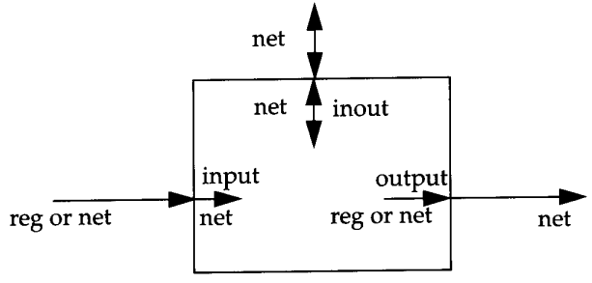
Port Connection Rules
Input Rule: A module only reads its input ports and cannot drive them internally, the internal port must be a wire. However, the external stimulus driving it can be a continuous assignment (wire) or procedural assignment (reg).

Slide 33
Port Connection Rules
Output Rule: If you generate an output inside an always block, its internal type must be reg. If you use a continuous assign statement, it must be a wire. Externally, it must connect to a wire so that the module can continuously pass data up to the parent.

Slide 34
Port Connection Rules
Inout Rule: Since bidirectional ports can change drive directions dynamically, they cannot hold state and must strictly be wire types on both sides.

Slide 35
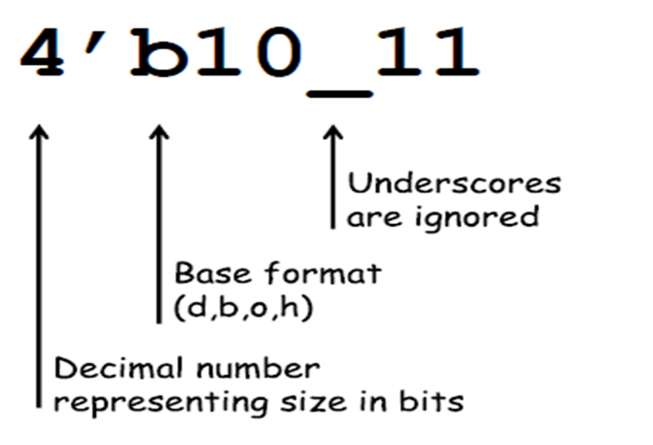
Number Specification
<sign><size>’<base format><number>
E.g: 4’b1111 //this is a 4-bit binary number
12’habc //this is a 12-bit hexadecimal number
16’d255 //this is a 16-bit decimal number

Slide 36
Data Types in Verilog HDL
Nets:
Nets represents a physical connection
Does not store a value
Driven continuously by a source
Declared using keyword wire.
Registers:
Can hold a value until it is assigned again
Declared using keyword reg.
Used for signals assigned inside initial or always blocks
reg does not necessarily mean a hardware register
integer → signed 32-bit integer, commonly used in testbenches
time → stores simulation time
real → floating-point value, mainly for simulation

Slide 37
Vector — Multiple Bits as One Signal
Ex:
wire [3:0] A; // 4-bit wire
reg [7:0] B; // 8-bit reg

Slide 38
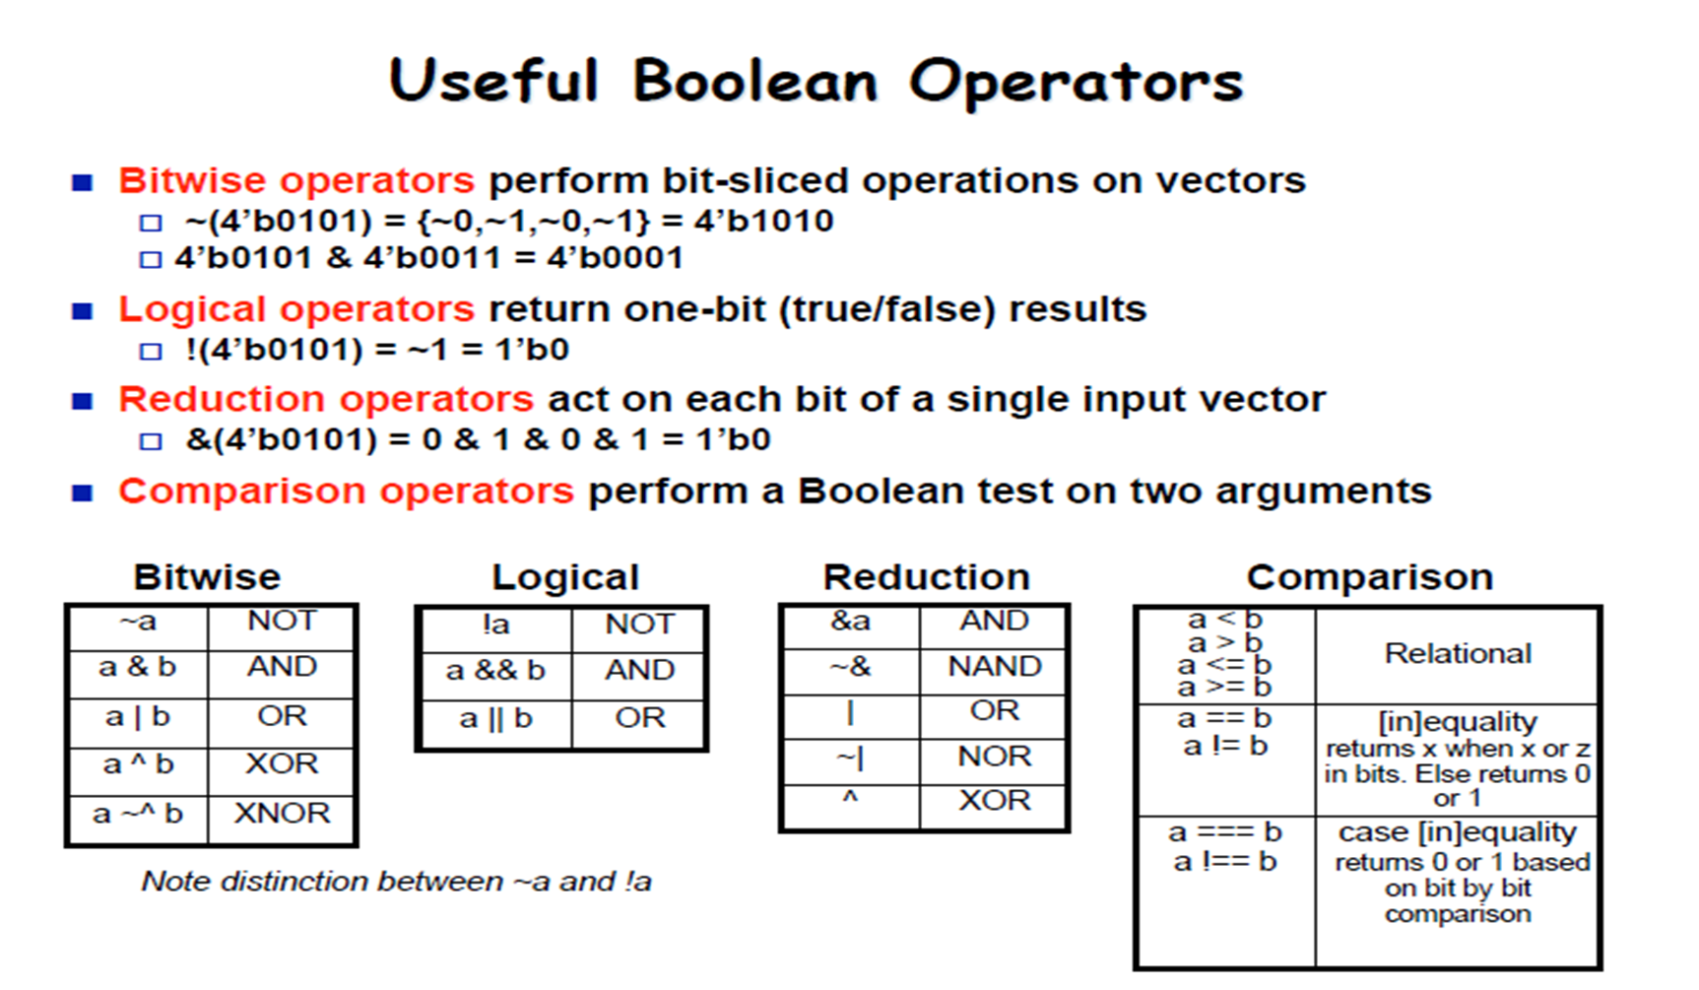

Slide 39
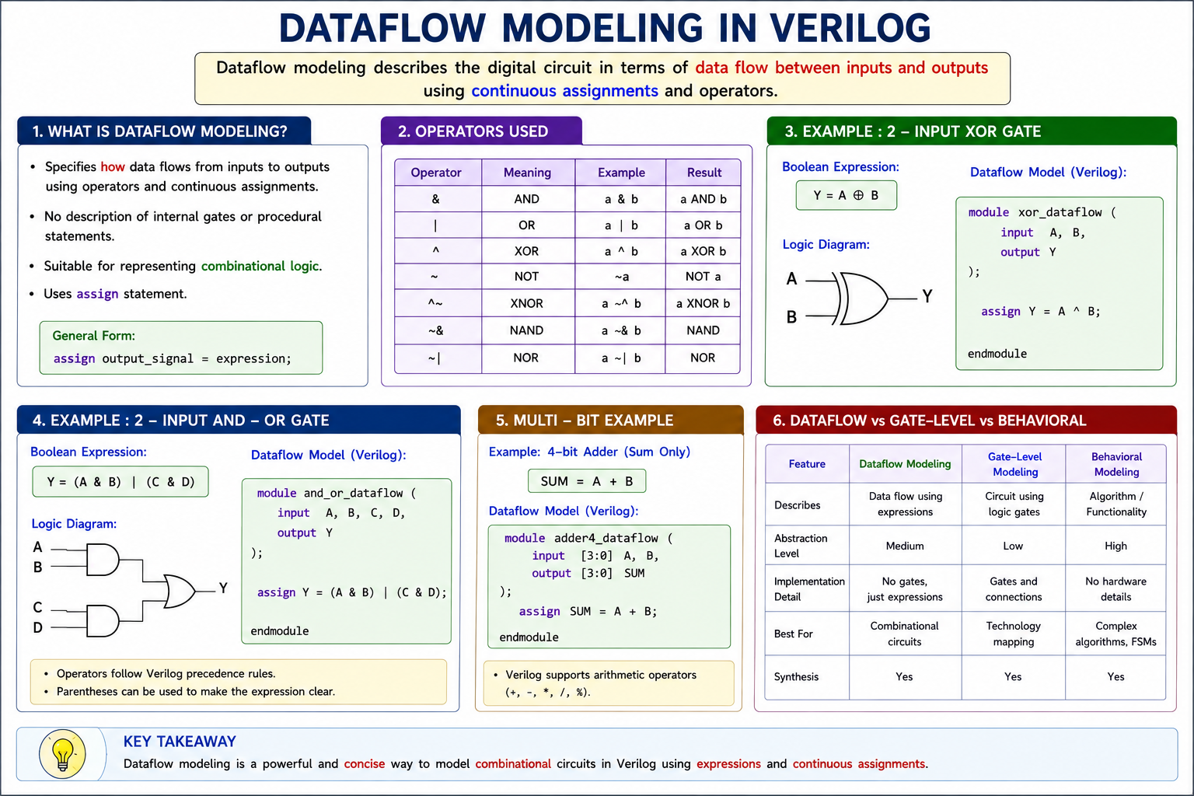

Slide 40
