Slide 1
BITS Pilani Digital Design
Prof. GSS Chalapathi, Prof. Saurabh Gandhi (EEE department)

Slide 2
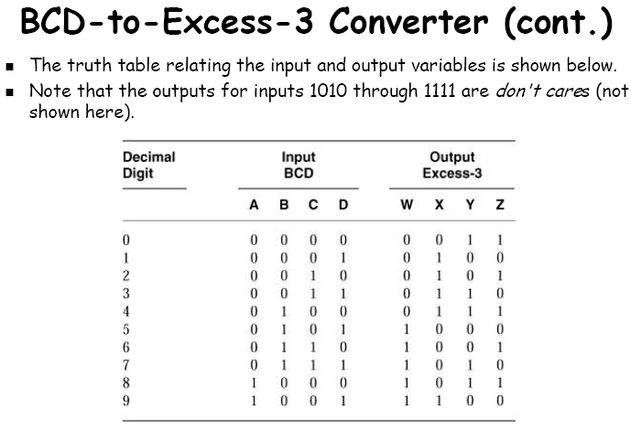
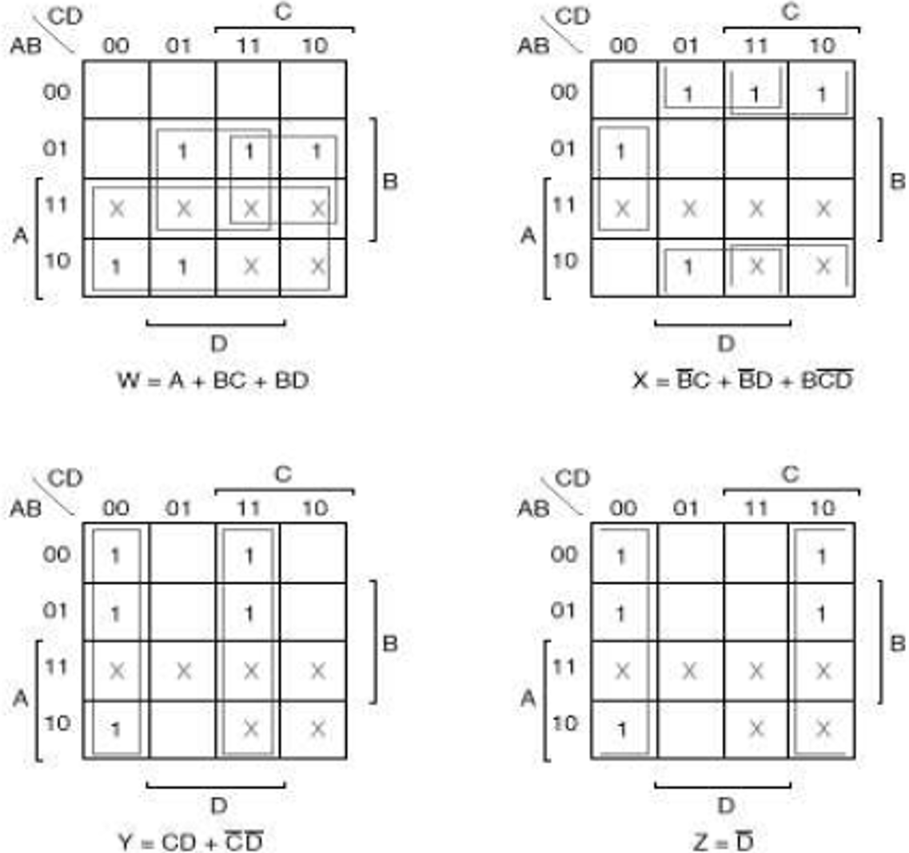
Working with decimal numbers
BCD to Excess 3 code converter
A circuit that converts a BCD codeword to the corresponding excess-3 codeword
Exces-3 code: Given a decimal digit n, it is encoded in excess-3 as (n+3)₂
Example: n = 5: 1000; n = 0: 0011
How many input and output variables?

Slide 3
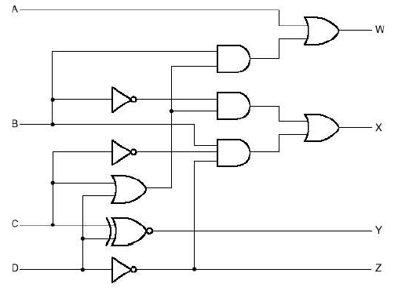
BCD to Excess-3 converter

Slide 4
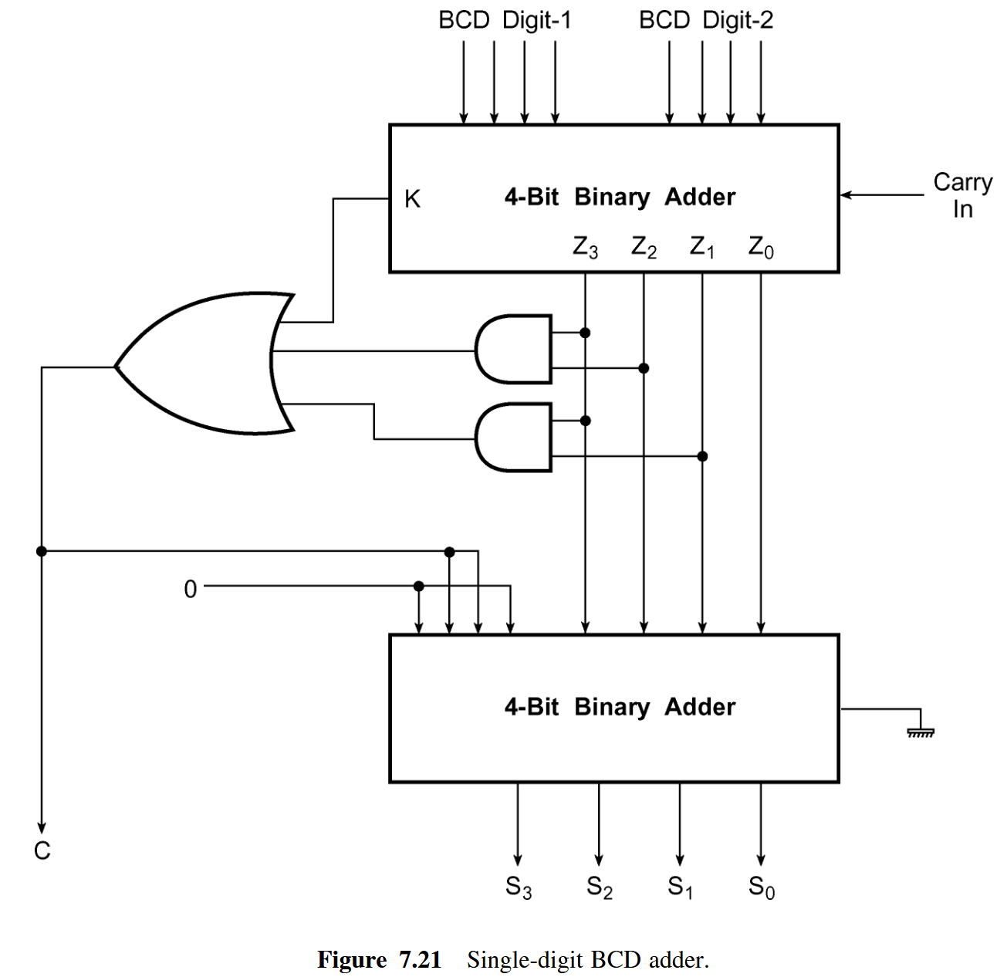
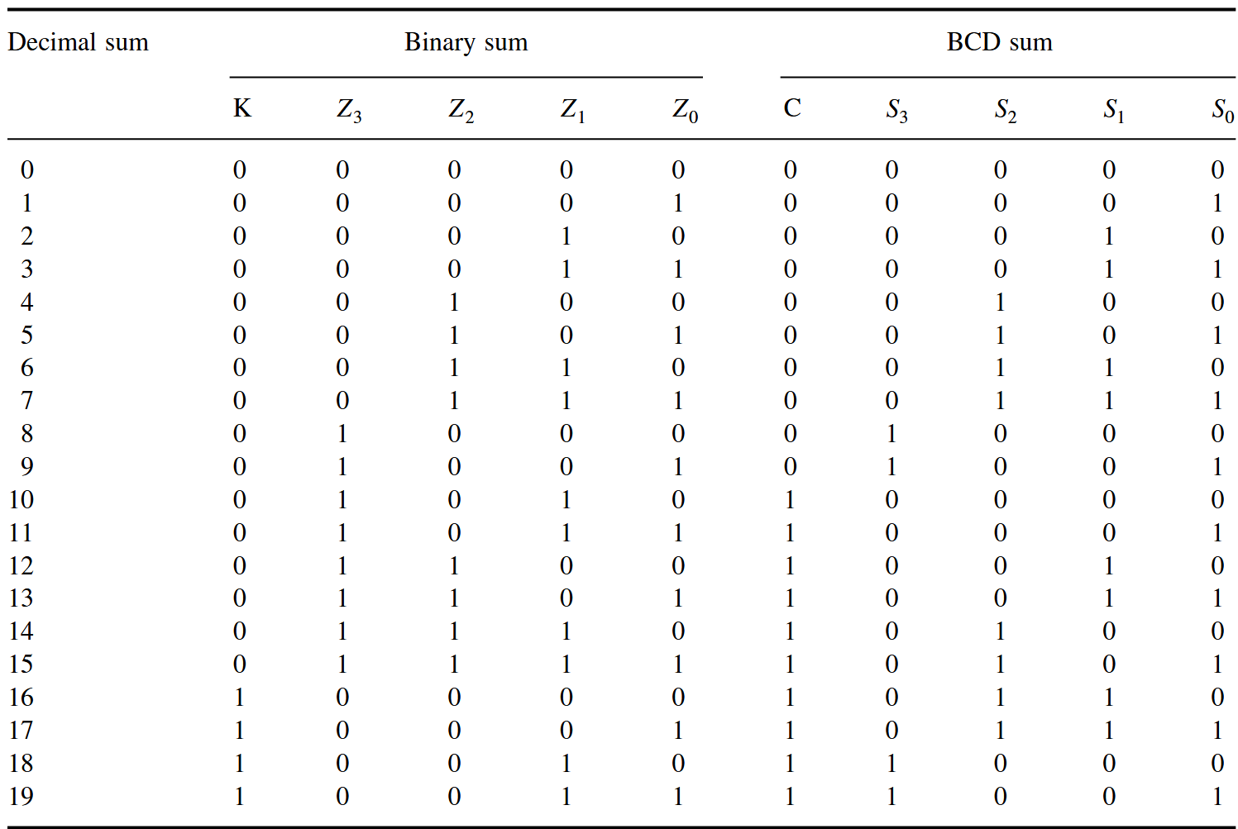
Decimal adders (adding BCD numbers)
Is binary sum less than or equal to 1001?
Yes: answer
No: add 0110 to get the answer (and a carry)

Slide 5
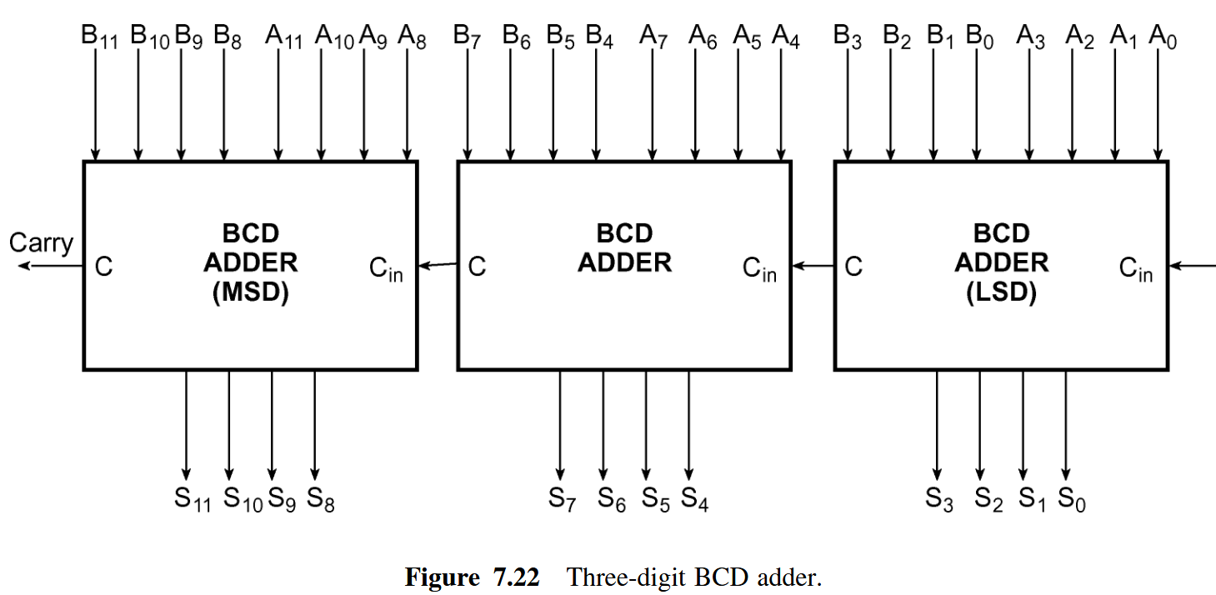
BCD adder

