Slide 1
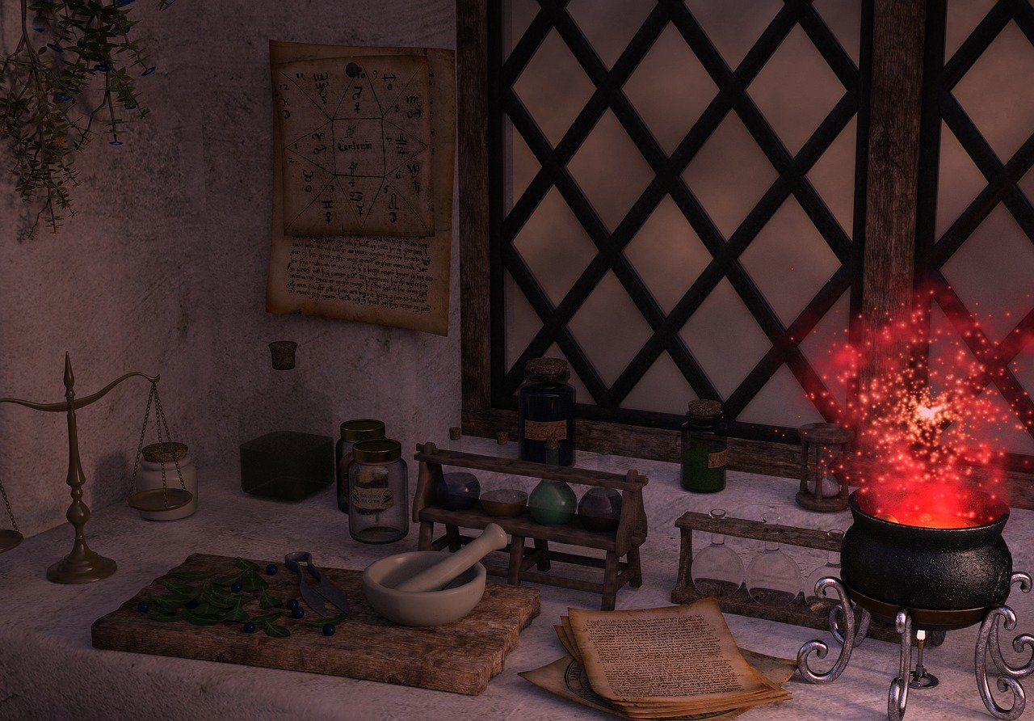
Potion Explosion
-Muhammad Haaris, Bilal Qureshi

Slide 2
What is Potion explosion
In Potion explosion players take on the role of students trying to pass their final exam for the year. To do this, they'll be creating potions by pulling marbles from the new plastic dispenser. These represent ingredients in the various potion recipes. When a marble is taken, the rest slide down the ramp.

Slide 3
How many players?
There can be numerous players for the actual game but in our case there are 2 players only

Slide 4
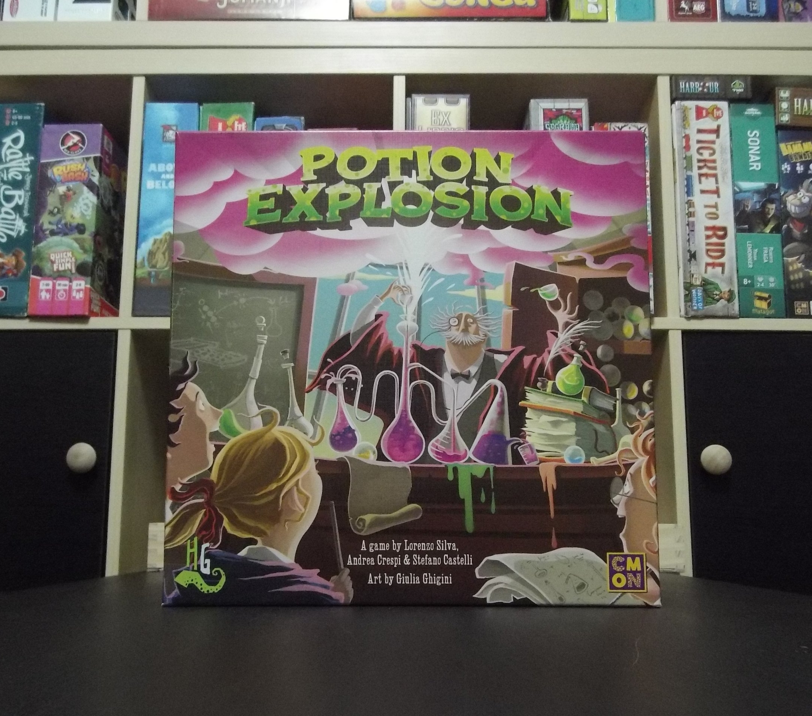
Introduction:
The purpose of the code is to implement a text-based game called "Potion Explosion."
Developed in the C programming language, the game involves potion brewing and strategic decision-making.
Key Features:
Game Logic: Players take turns selecting cells on a grid to create potion combinations and earn points.
Multithreading: Utilizes multithreading to simulate simultaneous processes for cell explosions, enhancing gameplay dynamics.
Semaphore Usage: Implements semaphores to control access to shared resources, ensuring thread synchronization and preventing race conditions.
Objective:
Develop an interactive and engaging game that demonstrates proficiency in C programming, multithreading, and semaphore usage.
Benefits:
Enhances understanding of C language features, concurrent programming, and synchronization mechanisms.
Provides hands-on experience in developing a complex game with strategic elements.

Slide 5
Libraries used
stdio.h: Standard Input/Output functions for console interaction.
stdlib.h: Standard Library functions for memory allocation and other utilities.
string.h: String manipulation functions for working with character arrays.
time.h: Functions related to time, used for randomization.
pthread.h: POSIX threads library for multithreading support.
semaphore.h: Library for implementing semaphores, facilitating thread synchronization.
stdint.h: Integer types with specified widths, enhancing code portability.
unistd.h: Provides access to POSIX operating system API, including sleep functions.
Purpose:
These libraries collectively provide the necessary tools and functionalities to implement the Potion Explosion game in C.
Each library serves a specific role, from standard I/O to thread management and synchronization.

Slide 6
Constants
Constants (ROWS and COLUMNS):
Purpose:
Define the dimensions of the game board in a modular and easily adjustable manner.
Facilitate code readability by using meaningful names for dimensions.
Importance:
Allows easy modification of the game board size without altering multiple instances throughout the code.
Enhances scalability for potential future updates or variations of the game.
Game Board Representation (2D Array - arr):
Purpose:
Represents the game board as a 2D array.
Each cell in the array corresponds to a position on the game board.
Key Features:
Rows: Represent the vertical dimension of the game board.
Columns: Represent the horizontal dimension of the game board.

Slide 7
Conclusion
Code Overview:
Developed in C, the Potion Explosion game utilizes multithreading and semaphores.
Features a modular structure with well-defined functions for various game aspects.
Libraries Included:
Standard libraries such as stdio.h, stdlib.h, and others contribute to the code's functionality.
Each library serves a specific purpose, ranging from I/O operations to thread management.
Constants and Game Board Representation:
Constants (ROWS and COLUMNS) define the game board's dimensions, promoting modularity and code readability.
A 2D array (arr) represents the game board, facilitating efficient storage and manipulation of the game state.
Global Variables:
Key global variables, including myRandom, Y, B, O, R, score1, score2, and turnCount, play pivotal roles in tracking game state and progress.
File Handling:
The code incorporates file handling functions (saveGameState and loadGameState) to save and load game states.
Game Logic and User Interface:
The main function orchestrates the game, utilizing threads and synchronization mechanisms.
User interaction is facilitated through a menu-driven user interface (UI_Interface), providing players with choices and actions.
Importance of Multithreading and Synchronization:
Enhanced Gameplay Dynamics:
Multithreading is employed to simulate simultaneous processes, creating a dynamic and interactive gaming experience.
Preventing Race Conditions:
Synchronization, implemented through semaphores, ensures orderly access to shared resources, preventing race conditions..

Slide 8
Thank You!

