Slide 1
Movie Library System
From 200OK

Slide 2
Introduction
Group:
Group Name: 200OK
Group Members: Yu-Hsiu Chang, Iana Vorobeva, Tung-Yu Chen
Agenda
Agenda & Ideation: Tung-Yu
ERD: Iana
Architectural and UX decisions: Yu-Hsiu
Demonstration & Conclusion: 200OK

Slide 3

Ideation
Nowadays, movies and streaming films are more popular than previous period. However, every platforms own their own account system.
As video-holics, we thought we need a platform that can save our favorite video products in one and the only account. Furthermore, we can add some reviews to remind ourself about the content of the movies.
According our needs, we start to design, plan and implement our movie library application.

Slide 4
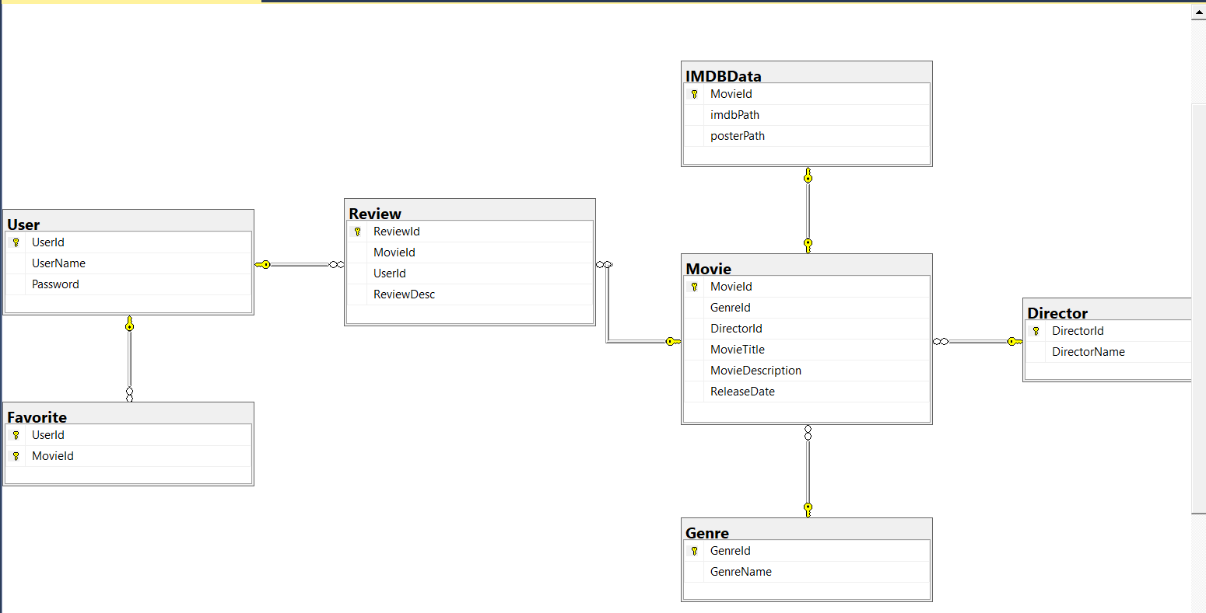
ERD - I

Slide 5
ERD - II
Table | Primary Key | Foreign Key
Director | [DirectorId] | N/A
Favorite | ([UserId], [MovieId]) | User] ([UserId])
Genre | [GenreId] | N/A
IMDBData | [MovieId] | [[Movie] ([MovieId])
Movie | [MovieId] | [Director] ([DirectorId]) [Genre] ([GenreId])
Review | [ReviewId] | [Movie] ([MovieId]) [User] ([UserId])
User | [UserId] | N/A

Slide 6
Architectural and
UX Decision
with Demonstration

Slide 7
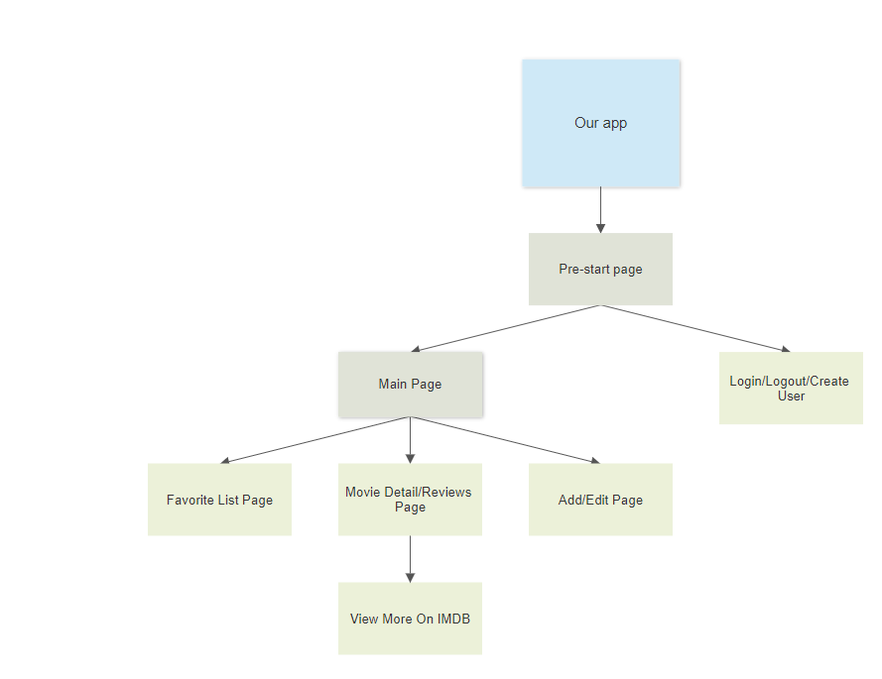
Architectural

Slide 8
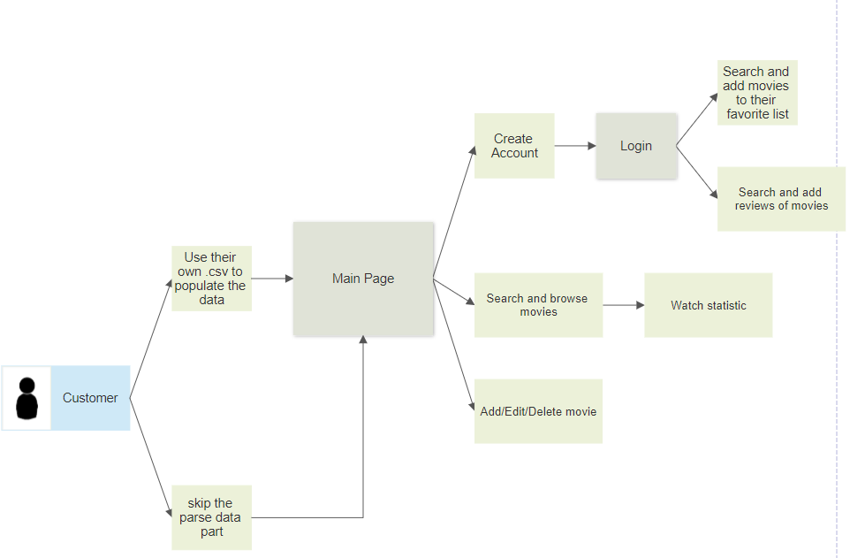
UX Decision

Slide 9
Conclusion – Tung-Yu
Most useful: Linq, it’s as a SQL in collections, easy to use and can be used in many key point.
Least useful: First class, I think students should have learnt the content already and have the responsibility to pick it up.
One topic add: if possible, deploy the application on cloud platform or docker. For me, the situation in real world would be more like this.
On topic remove: C# basic, provide some slides and ask students to pick it up is enough.

Slide 10
Conclusion – Iana
Most useful: LINQ & EF Core
Least useful: ADO.net Connected Layer
One topic add: Web applications
On topic remove: ADO.net Connected Layer

Slide 11
Conclusion – Yu-Hsiu
Most useful: It’s LINQ. LINQ makes the code more readable so other developers can easily understand and maintain it.
Least useful: There is less competition to get job in WPF as there are many new cross platform desktop app development frameworks available in market.
One topic add: Automapper/ Autofac.
On topic remove: C# warm up in the first class.

Slide 12
Thanks for your
kind listening!

