Slide 1
Kickstarter Project
Success Prediction
Capstone presentation
How can Kickstarter creators determine if the project that they are trying to launch is more likely to succeed or fail?

Slide 2
1. Business problem and project goal
The question was simple: can we predict campaign success before a Kickstarter project launches?
Why this matters
What the model uses
Creators lose time and effort when campaigns fail.
Platform teams need a way to spot risk early.
Better pre-launch guidance can improve campaign design.
The goal was to support decisions, not replace human judgment.
Funding goal
Campaign duration
Main category and subcategory
Launch timing such as month and weekday
Note:
Leakage-prone fields like pledged amount and backer count were removed so the model would only learn from information available before or at launch.

Slide 3
2. Data and workflow
The project followed a full machine-learning workflow from cleaning to final evaluation.
1
Clean
2
Explore
3
Prepare
4
Model
Handled missing values, removed invalid country records, and created campaign duration.
Looked for patterns in success rates across categories, goals, and timing.
Created a binary target, encoded categories, scaled numeric fields, and split train/test data.
Compared several classifiers and selected a tuned random forest as the best model.
372,066
211
297,649
74,413
cleaned projects
model features
train rows
test rows

Slide 4
3. The data story before modeling
Even before training a model, the data showed clear patterns linked to success.
Outcome balance
Three signals stood out
Unsuccessful
Successful
Goal size
Higher goals were much harder to reach.
64.0%
36.0%
Longer campaigns tended to do worse.
Most projects did not succeed, so class balance mattered when judging model performance.
Campaign length
Category fit
Some categories had much stronger baseline success than others.

Slide 5
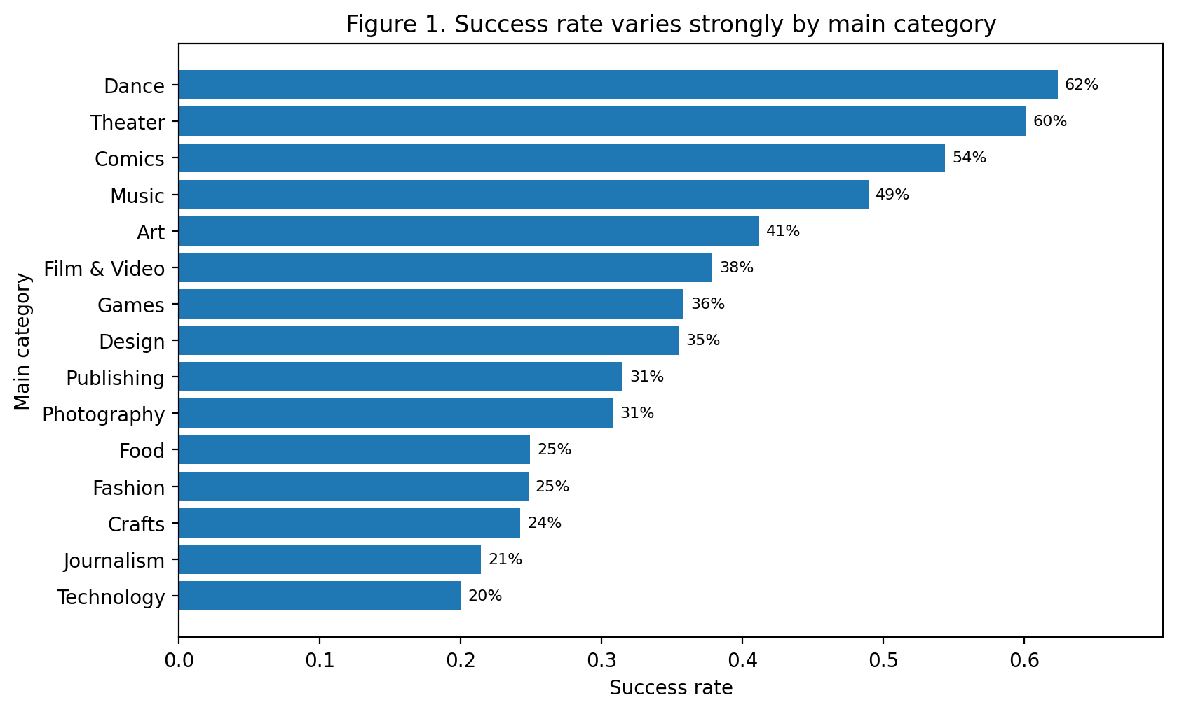
4. Finding #1: category matters a lot
Success rates were not evenly spread across project types.
What this means
Dance, Theater, Comics, and Music had stronger success rates.
Technology, Journalism, Crafts, and Fashion were weaker areas.
A single playbook will not fit every category.
Stakeholder takeaway
Support should be tailored by category risk, not offered in the same way to every creator.

Slide 6
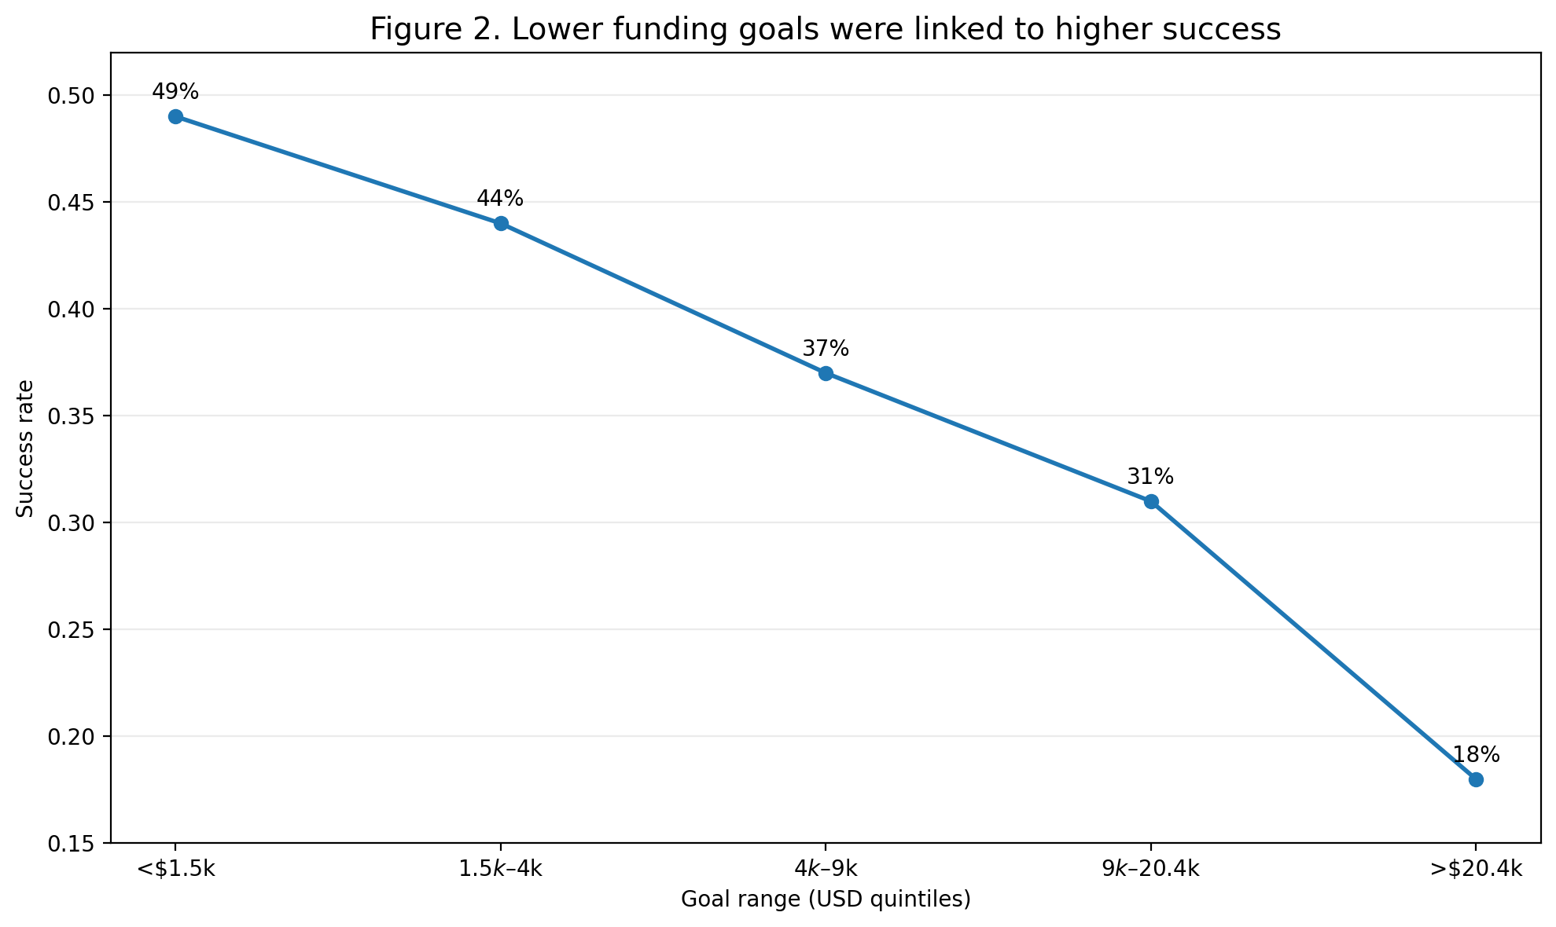
5. Finding #2: realistic goals improve success odds
The clearest pattern in the project was the drop in success as goals moved higher.
Projects with lower goals were far more likely to succeed than projects with very high goals.
~49%
~18%
lowest goal band
highest goal band
This gap is large enough to support practical goal-setting guidance before launch.

Slide 7
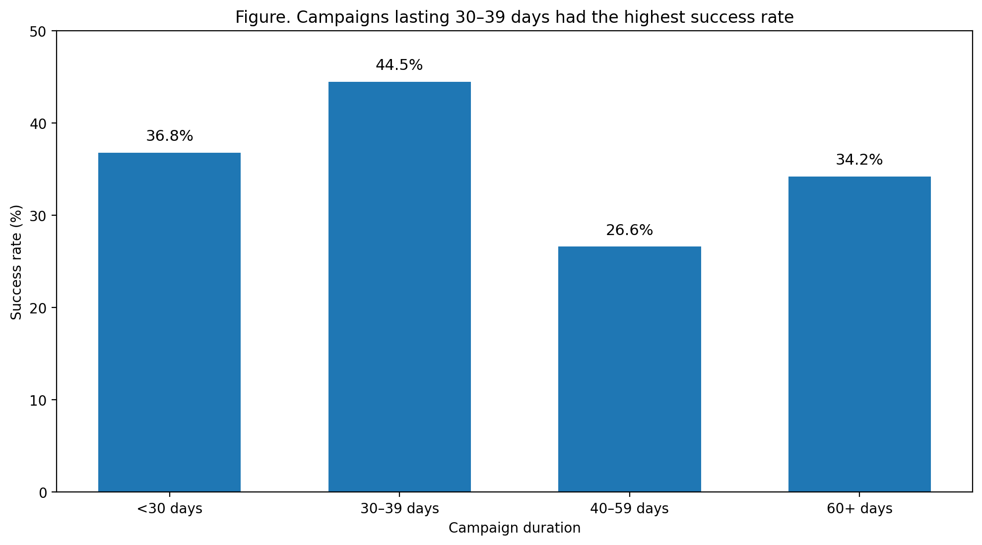
Campaign duration and success
Projects running 30–39 days outperformed longer 40–59 day campaigns.
What this shows
Under 30 days: 36.8% success
30–39 days: 44.5% success (highest)
40–59 days: 26.6% success
60+ days: 34.2% success

Slide 8
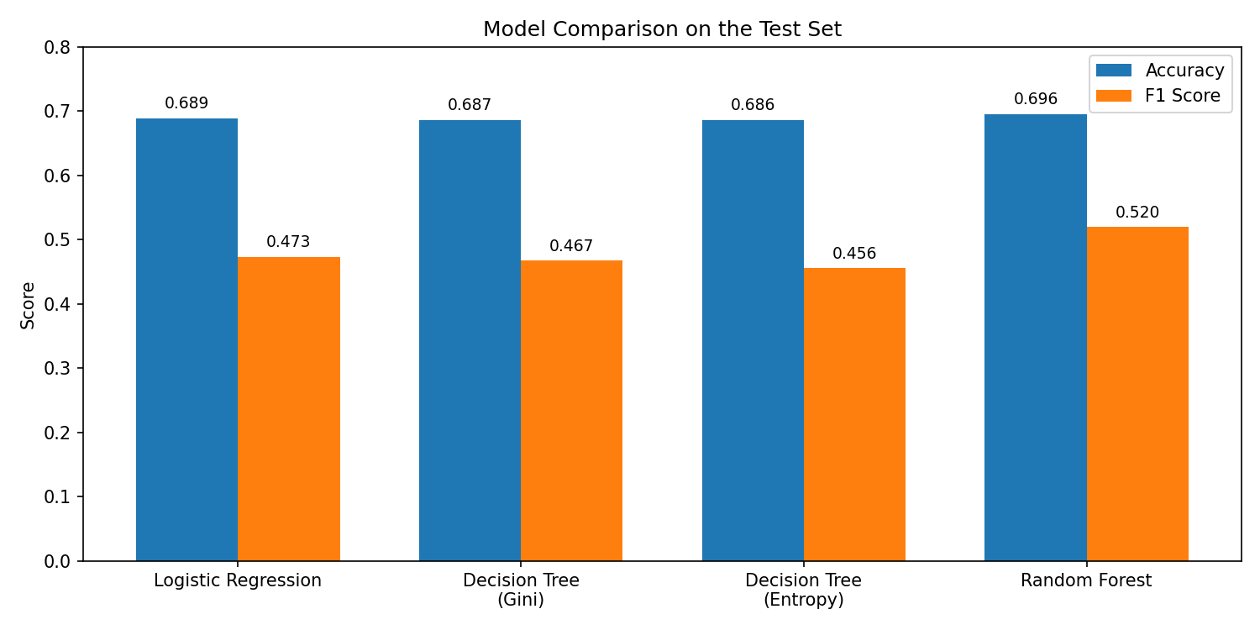
6. Model comparison
All four tested models were compared before choosing the final model
Tested models
Logistic regression: 68.9% accuracy, 0.47 F1
Decision tree (Gini): 68.7% accuracy, 0.47 F1
Decision tree (Entropy): 68.6% accuracy, 0.46 F1
Random forest (tuned): 69.6% accuracy, 0.52 F1
Why it won
Best F1 score and the strongest balance between catching likely successes and limiting false positives.

Slide 9
7. Final model performance
The tuned random forest was the strongest model tested on unseen test data.
69.6%
60.1%
45.7%
0.52
Accuracy
Precision
Recall
F1 score
How to read the result
Predicted vs. actual success rate
Accuracy was solid for a real-world classification problem.
Recall was lower, which means the model missed some future successes.
The model was better at identifying likely failures than guaranteed wins.
Actual
36.0%
Predicted
27.4%
The lower predicted rate shows the model was cautious about calling a project successful.

Slide 10
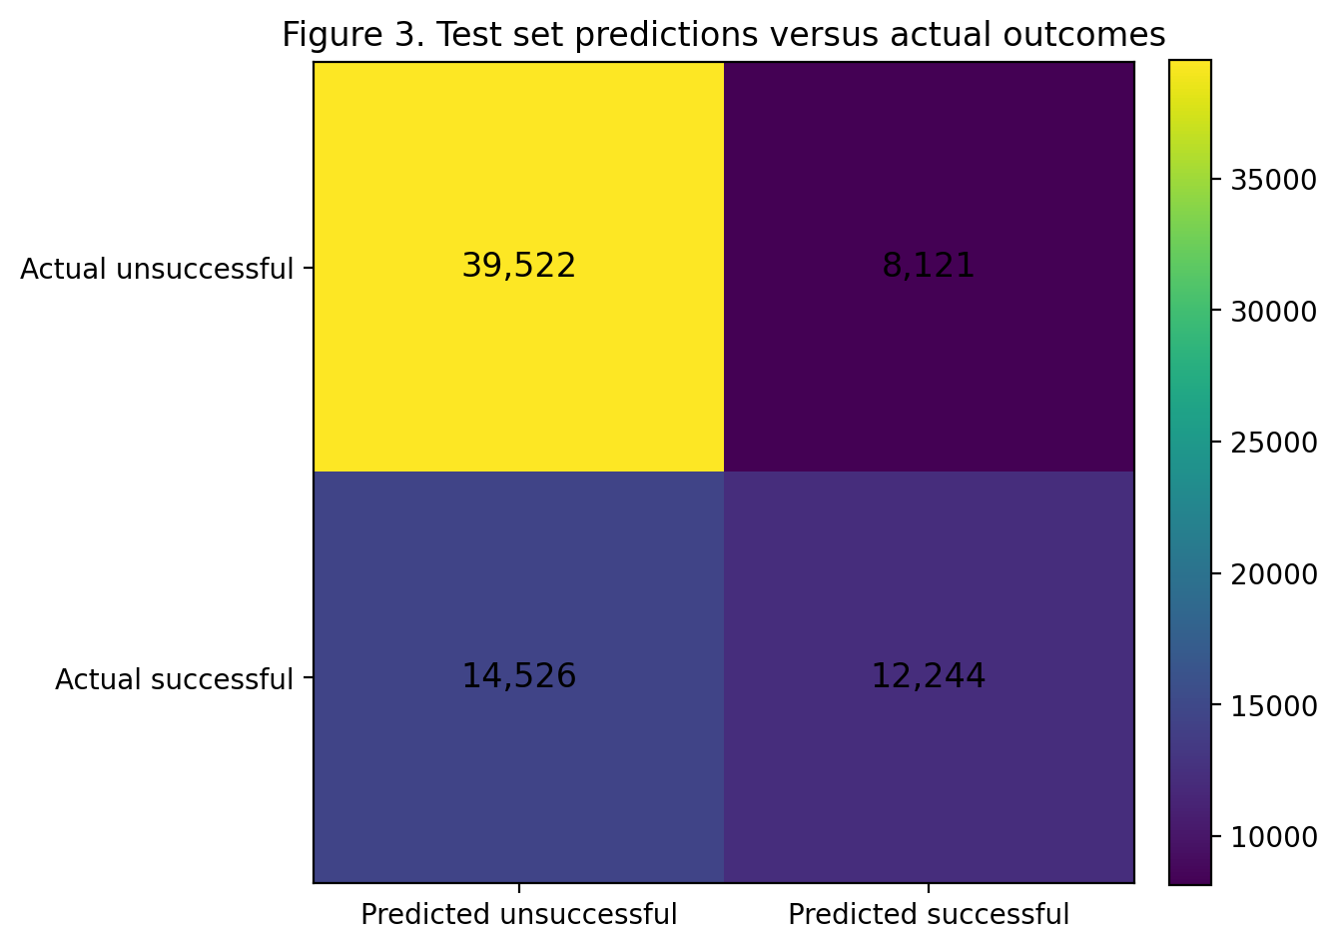
8. Test-set predictions vs. actual outcomes
The confusion matrix shows where the model was right and where it struggled.
Key reading
39,522 failures were correctly identified.
12,244 successes were correctly identified.
14,526 successes were missed and labeled as failures.
8,121 failures were incorrectly labeled as successes.
Takeaway
The model is better as a pre-launch risk screen than as a tool for declaring certain success.

Slide 11
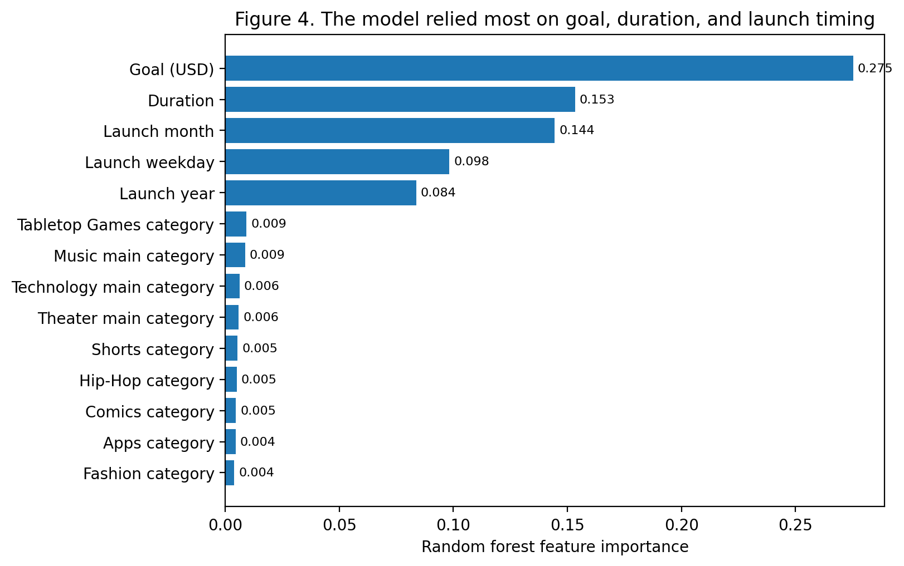
9. What drove the predictions
The model mostly learned from practical campaign choices that stakeholders can influence.
Top drivers
Funding goal was the strongest predictor.
Campaign duration mattered a lot.
Launch month and weekday also mattered.
Category indicators added extra context.
Why this matters
These are useful because they can shape guidance before launch.

Slide 12
10. Recommendations for the client
These actions follow directly from the patterns seen in the data and the model.
1. Add goal-setting guidance
Show creators typical goal ranges for similar projects and warn when a target looks unusually high.
2. Use a pre-launch risk screen
Score campaigns before launch and flag high-risk cases for extra coaching on scope, pricing, and timing.
3. Tailor support by category
Create category-specific playbooks, especially for weaker areas such as Technology and Journalism.

Slide 13
11. Limits and next steps
The model is useful, but it is not a crystal ball.
Current limits
Further research
Performance is moderate, not perfect.
The model misses some successful campaigns.
Story quality, audience fit, and creator reputation are not fully captured.
Try stronger models such as gradient boosting or XGBoost.
Add text, media, creator history, and social traction features.
Study fairness and business impact across categories and countries.

Slide 14
Final takeaway
Kickstarter outcomes are not random.
Campaigns with realistic goals, sensible duration, and better category fit are more likely to succeed — and those same patterns are visible in the final model.
Use the model as a smart pre-launch support tool.
Thank you

