Slide 1
Big Mountain Resort
Pricing Recommendation
by: Fahad Memon

Slide 2
1. Problem identification
Business question
Is Big Mountain charging too little for an adult weekend ticket?
$81
$95.87
Current price
Model-supported price
• The current adult weekend ticket price is $81.
• The resort has strong facilities compared with many other resorts.
This gap suggests the resort may be underpriced in the market.
• Management needs a clear pricing recommendation.
• The recommendation should balance revenue opportunity and model uncertainty.
• A gradual move is safer than one large jump.

Slide 3
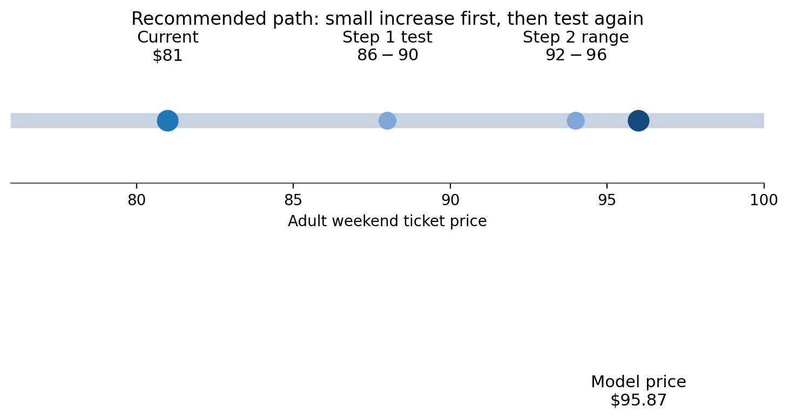
2. Recommendation and key findings
Recommendation
Raise the price in steps, starting around $86 to $90.
• Do not jump straight to $96. The model still has about $10 average error.
• After the first increase, track sales, revenue, and guest feedback.
• If demand stays strong, move toward about $92 to $96.
Suggested path: test a smaller increase first, then decide on the next step using real demand data.

Slide 4
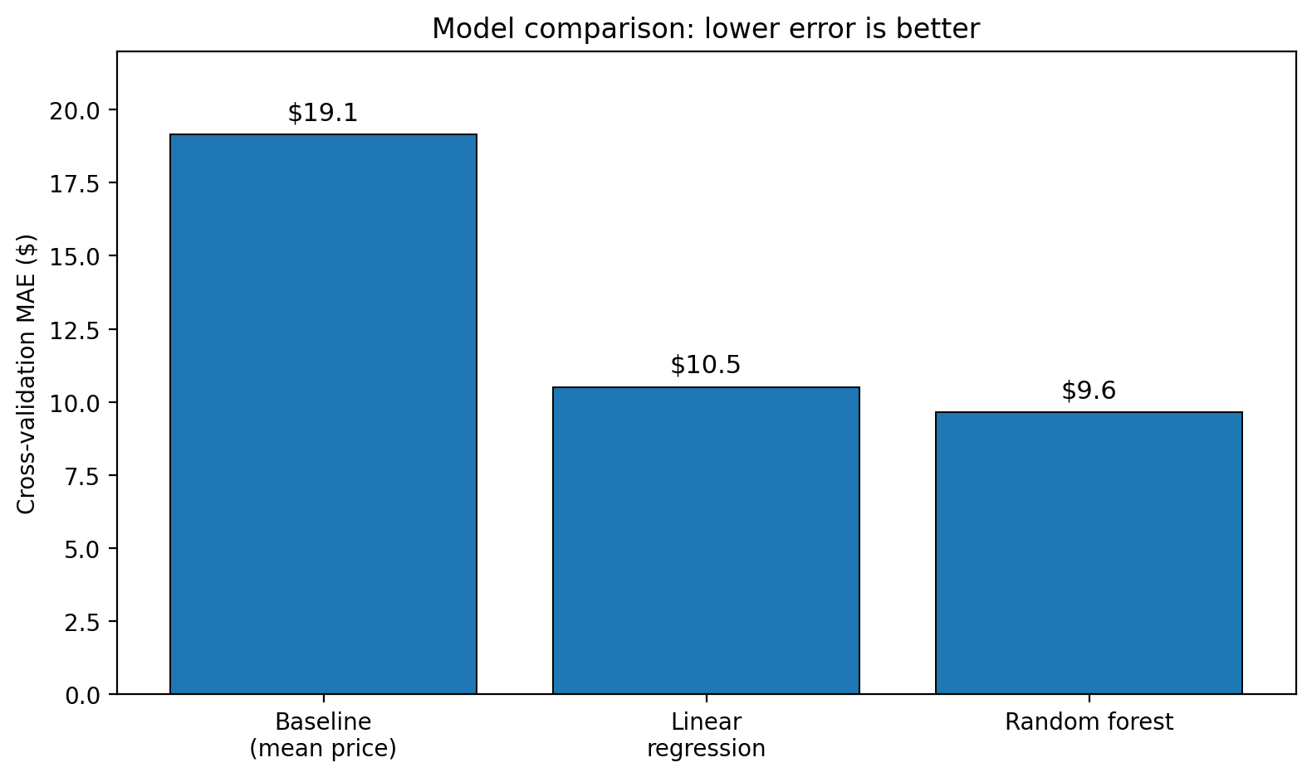
3. Modeling results: how the recommendation was built
METHOD
Simple process
• Start with 330 resorts and clean the data down to 277 usable resorts.
• Create extra features, such as chairs per run and state context.
• Compare a baseline, linear regression, and random forest using MAE in dollars.
Winning model
Random forest
MAE ≈ $9.6
Random forest had the lowest error, so it became the final model.

Slide 5
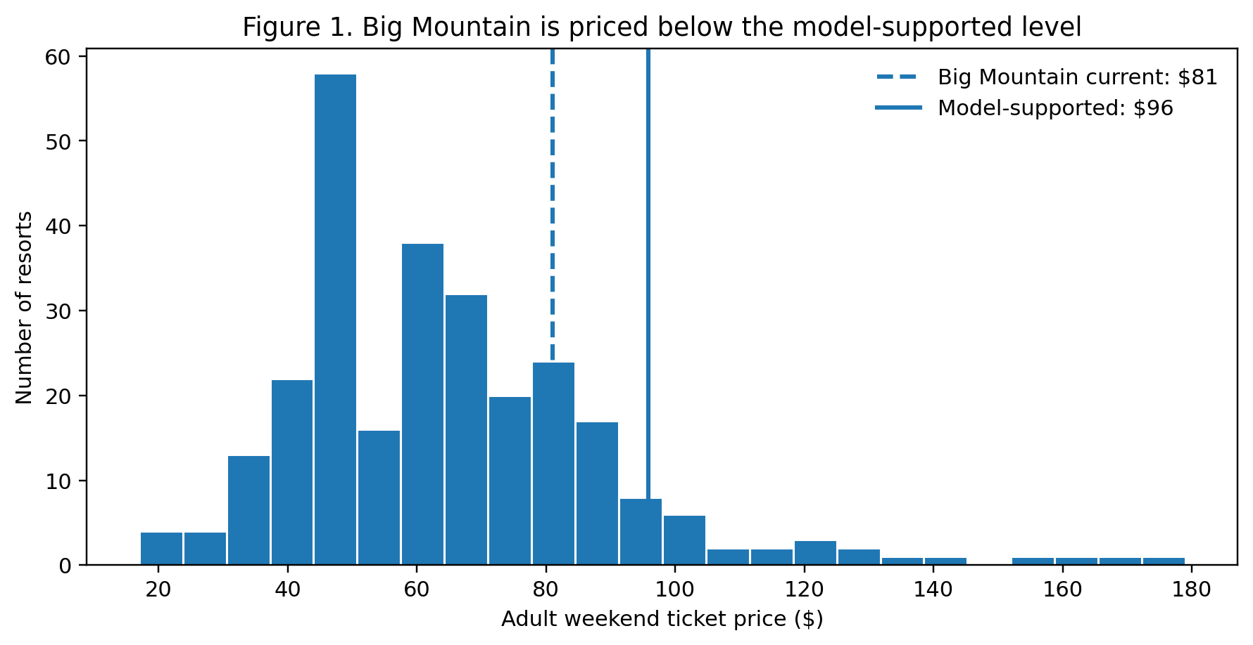
4. Market context: Big Mountain is priced below the supported level
ANALYSIS
What the chart shows
• The dashed line is the current Big Mountain price: $81.
• The solid line is the model-supported price: about $96.
• Big Mountain sits below the level suggested by similar resort features.

Slide 6
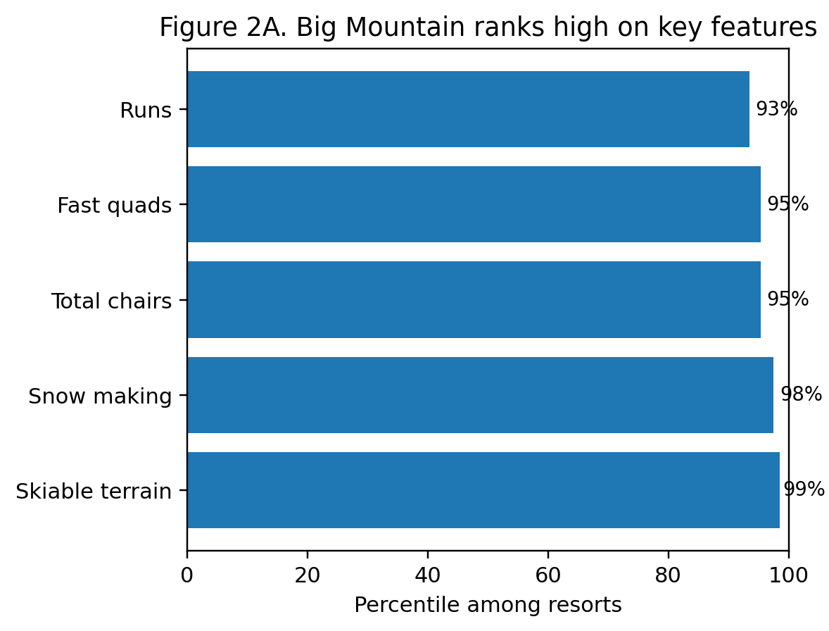
5. What supports a higher price
ANALYSIS
Big Mountain is strong on important resort features.
• The resort is near the top of the market for skiable terrain, snow making, total chairs, fast quads, and runs.
• These features are also linked with higher ticket prices in the models.
• This helps explain why the model says the current price looks low.
Main drivers: vertical drop, snow making, total chairs, fast quads, and runs.

Slide 7
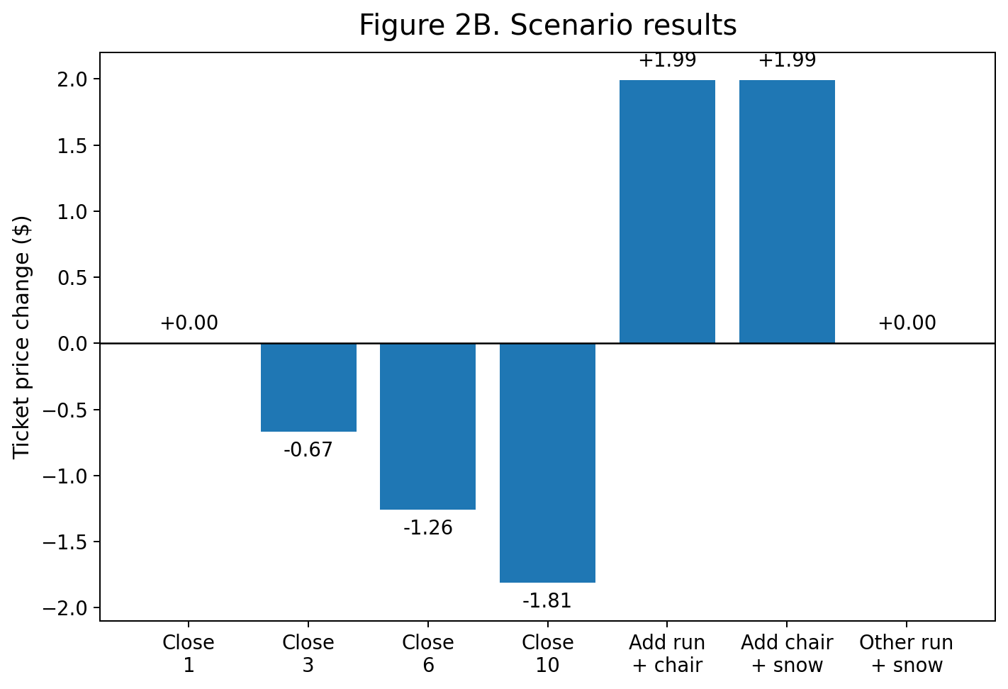
6. Scenario analysis
OPTIONS
Main lessons
• Best upside: add 1 run, 150 feet of vertical drop, and 1 chair lift.
• Model impact: about +$1.99 per ticket.
• That equals about $3.47M gross seasonal revenue before extra costs.
Risk to watch: closing many runs reduces price support, especially after about 3 runs.

Slide 8
7. Summary and conclusion
Final recommendation
Big Mountain should raise the adult weekend ticket price gradually, not all at once.
Action now
If demand stays strong
Future work
• Test a move from $81 to about $86–$90.
• Move toward about $92–$96.
• Add cost, competition, and demand data.
• Track revenue, ticket sales, and guest feedback.
• Use a measured test-and-learn approach.
• Turn price advice into profit advice.
Bottom line: the resort looks underpriced, but the safest business move is a gradual increase with clear monitoring.

