Slide 1
YouTube Trending
Engagement & Reach
Capstone 3 presentation | by Fahad Memon
1

Slide 2
CONTEXT
Problem and client decision
Business problem
What the client can do
A media or creator team wants to understand what stronger trending performance looks like across countries.
They need guidance on release timing, metadata packaging, and localization for priority videos.
Choose when to publish and promote.
Adjust titles, descriptions, and language strategy.
Use a model to rank which trending entries deserve faster follow-up action.

Slide 3
DATASET
Data source and sample design
Kaggle dataset of trending YouTube videos across 113 countries. Working window limited to 2024 and 2025.
2024
2025
113
100,000 rows
100,000 rows
Countries
91,033
42
2 years
Unique videos
Fixed seed
Balanced window

Slide 4
ANALYSIS FRAME
Project questions
Timing
Packaging
Reach
How long after publish do videos enter trending?
Does publish day matter for engagement?
Do description length, title style, and other metadata relate to engagement?
Is language connected with broader cross-country spread or stronger performance?

Slide 5
WHY BOTH ROW-LEVEL AND VIDEO-LEVEL TABLES
Two analysis grains
Row-level table
Video-level table
One row = one trending appearance for one country on one snapshot date.
Best for engagement distributions, weekday comparisons, and modeling.
One row = the first observed appearance for a unique video.
Best for timing-to-trend and cross-country reach without overweighting repeated appearances.

Slide 6
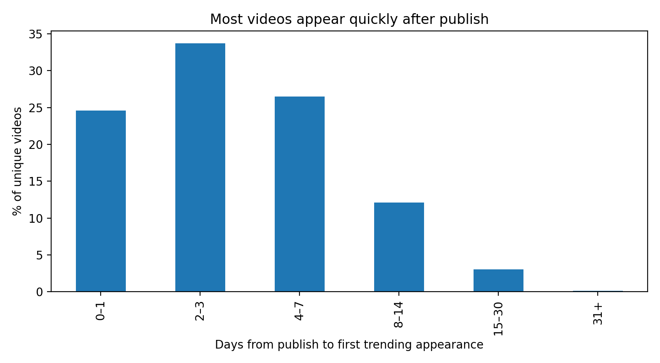
TIMING
Finding 1: trending is fast
85% within 7 days
Most videos reach their first trending appearance very soon after publish.
Median = 3 days
The operational window for promotion looks short and front-loaded.

Slide 7
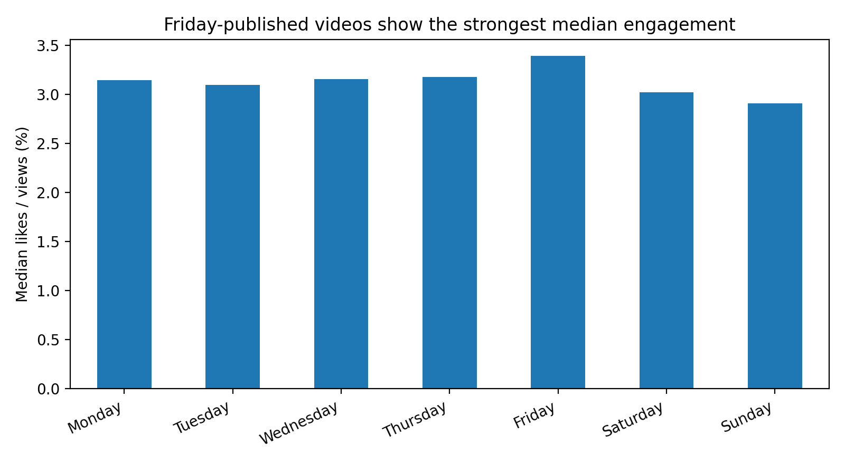
TIMING
Finding 2: publish day matters modestly
Friday leads
Median likes-to-views ratio is about 3.39% on Friday vs. 2.91% on Sunday.
Takeaway
The effect is not huge, but it is directionally useful for scheduling.

Slide 8
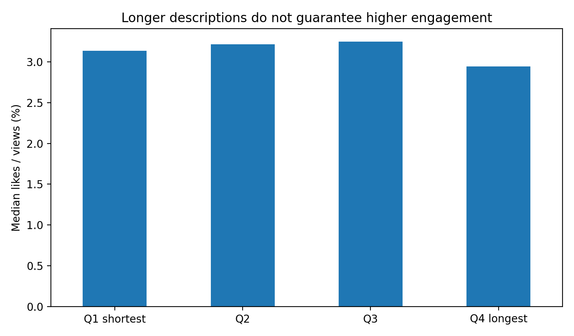
METADATA
Finding 3: longer descriptions are not a guarantee
Q4 is not best
Q represent quartiles for shortest to longest descriptions. The longest descriptions show lower median engagement than the middle quartiles.
Takeaway
Quality and clarity seem more important than simply adding more text.
Quartile

Slide 9
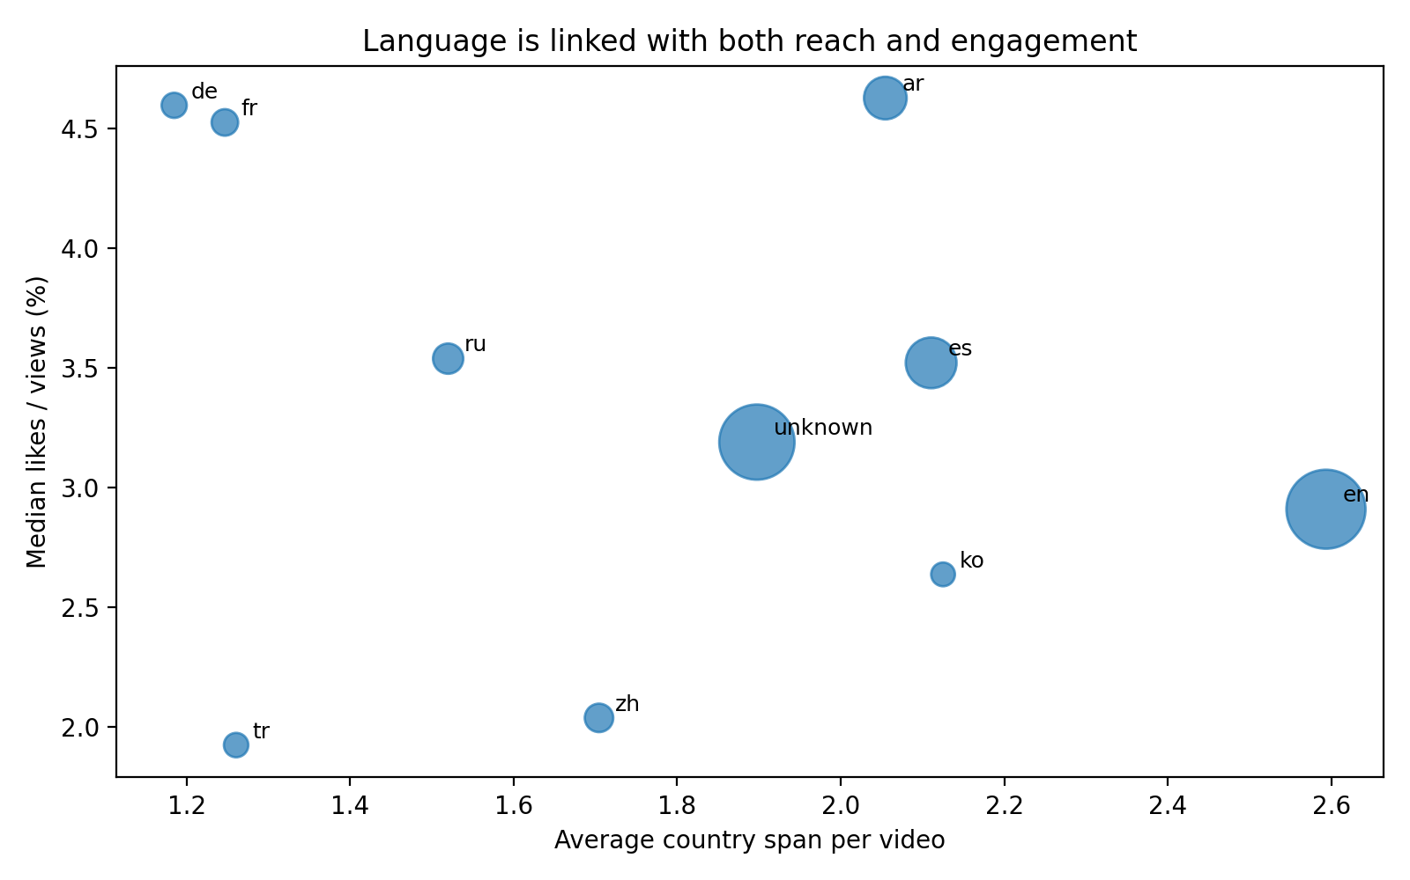
REACH
Finding 4: language is tied to both reach and engagement
English spreads widest
English videos have the broadest average country span among large language groups.
Engagement differs too
Arabic, French, and German show relatively strong median likes-to-views in this sample.

Slide 10
PREDICTIVE STEP
Modeling setup
Target
Split
Models
Classify whether a trending entry lands in the high-engagement group, defined from the 2024 training distribution.
Train on 2024 and test on 2025 so the model is evaluated on later unseen data, not a random mix of both years.
Baseline Logistic Regression and a final Random Forest using engineered timing, metadata, and language features.

Slide 11
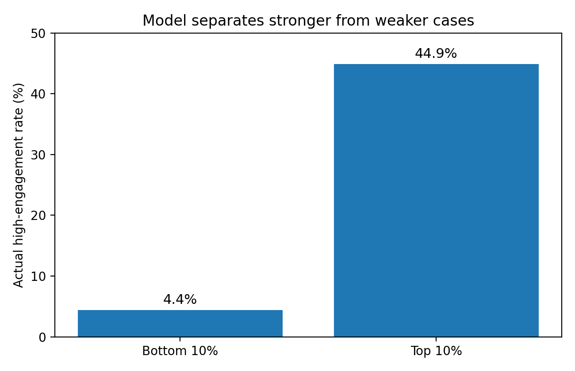
PREDICTION REVIEW
Model results
0.71
44.9%
4.4%
Random Forest ROC-AUC
Actual high-engagement rate in top 10%
Actual high-engagement rate in bottom 10%
Takeaway
The model separates stronger from weaker cases well enough to support prioritization. It should guide decisions, not replace editorial judgment.

Slide 12
ACTION
Recommendations for the client
1. Front-load promotion
2. Optimize packaging
3. Use Engagment Metrics
Because most first appearances happen within a week, concentrate launch support in the first few days after publish.
Use publish timing, concise descriptions, and language-aware metadata as controllable levers to improve engagement.
Use early performance signals to prioritize which trending videos to support more aggressively.

Slide 13
WHAT TO IMPROVE NEXT
Limitations and future work
Current limits
Next steps
The dataset only contains videos that already trended.
Results are about performance inside the trending sample, not about whether any upload will trend at all.
We also may need to consider artificial engagement by bots.
Add richer NLP features from titles and descriptions.
Test a random-split benchmark next to the time-based split.
Bring in channel history or content category features if available.

