Slide 1
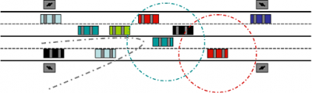
VANET Vehicular Ad Hoc Network
Felix Lu
November 21, 2012

Slide 2
VANET Articles
Routing in Sparse Vehicular Ad Hoc Wireless Networks
Authors: Nawaporn Wisitpongphan, Fan Bai, Priyantha Mudalige, Varsha Sadekar, and Ozan Tonguz
IEEE Journal on Selected Areas in Communications, Vol. 25, No. 8, October 2007 (pg 1538-1556)
Vehicular Mobility Simulation for VANETs
Authors: Marco Fiore, Jerome Hrri, Fethi Filali, Christian Bonnet
Simulation Symposium, 2007. ANSS ’07. 40th Annual
Analytical Model for Connectivity in Vehicular Ad Hoc Networks
Authors: Saleh Yousefi, Eitan Altman, Rachid El-Azouzi, Mahmood Fathy
IEEE Transactions on Vehicular Technology, Vol. 57, No. 6, November 2008
An Improved Vehicular Ad Hoc Routing Protocol for City Environments
Authors: Moez Jerbi, Sidi-Mohammed Senouci, Rabah Meraihi, Yacine Ghamri-Doudane
IEEE International Conference on Communications, 2007, ICC ‘07’ (pgs 3972-3979)

Slide 3
Routing in Sparse Vehicular Ad Hoc Wireless Networks
AUTHORS: Nawaporn Wisitpongphan, Fan Bai, Priyantha Mudalige, Varsha Sadekar, and Ozan Tonguz
IEEE Journal on Selected Areas in Communications, Vol. 25, No. 8, October 2007 (pg 1538-1556)

Slide 4
A Disconnected VANET
What are the consequences when trying to relay safety messages to other vehicle?
What are the key characteristics to observe and what are the adverse effects on performance in the network?
How can the affects of network fragmentation be minimized?
Given a collection of empirical data, how realistic is it to mathematically model for the scenario of expecting disconnections in a communication network?
Routing in Sparse Vehicular Ad Hoc Wireless Networks

Slide 5
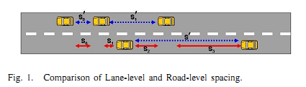
The Car Following Model
Single Lane Model (blue arrows)
Inter-vehicle distances measured between cars in the same lane
Multi Lane Model (red arrows)
Inter-vehicle distances measured between the closest adjacent vehicle, which more closely represents the situation of a communications network
Routing in Sparse Vehicular Ad Hoc Wireless Networks
Notes:
It is not relevant whether a car is in the same lane, but whether they are within the range of communication

Slide 6


The Car Following Model
Original Car Following Model
Modified Car Following Model
 | S’ - headway spacing between rear bumper to rear bumper L - effective vehicle length in meters - driver reaction time in seconds V - vehicle speed in meters/second - reciprocal of twice the max average deceleration of a following vehicle (ie approximately 0.075 )
 | - road level inter-vehicle spacing - minimum spacing between any two adjacent vehicles - inter-arrival time of vehicles on any lane from fix observation point V - vehicle sped in meters/second
Routing in Sparse Vehicular Ad Hoc Wireless Networks
Notes:
Basis of original model is empirical data gathered by Berkeley Highway Laboratory. However instead of driver reaction time we replace it with inter-arrival time of vehicles into the network. The modified equation then becomes the following: (second)

Slide 7
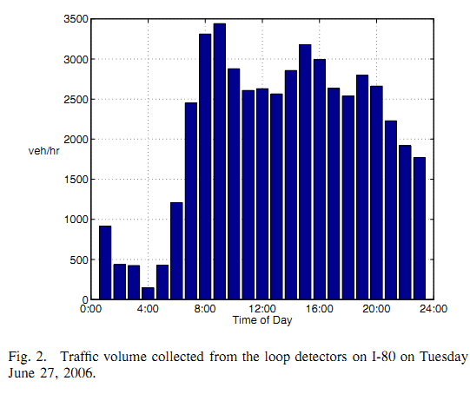
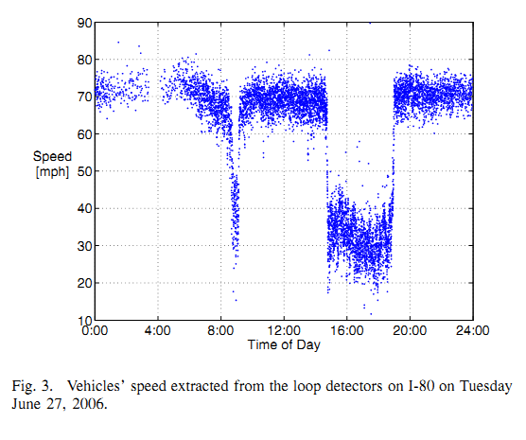
Berkeley Highway Laboratory (BHL) Empirical Data
Volume of cars entering network given time of day
Recordings taken at 60 readings/sec
Can be used to extract the inter-arrival times
Peak of traffic volume ~3-5pm
Valley of traffic volume ~1-3am
Vehicle speed (mph) given time of day
Rush hour traffic ~3-5pm
Causes slower speeds
Routing in Sparse Vehicular Ad Hoc Wireless Networks
Notes:
(1)

Slide 8
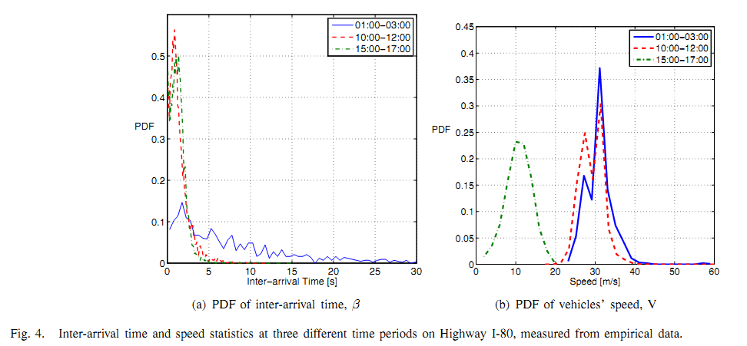
Probability Density Function (PDF) of Inter-Arrival Times and Vehicle Speeds
Blue line (1-3am data) most represents the disconnected VANET situation
PDF of Inter-arrival time similar to the general exponential distribution
Inter-arrival times range anywhere from 0 to past 30 seconds
PDF of vehicle speeds similar to a normal distribution
Routing in Sparse Vehicular Ad Hoc Wireless Networks

Slide 9
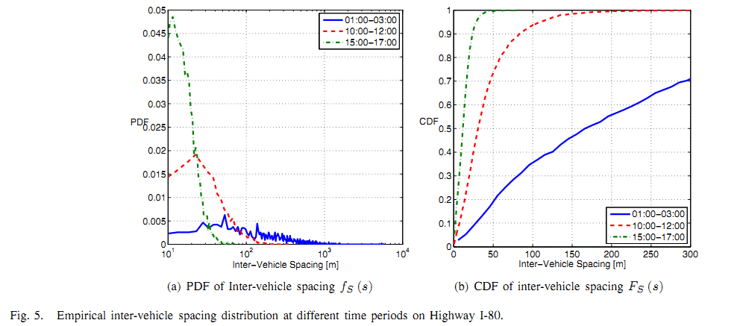


Inter-Vehicle Spacing
Modified Equation for the Inter-Vehicle Spacing:
Can approximate S = V, which results in figure 5(a)
Inter-vehicle spacing is anywhere from 0 to 1000km!
Can model PDF of inter-vehicle spacing by where
Integrating we can get the Cumulative Density Function of the inter-vehicle spacing.
Define range of communication to be 250m or less
From figure 5(b) we see there is a 65% chance of being connected to the network.
However, this assumes 100% market penetration… Highly unlikely!
Routing in Sparse Vehicular Ad Hoc Wireless Networks

Slide 10


Inter-Vehicle Spacing Distribution
This breaks down when the volume is greater than 1000 vehicles/hour, but we are emphasizing the time frame from 1-3am with a sparse traffic density to model a fragmented network.
Routing in Sparse Vehicular Ad Hoc Wireless Networks

Slide 11
Kolmogorov-Smirnov Test (K-S Test)
Tests the goodness-of-fit of the derived models against the empirical data.
Defined by:
For times 1-3am, the D statistic is accurate up to 3%.
For the other time frames, 10am-12pm and 3pm-5pm, the model breaks down and the D statistic is as high as 10%.
Routing in Sparse Vehicular Ad Hoc Wireless Networks

Slide 12
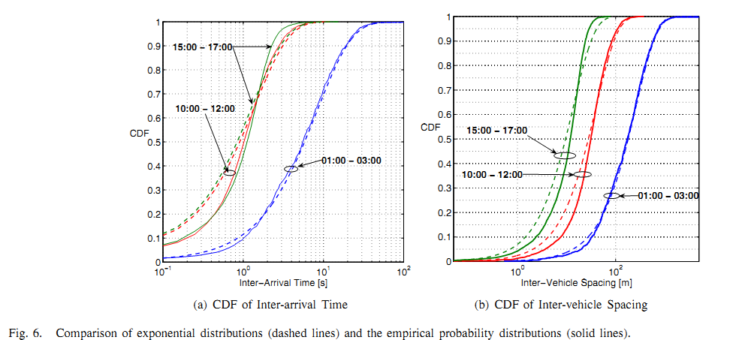
Kolmogorov-Smirnov Test (K-S Test)
Solid and dashed blue lines: 1-3am time frame
The derived model is a good fit to the empirical data for this time frame
The D statistic is at most 3% for this case
The other 2 time frames do not fit as well
Routing in Sparse Vehicular Ad Hoc Wireless Networks

Slide 13





Key Characteristics (Derivation in Paper)
Probability of being the last vehicle in a cluster
Average Intra-Cluster Spacing
Average Inter-Cluster Spacing
Average Cluster Size
Average Cluster Length
Routing in Sparse Vehicular Ad Hoc Wireless Networks

Slide 14
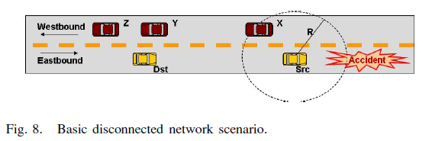
Disconnected Networks With Two Directional Traffic
Can utilize opposite direction traffic to bridge a network, however will have to incur additional temporal delay
Immediate goal is to broadcast a message from “Src” to “Dst”
Routing in Sparse Vehicular Ad Hoc Wireless Networks

Slide 15
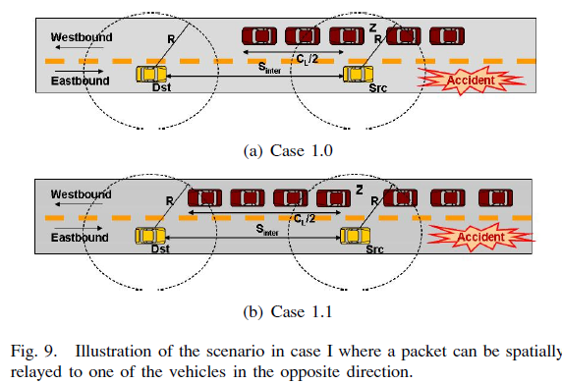
Spatial Delay
The delay incurred by broadcasting to vehicles in immediate range is Spatial Relay
Routing in Sparse Vehicular Ad Hoc Wireless Networks

Slide 16
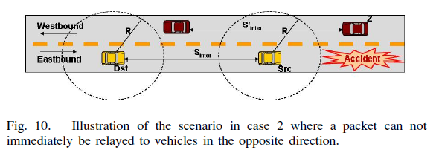
Store-Carry-Forward
Store-carry-forward referred to as Temporal Relay
Incurs greater temporal delay
Routing in Sparse Vehicular Ad Hoc Wireless Networks

Slide 17
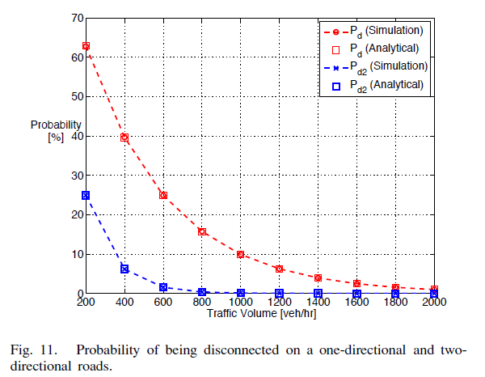
Simulation Results
Simulated results match extremely well with analytical results for both cases of one and two direction probability of being disconnected
Comparing with empirical results at 1-3am (which showed an approximate volume of 500 veh/hr), the probability of being disconnected is again 35%
Results also show that as traffic density increases, the disconnection probability decreases. This follows intuition because it increases likelihood of vehicles being in the range of R=250m.
Routing in Sparse Vehicular Ad Hoc Wireless Networks

Slide 18
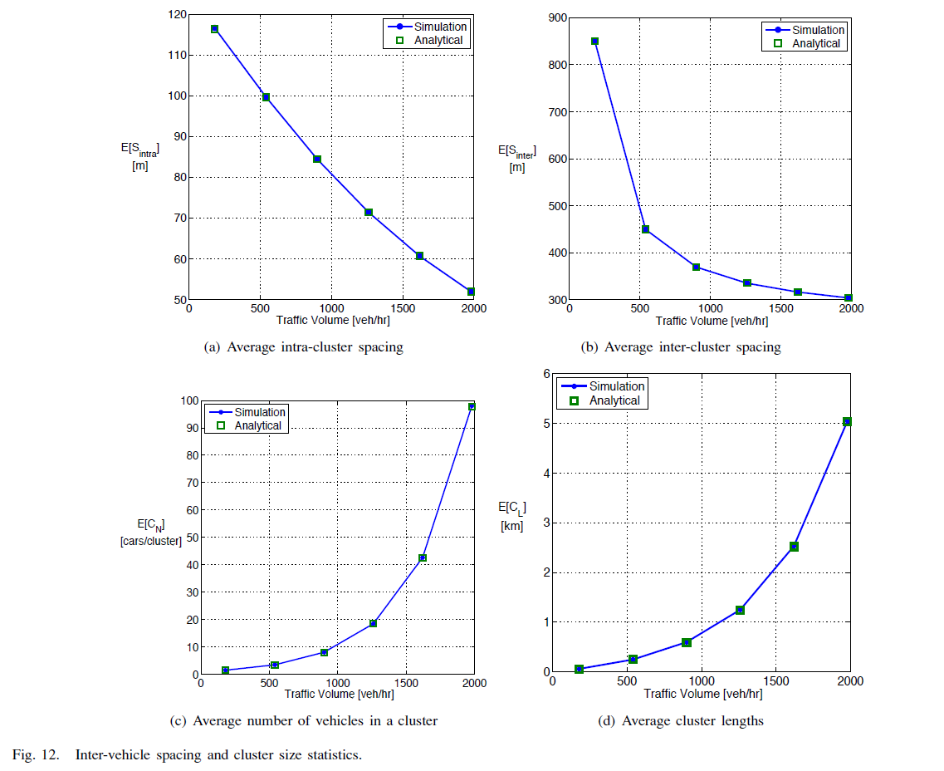
Simulation Results
Analytical and simulated results are nearly identical
As traffic volume increases, distance between vehicles decreases. This reduces the inter and intra-vehicle spacing as expected.
As more vehicles enter the network, results also show as expected that the average number of vehicles in a cluster increases. Intuitively, as cluster size increases, it should follow that cluster lengths also increase.
Routing in Sparse Vehicular Ad Hoc Wireless Networks

Slide 19
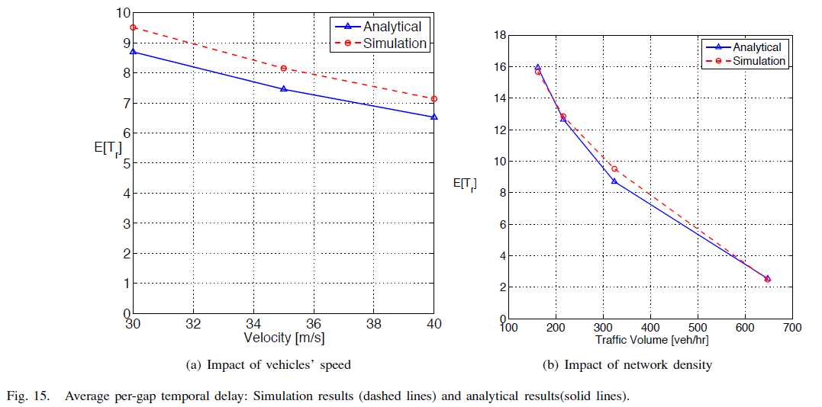
Simulation Results
The average re-healing time is shown to be impacted by a vehicles speed. It is shown that the re-healing time is dependent on the speed of both east and westbound vehicles. An increase in speed decreases the delay to store and forward messages.
We can also see that an increase in network density decreases the re-healing time. With more vehicles in range of the 250m constraint, the greater amount of spatial relays that can occur to relay messages. Spatial relays are negligible compared to temporal relays therefore significantly reducing the average re-healing times
Routing in Sparse Vehicular Ad Hoc Wireless Networks

Slide 20
Model for Disconnected VANET
The proposed framework shows that it is a viable solution to handle a fragmented VANET. The simulations as well as empirical results validates the proposed framework and can be used to further develop the understanding of VANETs.

Slide 21
Vehicular Mobility Simulation for VANETs
Authors: Marco Fiore, Jerome Hrri, Fethi Filali, Christian Bonnet
Simulation Symposium, 2007. ANSS ’07. 40th Annual

Slide 22
VanetMobiSim
There’s no arguing that wireless technology is infiltrating the vehicles we drive everyday. The possibilities are endless, however a common road block in testing prototypes and protocols lies with the resources needed (amount of vehicles) and the large scale of developed roads.
A viable solution is in the realm of simulation. However, a simulation is only as good as it’s ability to properly characterize reality.
One such tool is VanetMobiSim which allows a user to characterize criteria that influence traffic flow
Vehicular Mobility Simulation for VANETs

Slide 23
Realistic Simulations
Many simulation models do not factor in all the nuances that shape traffic congestion
Traffic conditions are composed of:
Road lengths, speed limits, and number of lanes
Characteristics of roads (stop signs versus stop lights at intersections)
Proximity to frequented buildings
Characteristics of individual drivers
VanetMobiSim offers the ability to take into account:
Physical characteristics of road environments
Characteristics of drivers to properly simulate traffic conditions given a road topology
Vehicular Mobility Simulation for VANETs

Slide 24
Macro-Mobility Features
Macro-Mobility features: physical characteristics that could possibly affect traffic conditions
Number of lanes on a road, Traffic signs, Speed limits, Paths traveled, Road topologies
VanetMobiSim allows the user to customize all these characteristics which is very important because obviously the physical limitations of the driving conditions have an affect on traffic.
Customizable road topologies is another option of VanetMobiSim that allows for realistic simulations.
Allows user to model a city-sized environment, which is a major roadblock to real world testing.
Vehicular Mobility Simulation for VANETs

Slide 25
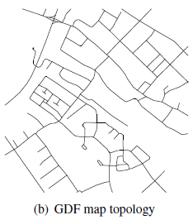
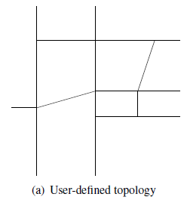
Macro-Mobility Features: Road Topologies
User-Defined Graph: User lists the vertices and connections to create the graph
GDF Map: Geographical Data File (Most of these are not free ☹)
Vehicular Mobility Simulation for VANETs

Slide 26
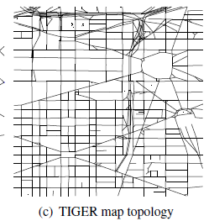
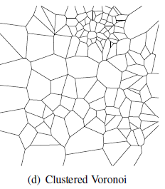
Macro-Mobility Features: Road Topologies
TIGER Map: road topologies taken from the TIGER database (free source but granularity of detail is not as high as with a GDF)
Clustered Voronoi Graph: Random generation via a Voronoi tessellation given a set of points (has ability to vary traffic densities)
Vehicular Mobility Simulation for VANETs

Slide 27
Macro-Mobility Features: Enhancements
VanetMobiSim offers the following enhancements from CanuMobiSim
Ability to model traffic with multiple lanes and directions
Road dividers can separate traffic flowing in opposite directions
Varying speed limits for different road topologies
Ability to have different traffic flow control mechanisms such as stop signs or traffic lights at intersections
User may moderate the timing in which traffic lights change
Vehicular Mobility Simulation for VANETs

Slide 28
Macro-Mobility Features: Movement Patterns
One important aspect of traffic modeling is applying movement patterns to vehicles. In the model, the movement patterns will dictate how each vehicle moves from vertice to vertice along the edges
Trip Generation Module: Allows the user to define a set of points of interest so that vehicles follow the given path across specified edges on the graph. This is ideal if we want to force vehicles on a particular path
Two models associated with the Trip Generation Module
Random Trip Model: Between a set of points, a random path is decided to reach the destination
Activity Sequences: The user provides the points of interest and the path to reach the destination
Vehicular Mobility Simulation for VANETs

Slide 29
Macro-Mobility Features: Movement Patterns
Path Computation Module: Given a set of points to traverse, the module computes the ideal path to each point.
May be used to model more random traffic as the user is not in full control of the path vehicles will take
Includes 3 models:
Dijkstra’s Algorithm: used by applying weight to each edge on the graph. As the edge decreases the cost increases.
Density Weighting: weighting can also be determined by the relation between how many vehicles are on the edge. This is used to simulate roads with different densities
A combination of the two methods with knowledge of the speed limit. This additional knowledge allows the decisions to be based on clearest and fastest path
Vehicular Mobility Simulation for VANETs

Slide 30
Micro-Mobility Features
Micro-Mobility Features: related to the behavior of individual cars.
Shapes how traffic is formed just as much as the physical contours of a given road topology
VanetMobiSim classifies the micro-mobility features into three categories based on how a vehicle accelerates
Deterministic, given some set of conditions an expected outcome occurs
Function of nearby vehicles in a single lane
Function of nearby vehicles for multiple lanes
Vehicular Mobility Simulation for VANETs

Slide 31
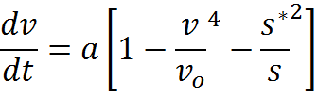

Models in VanetMobiSim
The Intelligent Driver Model is a form of the Car Following Model where results are based on the vehicle directly in front
Characterizes the instantaneous acceleration as a function of the current vehicle speed, desired velocity, distance from the next vehicle, and desired dynamical distance
Vehicular Mobility Simulation for VANETs

Slide 32

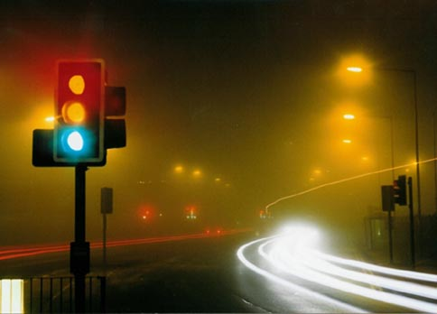
IDM-IM (Intersection Management)
With other simulations, the paths of vehicles can cross without any repercussions
VanetMobiSim offers a solution to this problem with their ability to model intersection traffic
Stop signs, traffic signals, and drivers changing lanes all contribute to how traffic is formed. Fortunately this can all be modeled with VanetMobiSim.
Vehicular Mobility Simulation for VANETs

Slide 33
IDM-IM Stop Signs and Traffic Signals
When a vehicle reaches a stop sign, the macro-mobility model passes information about the number of cars in front of that vehicle, if any.
Following the right-car priority rule, our vehicle waits its turn to move through a given intersection.
The traffic light mechanism decelerates a vehicle as it approaches a RED light and accelerates, to a max speed, if approaching a GREEN light.
Another feature is that if a vehicle is slowing down as it approaches a RED light, and the traffic signal turns GREEN, then the vehicle begins to accelerate which models a driver’s behavior.
Vehicular Mobility Simulation for VANETs

Slide 34

IDM-LC Lane Change
A definite enhancement to this simulation tool is the ability to model a drivers ability to change lanes to pass slower vehicles.
It follows a formula that weighs the pros of switching lanes against the cons of other vehicles in the same and new lane.
If the calculations show an advantage, and it is determined that a safe lane change is possible, then a driver may switch lanes.
Vehicular Mobility Simulation for VANETs

Slide 35
Simulation Setup
A 1500mx1500m road topology where squares represent entry/exit points for vehicles traveling 15 m/s and circles for vehicles traveling 20 m/s
Transition probability matrix shows the transitions from the slow to faster speeds
Traffic density varies from 10 to 50 vehicles/km
Simulations were done for RWP (Random Way Point), CSM (Constant Speed Motion), FTM, IDM, IDM-IM, IDM-LC
Vehicular Mobility Simulation for VANETs

Slide 36
Simulation Results
Notice that both RWP and CSM have a constant average speed with an increase in vehicle density. Intuitively we know that is not that case, but we emphasize this result because both models lack modeling of vehicle to vehicle interactions.
All other models have a decrease in velocity as the vehicular density increases, which is what we expect
Vehicular Mobility Simulation for VANETs

Slide 37
FTM (Fluid Traffic Model) Simulation
From Figure 5 we see that the FTM has the highest average velocity (due to lack of intersection modeling and
that the model does not allow vehicles to reach 0 m/s)
From the road topology, we see the greatest build up of vehicles between points A and B
All other intersections have relatively same density before and after intersections which is unrealistic (due to the lack of intersection modeling)
Vehicular Mobility Simulation for VANETs

Slide 38
IDM (Intelligent Driver Model) Simulation
IDM follows a car following model because it reacts to the vehicle directly in front
Attempts to maintain a desired dynamical distance from vehicles
Intersections A, B, and C have a significant increase in density as each vehicle attempts to maintain a safe distance from cross traffic as well as the vehicle immediately in front
Again, the lack of intersection modeling results in disproportionate density at busy intersections
Vehicular Mobility Simulation for VANETs

Slide 39
IDM-IM with Stop Lights Simulation
The average velocity is slower than IDM because of stop signs
Notice the smooth transition from low to high density as a vehicle approaches intersections A, B, and C. This is the queuing affect due many vehicles waiting their turn to cross
Every other intersection has a slight increase in density also due to the mandatory stop at intersections
Vehicular Mobility Simulation for VANETs

Slide 40
IDM-IM with Traffic Signals Simulation
At the busy intersections A, B, and C, notice an increase in density, but not as much as with stop signs.
This is because traffic signals allow for bursts of traffic to travel through the intersection
The non busy intersections have a slightly higher density than with stop signs.
This is because if vehicles are caught at a red light on non busy intersections, they are mandated to wait until the signal turns green
Vehicular Mobility Simulation for VANETs

Slide 41
IDM-LC (Lane Change) Simulation
Looking at Figure 9, as traffic density increases, the average vehicular velocity declines only slightly.
The ability to change lanes and avoid slower drivers attributes to this phenomena
At the busy intersections A, B, and C, the ability to change lanes also decrease traffic density
Vehicular Mobility Simulation for VANETs

Slide 42
Comparison of three IDM simulations
Stop signs perform well at low travelled roads
Traffic signals temper the queue effect
Lane changing reduces the density and queuing effect at busy intersections
Vehicular Mobility Simulation for VANETs

Slide 43
Conclusion
Main Focus: setting up a model that can realistically simulate real world traffic conditions.
Most realistic solutions were IDM with stop signs, traffic signals, and lane changes
Each model has it’s deficiencies and fortes
Results indicate best simulation should combine aspects of each model depending on whether roads are known to be busy (creates balanced and realistic simulation for vehicular traffic):
Traffic signals with lane changes at busy intersections
Stop signs at quiet streets
Vehicular Mobility Simulation for VANETs

Slide 44
Analytical Model for Connectivity in Vehicular Ad Hoc Networks
Authors:Saleh Yousefi, Eitan Altman, Rachid El-Azouzi, Mahmood Fathy
IEEE Transactions on Vehicular Technology, Vol. 57, No.6, November 2008

Slide 45
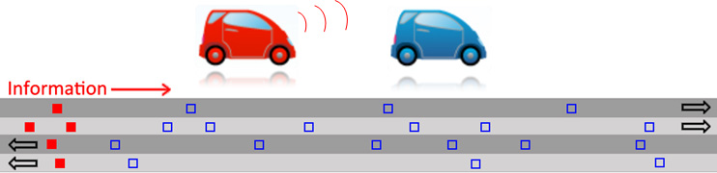
Analytical Model for Connectivity in a VANET
Article outlines a developed framework for analyzing factors that affect connectivity in a VANET:
Traffic flow (vehicle density)
Transmission range of the communication devices
Relationship of vehicle speeds
Analytical Model for Connectivity in Vehicular Ad Hoc Networks

Slide 46
Fundamental Traffic Theory
The general traffic flow is described as a product of the average speed and traffic flow.
Figure 1
Shows two regions of traffic flow given the vehicle density
Critical density represents the density in which traffic flow begins to degrade
Area of interest focused on stable flow because connectivity is well established in high density situations due to the saturation of vehicles.
F = S x K F: Traffic Flow S: Average Speed K: Traffic Density
Stable Flow
Forced Flow

Slide 47
Relation to Infinite Server Model
Yousefi relates connectivity distance distribution in a VANET to an infinite server queuing system during a busy period
The other relation is the distribution of number of customers served to the number of vehicles connected in the VANET
The inter arrival times in a server queuing system can also be related to the inter-vehicle distribution
The final component is having the service time distribution relate the transmission range of the communication devices
Analytical Model for Connectivity in Vehicular Ad Hoc Networks

Slide 48



Distribution of Inter-Vehicle Distances
Uses the common method of having an observer at a fixed point as vehicles pass.
Assumes vehicles arrive with a Poisson distribution
Leads to inter-arrival times being exponentially distributed with parameter λ
Let be the velocity where N is the number of discrete velocity states
With varying velocities we must account for differences in the parameter where we have
Analytical Model for Connectivity in Vehicular Ad Hoc Networks

Slide 49
Distribution of Inter-Vehicle Distances
S: inter-vehicle distance for the same speed
R: inter-vehicle between both speeds
L: inter-vehicle distance between each closest vehicle which, like S, is exponentially distributed
Analytical Model for Connectivity in Vehicular Ad Hoc Networks

Slide 50

Distribution of Inter-Vehicle Distances
Leveraging the memoryless property of exponential distributions we can denote:
Looking at figure 2, below is an example of how to determine the L inter-vehicle distance
Analytical Model for Connectivity in Vehicular Ad Hoc Networks

Slide 51



Distribution of Inter-Vehicle Distances
Following a common assumption that traffic flow follows a normal distribution and coupled with statistics collected from empirical experiments, we have the general normal distribution for vehicle speed
70 | 21
90 | 27
110 | 33
130 | 39
150 | 45
Analytical Model for Connectivity in Vehicular Ad Hoc Networks

Slide 52
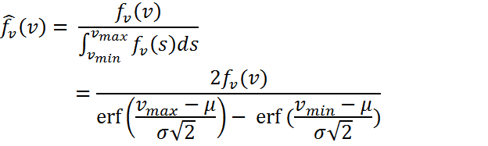


Distribution of Inter-Vehicle Distances
Let us define the function:
Then we can define the following
Analytical Model for Connectivity in Vehicular Ad Hoc Networks

Slide 53

Distribution of Inter-Vehicle Distances
The last thing to define is the max and min values for the velocities
In a normal distribution, 99.7% of all events occur between the range , so without loss of generality we can set the minimum and maximum values to this range
Analytical Model for Connectivity in Vehicular Ad Hoc Networks

Slide 54




Connectivity Analysis
Relating the platoon size to the busy period of a G/D/∞ queuing system, we can form the expression for the platoon size
Taking the summation from k to infinity, we form the expression for the tail probability of the platoon size
Analytical Model for Connectivity in Vehicular Ad Hoc Networks

Slide 55
Simulation: Inter-Vehicle Distance
Figure 3 shows that the simulated results lie very close against the model
The “x” represents the 95% confidence interval for this and subsequent graphs.
Analytical Model for Connectivity in Vehicular Ad Hoc Networks

Slide 56
Simulation: Platoon Size
Platoon size simulations are comparable with the framework developed
With increased traffic flow, the average platoon size increases as more vehicles are within transmission range of the communication devices
Analytical Model for Connectivity in Vehicular Ad Hoc Networks

Slide 57
Simulation: Connectivity Distance
The results match our intuition: as distance increases the probability of being connected decreases
Effects of traffic flow:
As traffic flow increases, the average connectivity distance also increases
As more vehicles enter the system and more vehicles are within transmission range, this inherently increases the average connectivity distance
Analytical Model for Connectivity in Vehicular Ad Hoc Networks

Slide 58
Simulation: Transmission Range
In this simulation the transmission range is varied
As the transmission range increases, the connectivity distance and average platoon size increases
Analytical Model for Connectivity in Vehicular Ad Hoc Networks

Slide 59
Simulation: Traffic Flow
As the traffic flow increases, the connectivity distance and average platoon size increases (similar to transmission range)
Increase in traffic flow also increases vehicular density, thereby increasing the average platoon size and then tail probability of platoon size
Analytical Model for Connectivity in Vehicular Ad Hoc Networks

Slide 60
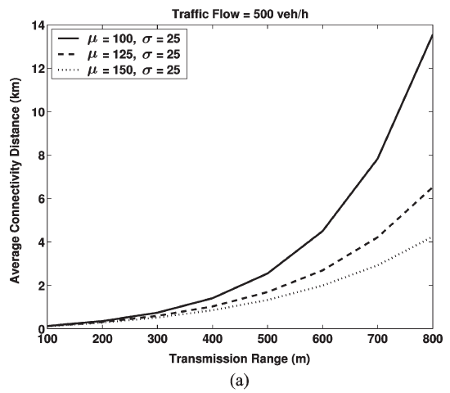
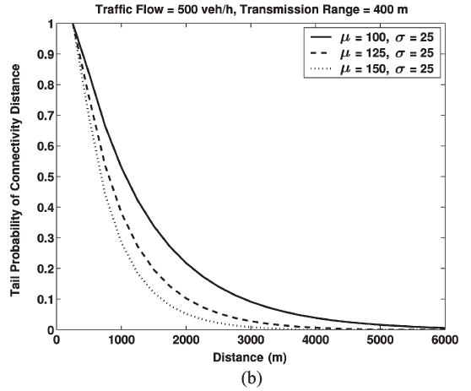
Simulation: Traffic Speed
As the speed of vehicles increase, the connectivity degrades.
By varying the average speed from 100-150 km/h, the average connectivity distance and tail probability of connectivity distance decrease significantly
Analytical Model for Connectivity in Vehicular Ad Hoc Networks

Slide 61
An Improved Vehicular Ad Hoc Routing Protocol for City Environments
Authors:Moes Jerbi, Sidi-Mohammed Senouci, Rabah Meraihi, Yacine Ghamri-Doudane
IEEE International Conference on Communications, 2007, ICC’07’ (pgs 3972-3979)

Slide 62
GyTAR
VANET communication in the city will probably be a heavily used technology in the near future.
The challenges with this technology is unique and requires more in depth research
The proposed GyTAR (improved Greedy Traffic Aware Routing) protocol offers an improvement to city vehicular communications
Simulations are utilized to verify the contributions that the GyTAR protocol can offer
An Improved Vehicular Ad Hoc Routing Protocol for City Environments

Slide 63
Uniqueness of a VANET
VANET depends on neighboring vehicles to form a connected network, therefore the nature is dynamic system capable of a multi-hop protocol
A VANET system has it’s unique problems and advantages over mobile devices which is why not all protocols are easily adopted with this type of network
Road topologies, traffic density play a big role with connectivity issues
The GyTAR protocol hopes to improve the packet delivery ratio, end to end delay, and reduce the routing overhead
An Improved Vehicular Ad Hoc Routing Protocol for City Environments

Slide 64
The GyTAR Protocol Assumptions
Through devices such as GPS, a vehicle is expected to know their relative position on a road
Employing any common vehicle location service, the transmitting vehicle knows the eventual destination of the transmitted packets
Each vehicle is aware of the current vehicular density in its surrounding environment
An Improved Vehicular Ad Hoc Routing Protocol for City Environments

Slide 65
First Premise with GyTAR
Ability to determine which intersection (junction) to send packets determines the path a packet of data traverses
Factors considered are vehicular density at each junction relative to the transmitting vehicles location
GyTAR then evaluates each possibility with a point system where the highest point total will be the selected data path
An Improved Vehicular Ad Hoc Routing Protocol for City Environments

Slide 66
GyTAR Evaluation System
J: Next candidate junction
I: The current junction
D_{j}: The curvemetric distance from the candidate junction J to the destination
D_{i}: The curvemetric distance from the current junction to the destination
D_{p}: D_{j}/ D_{i} (D_{p} determines the closeness of the candidate junction to the destination point)
Between junction I and J
N_{v}: Total number of vehicles between I and J
N_{c}: Number of cells between I and J
N_{avg}: Average number of vehicles per cell (N_{avg} = N_{v}/ N_{c})
N_{con}: Constant which represents the ideal connectivity degree we can have within a cell
α,β: Use as weighting factors for the distance and vehicular traffic respectively (with α+β=1)
The determining equation for the points system:
(J) =α x [1- D_{p}] + β[min((N_{avg}/ N_{con}),1)]
An Improved Vehicular Ad Hoc Routing Protocol for City Environments

Slide 67
Second Premise with GyTAR
The ability to forward packets between two selected junctions
The sending vehicle manages knowledge of the speed, direction, and position of neighboring vehicles to aid in the decision
Figure 2
Illustrates how the two premises are used together to decide which vehicles to send packets

Slide 68
GyTAR Evaluation System
The forwarding vehicle has 4 vehicles in it’s transmission range and knows the destination junction for the packets
At time t1, vehicle 4 is the closest vehicle to the desired junction
GyTAR accounts for the speed and direction of candidate vehicles.
Vehicle 3 and 4 are travelling in the opposite direction of the desired destination
At time t2, vehicle 1 passes vehicle 2 because it is travelling faster
Based on the point system vehicle 1 is chosen to forward the packet to the desired junction
An Improved Vehicular Ad Hoc Routing Protocol for City Environments

Slide 69
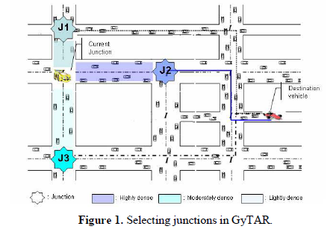
Simulation Setup
Simulation includes GyTAR, B-GyTAR (Basic GyTAR without recovery mechanisms), GSR (Geographic Source Routing), and LAR (Location Aided Routing)
Figure 1
2500x2500 m² city with 16 intersections and 26 two-way roads
Vehicles travel at speeds of 30-50 km/h
The number of vehicles in the VANET system at anytime is between 100-300 vehicles
The transmission range of the communication devices is 266 meters
An Improved Vehicular Ad Hoc Routing Protocol for City Environments

Slide 70
Packet Delivery Ratio
GyTAR has the best packet delivery ratio regardless of the packet sending rate or the number of nodes in a system
Attributed to the awareness of vehicle density and the protocol choosing the path best suited to transmit a message
The recovery protocol, store-carry-forward, bolsters the stability of the protocol
As the node number increases, the delivery packet ratio increases because there are less chances of having a disconnected network with more vehicles within transmission range
As the number of nodes increases past a threshold, the quality decreases as interference between an over-abundance of messages interfere with the network
An Improved Vehicular Ad Hoc Routing Protocol for City Environments

Slide 71
End to End Packet Delay
The GyTAR protocols clearly have a better end-to-end packet delay than both GSR and LAR
GyTAR saves time by not updating static routing tables to improve decision time
The greedy nature allows for GyTAR to choose the routes most likely to stay connected, reducing delay times
This is clear in figure b at low vehicular density as GyTAR is able to choose connected paths with a higher probability thus decreasing the delay
An Improved Vehicular Ad Hoc Routing Protocol for City Environments

Slide 72
Packet Overhead
For every protocol packet, overhead increases as the packet rate or number of nodes increase, however the GyTAR protocol outperforms GSR and LAR
By choosing paths with the highest connectivity, less packets are produced, reducing packet overhead
This is apparent when vehicular density is high, as GSR and LAR do not account for vehicular density
An Improved Vehicular Ad Hoc Routing Protocol for City Environments

Slide 73
Conclusion
Transmitting protocol can vastly improve the speed and quality of service in which data is transmitted
A dynamic protocol also improves the end-to-end delay which is the most notable result.
As technology improves, people expect devices to work faster, reducing any delays improves the user experience
An Improved Vehicular Ad Hoc Routing Protocol for City Environments

