Slide 1
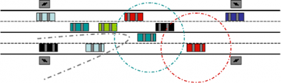
VANET Vehicular Ad Hoc Network
Felix MotherFuckin’ Lu
Month Day, Year

Slide 2
What is VANET?
Introduction to VANET

Slide 3
Routing in Sparse Vehicular Ad Hoc Wireless Networks
AUTHORS

Slide 4
Points of Discussion
What are the consequences when trying to relay safety messages to other vehicles when the network is constantly disconnected?
In a disconnected VANET what are the key characteristics to observe and what are the adverse effects on performance in the network?
What is the solution to a disconnected VANET if any? And if there is not a viable solution to this problem how can the affects of network fragmentation become minimized?
Given a collection of empirical data, how realistic is it to mathematically model for the scenario of expecting disconnections in a communications network?
Routing in Sparse Vehicular Ad Hoc Wireless Networks

Slide 5
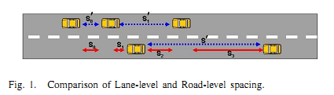
The Car Following Model
Single Lane Model (blue arrows)
Inter-vehicle distances measured between cars in the same lane
Multi Lane Model (red arrows)
Inter-vehicle distances measured between the closest adjacent vehicle, which more closely represents the situation of a communications network
One adjustment from the traditional Car Following Model
Routing in Sparse Vehicular Ad Hoc Wireless Networks
Notes:
It is not relevant whether a car is in the same lane, but whether they are within the range of communication

Slide 6
The Car Following Model
Original Car Following Model
Modified Car Following Model
 | S’ - headway spacing between rear bumper to rear bumper L - effective vehicle length in meters - driver reaction time in seconds V - vehicle sped in meters/second - reciprocal of twice the max average deceleration of a following vehicle (ie approximately 0.075 )
 | - road level inter-vehicle spacing - minimum spacing between any two adjacent vehicles - inter-arrival time of vehicles on any lane from fix observation point V - vehicle sped in meters/second
Routing in Sparse Vehicular Ad Hoc Wireless Networks
Notes:
Basis of original model is empirical data gathered by Berkeley Highway Laboratory. However instead of driver reaction time we replace it with inter-arrival time of vehicles into the network. The modified equation then becomes the following: (second)

Slide 7
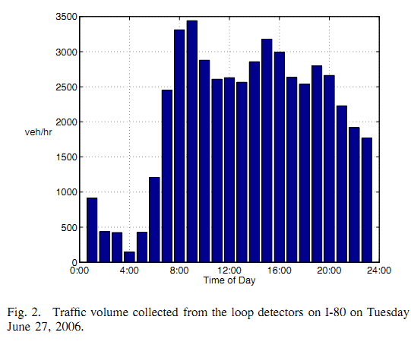
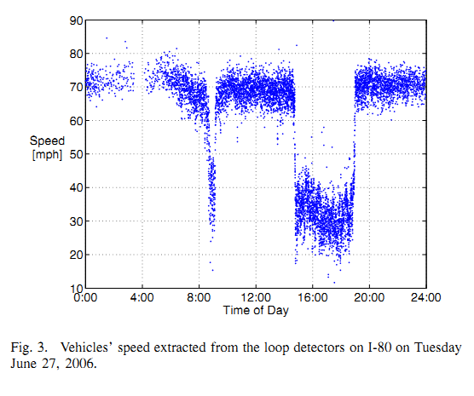
Berkeley Highway Laboratory (BHL) Empirical Data
Volume of cars entering network given time of day
Recordings taken at 60 readings/sec
Can be used to extract the inter-arrival times
Peak of traffic volume ~3-5pm
Valley of traffic volume ~1-3am
Vehicle speed (mph) given time of day
Rush hour traffic ~3-5pm
Causes slower speeds
Routing in Sparse Vehicular Ad Hoc Wireless Networks
Notes:
(1)

Slide 8
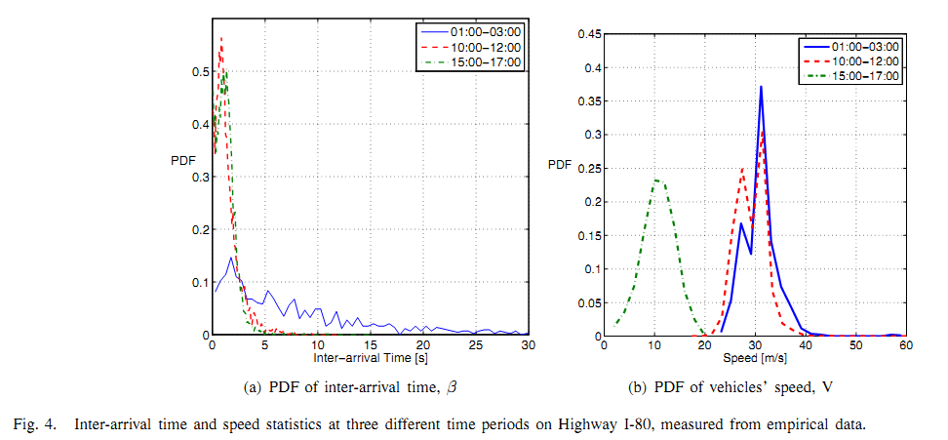
Probability Density Function (PDF) of Inter-Arrival Times and Vehicle Speeds
Since we are concerned with disconnected networks, will focus on the 1-3am data (The blue colored lines)
PDF of Inter-arrival time similar to the general exponential distribution
Inter-arrival times range anywhere from 0 to past 30 seconds
PDF of vehicle speeds similar to a normal distribution
Routing in Sparse Vehicular Ad Hoc Wireless Networks

Slide 9
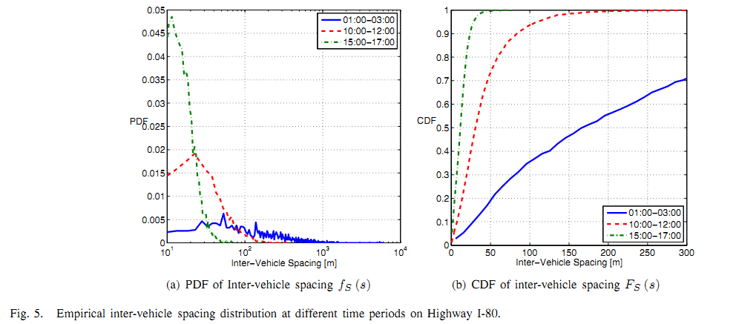


Inter-Vehicle Spacing
Modified Equation for the Inter-Vehicle Spacing:
Can approximate S = V, which results in figure 5(a)
Inter-vehicle spacing is anywhere from 0 to 1000km!
Can model PDF of inter-vehicle spacing by where
Integrating we can get the Cumulative Density Function of the inter-vehicle spacing.
Define range of communication to be 250m or less
From figure 5(b) we see there is a 65% chance of being connected to the network.
However, this assumes 100% market penetration… Highly unlikely!
Routing in Sparse Vehicular Ad Hoc Wireless Networks

Slide 10

Inter-Vehicle Spacing Distribution
This breaks down when the volume is greater than 1000 vehicles/hour, but we are emphasizing the time frame from 1-3am with a sparse traffic density to model a fragmented network.
Routing in Sparse Vehicular Ad Hoc Wireless Networks

Slide 11
Kolmogorov-Smirnov Test (K-S Test)
Tests the goodness-of-fit of the derived models against the empirical data.
Defined by:
For times 1-3am, the D statistic is accurate up to 3%.
For the other time frames, 10am-12pm and 3pm-5pm, the model breaks down and the D statistic is as high as 10%.
Routing in Sparse Vehicular Ad Hoc Wireless Networks

Slide 12
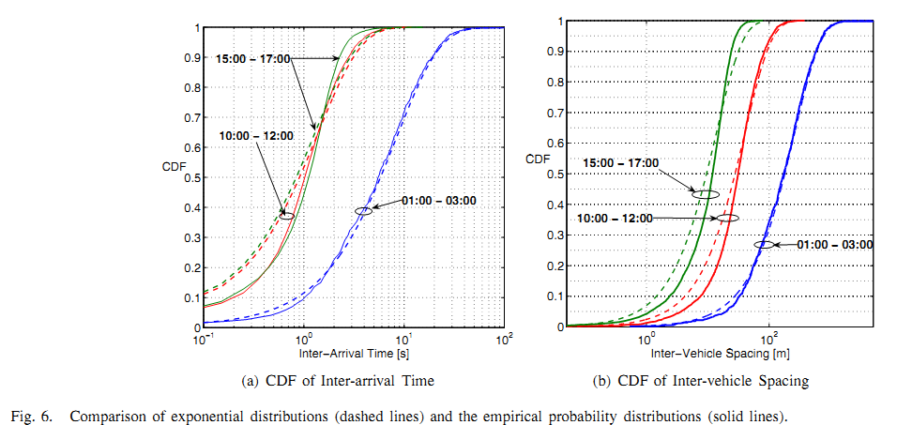
Kolmogorov-Smirnov Test (K-S Test)
Solid and dashed blue lines: 1-3am time frame
The derived model is a good fit to the empirical data for this time frame
The D statistic is at most 3% for this case
The other 2 time frames do not fit as well
Routing in Sparse Vehicular Ad Hoc Wireless Networks

Slide 13
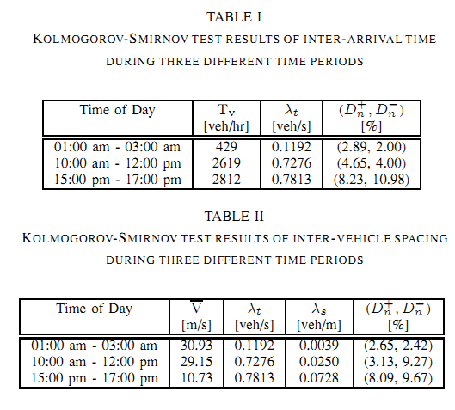
Analytical Data for D Statistics from Kolmogorov-Smirnov Test
Routing in Sparse Vehicular Ad Hoc Wireless Networks

Slide 14
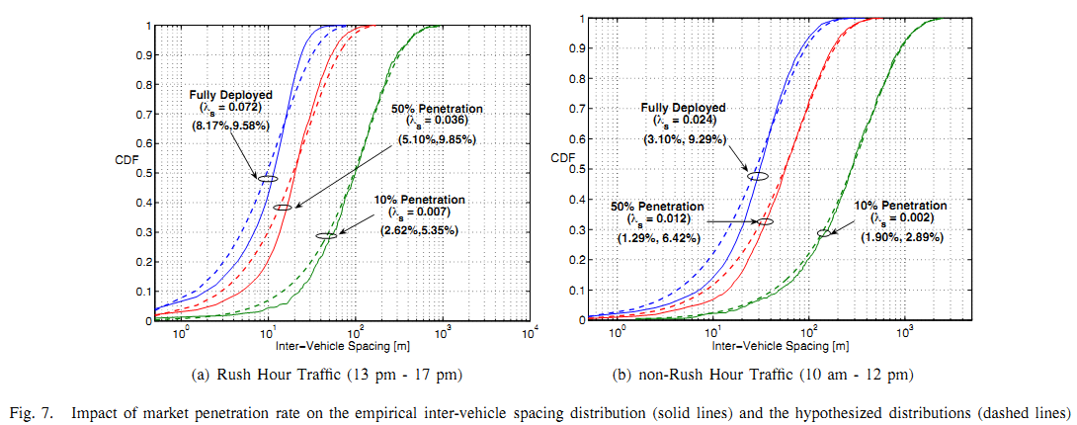

Slide 15
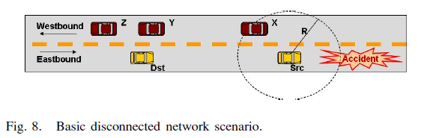

Slide 16
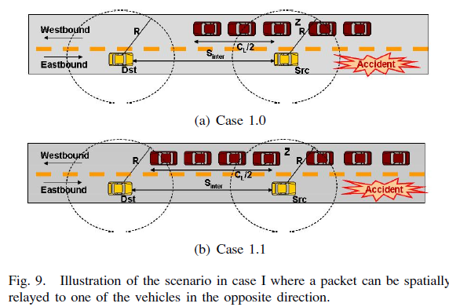

Slide 17
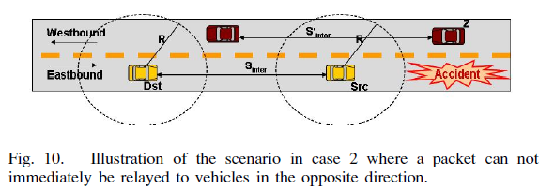

Slide 18
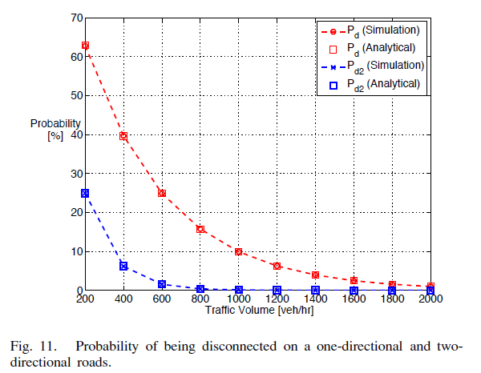

Slide 19
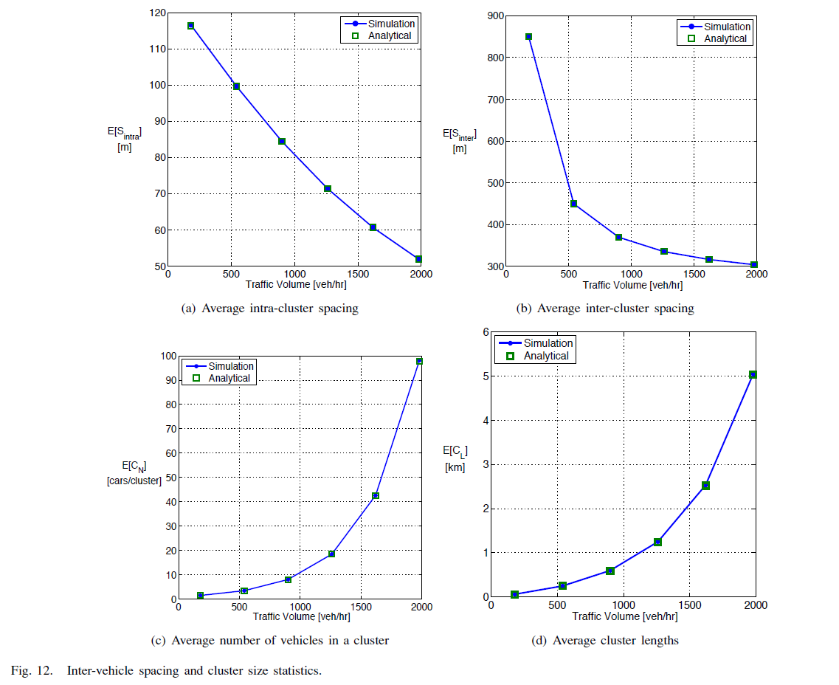

Slide 20
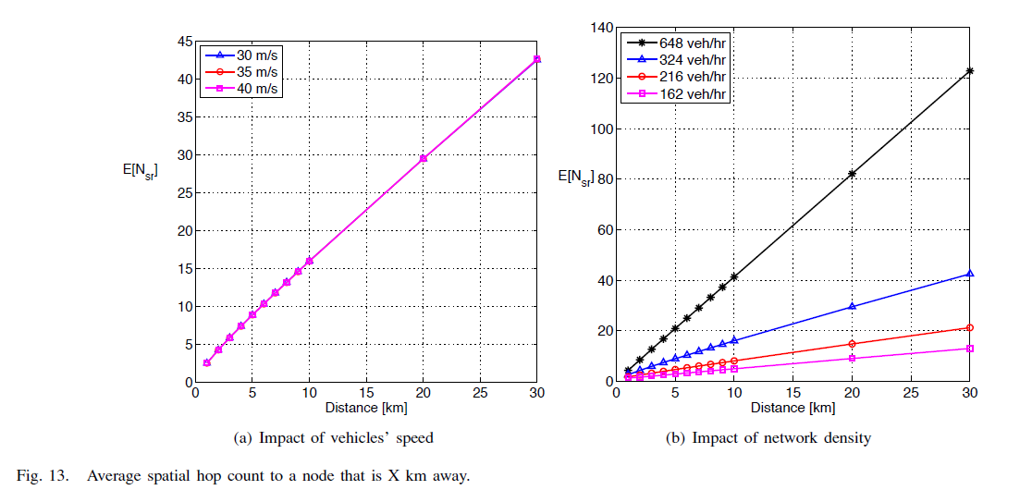

Slide 21
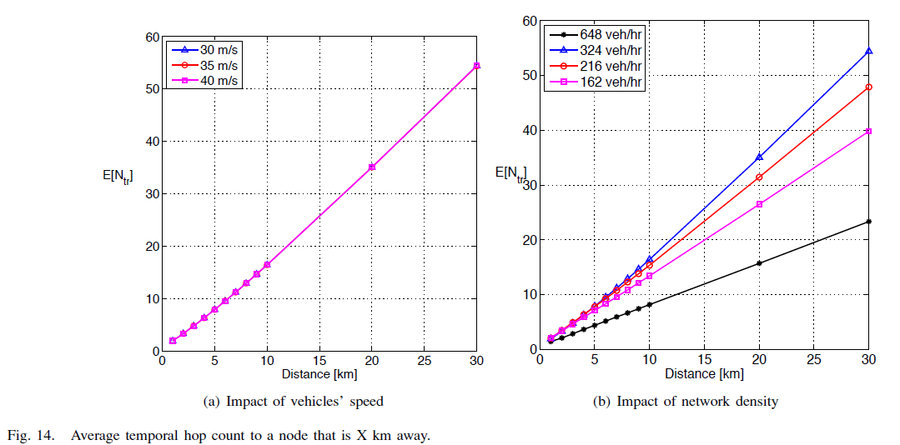

Slide 22
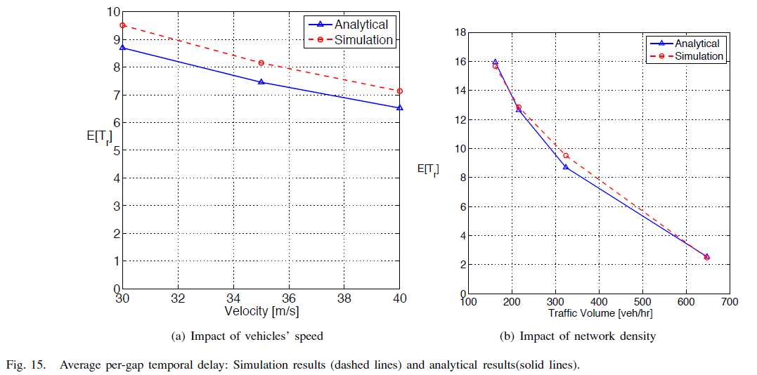

Slide 23
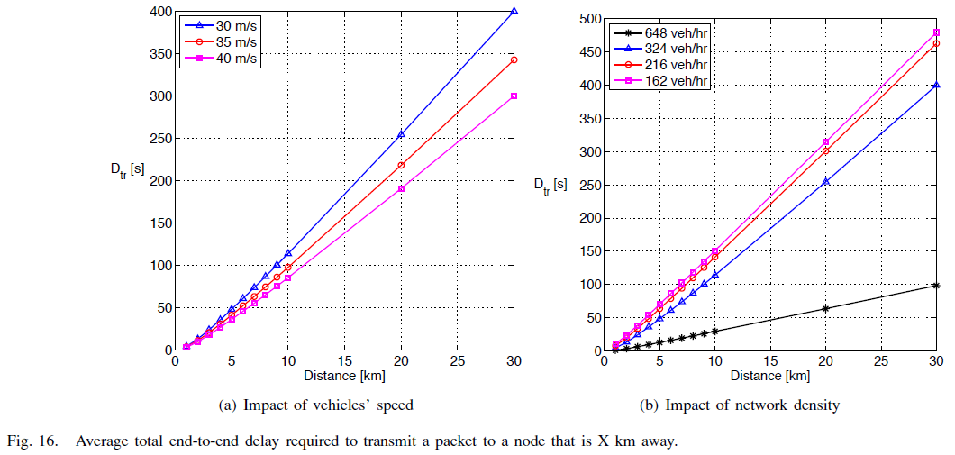

Slide 24
