Slide 1
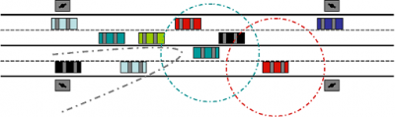
VANET Vehicular Ad Hoc Network
Felix MotherFuckin’ Lu
Month Day, Year

Slide 2
What is VANET?
Introduction to VANET

Slide 3
Routing in Sparse Vehicular Ad Hoc Wireless Networks
AUTHORS

Slide 4
Points of Discussion
What are the consequences when trying to relay safety messages to other vehicles when the network is constantly disconnected?
In a disconnected VANET what are the key characteristics to observe and what are the adverse effects on performance in the network?
What is the solution to a disconnected VANET if any? And if there is not a viable solution to this problem how can the affects of network fragmentation become minimized?
Given a collection of empirical data, how realistic is it to mathematically model for the scenario of expecting disconnections in a communications network?
Routing in Sparse Vehicular Ad Hoc Wireless Networks

Slide 5
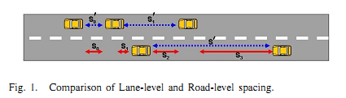
The Car Following Model
Single Lane Model (blue arrows)
Inter-vehicle distances measured between cars in the same lane
Multi Lane Model (red arrows)
Inter-vehicle distances measured between the closest adjacent vehicle, which more closely represents the situation of a communications network
One adjustment from the traditional Car Following Model
Routing in Sparse Vehicular Ad Hoc Wireless Networks
Notes:
It is not relevant whether a car is in the same lane, but whether they are within the range of communication

Slide 6
The Car Following Model
Original Car Following Model
Modified Car Following Model
 | S’ - headway spacing between rear bumper to rear bumper L - effective vehicle length in meters - driver reaction time in seconds V - vehicle sped in meters/second - reciprocal of twice the max average deceleration of a following vehicle (ie approximately 0.075 )
 | - road level inter-vehicle spacing - minimum spacing between any two adjacent vehicles - inter-arrival time of vehicles on any lane from fix observation point V - vehicle sped in meters/second
Routing in Sparse Vehicular Ad Hoc Wireless Networks
Notes:
Basis of original model is empirical data gathered by Berkeley Highway Laboratory. However instead of driver reaction time we replace it with inter-arrival time of vehicles into the network. The modified equation then becomes the following: (second)

Slide 7
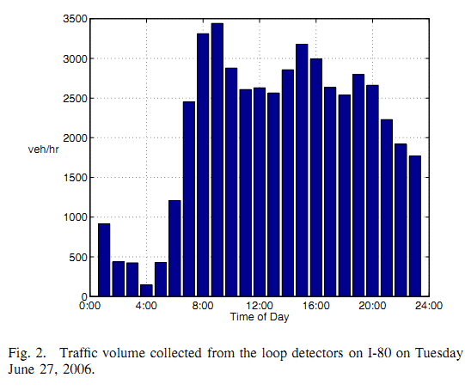
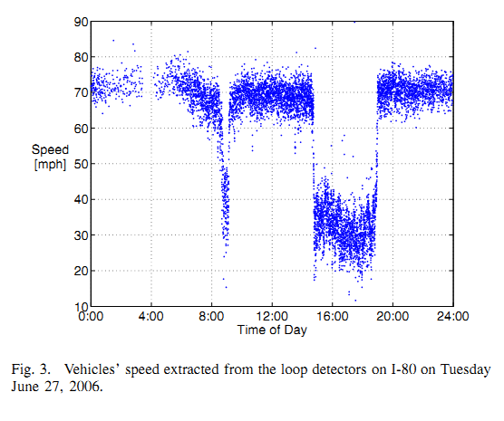
Berkeley Highway Laboratory (BHL) Empirical Data
Volume of cars entering network given time of day
Recordings taken at 60 readings/sec
Can be used to extract the inter-arrival times
Peak of traffic volume ~3-5pm
Valley of traffic volume ~1-3am
Vehicle speed (mph) given time of day
Rush hour traffic ~3-5pm
Causes slower speeds
Routing in Sparse Vehicular Ad Hoc Wireless Networks
Notes:
(1)

Slide 8
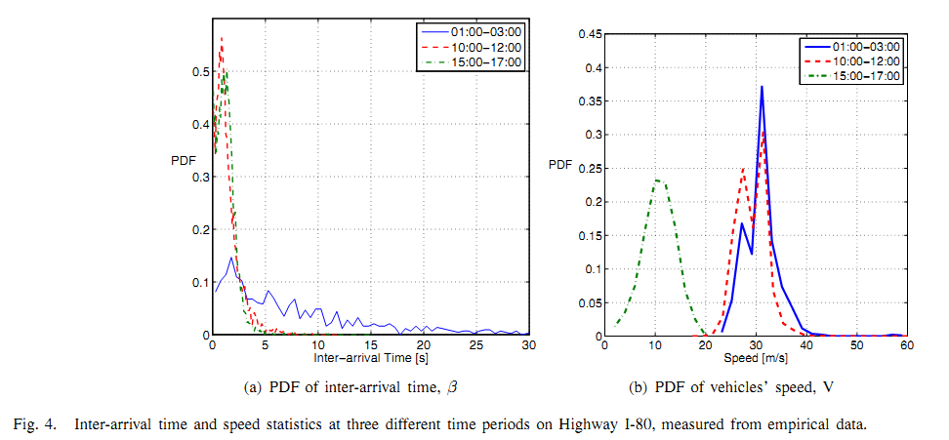
Probability Density Function (PDF) of Inter-Arrival Times and Vehicle Speeds
Since we are concerned with disconnected networks, will focus on the 1-3am data (The blue colored lines)
PDF of Inter-arrival time similar to the general exponential distribution
Inter-arrival times range anywhere from 0 to past 30 seconds
PDF of vehicle speeds similar to a normal distribution
Routing in Sparse Vehicular Ad Hoc Wireless Networks

Slide 9
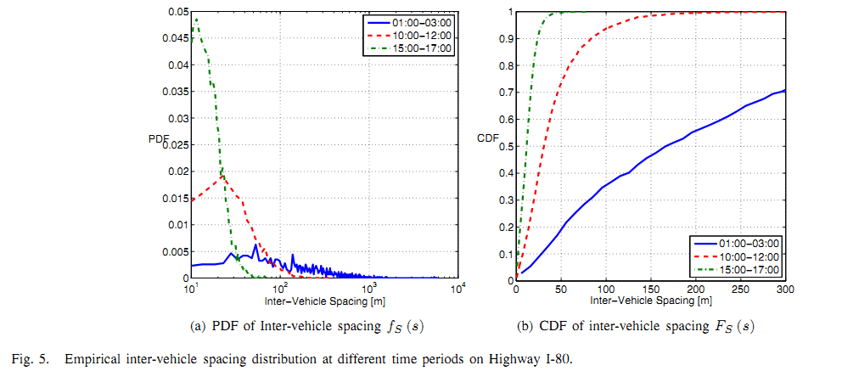


Inter-Vehicle Spacing
Modified Equation for the Inter-Vehicle Spacing:
Can approximate S = V, which results in figure 5(a)
Inter-vehicle spacing is anywhere from 0 to 1000km!
Can model PDF of inter-vehicle spacing by where
Integrating we can get the Cumulative Density Function of the inter-vehicle spacing.
Define range of communication to be 250m or less
From figure 5(b) we see there is a 65% chance of being connected to the network.
However, this assumes 100% market penetration… Highly unlikely!
Routing in Sparse Vehicular Ad Hoc Wireless Networks

Slide 10

Inter-Vehicle Spacing Distribution
This breaks down when the volume is greater than 1000 vehicles/hour, but we are emphasizing the time frame from 1-3am with a sparse traffic density to model a fragmented network.
Routing in Sparse Vehicular Ad Hoc Wireless Networks

Slide 11
Kolmogorov-Smirnov Test (K-S Test)
Tests the goodness-of-fit of the derived models against the empirical data.
Defined by:
For times 1-3am, the D statistic is accurate up to 3%.
For the other time frames, 10am-12pm and 3pm-5pm, the model breaks down and the D statistic is as high as 10%.
Routing in Sparse Vehicular Ad Hoc Wireless Networks

Slide 12
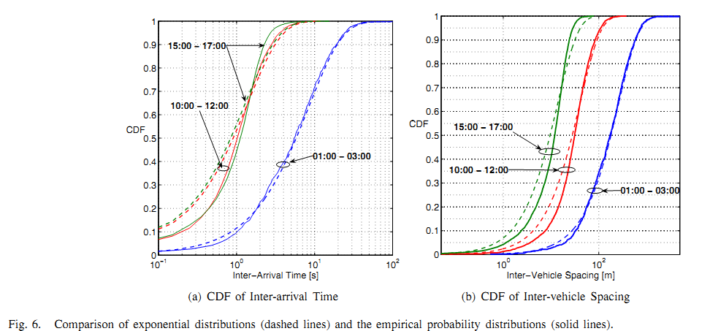
Kolmogorov-Smirnov Test (K-S Test)
Solid and dashed blue lines: 1-3am time frame
The derived model is a good fit to the empirical data for this time frame
The D statistic is at most 3% for this case
The other 2 time frames do not fit as well
Routing in Sparse Vehicular Ad Hoc Wireless Networks

Slide 13
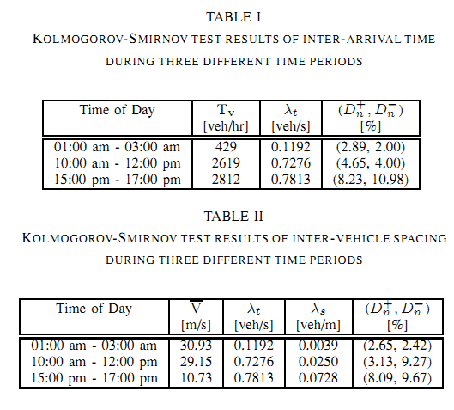
Analytical Data for D Statistics from Kolmogorov-Smirnov Test
Routing in Sparse Vehicular Ad Hoc Wireless Networks

Slide 14





Key Characteristics
Probability of being the last vehicle in a cluster
Average Intra-Cluster Spacing
Average Inter-Cluster Spacing
Average Cluster Size
Average Cluster Length

Slide 15
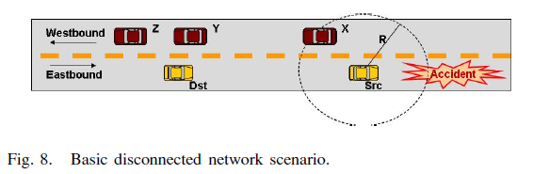

Slide 16
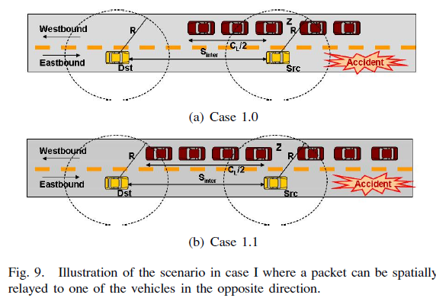

Slide 17
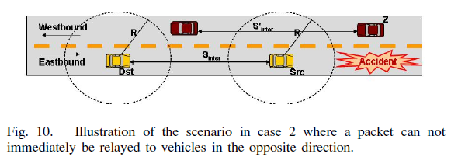

Slide 18
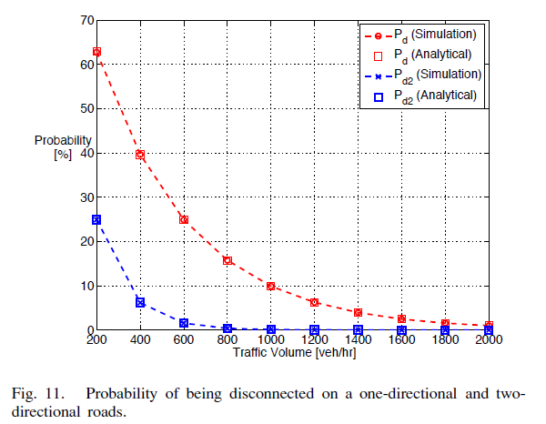

Slide 19
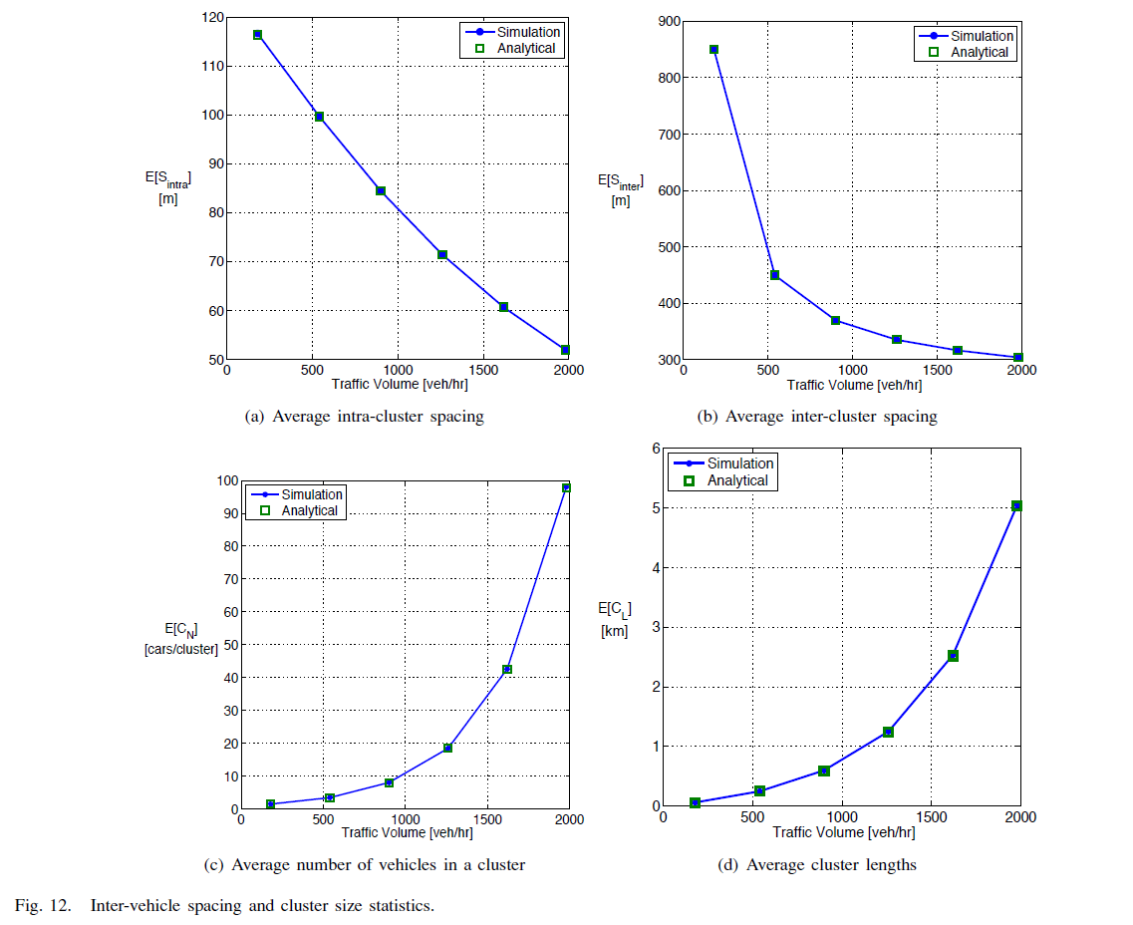

Slide 20
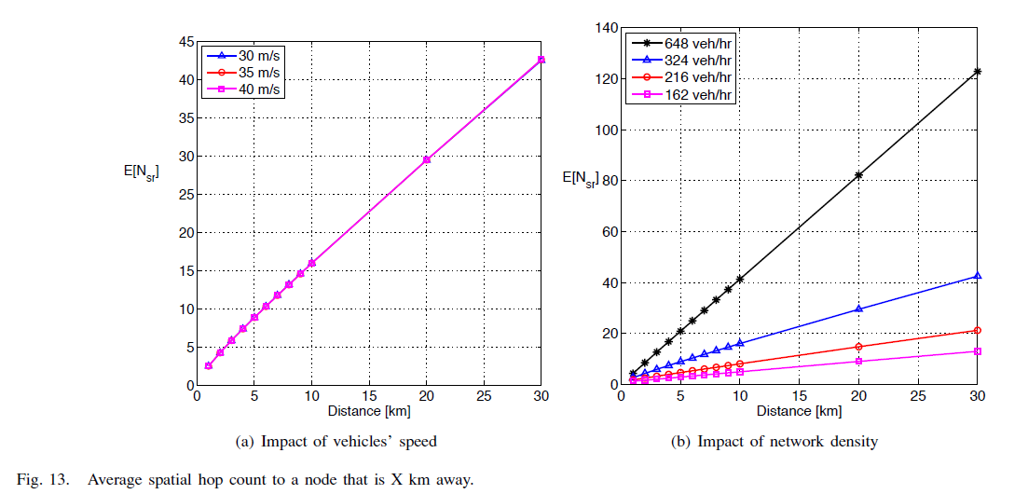

Slide 21
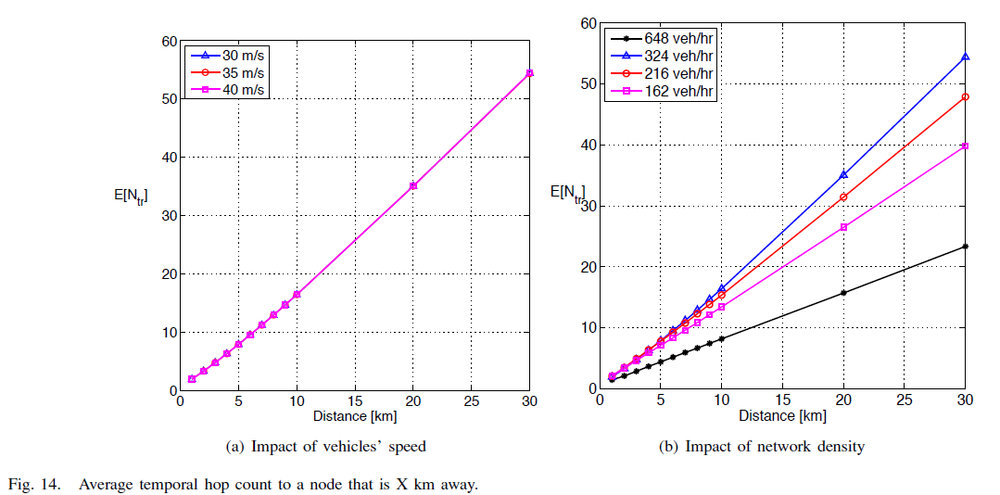

Slide 22
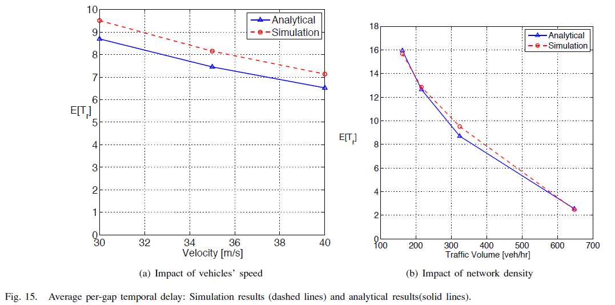

Slide 23
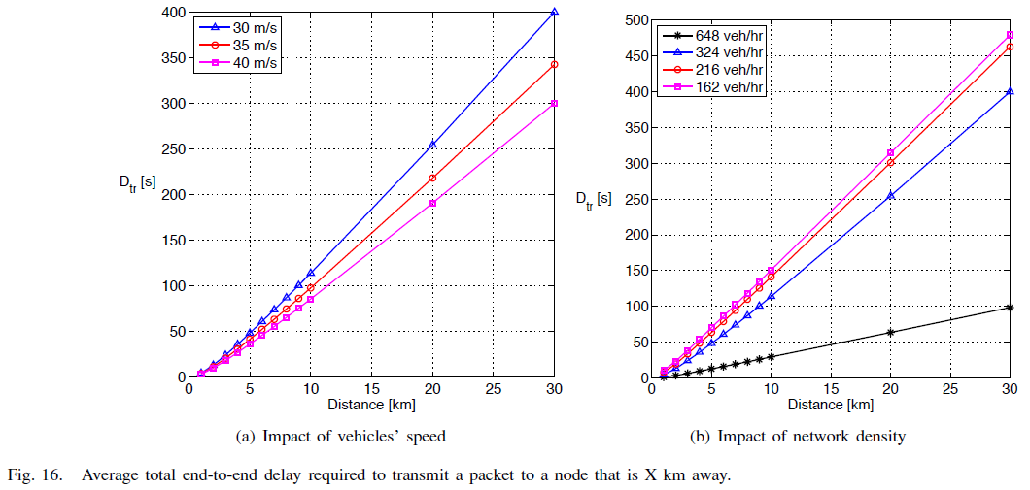

Slide 24
