Slide 1
Routing in Sparse Vehicular Ad Hoc Wireless Networks
TODO: Find one of the images to represent this.
TODO: Authors of this paper

Slide 2

Car following model

Slide 3
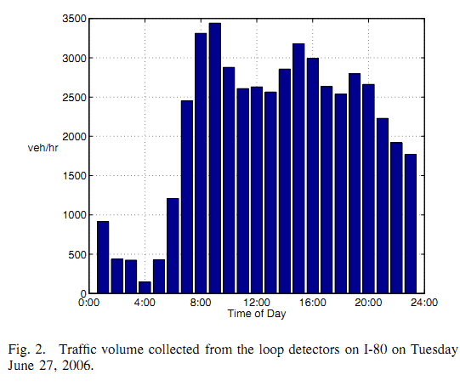

Slide 4
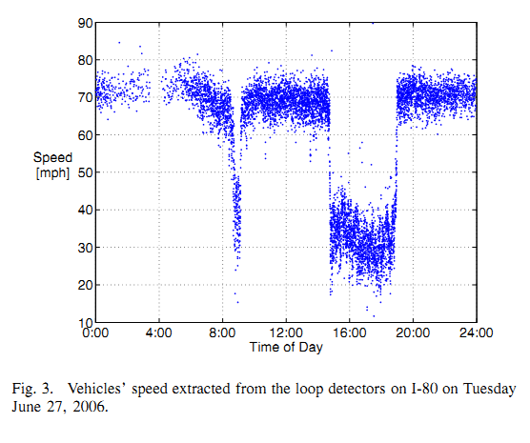

Slide 5
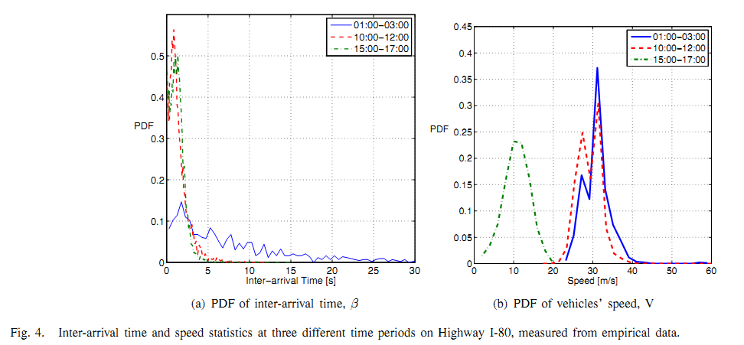

Slide 6
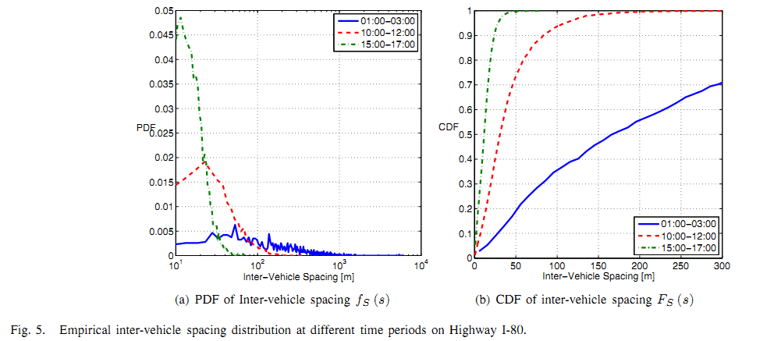

Slide 7
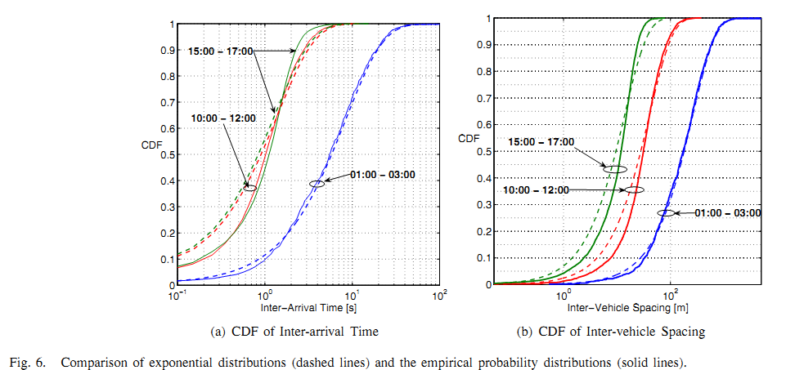

Slide 8
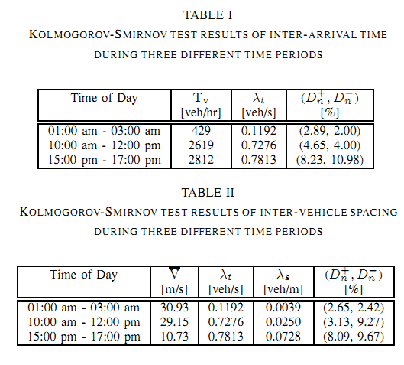

Slide 9
