Slide 1
Routing in Sparse Vehicular Ad Hoc Wireless Networks
TODO: Find one of the images to represent this.
TODO: Authors of this paper

Slide 2
What this research hopes to solve
In a VANET what happens when a message can not be routed to another vehicle because it is out of range?
Can a reliable model be developed to characterize a VANET that assumes a communication network is fragmented and unreliable?
Given a collection of empirical data, how realistic is it to mathematically model for the scenario of expecting disconnections in a communications network?

Slide 3
What we hope to answer
What are the consequences when trying to relay safety messages to other vehicles when the network is constantly disconnected?
In a disconnected VANET what are the key characteristics to observe and what are the adverse effects on performance in the network?
What is the solution to a disconnected VANET if any? And if there is not a viable solution to this problem how can the affects of network fragmentation become minimized?

Slide 4
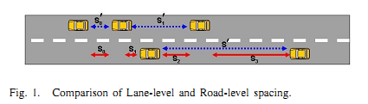
The basis of the model, the Car Following Model
The blue arrows represent a single lane model. Inter-vehicle distances are measured between cars in the same lane.
The red arrows represent a multi lane mode. Inter-vehicle distances are measured between the closest adjacent vehicle, which more closely represents the situation of a communications network.
It is not relevant whether a car is in the same lane, but whether they are within the range of communication.
Using a multi-lane model is one adjustment from the traditional Car Following Model.

Slide 5
The modified Car Following Model
 | S’ - headway spacing between rear bumper to rear bumper L - effective vehicle length in meters - driver reaction time in seconds V - vehicle sped in meters/second - reciprocal of twice the max average deceleration of a following vehicle (ie approximately 0.075 )
Basis of model is empirical data gathered by Berkeley Highway Laboratory. However instead of driver reaction time we replace it with inter-arrival time of vehicles into the network. The modified equation then becomes the following:
 | – road level inter-vehicle spacing - minimum spacing between any two adjacent vehicles - inter-arrival time of vehicles on any lane from fix observation point V - vehicle sped in meters/second

Slide 6
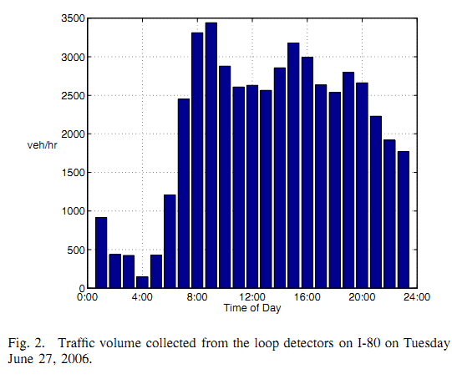
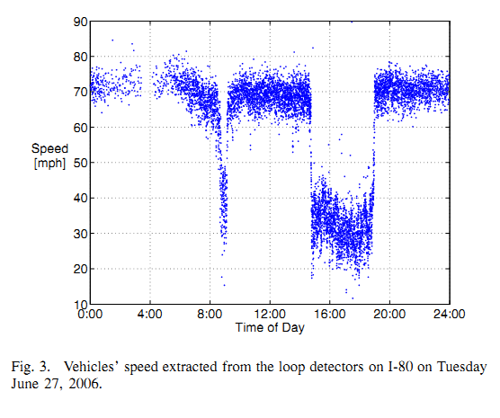
Empirical data collected by Berekely Highway Laboratory (BHL)
Volume of cars entering network given the time of day.
Recordings taken at 60 readings/second
Can be used to extract the inter-arrival times
Peak of traffic volume is around 3-5pm
Valley of traffic volume around 1-3am
Recording of the speed of vehicles given the time of day.
Rush hour traffic around 3-5pm causes slower speeds

Slide 7
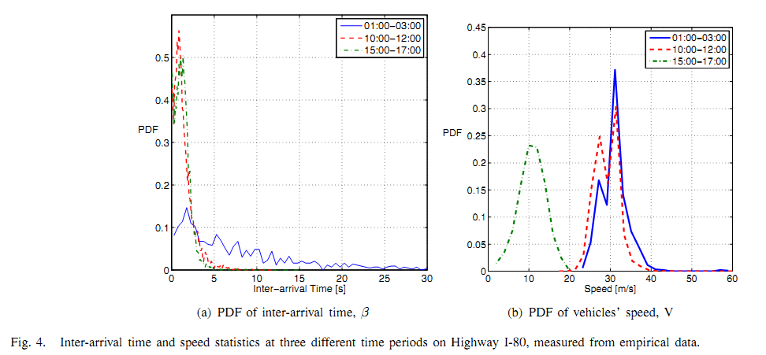
Probability Density Function (PDF) of Inter-Arrival Times and Vehicle Speeds
Since we are concerned with disconnected networks, will focus on the 1-3am data (The blue colored lines)
PDF of Inter-arrival time similar to the general exponential distribution
Inter-arrival times range anywhere from 0 to past 30 seconds
PDF of vehicle speeds similar to a normal distribution

Slide 8
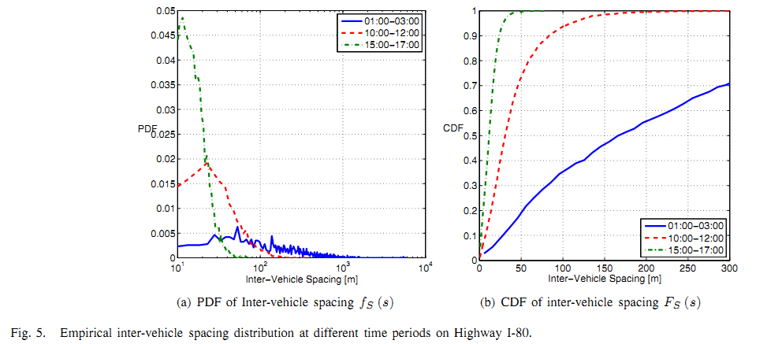


Using the inter-arrival times to calculate the inter-vehicle spacing
Modified equation for the inter-vehicle spacing
Can approximate S = V, which results in figure 5(a)
Inter-vehicle spacing is anywhere from 0 to 1000km!
Can model PDF of inter-vehicle spacing by where
Integrating we can get the Cumulative Density Function of the inter-vehicle spacing.
Define range of communication to be 250m or less
From figure 5(b) we see there is a 65% chance of being connected to the network.
However, this assumes 100% market penetration… Highly unlikely!

Slide 9

Inter-Vehicle Spacing
In a similar manner can derive the Inter-vehicle spacing distribution.
,
This breaks down when the volume is greater than 1000 vehicles/hour, but we are emphasizing the time frame from 1-3am with a sparse traffic density to model a fragmented network.

Slide 10
Kolmogorov-Smirnov Test (K-S Test)
Tests the goodness-of-fit of the derived models against the empirical data.
Defined by,
For times 1-3am, the D statistic is accurate up to 3%.
For the other time frames, 10am-12pm and 3pm-5pm, the model breaks down and the D statistic is as high as 10%.

Slide 11
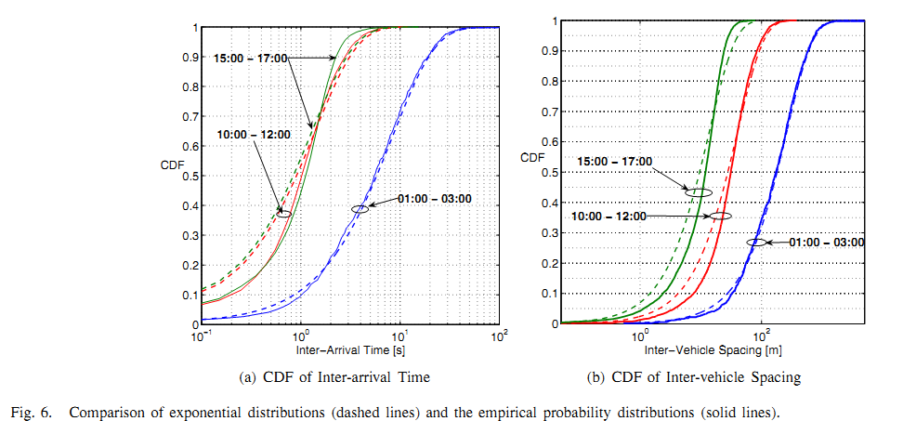
The solid and dashed blue lines represent the time frame 1-3am
The derived model is a good fit to the empirical data for this time frame
The D statistic is at most 3% for this case
The other 2 time frames do not fit as well

Slide 12
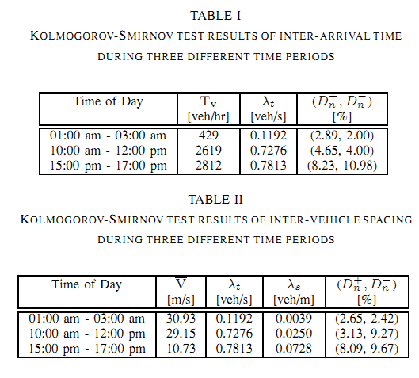
Analytical data for the D statistics from the K-S Test

Slide 13
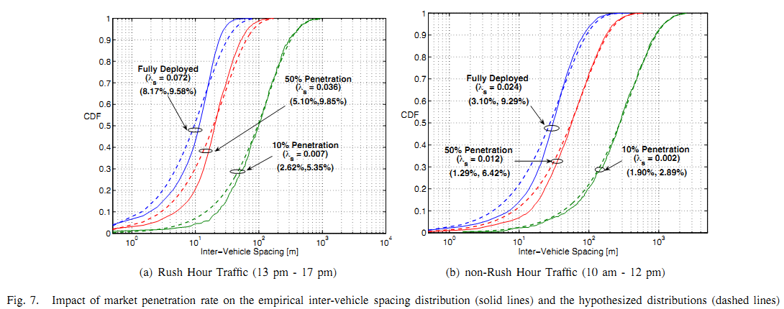

Slide 14
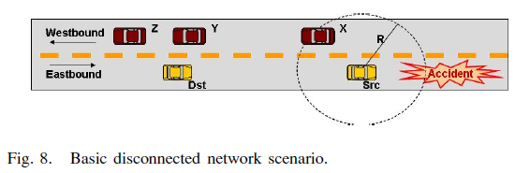

Slide 15
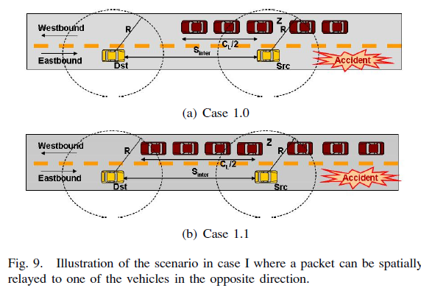

Slide 16
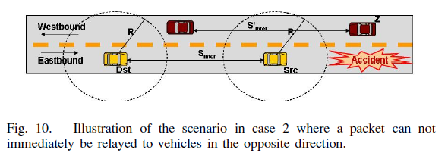

Slide 17
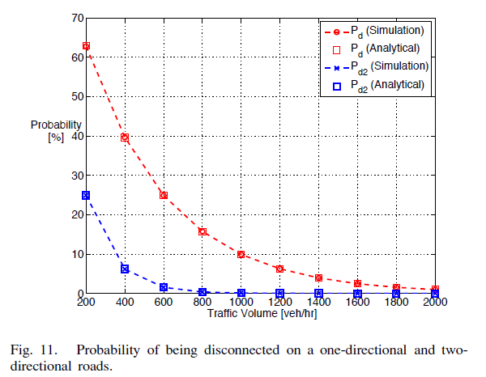

Slide 18
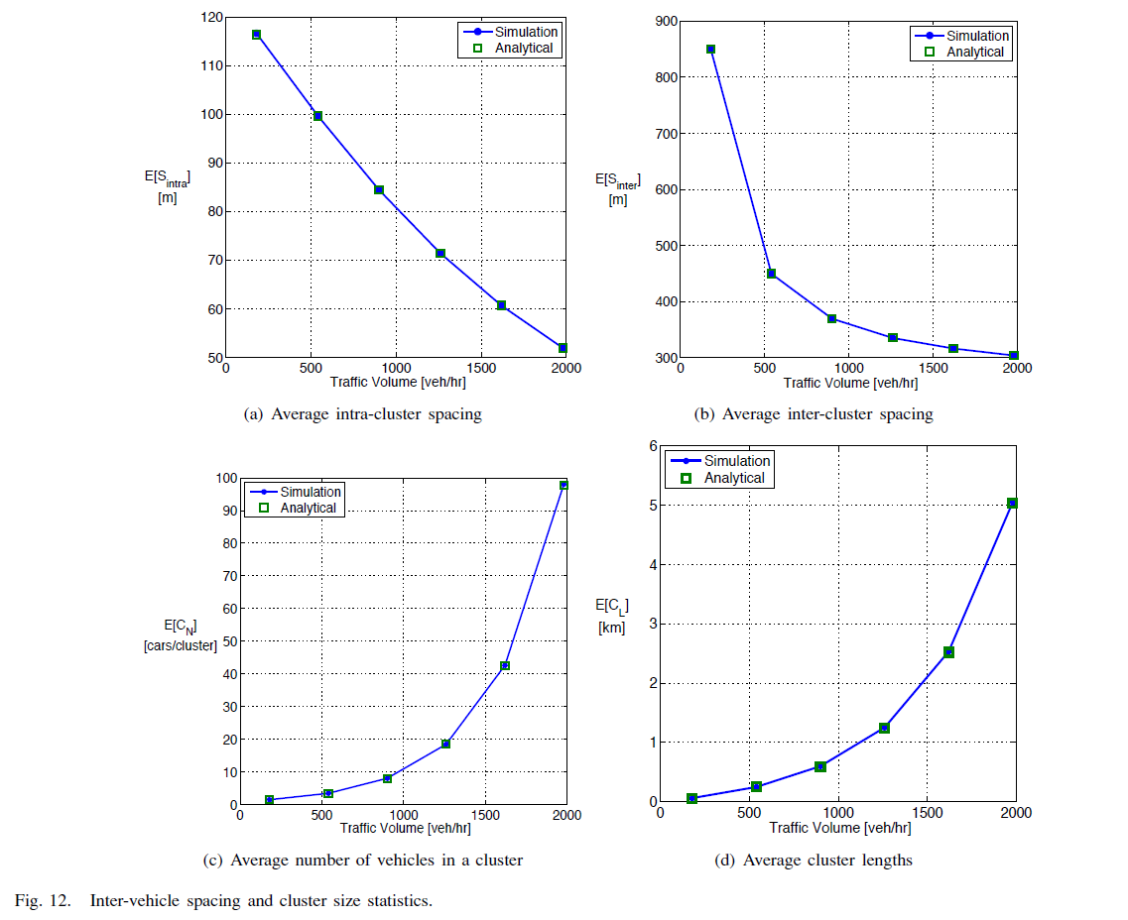

Slide 19
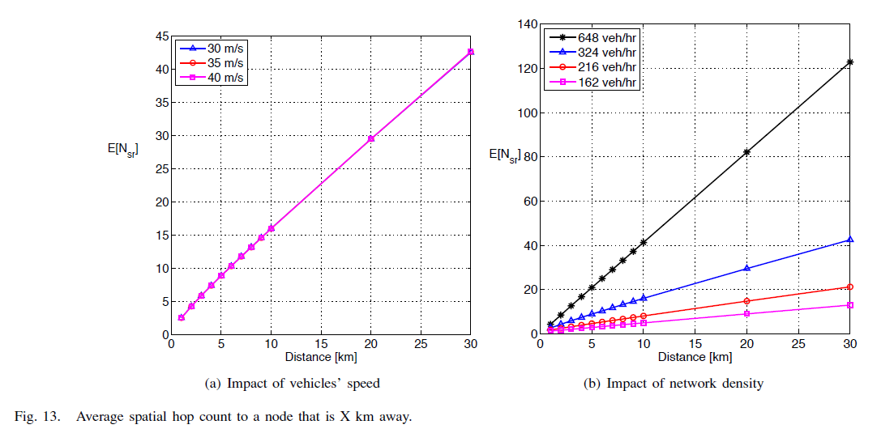

Slide 20
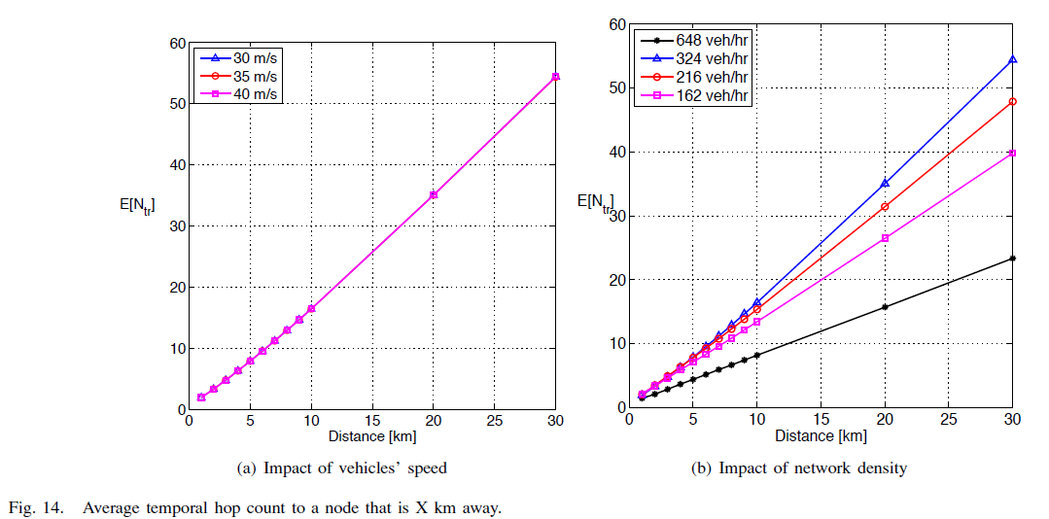

Slide 21
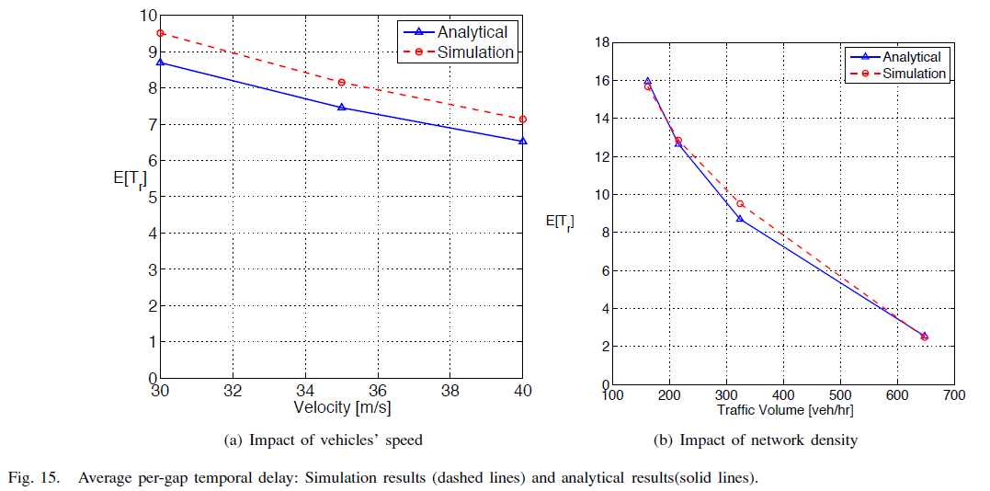

Slide 22
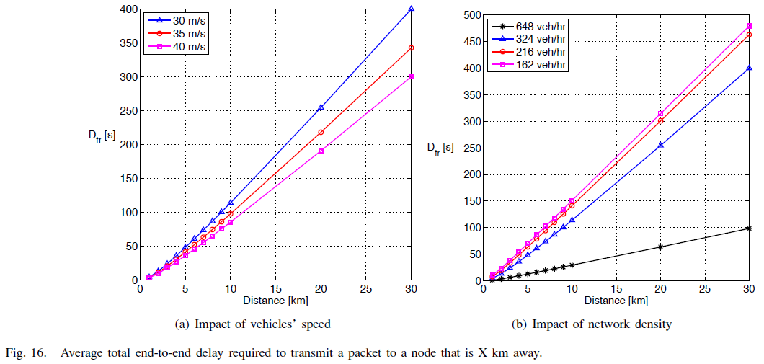

Slide 23
