Slide 1

Car following model

Slide 2
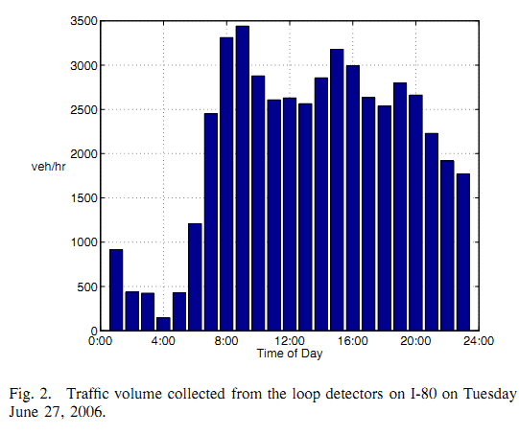

Slide 3
