Slide 1

Firma convenzione
Politecnico di Milano e Veneranda Fabbrica del Duomo di Milano
SafeStreets
Software Engineering 2 Project
AY 2019/2020
Federico Cazzola
Francesco Dotti
Aula Magna – Rettorato
Mercoledì 27 maggio 2015

Slide 2

RASD
Requirements Analysis and Specification Document

Slide 3
Goals of the system
The system must allow users to send a report of traffic violations
The system must allow all users to mine the information that has been received by highlighting the streets (or the areas) with the highest frequency of violations
The system must allow authorities to mine the information that has been received to see the ranking of vehicles that commit more violations
The system must cross the information provided by the municipality about the accidents with its own data to identify potentially unsafe areas and suggest possible interventions.

Slide 4
Users Groups
“STANDARD” USER: Common citizen who signs up to use the SafeStreet service. He uses the app to report a traffic violation or to visualize public available data on the map
TRAFFIC WARDEN: The sign up process is made in collaboration with the authorities to guarantee their identity. He has to take on and verify the violations. Also he can access the ranking of vehicles that commited violations.
MUNICIPALITY’S CLERK: Certified municipality's clerk who can access the suggestions for possible interventions.

Slide 5
Boundaries between world and machine
The system doesn’t verify the reports automatically
The sytems handles a request only if it comes from a user that has the required authorization:
Only police officers can access information about a vehicle
Only municipality’s clerks can see suggestions for possible interventions

Slide 6
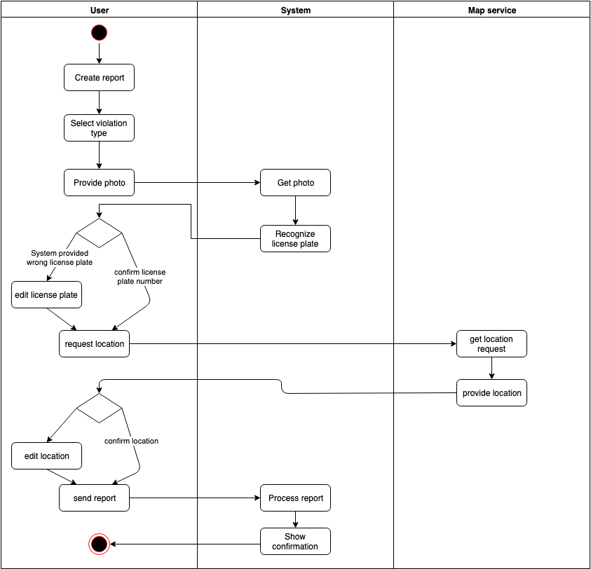
Meaningful use cases - User reports violation

Slide 7
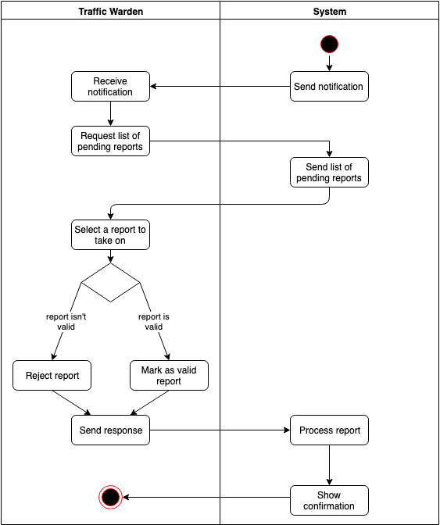
Meaningful use cases - Traffic warden verifies violation report

Slide 8
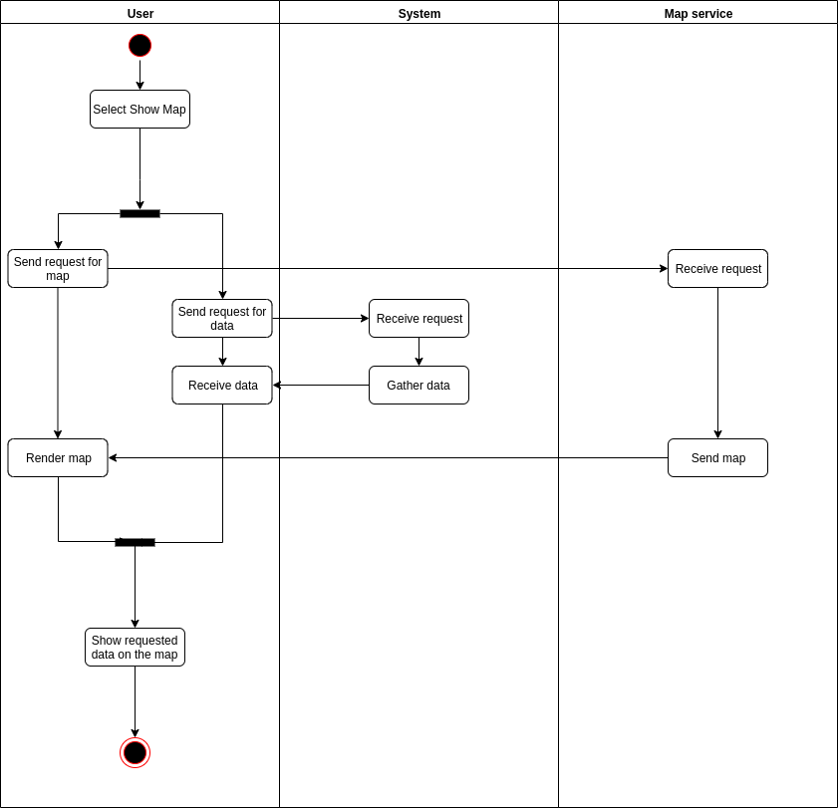
Meaningful use cases - Visualize public available data on map

Slide 9
The most important requirements
R3 The system must allow users to send pictures of violations, including their date, time, and position to authorities.
R5-R6 The system must allow the user to fix the license plate ,if the algorithm read it wrong, and the location if the GPS acquired the wrong location.
R10 The system has to allow the traffic warden to validate or to invalidate the report.
R16 The system must cross the information provided by the municipality about the accidents with its own data to identify potentially unsafe areas.

Slide 10
The most important assumptions
D1: All traffic wardens have a smartphone.
D4: The map provider will provide only well formatted data.
D3: The municipality will provide only well formatted report of accidents.

Slide 11
Alloy model
Signatures define how the data is structured and the relationships between entities.
Facts statements model the domain assumptions which are necessary to make the system work
Assert statements model the requirements which must be guaranteed by the system
Pred statements show how the system should function through generated worlds

Slide 12
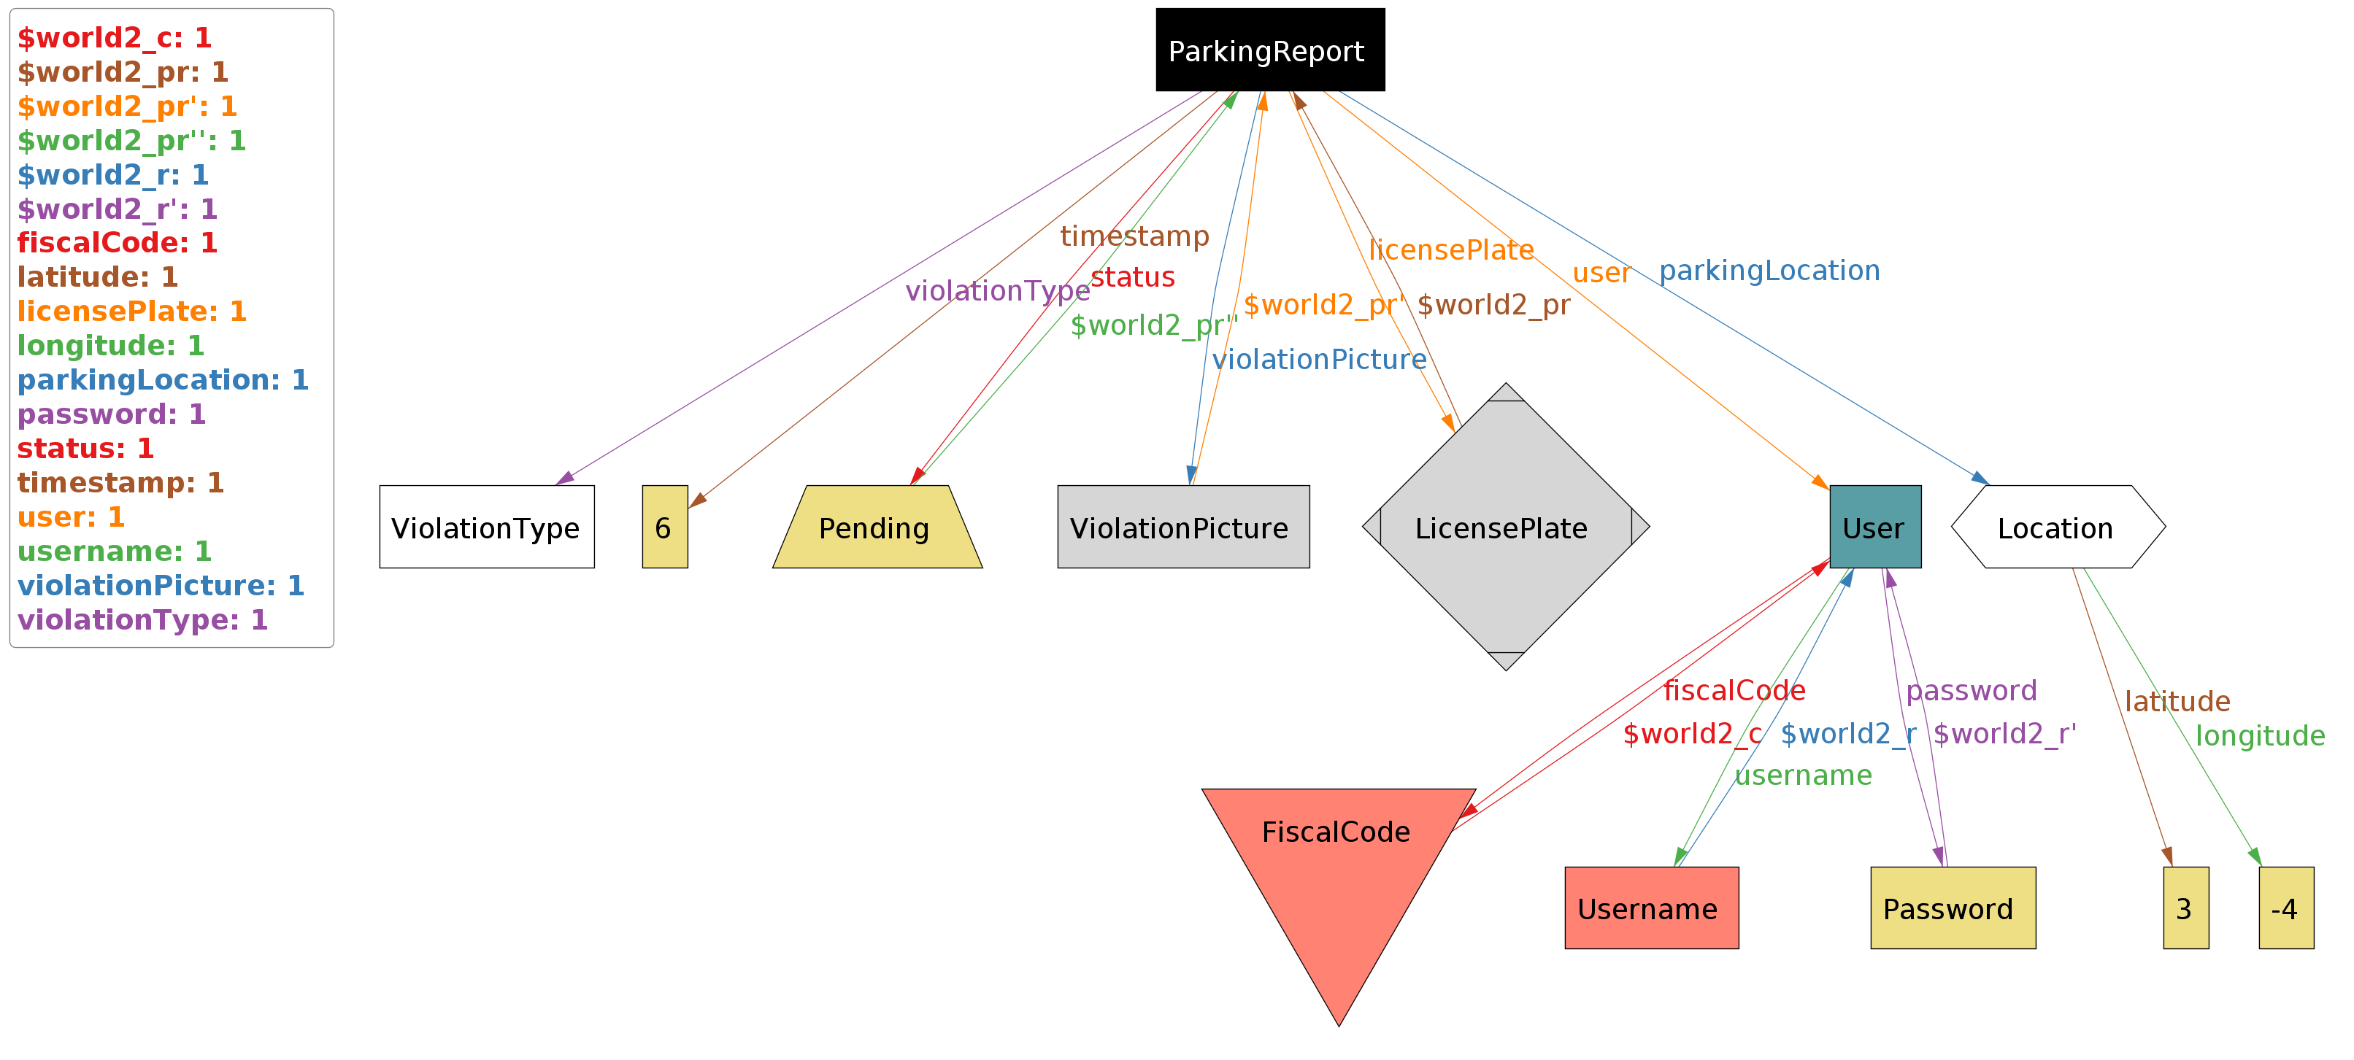
Alloy model
In this world without traffic wardens, parking report status can only be pending. None can take on the requests.

Slide 13
DD - Design Document

Slide 14
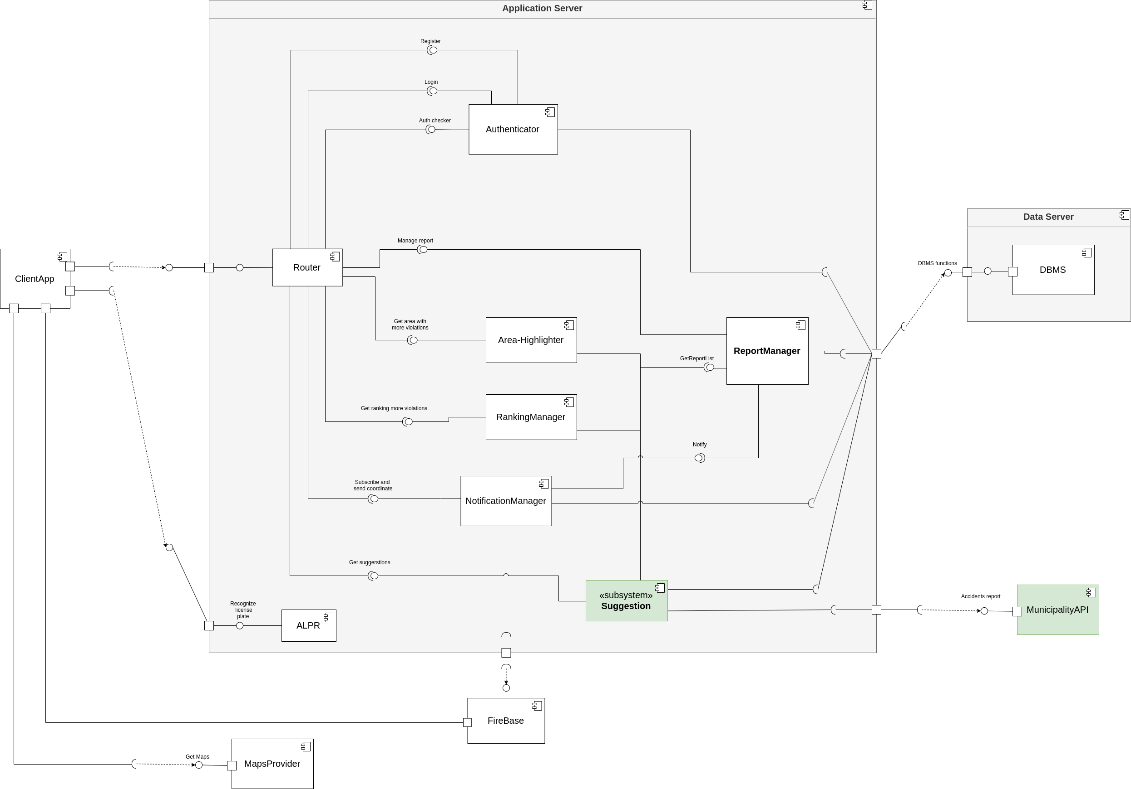
The components of the system

Slide 15
Meaningful interactions
The component structure is made so that every incoming request from clients is caught by the Router, which, if needed, checks if the clients has the permission to execute the request, exploting the Authenticator interface, and then forwards the request to the right component
The only type of request from the client that is not handled by the router is the request to analyze a photo of a license plate. This request is directly handled by the ALPR. (For scalability reasons it may be deployed on a different server) (Also it could be provided as an external service for the community)
The ReportManager is the only component to query the database in order to get the reports list (maintainability)

Slide 16
The architectural styles/patterns and important design decisions
RESTful architecture
Three-tier architecture: Presentation – Logic – Data
Relational Database: The advantages of relational databases (Expressive query language, secondary indexes, strong consistency, etc.) make them a preferred choice for this application as it will handle well-structured data
Safestreets will be available as a web application and as a native app for Android and iOS. The user interface and the UX should be the same on every device

Slide 17
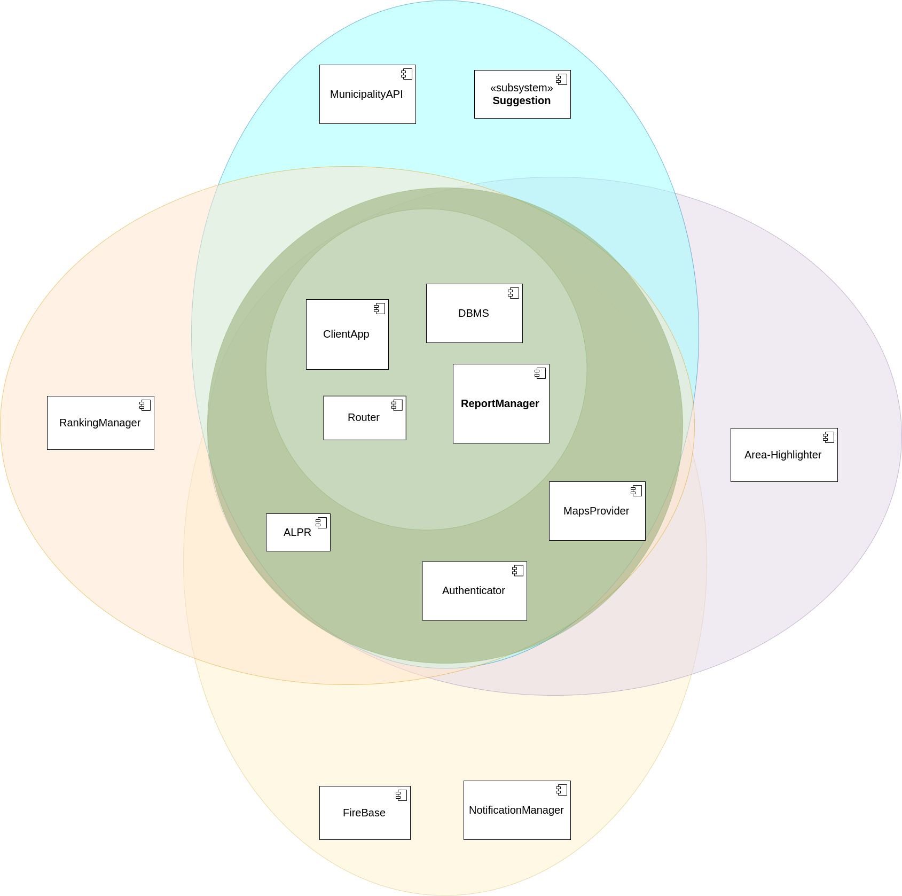
Integration strategy

