Slide 1
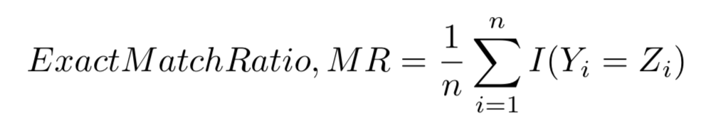

Evaluation
Exact Match Ratio :
Y₁
[1,0,0,1]
Z₁
[1,0,0,1]
Y₂
[1,0,0,1]
Z₂
[1,0,1,1]
Ratio = $\frac{1}{3}\left(1+0+1\right)$ = 0.66
Y₃
[1,1,0,1]
Z₃
[1,1,0,1]
A Literature Survey on Algorithms for Multi-label Learning

Slide 2
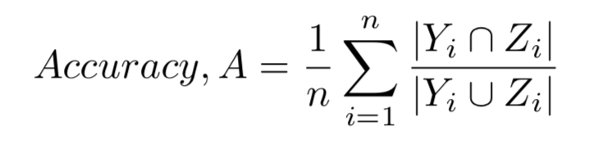

Evaluation
Accuracy:
Y₁
{A,B,C}
Z₁
{A,C,D}
Y₂
{A,B,C}
Z₂
{A,B,C}
Accuracy = $\frac{1}{3}(\frac{2}{4}+\frac{3}{3}+\frac{0}{3})$ = 0.5
Y₃
{A,D}
Z₃
{C}
A Literature Survey on Algorithms for Multi-label Learning

Slide 3
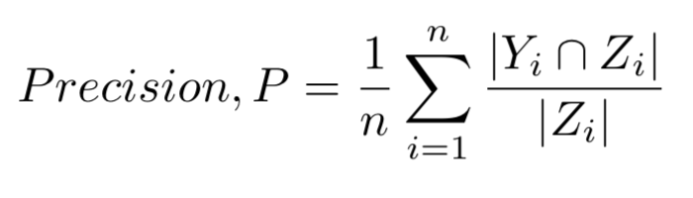

Evaluation
Precision:
Y₁
{A,B,C}
Z₁
{A,C,D}
Y₂
{A,B,C}
Z₂
{A,B,C}
Precision = $\frac{1}{3}(\frac{2}{3}+\frac{3}{3}+\frac{0}{1})$ = 0.55
Y₃
{A,D}
Z₃
{C}
A Literature Survey on Algorithms for Multi-label Learning

Slide 4
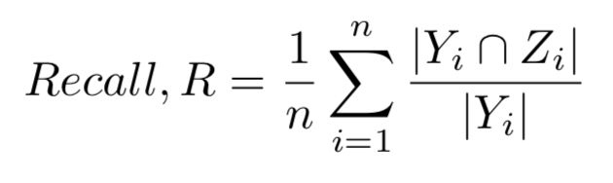

Evaluation
Recall:
Y₁
{A,B,C}
Z₁
{A,C,D}
Y₂
{A,B,C}
Z₂
{A,B,C}
Recall = $\frac{1}{3}(\frac{2}{3}+\frac{3}{3}+\frac{0}{2})$ = 0.55
Y₃
{A,D}
Z₃
{C}
A Literature Survey on Algorithms for Multi-label Learning

Slide 5
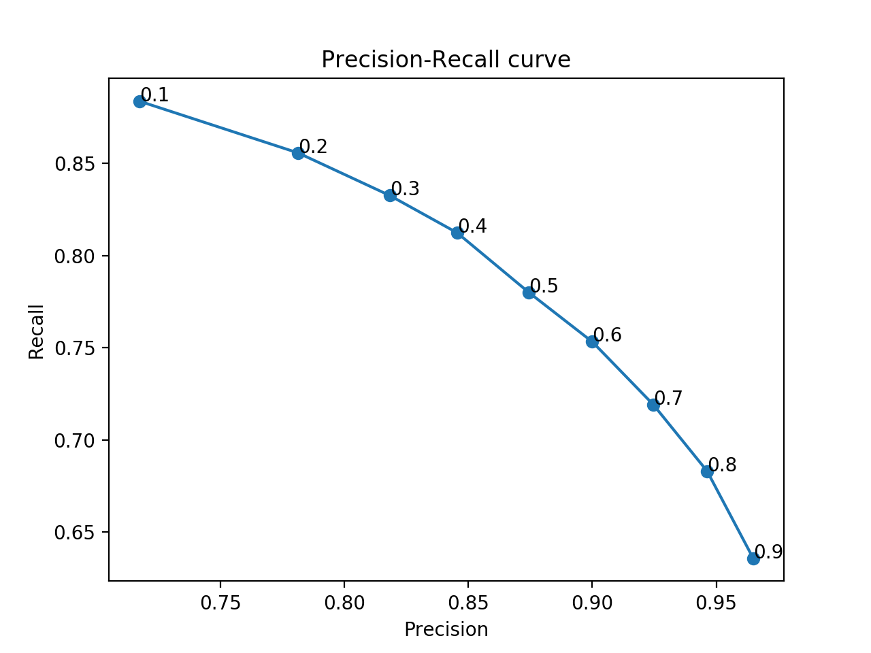
Multilabel
Input dimension: 365
Number of neurons: 300
Number of hidden layer: 2
Output dimension: 492
Binary cross entropy
3-fold cross validation:
Exact Match Ratio : 0.49
Accuracy: 0.73
Precision: 0.87
Recall: 0.77
Notes:
dataset1

Slide 6
Multilabel
Input dimension: 365
Number of neurons: 300
Number of hidden layer: 2
Output dimension: 492
Cross entropy
3-fold cross validation:
Exact Match Ratio : 0.51
Accuracy: 0.75
Precision: 0.85
Recall: 0.81

Slide 7
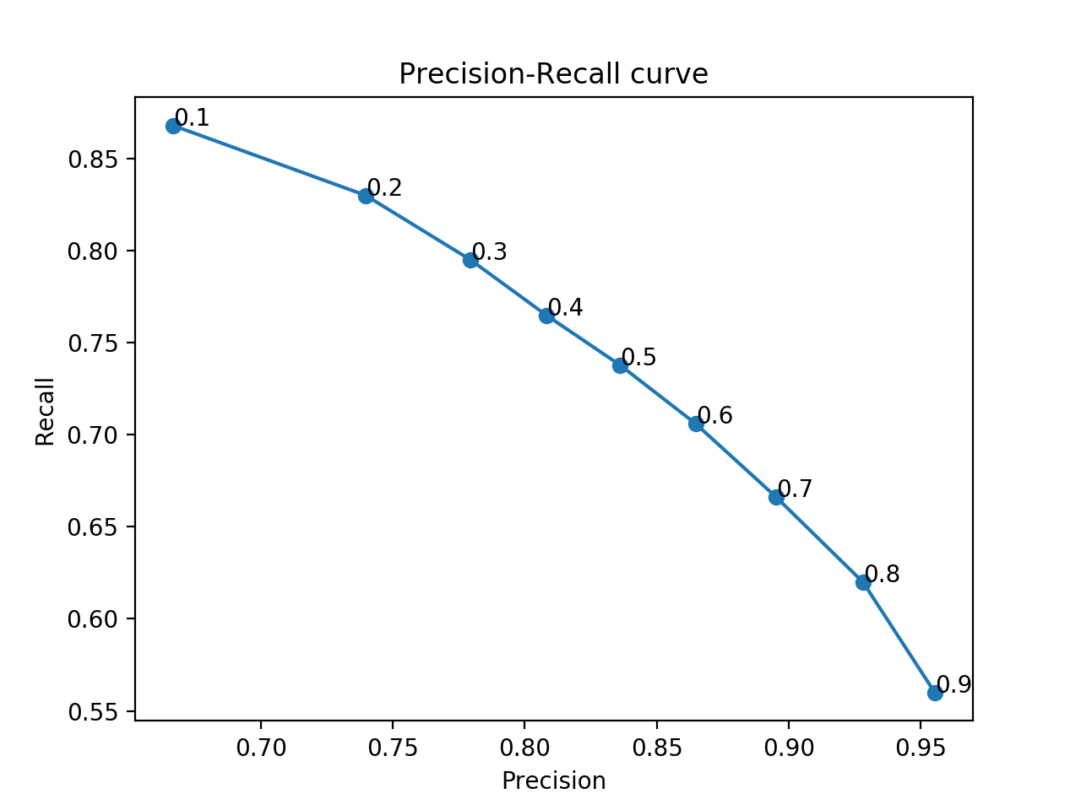
Multilabel (0226)
Input dimension: 366
Number of neurons: 300
Number of hidden layer: 2
Output dimension: 495
Binary cross entropy
3-fold cross validation:
Exact Match Ratio : 0.48
Accuracy: 0.69
Precision: 0.83
Recall: 0.73
Notes:
dataset6

Slide 8
Multilabel (0226)
Input dimension: 366
Number of neurons: 300
Number of hidden layer: 2
Output dimension: 495
Cross entropy
3-fold cross validation:
Exact Match Ratio : 0.48
Accuracy: 0.69
Precision: 0.80
Recall: 0.77

Slide 9
Multiclass
Input dimension: 368
Number of neurons: 300
Number of hidden layer: 2
Output dimension: 28
3-fold cross validation
Exact Match Ratio : 0.71

