Slide 1
ECE 455: FINAL PROJECT
Lecture #12
Yuri Hu and Faith Lin

Slide 2
Problem Statement
Evaluate web server paywalls
Analyze user authentication mechanisms
JavaScript-based content blocking
Paywall bypass chrome extension

Slide 3
Our Methodology
Create pseudo website with JavaScript
User accounts with different subscription privileges
Generate JWT token for session management

Slide 4
DEMONSTRATION

Slide 5
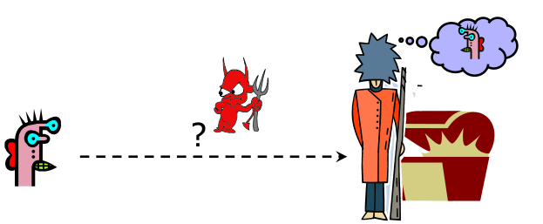
Threat model/ Risk analysis
JWT tokens are generated server-side, stored in localStorage
Token theft
XSS attacks
Notes:
We recognize there are vulnerabilities when using JWT tokens,

Slide 6
Real bypass applications
https://github.com/iamadamdev/bypass-paywalls-chrome
Clears browser’s local storage, reset data associated to paywall tracking or user session limits
Detect and remove elements with paywall or ads
Manipulate CSS classes
removeDOMElement and removeClassesByPrefix

Slide 7
Countermeasures
Implement HTTPS to encrypt data between client and server
Token security (expiration time)

Slide 8
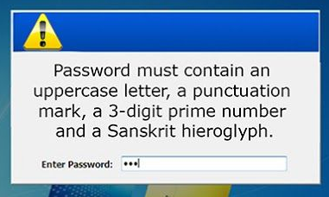
Password Usability
Classic recommendation:
> 8 characters
At least 3: digits, lower/upper case, symbol
Backfires!
Paper notes
Loopholes in rules

Slide 9
More Password Issues
Credential Stuffing
using stolen credentials on other sites
No rate limiting
Website allows brute force (automated guesses)
No multi-factor authentication
Just password is enough
Weak password recovery mechanisms
Remember the Palin email hack?
Application timeouts too long
Did you know that sudo lasts 15 minutes?

Slide 10
Even More Password Issues
Keystroke loggers
Hardware
Software (spyware)
Shoulder surfing
Same password at multiple sites
One breach becomes many!
Broken implementations
TENEX timing attack

Slide 11
Improving Passwords
Add biometrics
For example, keystroke/mouse dynamics or voice print
Graphical passwords
Goal: easier to remember? no need to write down?
Password managers
Examples: LastPass, built into browsers
Can have security vulnerabilities...
Two-factor authentication
Leverage phone (or other device) for authentication

Slide 12

ACCESS CONTROL

Slide 13
Introduction
User is authenticated
I know who you are!
Who is allowed to do what?
What privileges, permissions, power do you have?
Traditionally, consists of an operation performed on a resource
read, write, execute on a file, directory, or port
Today, this can be more abstract

Slide 14
Agenda
Fundamental terminology
Principals & subjects, access operations
Authentication & authorization
Policies
Capabilities & access control list
Discretionary & mandatory access control
Role Based Access Control
Policy instantiation
Structuring policies
Partial orderings & lattices

Slide 15
Security Policies
Access control enforces operational security policies.
A policy specifies who is allowed to do what.
The active entity requesting access to a resource is called the principal
The resource access is requested for is called the object.
Traditionally, policies refer to the requester’s identity and decisions are binary (yes/no).

Slide 16
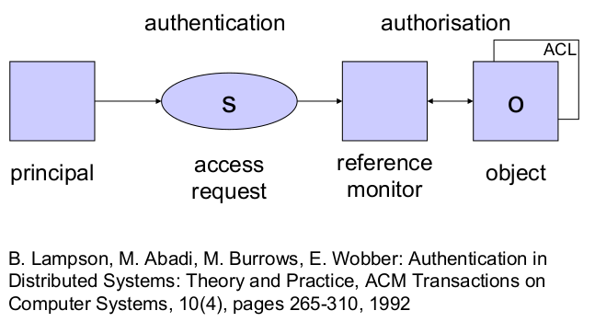
Authentication vs. Authorization

Slide 17
Authentication vs. Authorization
Authentication: reference monitor verifies the identity of the principal making the request.
A user identity is one example for a principal.
Authorization: reference monitor decides whether access is granted or denied.
Reference monitor has to find and evaluate the security policy relevant for the given request.
“Easy” in centralized systems.
In distributed systems,
How do we find all relevant policies?
How do we make decisions if policies may be missing?

Slide 18
Post-authentication
User enters username and password.
If the values entered are correct, the user is “authenticated”.
“The machine now runs on behalf of the user”.
This might be intuitive, but it is imprecise.
Log on creates a process that runs with access rights assigned to the user.
Typically, the process runs under the user identity of the user who has logged on.

Slide 19
Users & User Identities
Requests to reference monitor do not come directly from a user or a user identity, but from a process.
The process “speaks for” the user (identity).
The active entity making a request within the system is called the subject.
Three concepts:
User: person (Peter Cooper);
User identity (principal): name used in the system, possibly associated with a user (pcooper);
Process (subject) running under a given user identity (ls).

Slide 20
Principals & Subjects
Policy: A principal is an entity that can be granted access to objects or can make statements affecting access control decisions.
Example: user ID
System: Subjects operate on behalf of principals; access is based on the principal’s name bound to the subject in some un-forgeable manner at authentication time.
Example: process (running under a user ID)

Slide 21
Principals & Subjects
Principal and subject are both used to denote the entity making an access request.
The term principal can have different connotations, causing confusion.
M. Gasser (1990): Because access control structures identify principals, it is important that principal names be globally unique, human-readable and memorable, easily and reliably associated with known people.
We will examine later whether this advice is still valid.

Slide 22
Basic Terminology – Recap
Subject/Principal: Active entity – user or process.
Object: Passive entity – file or resource.
Access operations: basic memory access (read, write), method calls, push to network, etc.
Comparable systems may use different access operations or attach different meanings to operations which appear to be the same.

Slide 23
Access Operations
Access right: right to perform an access or operation
Permission: typically a synonym for access right.
Privilege: typically a set of access rights given directly to roles like administrator, operator, ...
These terms may have specific meanings in different systems.

Slide 24
Access Operations
On the most elementary level, a subject may
observe an object, or
alter an object.
Some policies can be expressed with these access modes.
A richer set of operations is more convenient.

Slide 25
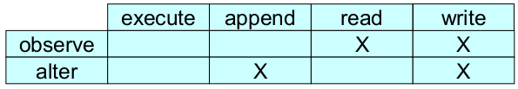
Elementary Access Operations
Bell-LaPadula model (see chapter 11) has four access rights:
execute
read
append, also called blind write
write
Mapping between access rights and access modes:

Slide 26
Rationale
Multi-user O/S:
users open files to get access
files are opened for read or for write access
O/S can avoid conflicts like two users simultaneously writing to the same file.
Write access usually includes read access
user editing a file should not be asked to open it twice
write includes observe and alter mode.
Few systems implement append
altering an object without observing its content is rarely useful
A file can be used without being opened (read)
example: running a binary or using a secret key

Slide 27
Access Rights (Unix/Linux)
Three access operations on files:
read: from a file
write: to a file
execute: a file
Access operations on directories:
read: list contents
write: create or rename files in the directory
execute: search directory
Deleting files/sub-directories handled by access operations in the directory.

Slide 28
Administrative Access Rights
Policies for creating and deleting files expressed by
access control on the directory (Unix)
specific create and delete rights (Windows, OpenVMS)
get, set, use, manage (in CORBA)
Policies for defining security settings such as access rights handled by:
access control on the directory
specific rights like grant and revoke

Slide 29
ACCESS CONTROL STRUCTURES

Slide 30
Policy Focus
Principals & objects provide a different focus of control:
What is the principal allowed to do?
What may be done with an object?
OS provides infrastructure for managing files and resources, i.e. objects
Access control takes the second approach.
Application oriented systems, (e.g. database) provide services to the user
Control actions of principals.
Note: some sources use authorization to denote the process of setting policies.

Slide 31
Access Control Structure
Policy is stored in an access control structure.
Captures your desired access control policy.
You should be able to check that your policy has been captured correctly.
Access rights can be defined individually for each combination of subject and object.
For large numbers of subjects and objects, such structures are cumbersome to manage; intermediate levels of control are preferable.

Slide 32
Access Control Matrix
At runtime, we could specify for each combination of subject and object the operations that are permitted.
S ' set of subjects
O ' set of objects
A ' set of access operations
Access control matrix: M = (M_{so})_{s ∈ S,o ∈ O}
Matrix entry M_{so} ⊆ A the operations subject s may perform on object o
You can visualize the matrix as a (big) table.

Slide 33
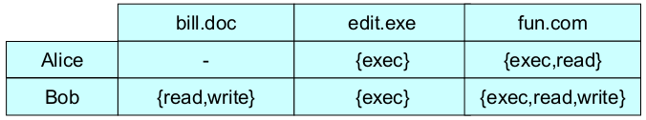
Access Control Matrix
Access control matrix has a row for each subject and a column for each object.
The control matrix is an abstract concept,
not very suitable for direct implementation,
not very convenient for managing security.
How do you answer the question: Has your security policy been implemented correctly?

Slide 34
Capabilities
Focus on the subject
access rights stored with the subject
capabilities = rows of the access control matrix
Subjects may grant rights to other subjects; subjects may grant the right to grant rights.
How to check who may access a specific object?
How to revoke a capability?
Distributed system security has created renewed interest in capabilities.

Slide 35
Access Control Lists (ACLs)
Focus on the object
access rights of principals stored with the object
ACLs = columns of the access control matrix
How to check access rights of a specific subject?
ACLs implemented in most commercial operating systems but their actual use is limited.

Slide 36
Who Sets the Policy?
Security policies specify how principals are given access to objects.
Responsibility for setting policy could be assigned to:
the owner of a resource, who may decree who is allowed access; such policies are called discretionary as access control is at the owner’s discretion.
a system wide policy decreeing who is allowed access; such policies are called mandatory.
Warning: other interpretations of discretionary and
mandatory access control exist.

Slide 37
DAC & MAC
Access control based on policies that refer to user identities was historically called discretionary access control (DAC).
Referring to individual users in a policy works best within closed organizations
Access control based on policies that refer to security labels (confidential, top secret, ') was historically called mandatory access control (MAC).
DAC and MAC have survived in computer security text books, but not very much in the wild.

Slide 38
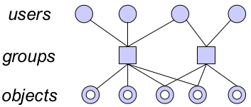
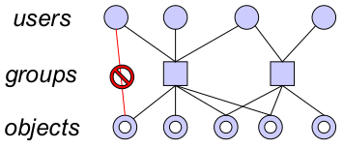
Groups & Negative Permissions
Groups: intermediate layer between users and objects.
To handle exceptions, negative permissions withdraw rights

Slide 39
Roles
Alternatively, we could have created a role ‘student’.
A role is a collection of procedures assigned to users
A user can have more than one role and more than one user can have the same role.
Teacher creates a procedure for reading course material, assigns this procedure to the role ‘student’.
A role ‘course tutor’ could be assigned a procedure for updating documents.

Slide 40
RBAC
Role Based Access Control
Procedures: ‘High level’ access operations
more complex semantic than read or write
procedures can only be applied to objects of certain data types
Example: Funds transfer between bank accounts.
Roles are a good match for typical access control requirements in business.
RBAC typical found at the application level.
Difference between groups and roles??

Slide 41
More on RBAC
Role hierarchies define relationships between roles:
Senior role has all access rights of the junior role.
Do not confuse the role hierarchy with the hierarchy of positions (superior – subordinate) in an organization
These two hierarchies need not correspond.
Separation of duties is an important security principle
numerous flavors of static and dynamic separation of duties policies exist.
Example: a manager is given the right to assign access rights to subordinates, but not the right to exercise those access rights
Example: accountant can submit expenses, but only treasurer can sign-off on spending

Slide 42
NIST: RBAC Levels
Flat RBAC:
users are assigned to roles,
permissions are assigned to roles,
users get permissions via role membership;
support for user-role reviews.
Hierarchical RBAC: adds support for role hierarchies.
Constrained RBAC: adds separation of duties.
Symmetric RBAC: support for permission-role reviews (can be difficult to provide in large distributed systems).

Slide 43
Role Based Access Control
Standard: American National Standards Institute: Role Based Access Control, ANSI-INCITS 359-2004.
RBAC itself does not have a generally accepted meaning, and it is used in different ways by different vendors and users.
[R. Sandhu, D. Ferraiolo, and R. Kuhn: The NIST Model for Role-Based Access Control: Towards a Unified Standard, Proceedings of the 5th ACM Workshop on Role-Based Access Control, Berlin, Germany, July 26-27, 2000

Slide 44
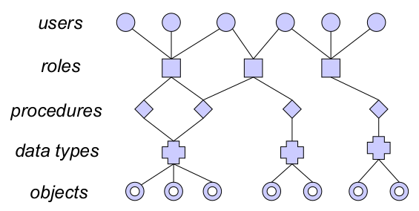
Lesson: Intermediate Controls
Intermediate controls for better security management; to deal with complexity, introduce more levels of indirection.

Slide 45
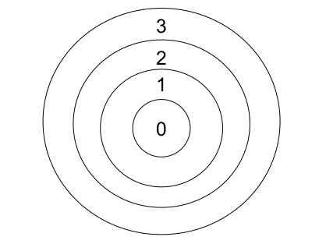
Protection Rings
Protection rings are mainly used for integrity protection.

Slide 46
Protection Rings
Each subject (process) and each object is assigned a number, depending on its ‘importance’, e.g.
-1 – firmware or BIOS or hardware
0 – operating system kernel
1 – operating system
2 – utilities
3 – user processes
Numbers correspond to concentric protection rings, ring 0 in center gives highest degree of protection.
If a process is assigned number i, we say the process “runs in ring i”.
Access control decisions are made by comparing the subject’s and object’s ring.

Slide 47
Policy Instantiation
When developing software you will hardly know who will eventually make use of it.
At this stage, security policies cannot refer to specific user identities.
A customer deploying the software may know its “authorized” users and can instantiate a generic policy with their respective user identities.
Generic policies will refer to ‘placeholder’ principals like owner, group, others (world, everyone).
Reference monitor resolves values of ‘placeholders’ to user identities when processing an actual request.

Slide 48
STRUCTURING POLICIES

Slide 49
Structuring Access Control
Some resources in an academic department can be accessed by all students, other resources only by students in a particular year.
Department creates groups like ‘All-Students’ and ‘Y1-Students’.
The two groups are related, Y1-Students is a subgroup of All-Students; if All-Students has access to a resource, so has Y1-Students.
No such direct relationship between Y1-Students and Y2-Students.

Slide 50
Partial Orderings
We now can use comparisons in security policies:
Is the user’s group a subgroup of the group permitted to access this resource?
Some groups are related but others are not (e.g. Y1-Students and Y2-Students).
Relationships are transitive: CS102-Students ⊆
Y1-Students ⊆ All-Students
In mathematical terms, we are dealing with a partial ordering.

Slide 51
Mathematical Definition
A partial ordering ≤ (‘less or equal’) on a set L is a relation on L×L that is
reflexive: for all a∈L, a≤a
transitive: for all a,b,c∈L, if a≤b and b≤c, then a≤c
anti-symmetric: for all a,b∈L, if a≤b and b≤a, then a=b
If a≤b, we say ‘b dominates a’ or ‘a is dominated by b’.

Slide 52
Examples
Integers with the relation “divides by”:
We can order 3 and 6 (3 divides 6); we cannot order 4 and 6.
Integers with the relation ≤ (“less or equal”):
We can order any two elements (total ordering).
Strings with the prefix relation:
We can order AA and AABC (AA is a prefix of AABC) but not AA and AB.
Power set P(C) with subset relation ⊆:
We can order {a,b} and {a,b,c} ({a,b} ⊆ {a,b,c}) but not {a,b} and {a,c}.

Slide 53
Example: VSTa Microkernel
Groups in Unix are defined by their group ID and are not ordered.
VSTa uses capabilities to support hierarchies:
VSTa capability is a list of integers .i₁.i₂. ⋅⋅⋅ .i_{n} , e.g. .1, .1.2, .1.2.3, .4, .10.0.0.5
Abilities are ordered by the prefix relation:
a₂ is a prefix of a₁ (written as a₂ ≤ a₁ ) if there exists a₃ s. t. a₁ = a₂a₃ .
The empty string ε is the prefix of any ability.
For example: .1 ≤ .1.2 ≤ .1.2.4 but not .1 ≤ .4 !

Slide 54
Abilities and our Example
Assign abilities to groups:
All-students: .3
Y1-Students: .3.1
CS102-Students: .3.1.101
ECE130-Students .3.1.130
Label objects with appropriate abilities
Access is given if the object’s label is a prefix of the subject’s label
CS102-Students have access to objects labeled .3.1.102 or .3.1 or .3 but not to objects labeled .3.1.130

Slide 55
Null Values
Consider the dual of the previous policy:
access is granted if the subject’s ability is a prefix of the ability of the object.
A subject without an ability has access to every object.
Frequent problem: when an access control parameter is missing the policy is not evaluated and access is granted.
NULL DACL problem in Windows:
Nobody has access to a file with an empty ACL but everyone has access to a file with no ACL.

Slide 56
Towards Lattices
How should we label objects that may be accessed both by CS102-Students and ECE130-Students?
How should we label a subject that may access resources earmarked for CS102-Students and resources earmarked for ECE130-Students?
To answer both questions, we need more structure than just partial orderings.

Slide 57
Towards Lattices
Assume that a subject may observe an object only if the subject’s label is higher than the object’s label. We
can ask two questions:
Given two objects with different labels, what is the minimal label a subject must have to be allowed to observe both objects?
Given two subjects with different labels, what is the maximal label an object can have so that it still can be observed by both subjects?
A lattice is a mathematical structure where both questions have unique ‘best’ answers.

Slide 58
Lattice (L,≤) (The slide on lattices you must not memorize)
A lattice (L,≤) is a set L with a partial ordering ≤ s.t. for every two elements a,b ∈ L there exists
a least upper bound u ∈ L: a ≤ u, b ≤ u, and for all v ∈ L: (a ≤ v ∧ b ≤ v) ⇒ u ≤ v .
a greatest lower bound l ∈ L: l ≤ a, l ≤ b, and for all k ∈ L: (k ≤ a ∧ k ≤ b) ⇒ k ≤ l .
Lattices come naturally whenever one deals with hierarchical security attributes.

Slide 59
System Low & System High
A label that is dominated by all other labels is called System Low.
A label that dominates all other labels is called System High.
System Low and System High need not exist; if they exist, they are unique.
When L is a finite set, the elements System Low and System High exist.

Slide 60
Lattices - Example 1
The natural numbers with the ordering relation ‘divides by’ form a lattice:
The l.u.b. of a,b is their least common multiple.
The g.l.b. of a,b is their greatest common divisor.
There exists an element System Low: the number 1.
There is no element System High.

Slide 61
Lattices - Example 2
The integers with the ordering ≤ form a lattice:
The l.u.b. of a,b is the maximum of a and b.
The g.l.b. of a,b is the minimum of a and b.
Elements System Low and System High do not exist.
The integers with the ordering ≤ are a total ordering.

Slide 62
Summary
Security terminology is ambiguous.
Distinguish between access control as a security service and its various implementations.
Policies expressed in terms of principals and objects.
In identity-based access control, users are principals.
Deployed in practice: RBAC, ACLs to a minor extent.
More sophisticated policies draw you into mathematics.
We have covered ‘classical’ access control; we return to current trends later.

Slide 63
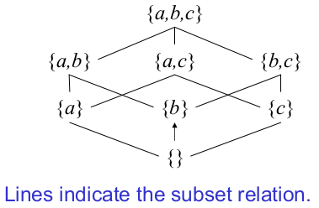
Lattices - Example 3
P({a,b,c}), ⊆), i.e. the power set of {a,b,c}, with the subset relation as partial ordering:
least upper bound: union of two sets.
greatest lower bound: intersection of two sets.

