Slide 1
ADC Performance-based Autoscaling
Centralized application delivery monitoring and and scaling
Gregory Coward – Solution Architect, Business Development - Emerging Solutions
David Garrison – Solution Architect, Business Development - Emerging Solutions

Slide 2
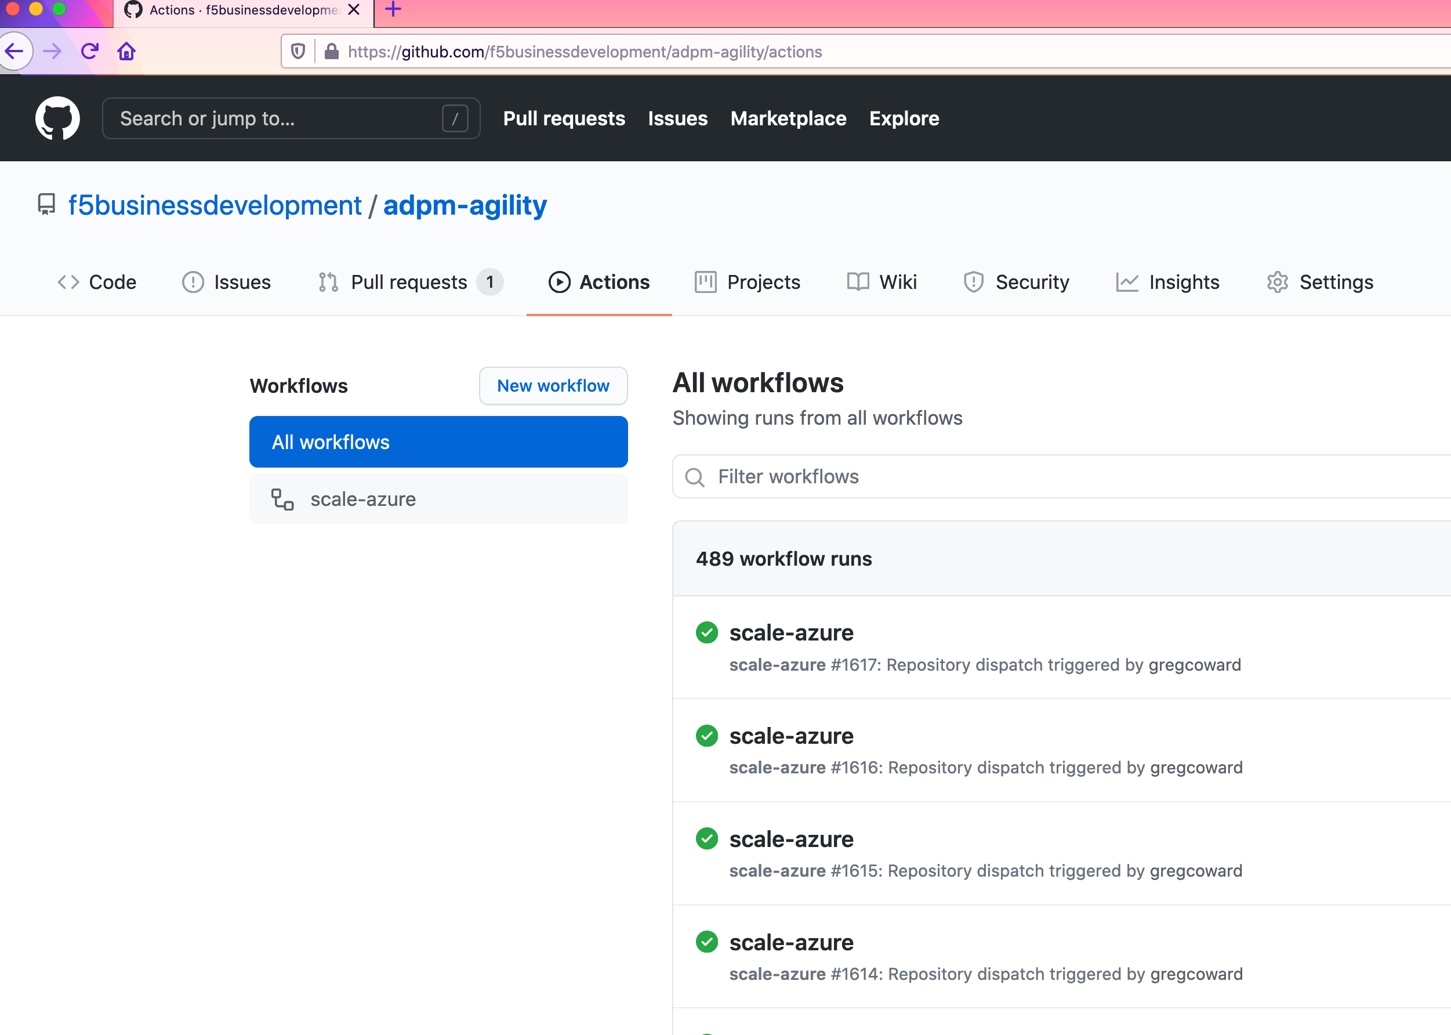
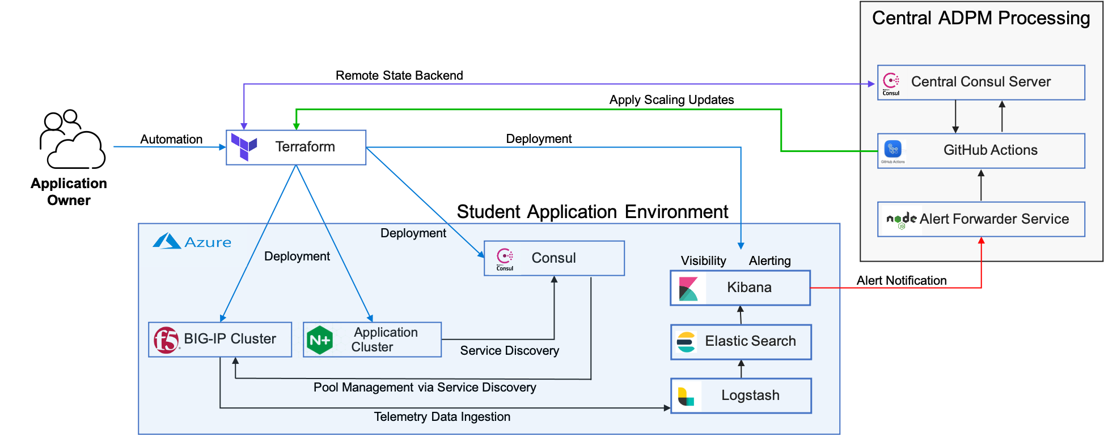
ADC Performance-based Autoscaling
Centralized adc monitoring and automated remediation
Cloud agnostic solution for centralized monitoring of application delivery performance
Integrates with third-party analytics providers
Scaling enables applications to adapt to varying workload demands
Affords enterprises the flexibility to configure and control consistent scaling policies for all their applications regardless of where they reside
Utilizes and F5’s Automation Toolchain and BIG-IP Terraform module
Architected to use various partner and third party open-source/free products and services

Slide 3



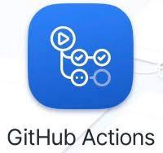

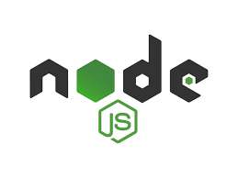


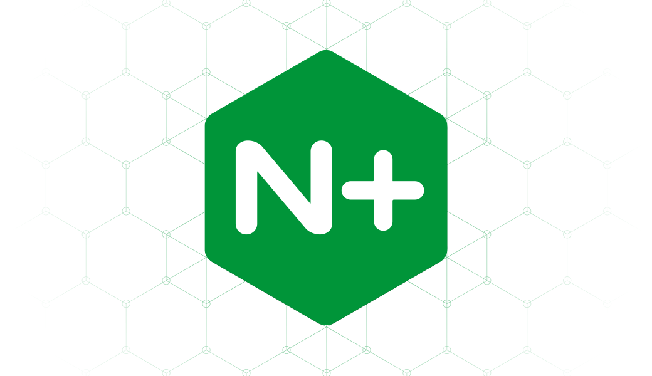


ADC Performance-based Autoscaling
Centralized adc monitoring and automated remediation
Central ADPM Processing
Remote State Backend
Central Consul Server
Apply Scaling Updates
Automation
Terraform
Deployment
GitHub Actions
Application Owner
Student Application Environment
Alert Forwarder Service
Deployment
Deployment
Consul
Visibility Alerting
Kibana
Alert Notification
BIG-IP Cluster
Application Cluster
Elastic Search
Service Discovery
Pool Management via Service Discovery
Logstash
Telemetry Data Ingestion

Slide 4
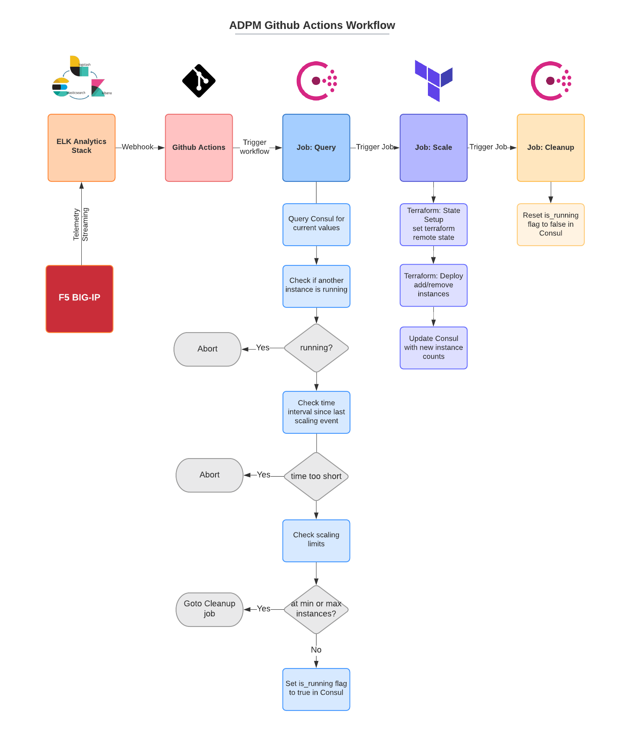
ADC Performance-based Autoscaling
“Github Actions” - CI/CD tool integrated with Github
A Github Action is a reusable software component that does something useful. For the Agility lab, we are using several Github Actions including one that prepares the workflow environment to run Terraform
A Github Actions workflow consists of one or more jobs and each job consists of one or more steps
Workflows can be triggered by any Github event such as a push, issue or pull request
The lab workflows are triggered by a webhook call from the Alert Forwarder service
Github Actions are available from the Github Actions marketplace and you can also create your own

Slide 5
Let’s See it in action!
Student Demonstration

Slide 6
ADC Performance-based Autoscaling
Centralized adc monitoring and automated remediation
Central ADPM Processing
Remote State Backend
Central Consul Server
Apply Scaling Updates
Automation
Terraform
Deployment
GitHub Actions
Application Owner
Student Application Environment
Alert Forwarder Service
Deployment
Deployment
Consul
Visibility Alerting
Kibana
Alert Notification
BIG-IP Cluster
Application Cluster
Elastic Search
Service Discovery
Pool Management via Service Discovery
Logstash
Telemetry Data Ingestion

