Slide 1

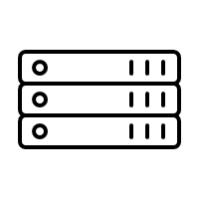




On Prem data center
Health Check Origin Pool
Load Balancer
IPSEC Tunnel
K8s Worker 1
F5XC RE
F5XC CE
F5XC GLOBAL NETWORK
K8s Worker 2
Firewall
ADC

Slide 2

On Prem data center
Stocks
Health Check Origin Pool
Load Balancer
IPSEC Tunnel
K8s Worker 1
F5XC RE
F5XC CE
F5XC GLOBAL NETWORK
K8s Worker 2
Firewall
ADC

Slide 3
On Prem data center
Stocks
Health Check Origin Pool
Load Balancer with WAF
IPSEC Tunnel
K8s Worker 1
F5XC RE
F5XC CE
F5XC GLOBAL NETWORK
K8s Worker 2
Firewall
ADC

Slide 4
On Prem data center
Load Balancer
IPSEC Tunnel
F5XC RE
F5XC CE Managed
F5XC GLOBAL NETWORK

Slide 5
On Prem data center
K8s cluster
Load Balancer
IPSEC Tunnel
F5 XC CE
App Containers
F5XC RE
F5XC GLOBAL NETWORK

