Slide 1
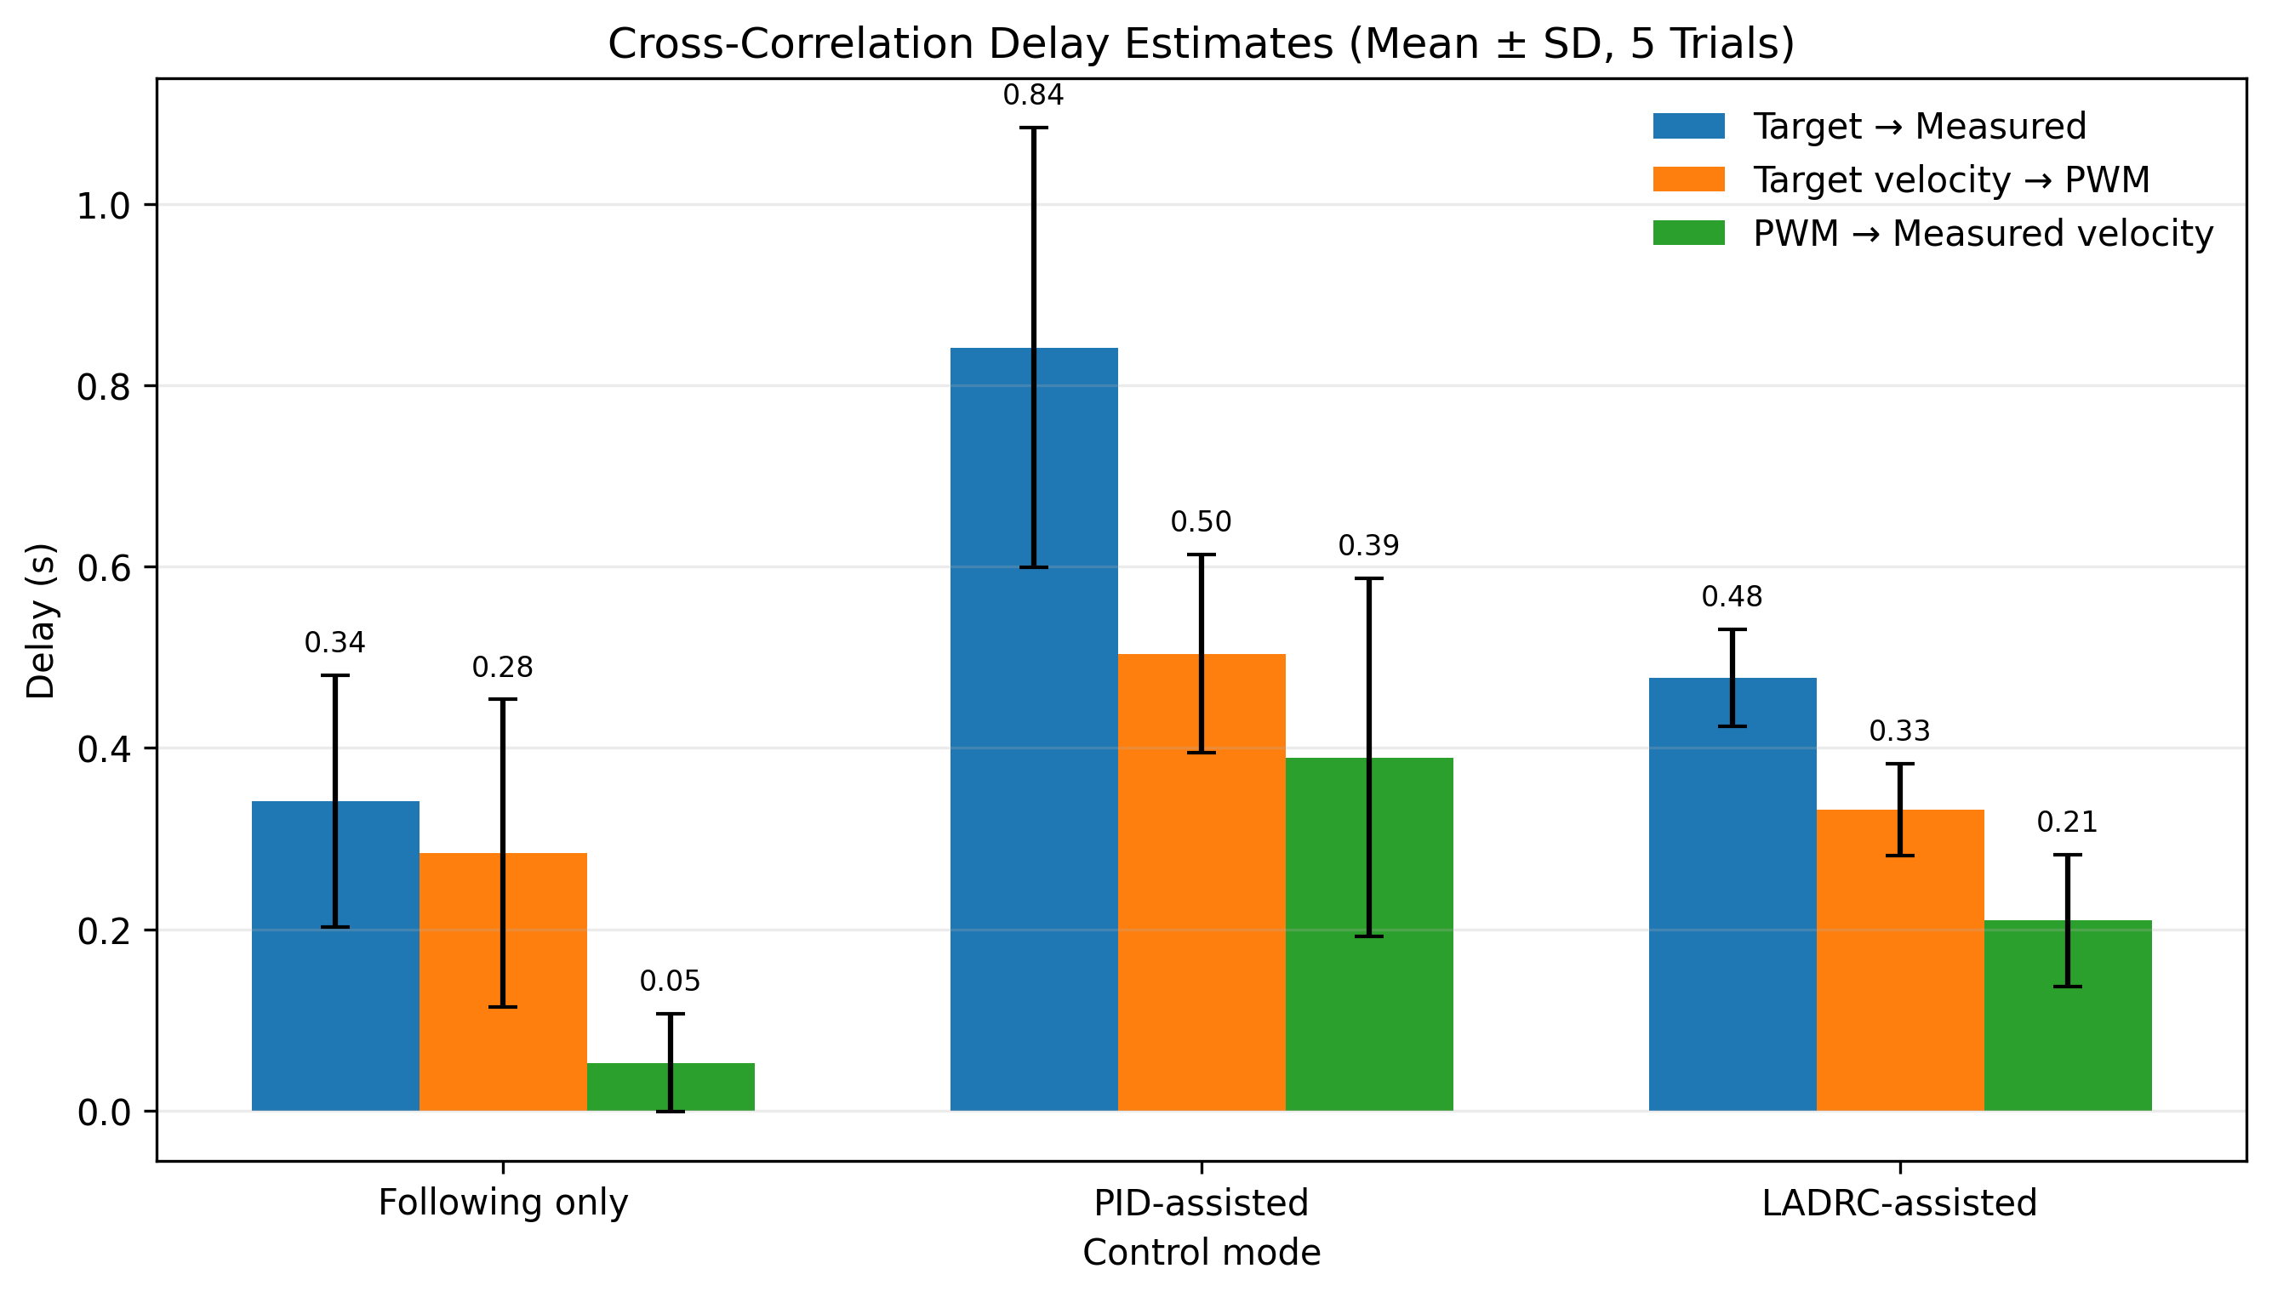
SUPPLEMENTARY EXPERIMENTAL RESULTS
Cross-Correlation Delay Analysis
Mean ± SD across 5 repeated trials per control mode
KEY FINDINGS
0.84 s
PID overall tracking delay
0.48 s
LADRC overall tracking delay
Controller response
PID 0.50 s LADRC 0.33 s
Actuator and system response
PID 0.39 s LADRC 0.21 s
LADRC improved responsiveness on both sides of the control loop.
Method: 1.5-s startup transient removed, signals uniformly resampled, and delay estimated by cross-correlation. Target angle versus PWM was excluded because PWM represents a drive command rather than an angle command.
LADRC reduced both controller-side and system-side delay, resulting in faster overall trajectory tracking than PID.
Q&A BACKUP
SUPPLEMENTARY RESULT
Notes:
Source: user-provided FINAL_CrossCorrelation_Delay_Summary.png. Final rapid-test dataset with five trials per mode. Processing removed the first 1.5 seconds, resampled signals to a uniform time base, and estimated lag using cross-correlation. Mean ± SD values: Following only, 0.342 ± 0.139 s target-to-measured, 0.284 ± 0.169 s target-velocity-to-PWM, and 0.053 ± 0.054 s PWM-to-measured-velocity. PID-assisted, 0.842 ± 0.243 s, 0.504 ± 0.109 s, and 0.389 ± 0.198 s. LADRC-assisted, 0.477 ± 0.053 s, 0.332 ± 0.051 s, and 0.210 ± 0.073 s. Interpret as development-stage engineering results, not clinical efficacy evidence.

