Slide 1
Philosophy and software testing
Gunnar Johansson
Safer Society Group

Slide 2
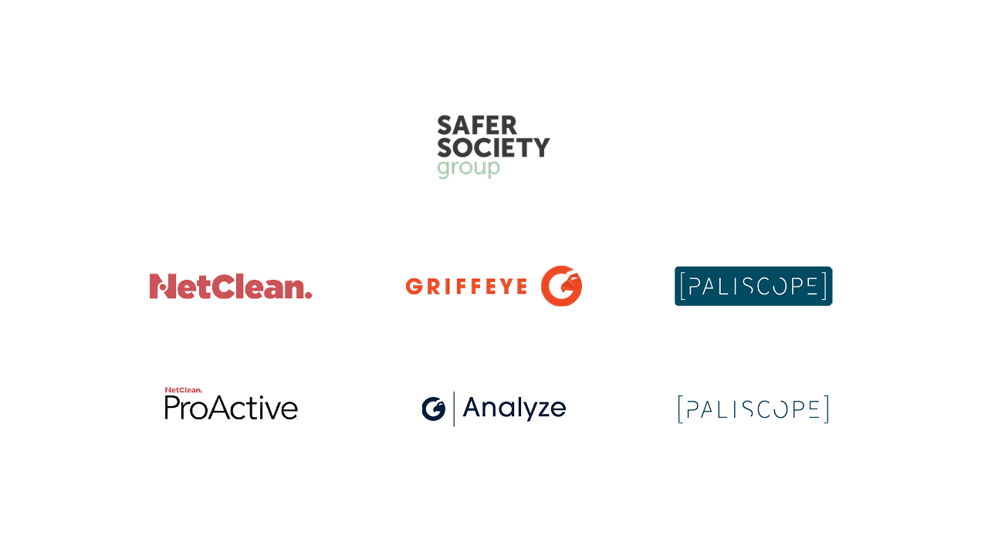
Notes:
Two years ago the Safer Society group of companies was launched, and separating the different product focuses into different companies.
The products you see here are developed in house – there are some other products that are built by partners.
NetClean ProActive is intended to be installed on the work computers of companies. It generally works in the same way as an antivirus program. The difference is that ProActive identifies child sexual abuse material instead of a computer virus
Griffeye provides law enforcement with a platform to feed in these huge amounts of image and video material.
And then helps the police to intelligently classify everything and enables teamwork, speeding up that whole process substantially.
Paliscope is the newest addition to the family. We haven’t released yet, so I can’t talk too much about it – but I’ll say this:
It is a tool to help with online investigations.

Slide 3
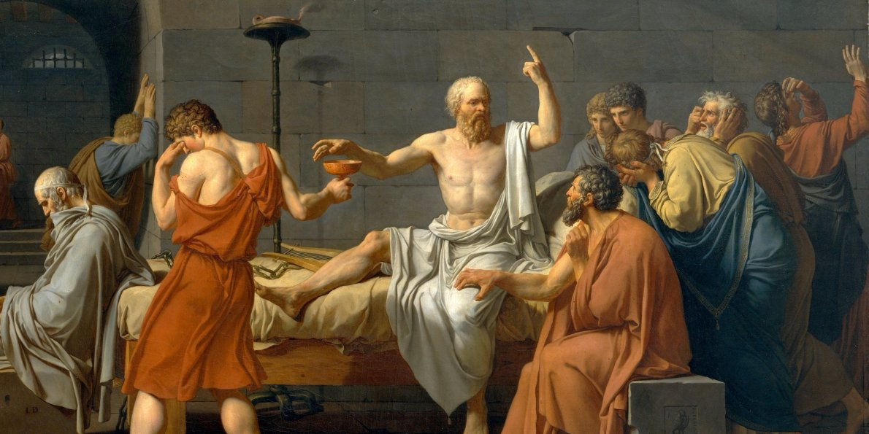
Notes:
Greatest minds have thought long and hard, anything useful
History of human folly
Lots of strange ideas, but an ongoing debate
Everything used to be philosophy, enlightenment
The questions that we still don't know how to answer, maybe not even what the answer looks like
Testing not necessarily about technical skills, using specific tools; more about mindset, finding assumptions (others as well as your own...)
Like testing, philosophy is really about doing, not so much a body of knowledge, as it is an activity
Begin with some of the fundamentals

Slide 4
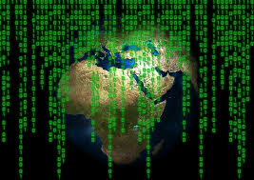
Metaphysics
Notes:
Context:
Metaphysics origin and ontology
What is there, and what is it like,
How can we classify and order what there is,
Essential vs Accidental,
Das ding an sich, phenomenology
Example:
Testing, do it via thinking long and hard up front, before actually working with the product, or experimenting and using the feedback to learn more?
There is always classification going on, is this thing like that thing, is it a part of this or a part of that. Mindmaps or models
Essential and accidental, the sut should do this, but does it have to be a blue button. What is most important to test?
What is it really, and what is it like? Code, or behaviour, intended use of actual use. We don’t actually test what is being built (code) but something else
Doubts about the existence of an outside world, leads to philosophy of mind

Slide 5
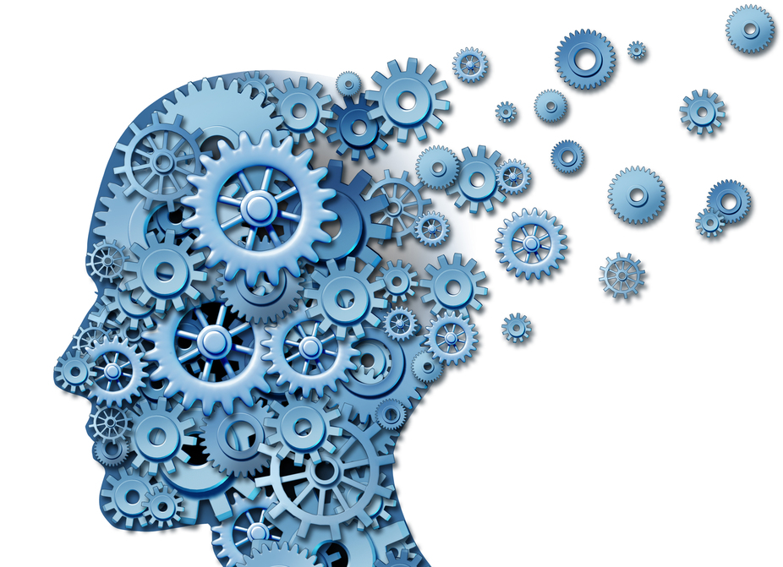
Mind
Notes:
-Philosophy of Mind
Context:
Descartes
Body vs Mind duality
Meat machines/zombies. Or everything has a mind
qualia, what is it like
Colours and taste
Category mistake
Example:
Category mistake, thinking something is one type of thing, when it really is something else
Duality with Hardware and software? Or is it the combination we test?
The tester as part of the system?
Works on my machine?
No user would ever do that
Communicate with other minds

Slide 6
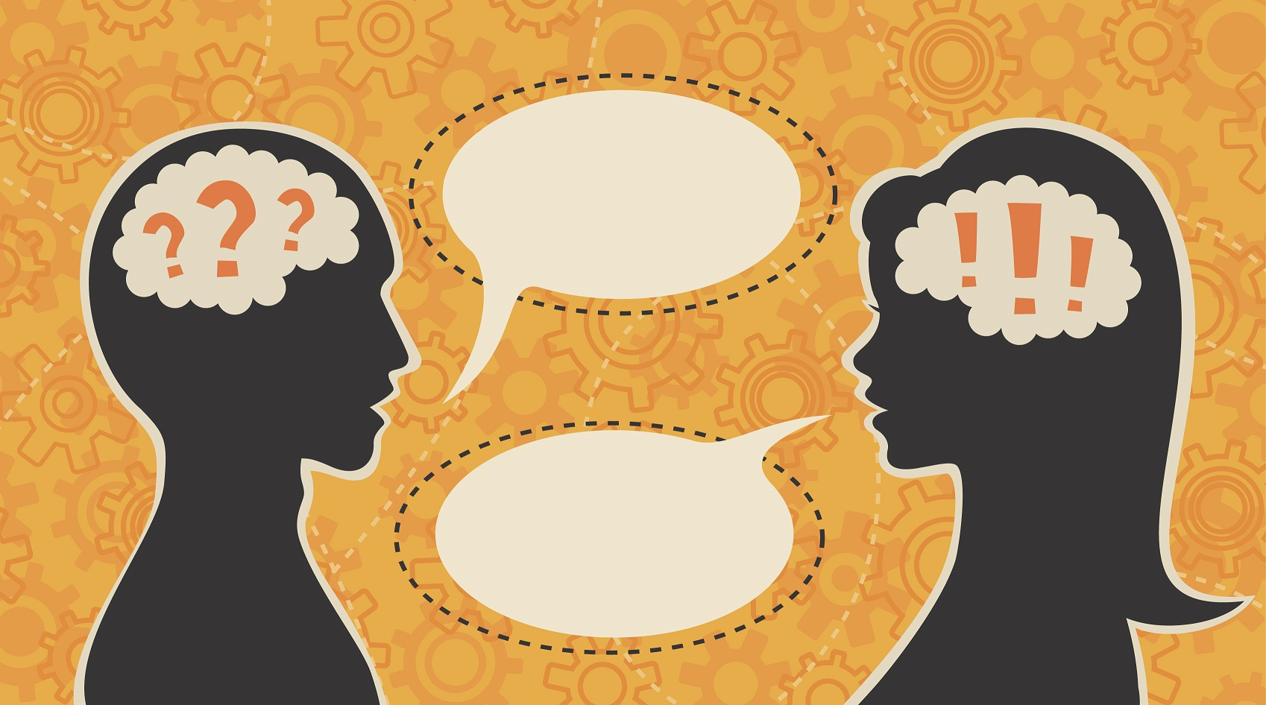
Language
Notes:
-Philosophy of Language
Context:
Limits of my language
Wovon man nicht sprechen kann, daruber muss man zweigen
Meaning is use
Speech acts, I promise, vs I paint
The words, the intended meaning, the reason for saying it
Vague terms (how many hairs to be bald?)
Example:
Language is fine as it is? Or are their vague terms, bug or issue?
Domain specific language?
Semantic vs syntactic
Obscurantism?
Unambigous requirement?
Confusion of some terms, smoke test, regression etc
Why vs How
Shallow agreement, what does it actually mean
Are there ways for us to see consequences just from syntax?

Slide 7
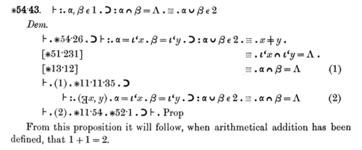
Logic
Notes:
Context:
syllogism
Tertium non datur (identity, non-contradiction, excluded middle)
propositional, FOL, SOL
syntax vs semantics
Necessary and sufficient
Example:
Test cases are sometimes about propositional logic, if A then B, A and B
Sometimes about FOL, For all these, this happens, for none of these, this happens
Pass or fail, is there no third
The problem of antecedent, if A then B, what happens if A is false.
If NotB then NotA? If something is a bat, then it is an mammal. If it is not a mammal, then it is not a bat.
Testing example? If user is logged in, then something should happen.
From false premise everything follows
So what can we know

Slide 8
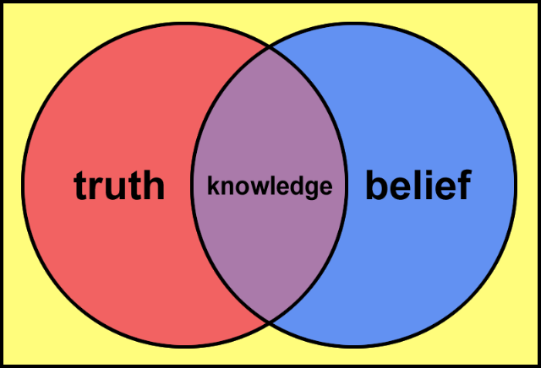
Epistemology
Notes:
Context:
How do we know, how do we know something to be true
Brain in a vat, scepticism, cogito ergo sum
Justified true belief, or sui generis (not possible to break down)
Knowing what and knowing how (episteme vs techne)
A priori and a posteriori, All crows are birds, all crows are black, experience with and without, epistemic
Analytic vs synthetic, bachelors are unmarried men, otherwise you don’t know what bachelor is, semantic/logical
Rationalism vs Empiricism
Pragmatism, is it useful
Right for the wrong reasons
Example:
How do we know we are done
How do we know there is a bug, reproducability
How do we know there are no bugs
Circular requirement
Do we trust other testers, trust devs, trust customers? When a bug is reported.
What does it mean to know that the system does something? Or just believe it.
Justification
Is there a method to add knowledge

Slide 9

Science
Notes:
Context:
what qualifies as science?
Line of demarcation. Still a debate
Falsifiable, Popper, if it explains everything, it explains nothing (Freud vs Einstein)
Paradigm, Kuhn, be stuck in the old way of thinking, find different things when shifted.
explanatory power
Induction, from the specific to the general, and back down again
Generalisation
Observer
Example:
Everybody knows it is so, our users do this
Build the right thing vs build the thing right?
Check that it works, test when it doesn't work
If everything is always ok, then no need to test (not falsifiable). Not a bug it’s a feature
Based on limited observation, test cases, what can we deduce/induce? Risk
Tester part of the system? What does the system do when no one is watching?

Slide 10
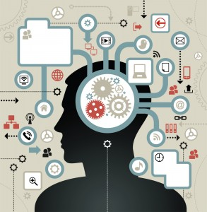
Notes:
So much I did not talk about
Discussions, distinctions and history not mentioned
Not discussion philosophy of testing
Activity based
Testing is closely related to large parts of philosophy, perhaps one of the most philosophical jobs
If that is true, it couldn’t hurt to know a little more about philosophy
Hopefully you've found some places to go looking for more test ideas, and realize that some of the problems of testing, are some of the problems of philosophy
Standing on the shoulders of giants

