Slide 1
Developer Testing
April 2016

Slide 2
Overview
Unit Testing using mocking framework
Integration Testing using SpringJUnit4Runner
Functional Testing using Selenium web driver
Code Refactoring and Metrics

Slide 3
Setting up Environment
Open Eclipse,
Create workspace
Clone existing project from remote server
Import the existing project.

Slide 4
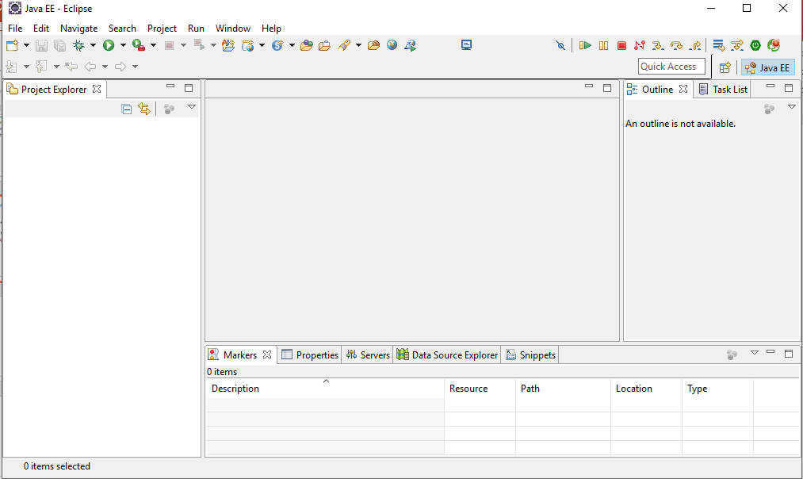
Create Workspace
Specify where you want your workspace and ok.

Slide 5
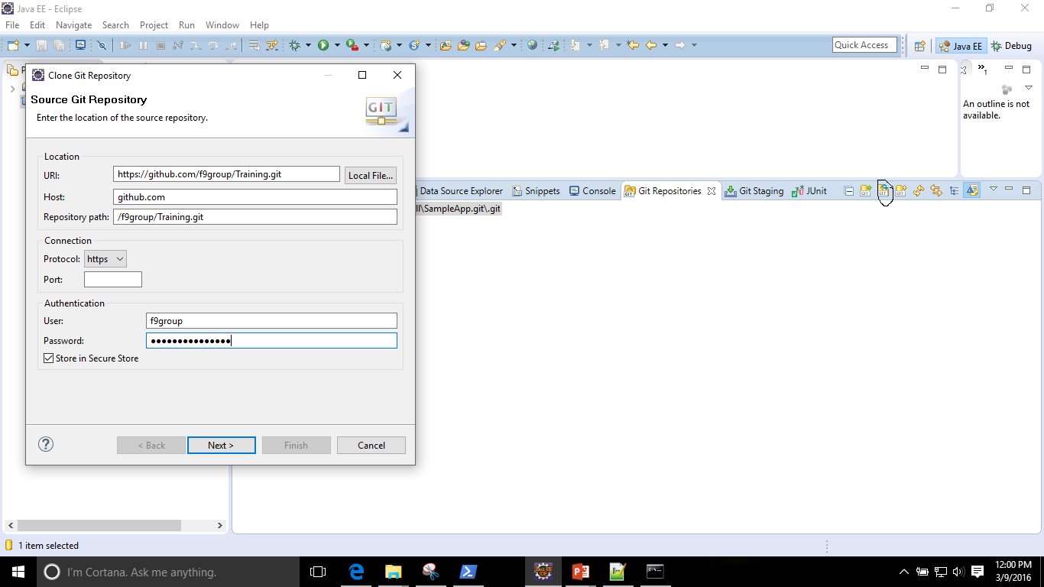
Clone existing project from remote server
A sample Application is already checked in to the remote server. We will fetch that to eclipse by navigating to Repository view →Clone Repository .

Slide 6
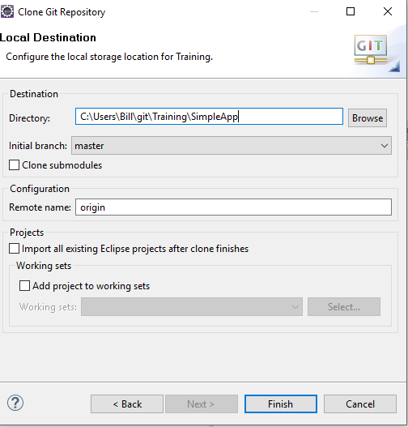
Clone existing project from remote server cont’d
You will need proper credentials to fetch the project.
Select where you want the project in your local drive and then the wizard will navigate you through the process

Slide 7
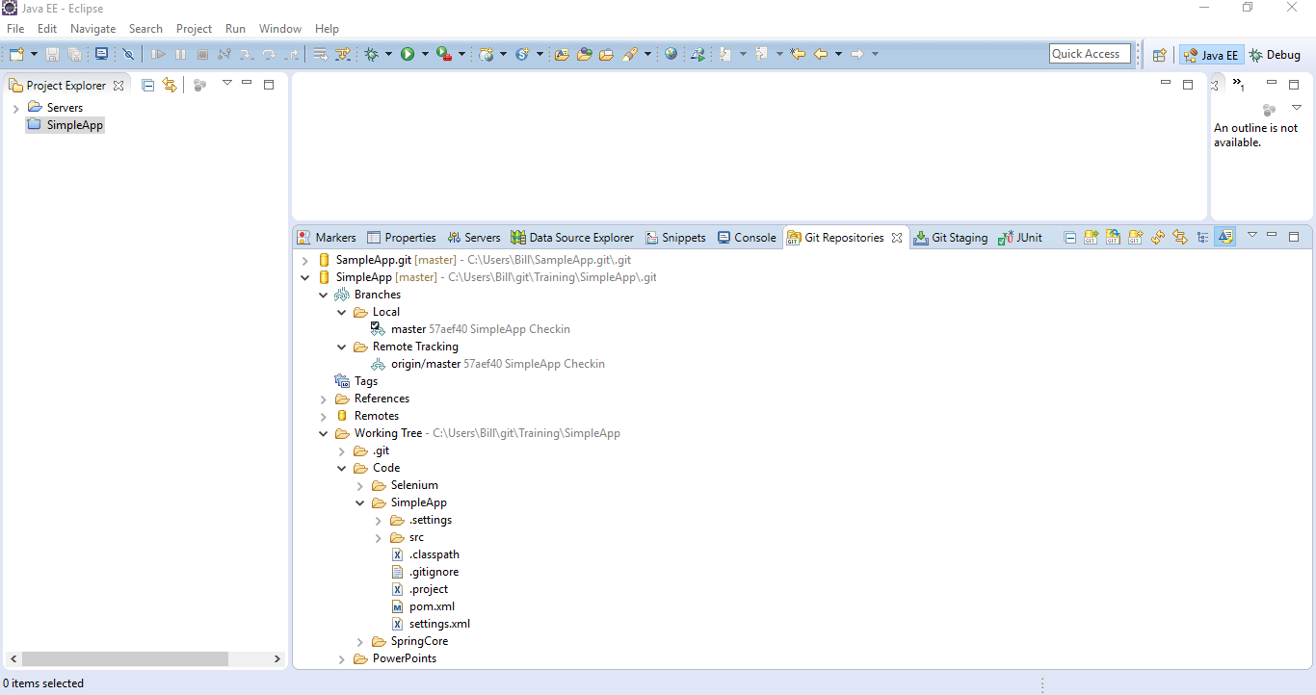
Fetched project
At the end, the repository view will look like this.

Slide 8
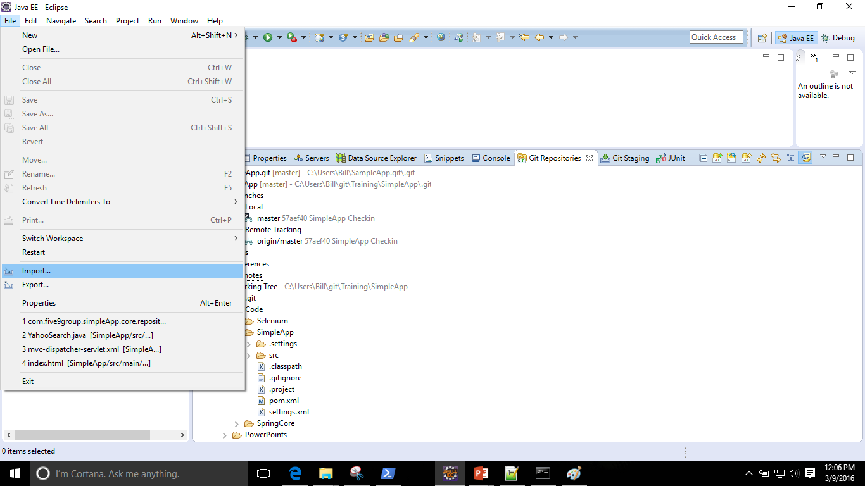
Importing project to your workspace
Next step is to import the project to your workspace

Slide 9
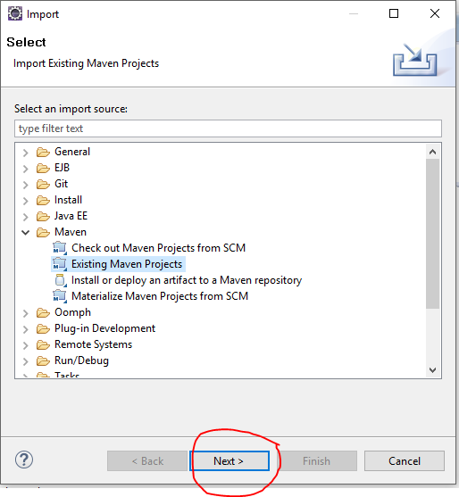
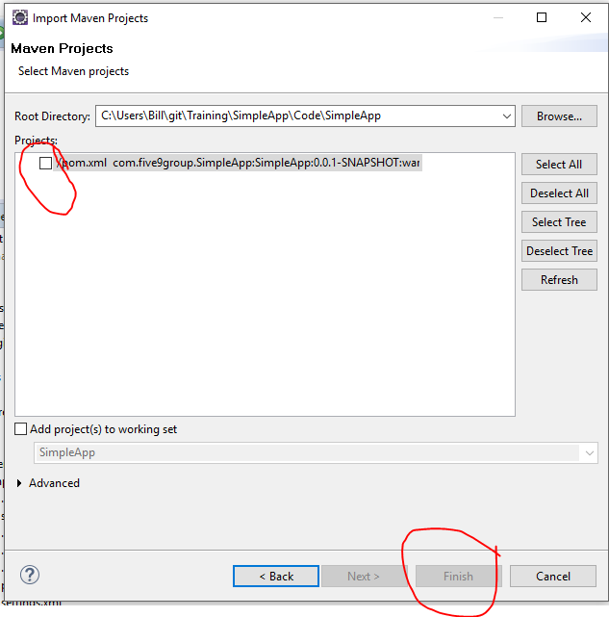
Importing project to your workspace

Slide 10
Unit Vs Integration Testing
Unit Testing
Tests one unit of functionality
Keeps dependencies minimal
Stub or mock out dependencies if needed
Each test exercise a single scenario.
Integration Testing
Tests the interaction of multiple units working together
Integrates infrastructure

Slide 11
Unit Testing with mocking framework (Mockito): Overview
Use a mocking library to generate a mock object
Record the mock with expectations of how it will be used for a scenario
What methods will be called
What values to return
Exercise the scenario
Verify mock expectations were met.

Slide 12
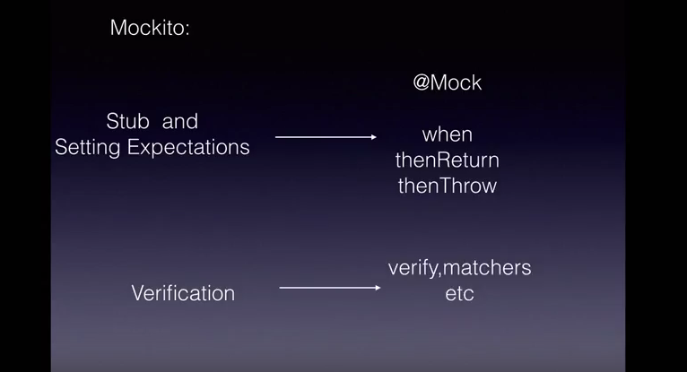
Conceptualize

Slide 13
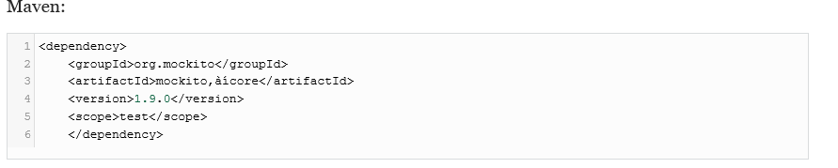

Adding Mockito to the project
You can configure Mockito in maven project just by including the dependency.
You can create a mock object either calling a static method or annotating with @Mock

Slide 14
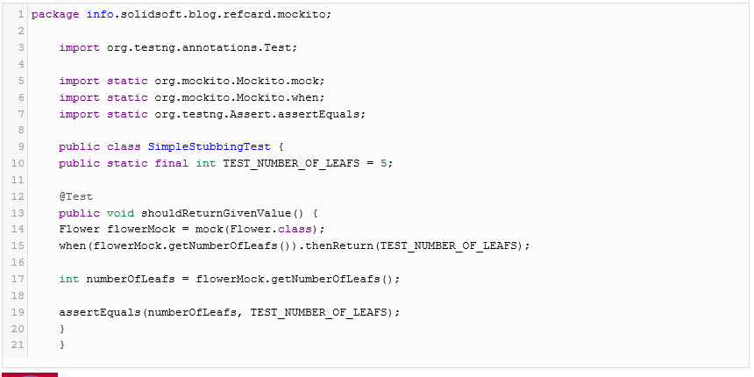
Stubbing Method’s return value
Mockito has the ability to return a given value when a specific method is called.
when(....).thenReturn(....)

Slide 15
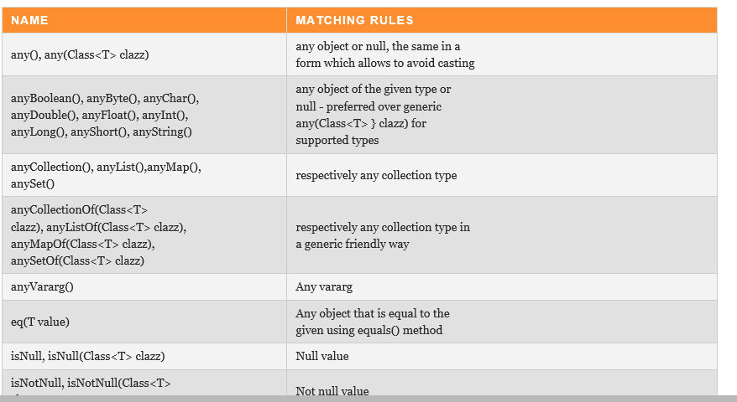
Argument Matching
Mocks can return different values depending on arguments passed into a method.
You can use Mockito’s several methods to define that independent of the input value a certain return value should be returned.

Slide 16
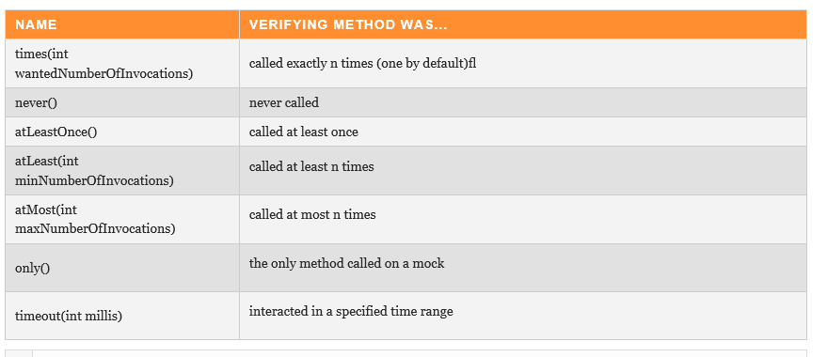
Verifying Behavior
To verify that the specified conditions were met Mockito uses verify method.(Behavior testing)

Slide 17
Advantages of Integration Testing
The code can be tested without deploying to any container.
i.e. you can test everything within eclipse.
You can re-use your configuration file to test in different environments.
i.e. create different configuration file for each environment if the infrastructure is different without having to change an code.

Slide 18
Integration Testing :SpringJUnit4Runner
SpringJUnit4Runner consists of several Junit test support classes.
It uses shared Application Context across test methods.
The tests are annotated with @ContextConfiguration
We can specify the location of our configuration file by specifying the classpath.
We can inject a bean by using @Autowired annotation.

Slide 19
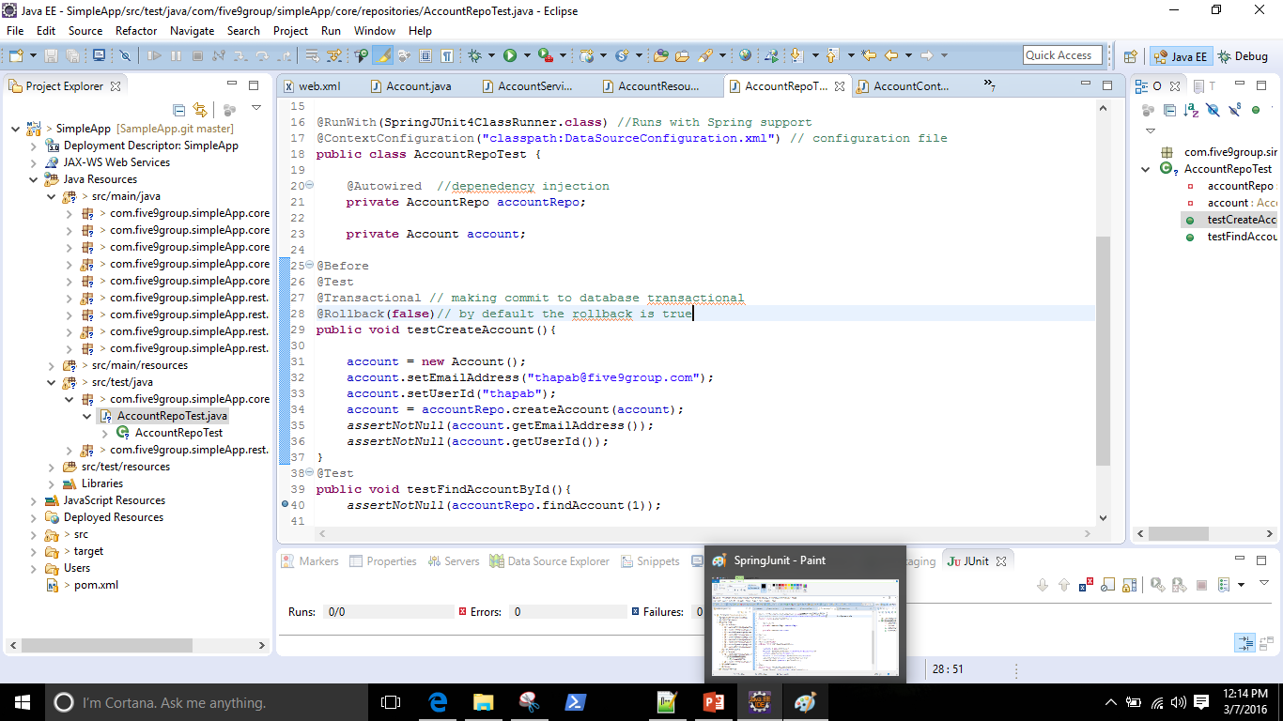
Sample configuration to run Integration Tests

Slide 20
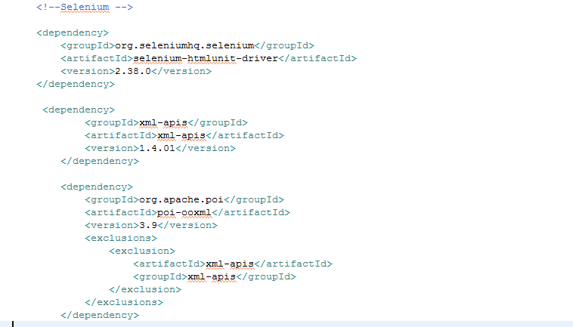
Functional Testing: Selenium
You can configure Selenium in maven project just by including the dependency

Slide 21
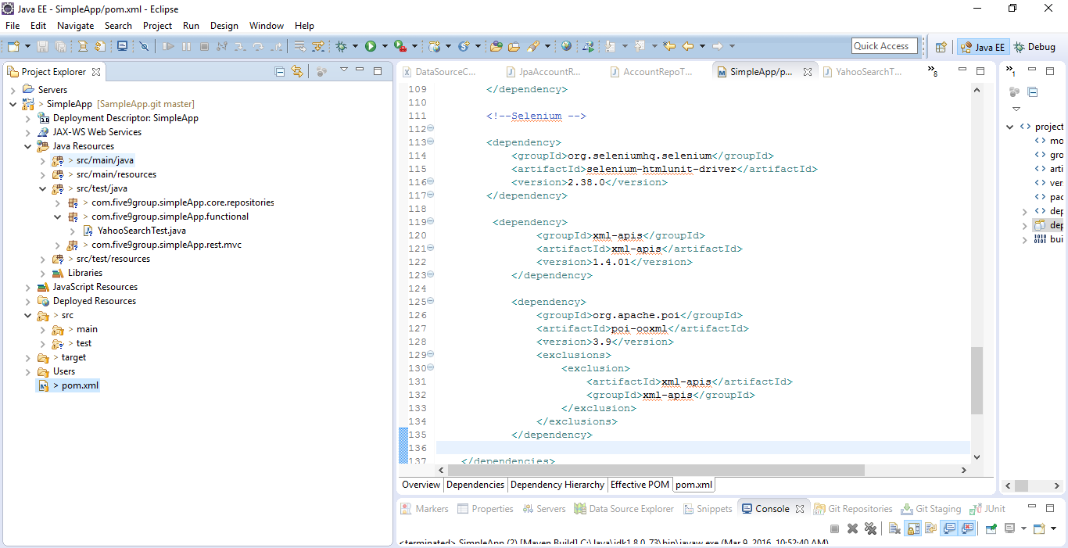
Create package for functional testing
Create a separate package as out lined below and add tests to it.

Slide 22
Selenium core classes
org.openqa.selenium.WebDriver: The main interface to use for testing, which represents an idealised web browser. The methods in this class fall into three categories – Control of the browser itself, Selection of WebElements, Debugging aids
org.openqa.selenium.WebElement: Represents an HTML element. Generally, all interesting operations to do with interacting with a page will be performed through this interface.
org.openqa.selenium.By: Mechanism used to locate elements within a document

Slide 23
Locator techniques to identify html objects
Xpath
ID
ClassName
Name
LinkText
CssSelector
Partial link text

Slide 24
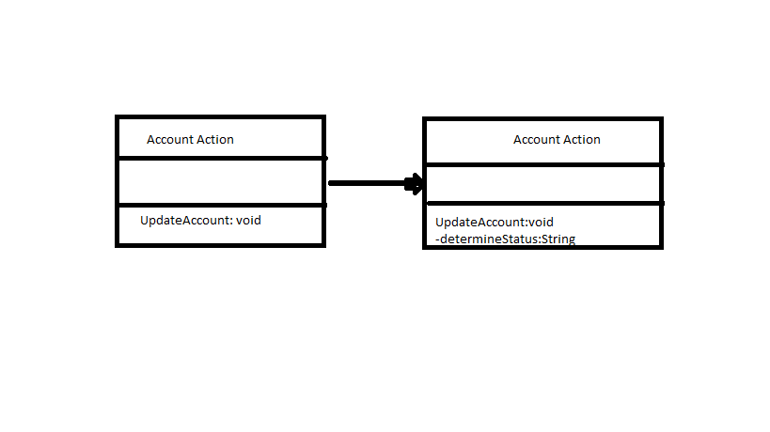
Code Refactoring
The process of cleaning code without changing the underlying functionality to improve the structure of code and reduce complexity.​
The best way to refactor code is to extract method.

Slide 25
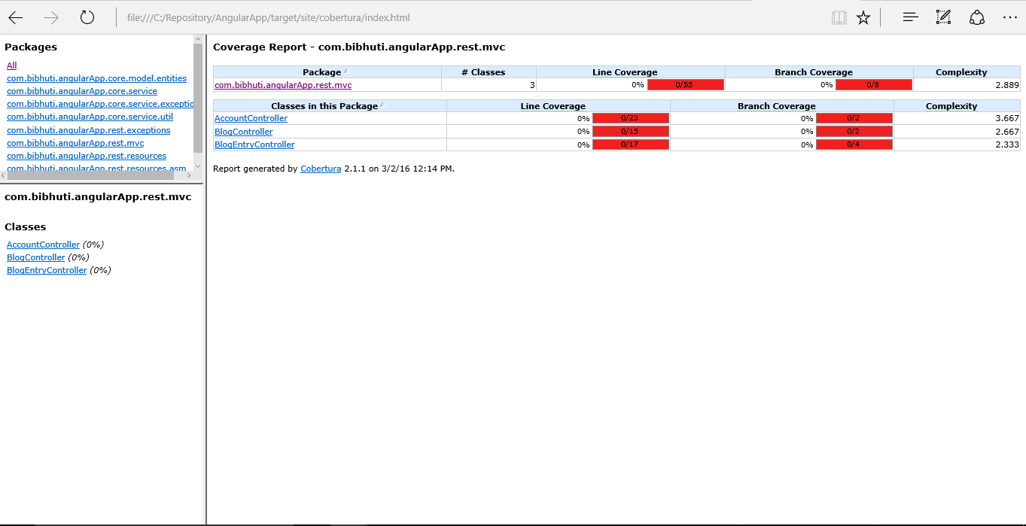
How do you identify code that needs refactoring?
Tools that analyze cyclomatic complexity is good at pointing out code that needs to be refactored.​
Running Cobertura to identify cyclomatic complexity from maven​
Higher the complexity number better it is to refactor code.

Slide 26
Code Metrics
Why measure code attributes​
Complexity ​
Maintainability ​
Risk​
Extensibility​
Waste

Slide 27
Code Metrics Terminology
Cyclomatic Complexity
Duplicate Code Analysis
Circular Dependencies
Code Coverage

Slide 28
Cyclomatic Complexity
Measurement of number of paths through the methods. More the number of paths complexity increases linearly.
Tools used to measure cyclomatic Complexity
PMD
The Eclipse Metrics plug-in
JavaNCSS
Cobertura
To reduce Cyclomatic Complexity we can introduce isolation via refactoring
Break the method into smaller ones
Introduce more classes

Slide 29
Duplicate Code Analysis
Duplicate code with demonstrates poor coding standards and replicate defects
Tools used for Duplicate code analysis
CPD
Resolution for duplicate code issues
Refactor code to extract super class
Extract Methods

Slide 30
Circular Dependencies
Occurs when one part of the code(say X) depends on the other(say Y) and that in turn depends on the first; so you get a dependency like the one below
X <-->Y
This creates compilation and deployment issues.
Tools used to measure circular dependencies
JDepend
Resolution for circular dependencies
Make the code modular by extracting packages.

Slide 31
Code Coverage
Used to determine how much of the code is being tested by coded test.(JUnit, selenium).
Higher the number better is the code coverage
Tools used to measure code coverage.
Cobertura
Running Cobertura via maven command.
mvn cobertura:cobertura

Slide 32
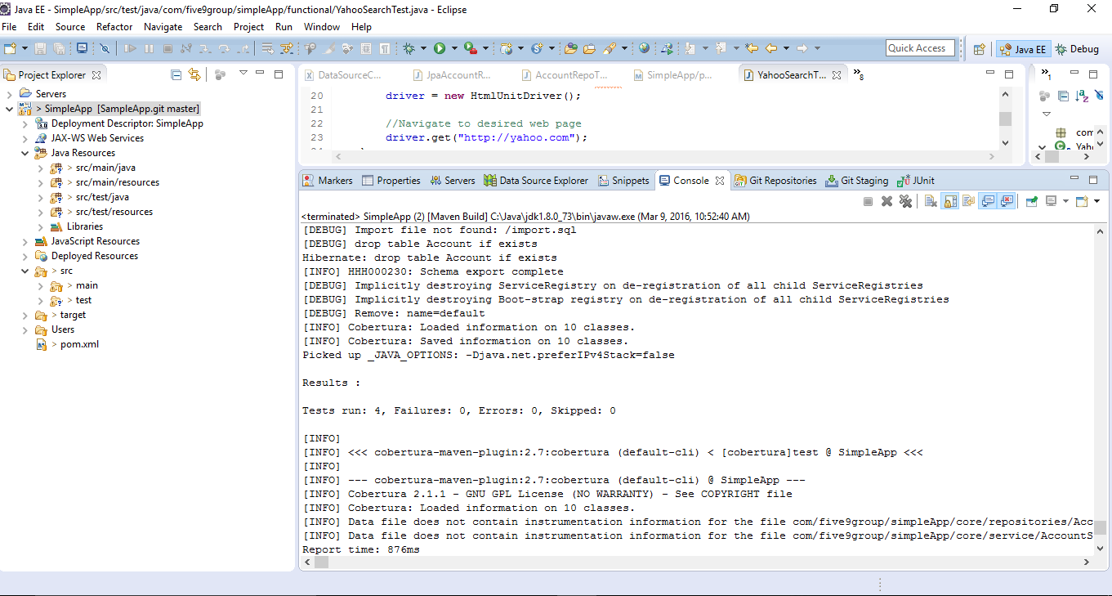
Code Coverage

Slide 33
Assignment
Extend code coverage for
Getting all available accounts method in the controller.
Write integration testing for get all accounts.
Write functional tests to test the SimpleApp application.

