Slide 1
Web Services Testing with SOAPUI

Slide 2
Web Services Introduction
Web Services are services that are made available from a business's Web server for Web users or other Web-connected programs to use, using standard Internet protocols via standardized XML messaging system.
There are specific standards to exchange the information between Web Services.
Web Services Description Language (WSDL) is a format for describing a Web Services interface.WSDL is an XML document. WSDL has three parts:
Definition
Operations
Service bindings
SOAP(Simple object Access Protocol ) is an XML-based protocol for exchanging information between Web services
Because all communication is in XML, web services are not tied to any one operating system or programming language
SOAP requests are sent via an HTTP request and SOAP responses are returned within the content of the HTTP response

Slide 3
SOAP Concepts
SOAP is a communication protocol that enables client applications to easily connect to remote services and invoke remote methods.
A SOAP message is an ordinary XML document containing the following elements Envelope: Mandatory: start and end of messages.Root of soap structure. Header :Optional: usually contains authentication information Body: Mandatory: contains information that is passed as request Fault: Optional: Contains error messages that is passed back to the client
Two types of messages SOAP request SOAP response

Slide 4
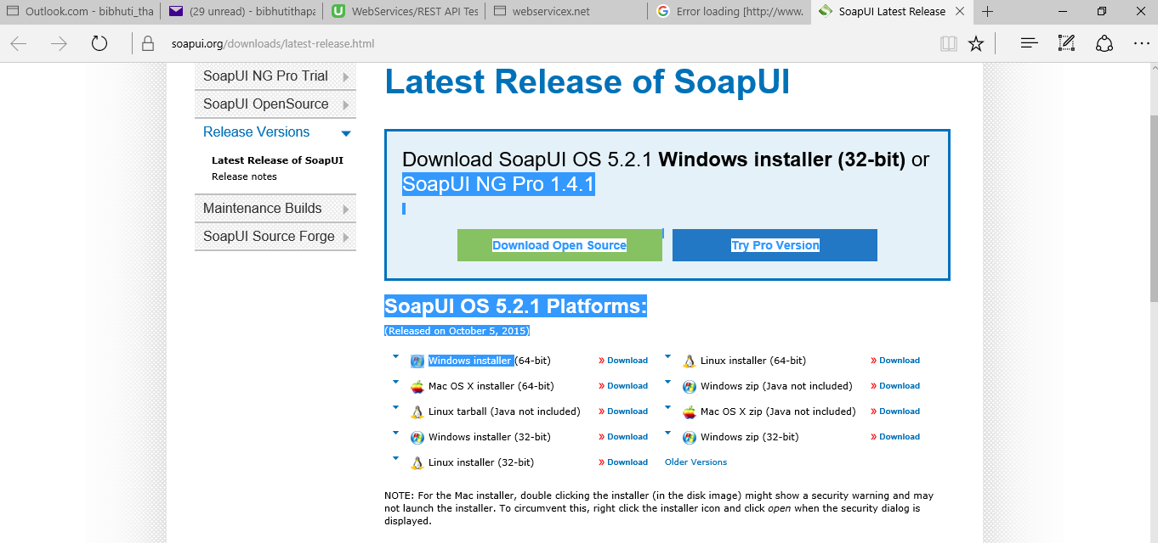
Testing Web Services using SOAPUI
SOAPUI is a tool that can be used for testing Web services.
Download SOAPUI from the site below.
https://www.soapui.org/downloads/soapui.html
Execute the .exe file and the wizard will navigate you with the process.

Slide 5
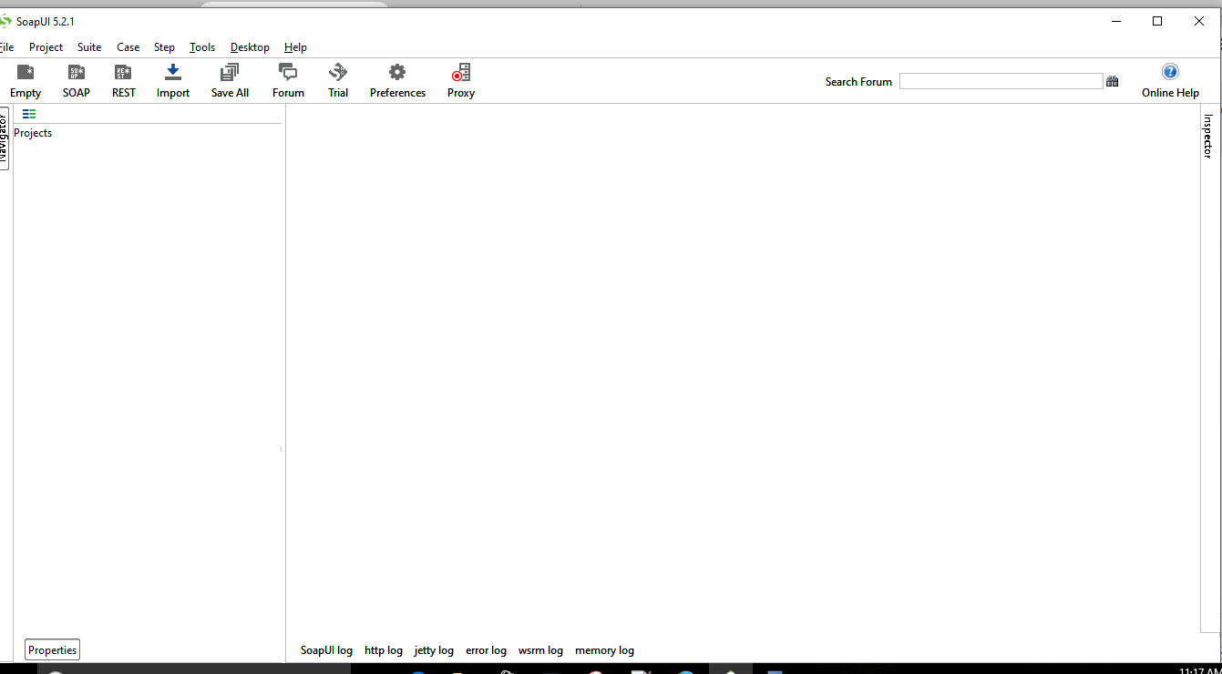
SOAPUI Screen after installation

Slide 6
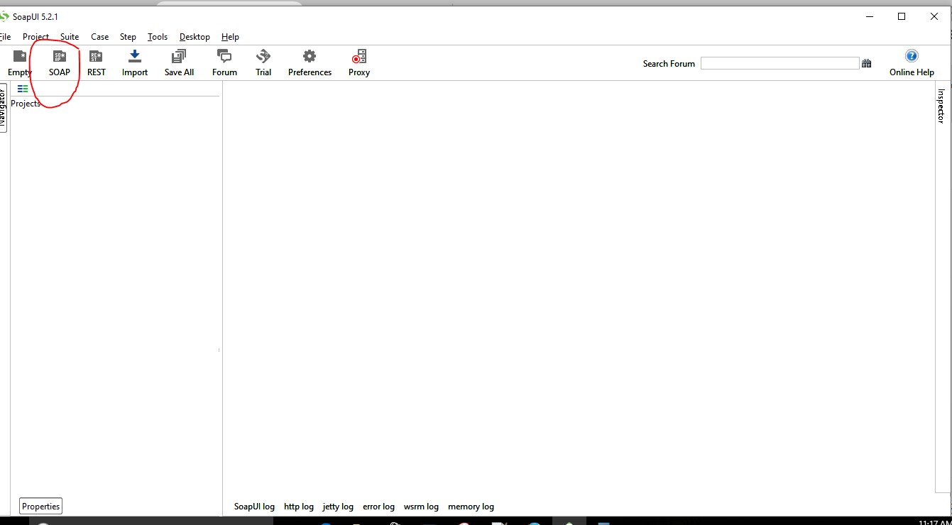
Creating a SOAP UI project to run tests
As simple as clicking on the SOAP image on the top left corner.

Slide 7
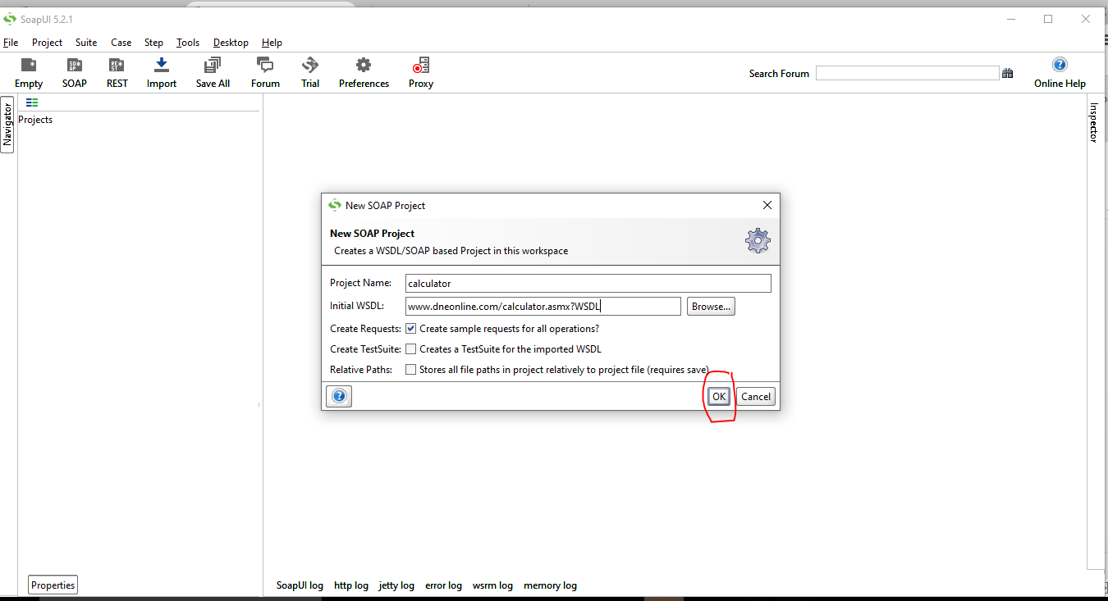
Give Project a name & get the WSDL for the application under test
When you click on the SOAP icon as mentioned in the slide above; a dialog box opens. Give a name to the SOAP UI project. For demonstration purposes we are going to use available online web services
(http://www.dneonline.com/calculator.asmx?WSDL )as our target test application.Copy and paste the url as shown below and say OK.

Slide 8
Gotcha when getting the WSDL file
If there is an error while getting the WSDL file and the error says something like this:
Exception java.net.SocketException: Address family not supported by protocol family: connect
Please follow the following steps:
1.Open command prompt (windows start button, type cmd in search) 2.Click top left of command prompt, click properties, enable quick edit mode 3.Copy: setx _JAVA_OPTIONS -Djava.net.preferIPv4Stack=true 4.Right click on command prompt, should paste 5.Hit enter.

Slide 9
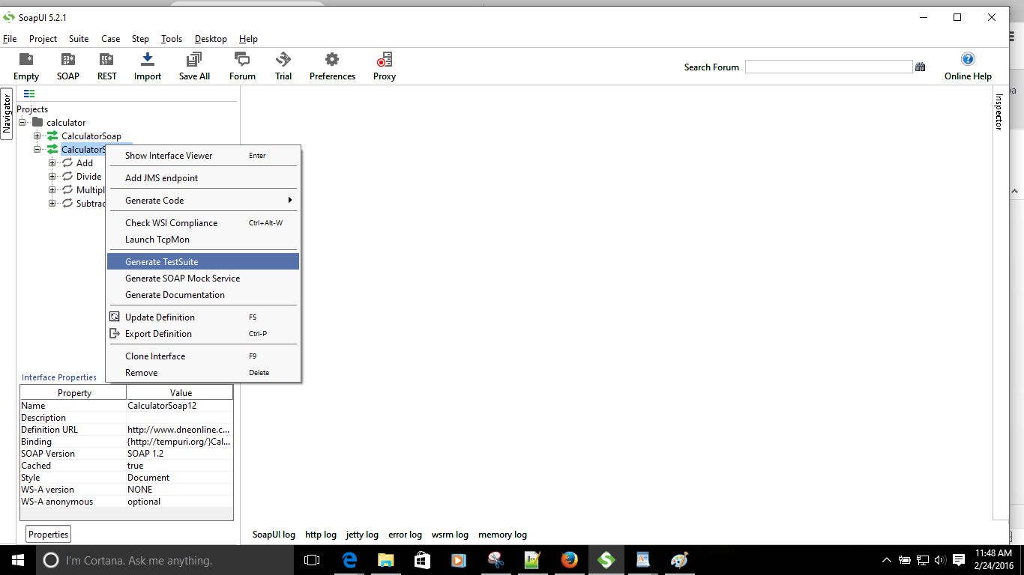
Generating Test Suite, Test Case and Test step
If getting the WSDL file is successful, your screen should look like the one below.
It is always best to create test suite, test cases and test steps for maintainability purposes. SOAP UI should be able to generate test suite just by clicking on the Generate Test Suite menu item as shown below.

Slide 10
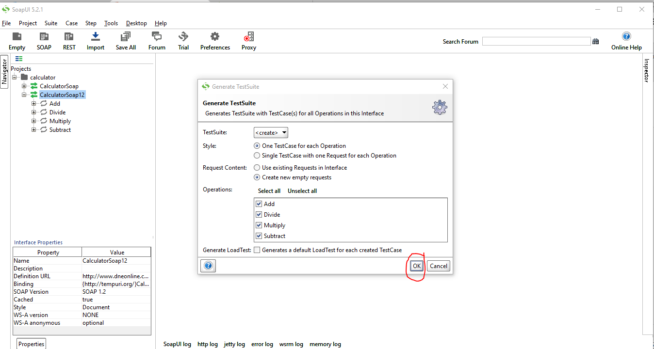
Generating Test suite Test Case and Test step cont'd
When generating test suite SOAP UI will ask you if you want to generate test suite for all the operations. Enter the name of the test suite when prompted and say OK.

Slide 11
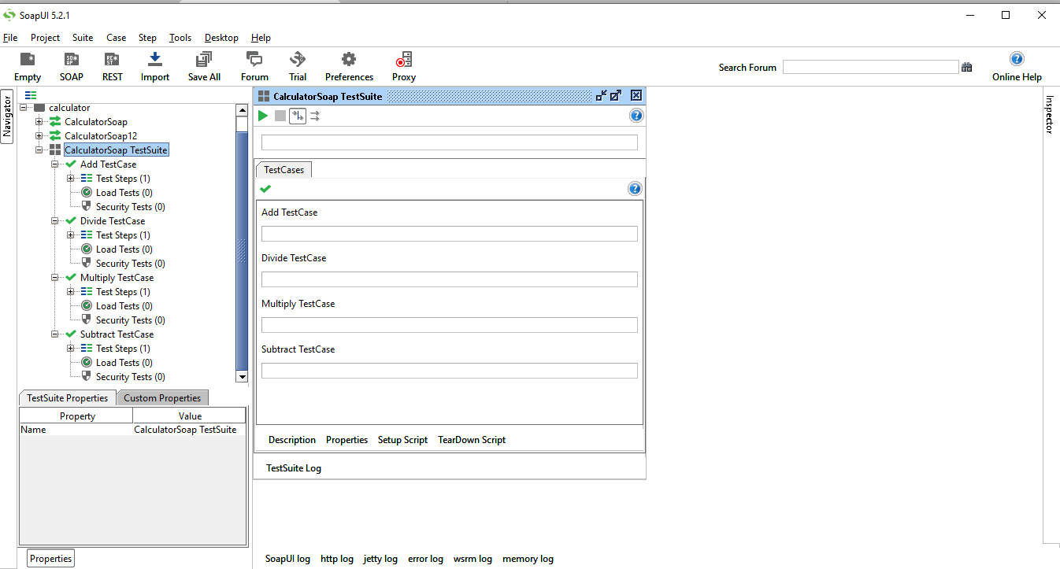
Generated Test suite
At the top hierarchy is the test suite
For each of the operations that was defined in WSDL file, SOAPUI has generated a test case.
Under each Test Case we have Test steps.
If you expand the Test step and double click on " Add "; on the right a window opens for you to supply the parameters and execute the add functionality.

Slide 12
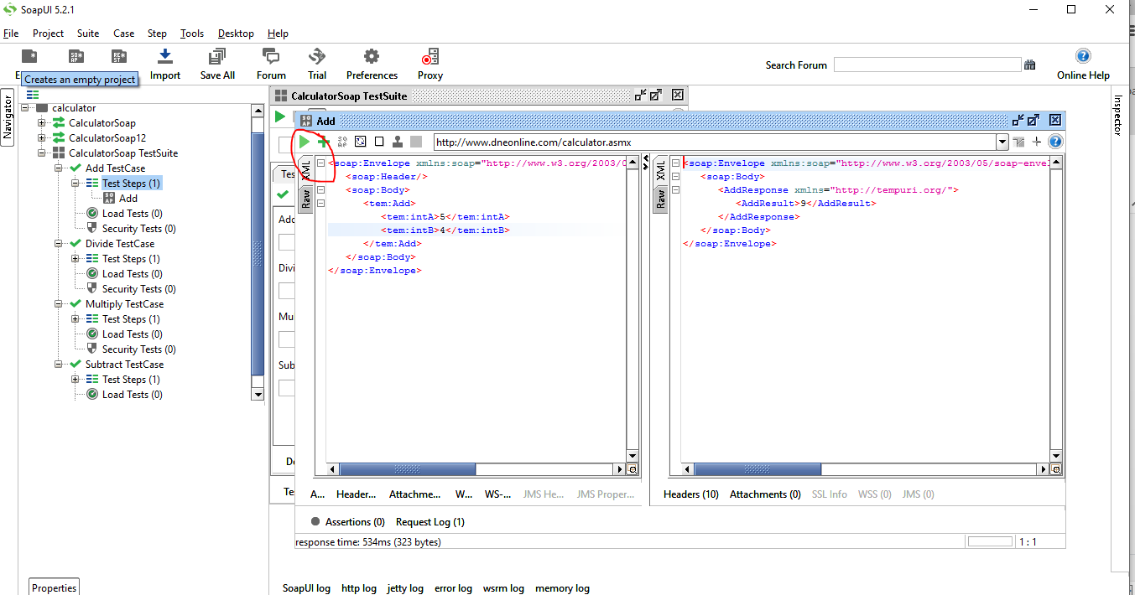
Running Add operation to test the add functionality of the Web Service
Supply two values for the first and the second arguments by replacing the "?" With the value as shown and execute the test.
After you execute the test a Response is generate on the right side with the sum of two numbers you have provided. See snapshot for more details.

Slide 13
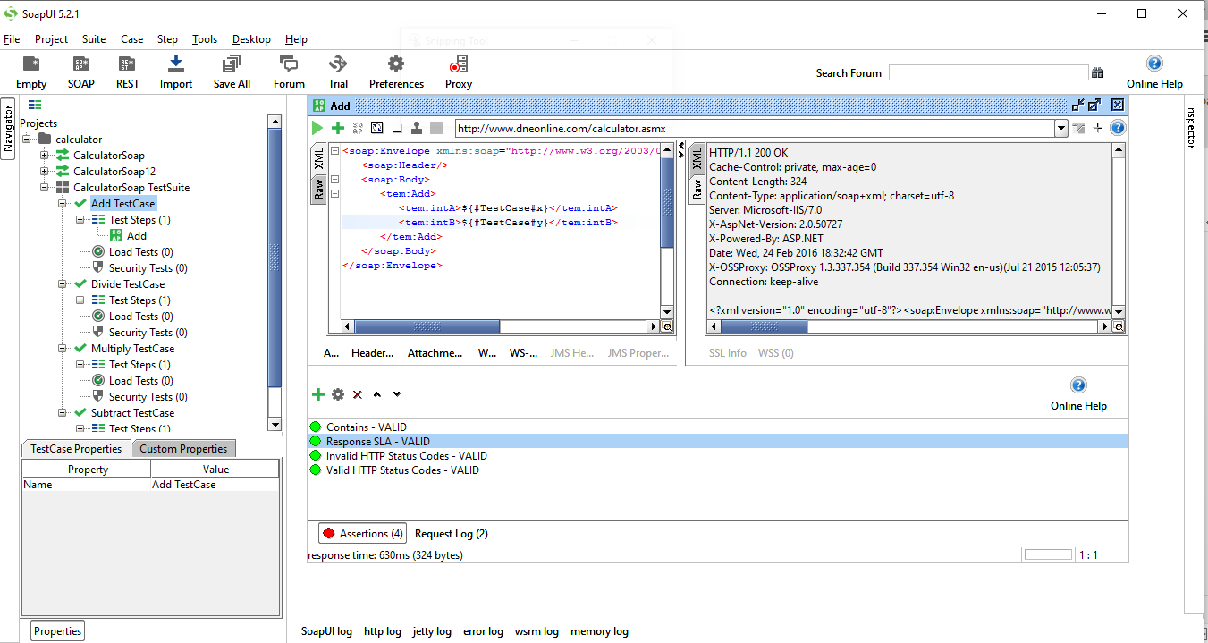
Basic Assertions for add functionality
Verify the sum of 5 & 4 is 9.: Contains Assertion
Verify the response is valid SOAP response: Soap Assertions
Verify the response has valid Http Code: Http status code assertion
Verify that response time is within boundaries.: Response status
Verify that <AddResult> attribute is present in the response.: Xpath assertion

Slide 14
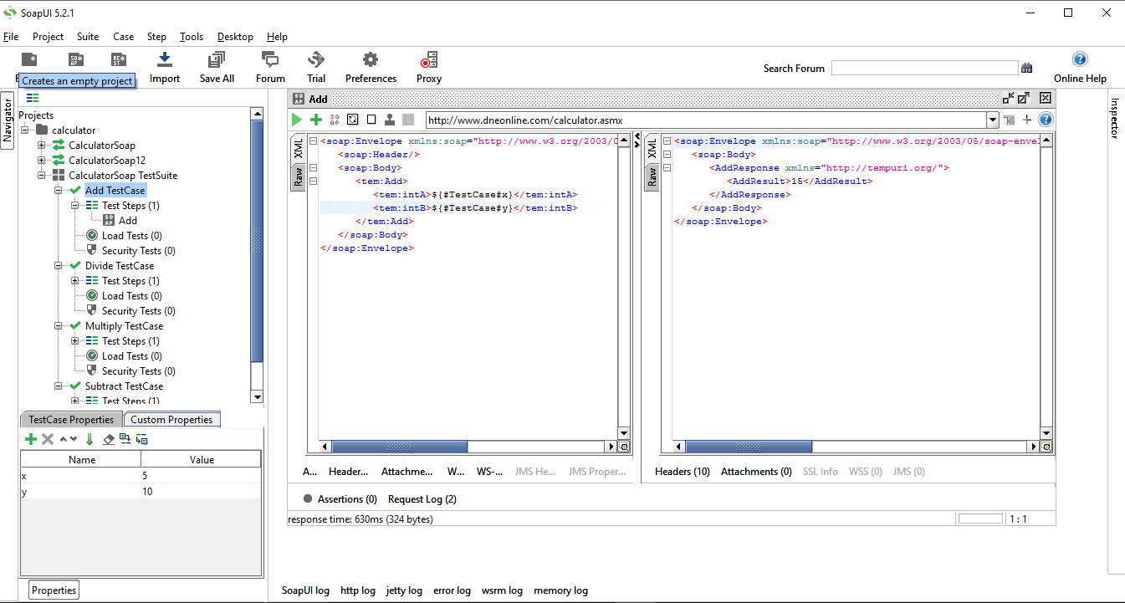
Properties
Most of the time hard coding the value of the parameter is not a good option because of the maintainability purposes. We can make use of properties to parameterize the values.
We can also maintain a separate *.properties file and import it so that our test case is totally data driven.

