Slide 1
Selenium

Slide 2
Selenium Fundamentals
Selenium is open source testing testing framework primarily used for testing web based application.
Supports multiple operating systems(Linux, Windows iOS) and multiple languages(java, C#, Perl).
Selenium 1.0 RC is depreciated ; Web Driver Selenium 2.0
Most applications don't allow to trigger the event. Web driver uses the browsers native languages to talk to the application.
Web Driver is an interface.
Few Implementing classes in the interface: AndroidDriver,AndriodWebDriver,InternetExplorerDriver,ChromeDriver

Slide 3
Setting up Selenium environment
Download Java
Download Eclipse
Create Java Project
Download Selenium jars
Import Selenium jars to Project
Running Selenium Basic program

Slide 4
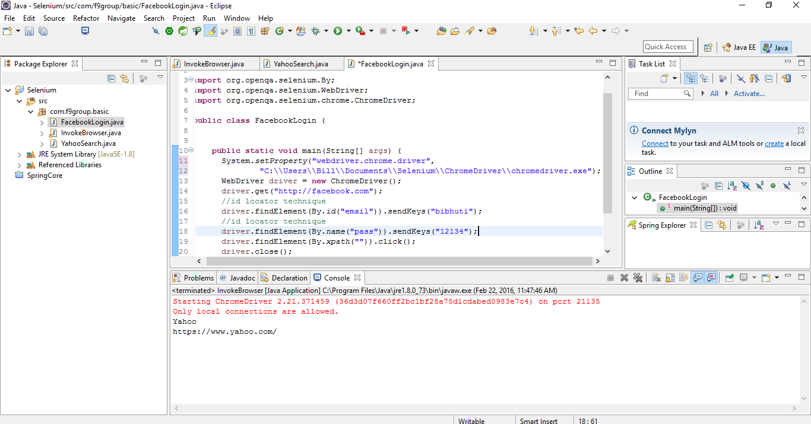
Create Java Project

Slide 5
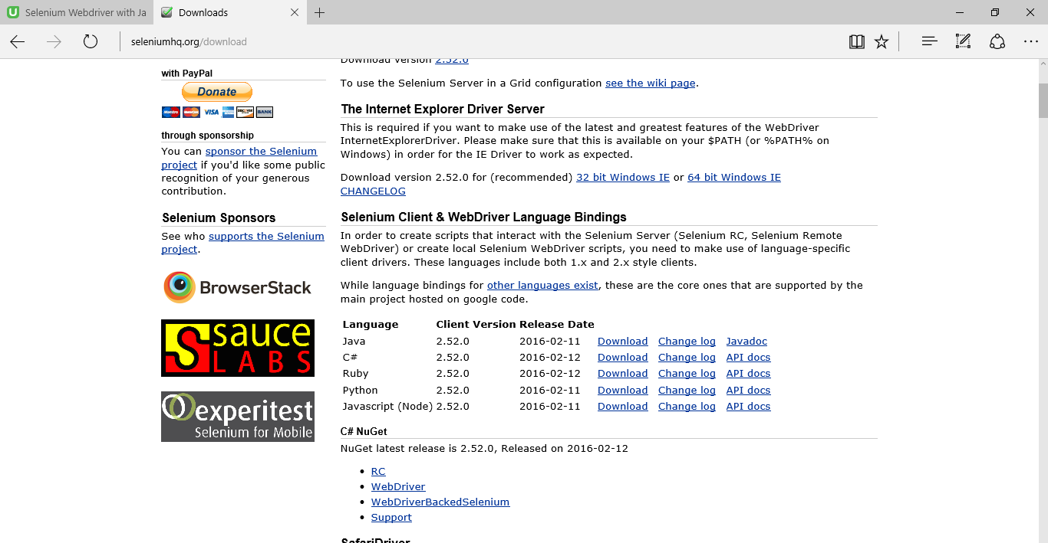
Download Selenium jars

Slide 6
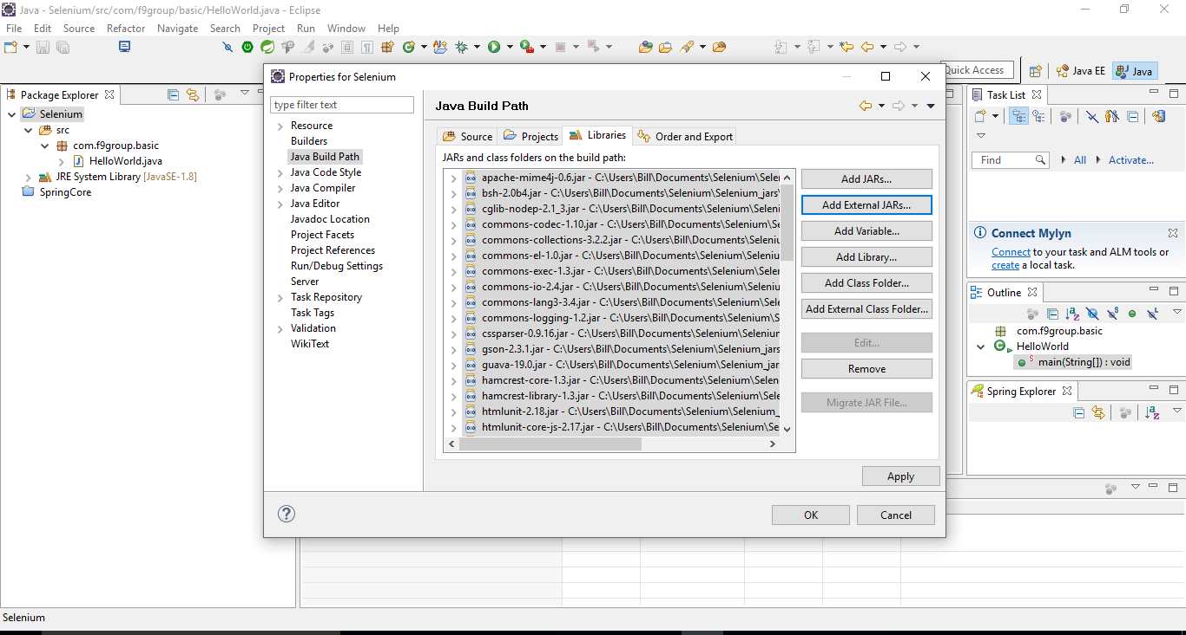
Import Selenium jars to your project

Slide 7
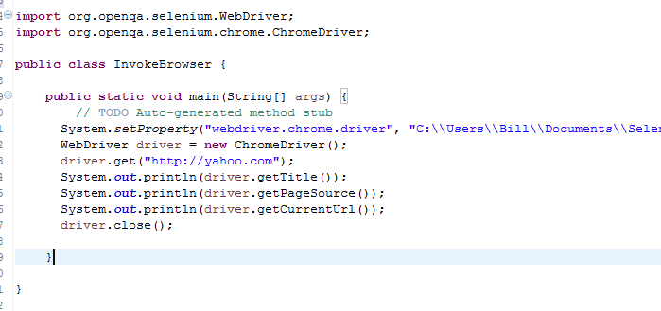
Running Selenium basic program

Slide 8
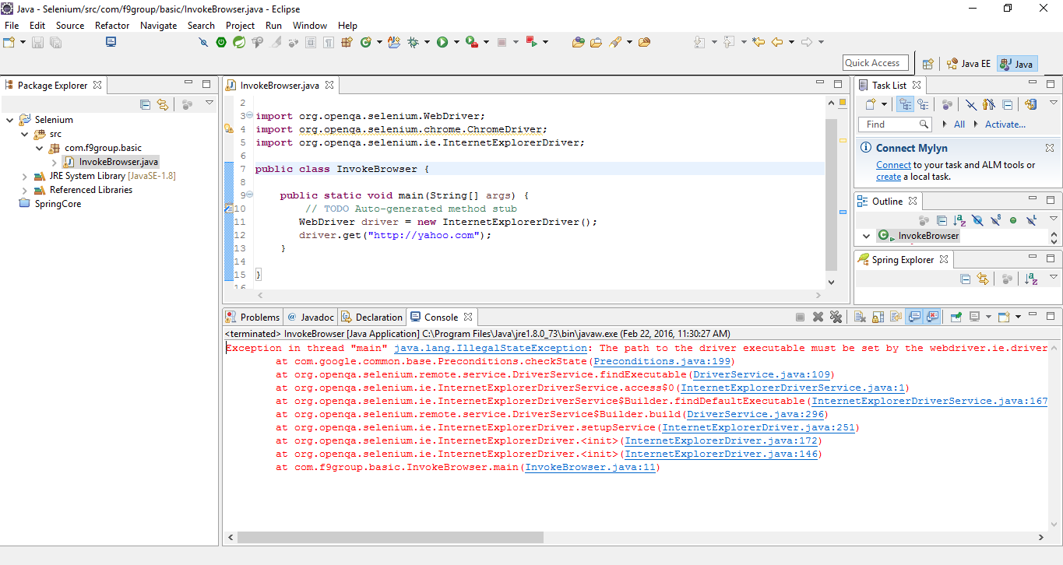
Gotchas when running the tests
When using chrome or IE without setting the system property to the driver; you will see the following error.
The path to the driver executable must be set by the webdriver.chrome.driver system property:

Slide 9
Gotcha cont'd
To resolve this issue you will have to download the driver and set the path to the driver as shown below in your java class.

Slide 10
Locator techniques to identify html objects
Xpath
ID
ClassName
Name
LinkText
CssSelector
Partial link text

Slide 11
Tools used to Identify HTML objects
Firefox : Install Firebug, firepath
Chrome : Chrome inspector
Internet Explorer : F12

