Slide 1
Spring Framework
Date

Slide 2
Modules
Introduction to Spring
Spring Bean Configuration
Data Access with Spring JDBC Template
Spring Web MVC

Slide 3
Introduction and Spring Bean Configuration

Slide 4
Introduction to Spring
The Spring Framework is an open source application framework.
It provides comprehensive infrastructure support for developing Java application
Spring deals with plumbing
Spring Integrates well with other enterprise services
Messaging, Remote Access
Spring makes data access easier to do
Manages Resources, supports all major data access technologies.

Slide 5
Why Spring?
Lightweight and minimally invasive development with POJO
Loose coupling through dependency injection
Declarative programming through aspects
Boilerplate code reduction through templates

Slide 6
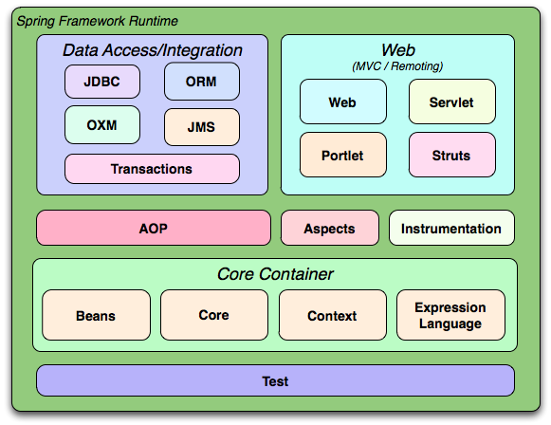
Spring Architecture

Slide 7
Spring core
Beans
Implements beanfactory through factory pattern
Core
It has dependency injection and IOC features
Context
Used for application context
Expression Language
Used for querying and manipulating objects at runtime

Slide 8
Inversion of Control Container(Dependency Injection)
Objects created by the IoC container is called as bean
The container can be configured by
Loading XML file
Writing Java configuration classes
The IoC container is responsible for managing object lifecycle, initializing them and configuring these objects by wiring them together.

Slide 9
Application Context
Spring comes with several flavors of Application Context.
Some of the important classes that implement Application Context are
ClassPathXmlApplicationContext: Defines that your configuration file is within the class path.
FileSystemXmlApplicationContext: Defines where your configuration is located.
XmlWebApplicationContext: Used for web applications

Slide 10
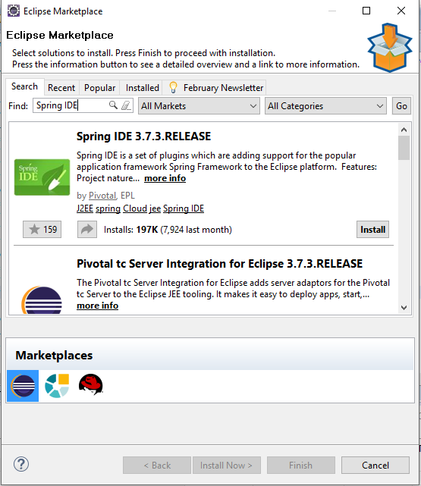
Getting hands dirty
Let us install spring IDE plugin in our workspace
Go to Help → Eclipse Market Place and type Spring IDE
Create a new Maven project.

Slide 11
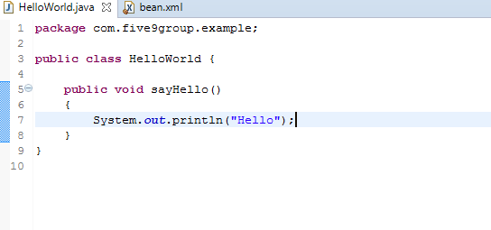
Getting hands dirty
Update pom.xml to include dependency for
spring-core
spring-context
spring-beans
Let’s create a simple Hello world. Create a package with the name
com.five9group.example
Create a class called HelloWorld in the package.

Slide 12
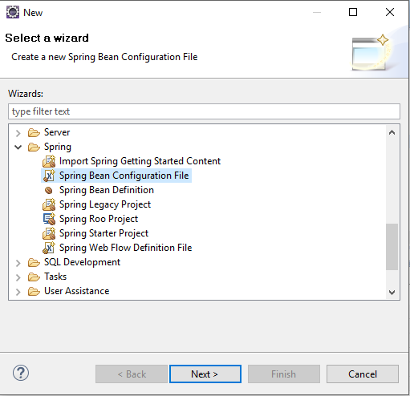
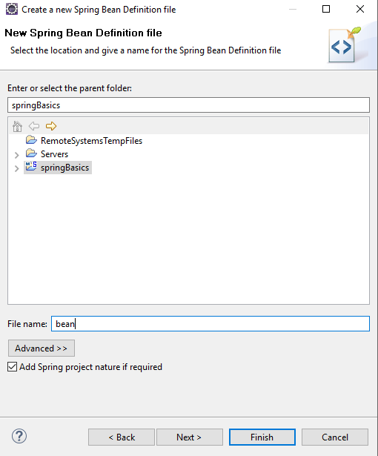
Creating a bean configuration file
Spring IDE can help us create a bean configuration file easily. Here is how…. Right click on the project → New→ Other

Slide 13
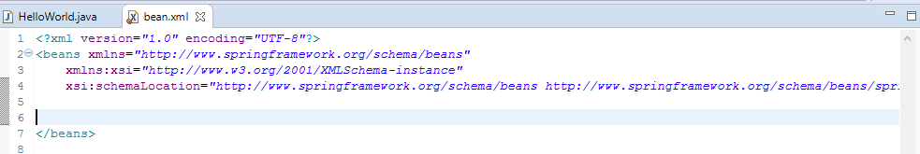
Adding to bean configuration file
An empty bean configuration file will look something like this…
Now let us add a bean definition for the class HelloWorld

Slide 14
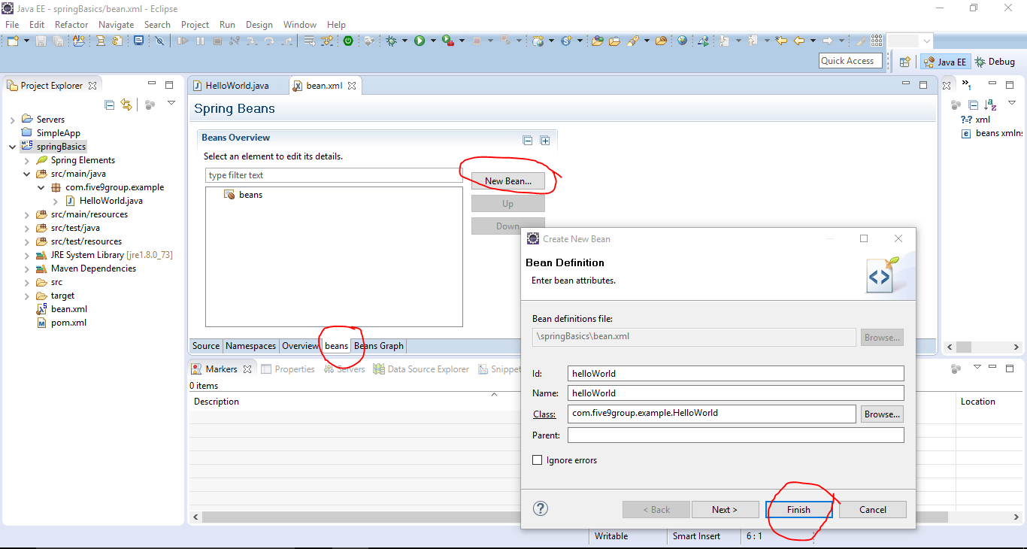
Adding bean definition for the class
Navigate to bean.xml file and add bean definition of HelloWorld class as shown below.

Slide 15
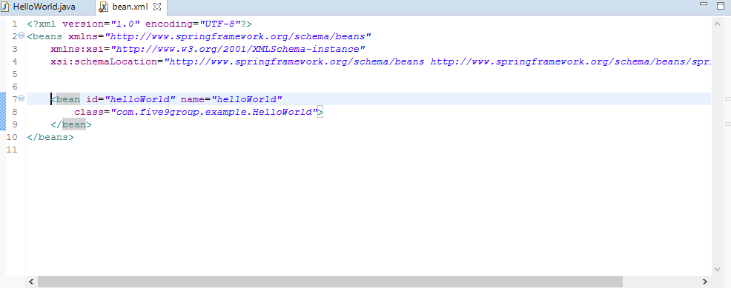
Added bean definition for HelloWorld
Here is the outcome of the bean definition we have just added.

Slide 16
Putting it together…
Let us now create a test class and call the method sayHello.
In the source folder “src/test/java” , create a package
com.five9group.example
Create a test class called TestingHelloWorld
We are now going to:
Create a main method,
Load the bean configuration in Application Context
Use that to invoke the sayHello method in HelloWorld

Slide 17
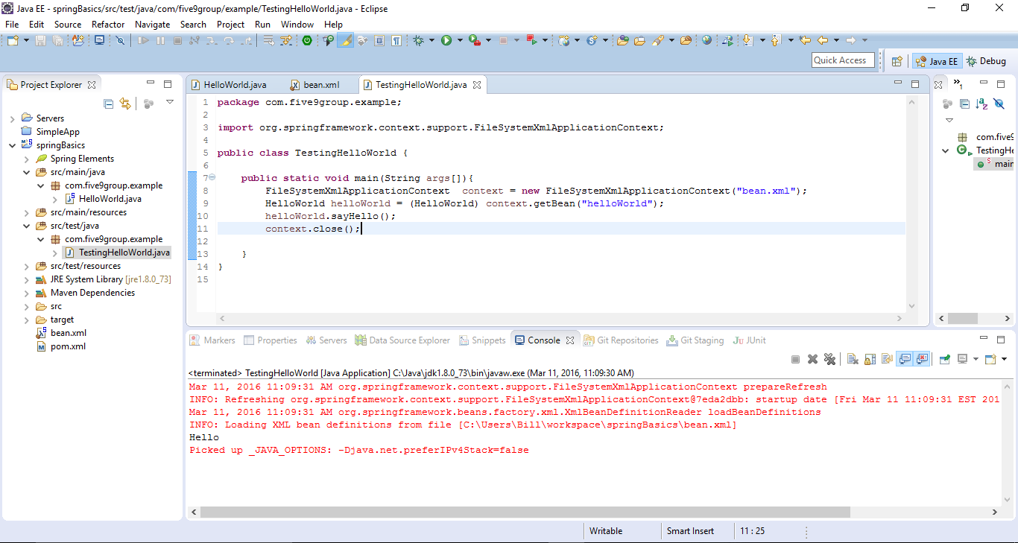
Run it as java application
The container created an instance of HelloWorld class and therefore we didn’t have to use the new keyword.

Slide 18
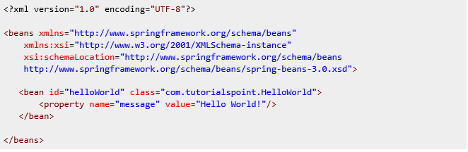
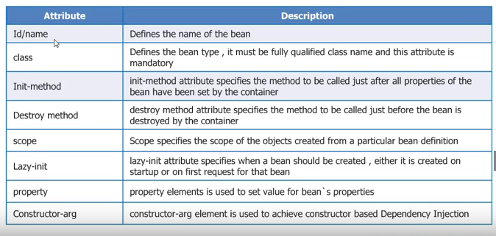
Attributes of a Bean Tag
A bean can have other attributes, the table below shows available attributes

Slide 19
Dependency Injection
Types of dependency injection supported by Spring
Setter injection: In this type of DI the required values are injected using the setter method to a bean.
Constructor injection: In this type of DI the bean is injected through the constructor arguments

Slide 20
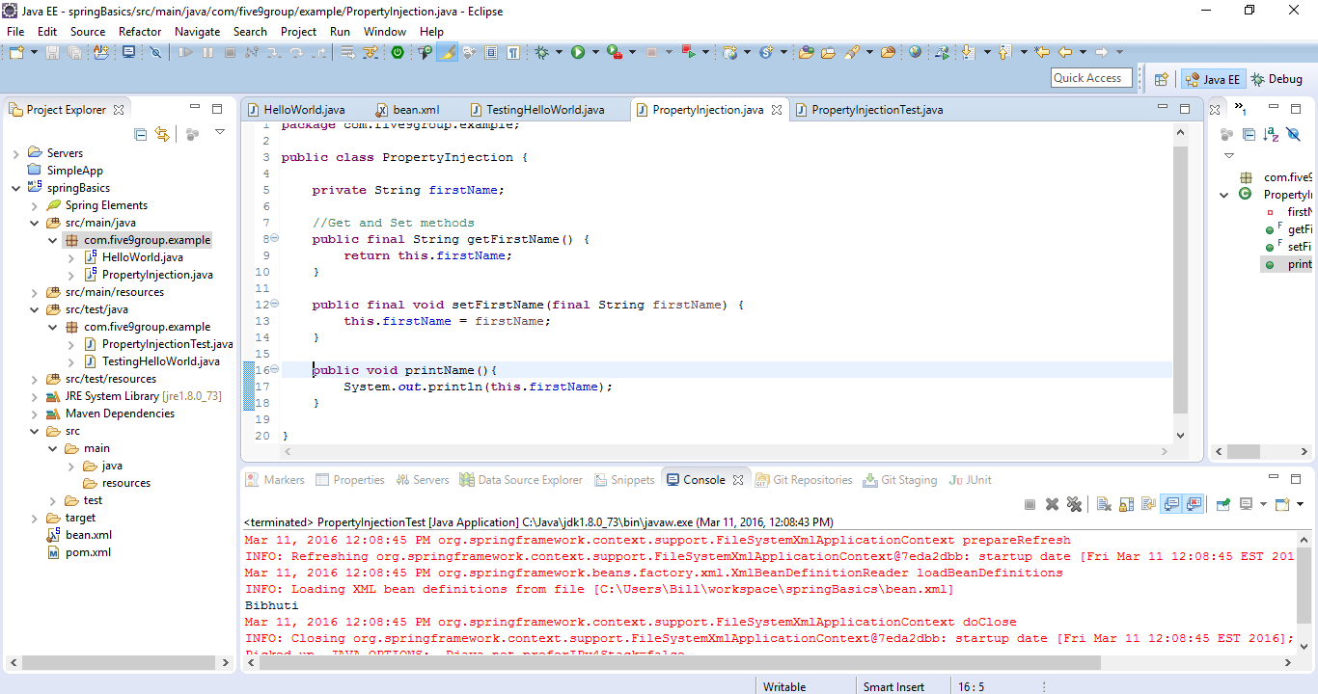
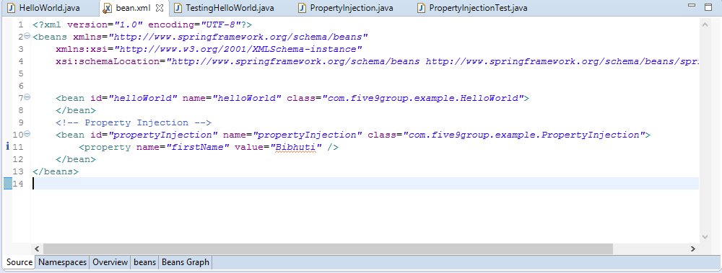
Setter Injection
This is how you inject values to a bean using setter injection

Slide 21
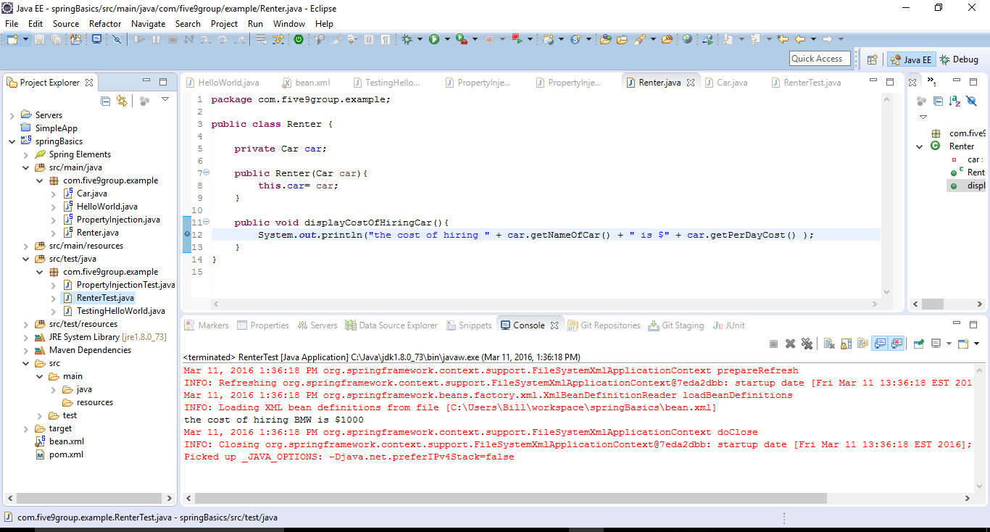
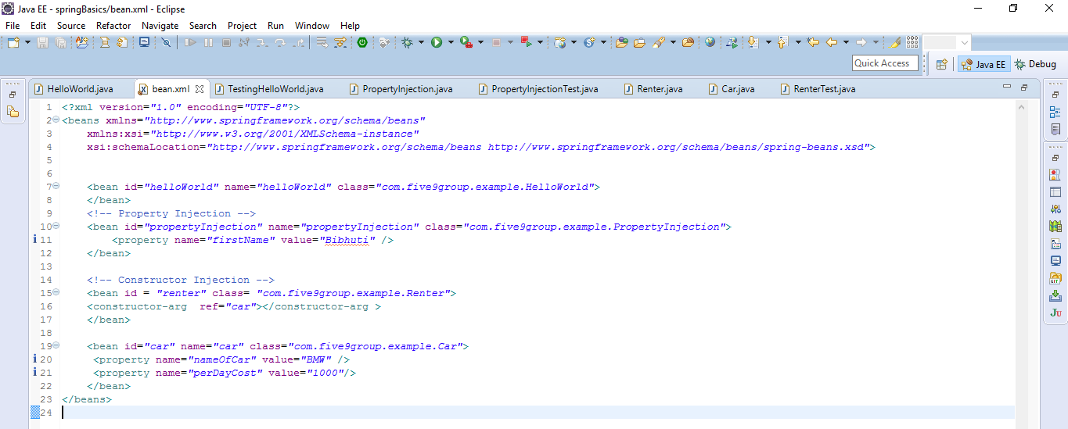
Constructor injection

Slide 22
Assignment
Update the PropertyInjection class to print first and last name.

Slide 23
Data Access with Spring JDBC Template

Slide 24
Spring Data Access
Spring makes data access easier because:
It manages resources for you
Provides API helpers
Supports all major data access technologies
Jdbc
Hibernate
JPA
ibatis

Slide 25
Getting hands dirty…
We are going to create database schema called testdb
Create a table called tutorials_tbl, insert data to the table
Use that table as a basis to create our domain class in java.
Define a DAO(Data Access object) or a service
Implement one of DAO’s method to insert data into the tutorials_tbl using Spring JDBC.

Slide 26
Getting the Database Server
Install MySql from the url below.
https://dev.mysql.com/downloads/mysql/
Create a database schema
shell> create database testdb;
Create a user and grant all privileges to that user.
shell> CREATE USER ‘bibhuti'@'localhost' IDENTIFIED BY 'password';
shell>GRANT ALL PRIVILEGES ON * . * TO ‘bibhuti'@'localhost';
Login as the created user:
shell> mysql -u <bibhuti> –p password testdb

Slide 27
Create a table
Create a table in the schema
shell> use testdb;
shell> CREATE TABLE tutorials_tbl(
tutorial_id INT NOT NULL AUTO_INCREMENT,
tutorial_title VARCHAR(100) NOT NULL,
tutorial_author VARCHAR(40) NOT NULL,
tutorial_description VARCHAR(100),
PRIMARY KEY ( tutorial_id ) );

Slide 28
Inserting data in the table
INSERT INTO tutorials_tbl
(tutorial_title, tutorial_author, tutorial_description )
VALUES ("JAVA Tutorial", "Sanjay", “Spring 3.0 Basic example”);
INSERT INTO tutorials_tbl
(tutorial_title, tutorial_author, tutorial_description )
VALUES ("Learn MySQL", "Abdul S", “Spring Security”);
INSERT INTO tutorials_tbl
(tutorial_title, tutorial_author, tutorial_description )
VALUES ("Learn PHP", "John Poul", “Spring by example”);

Slide 29
Spring JDBC
Spring JDBC is the central framework class that manages all the database communication and exception handling
JdbcTemplate class executes SQL queries, update statements and stored procedure calls, performs iteration over ResultSets and extraction of returned parameter values.
Instances of the JdbcTemplate class are threadsafe once configured. So you can configure a single instance of a JdbcTemplate and then safely inject this shared reference into multiple DAOs

Slide 30
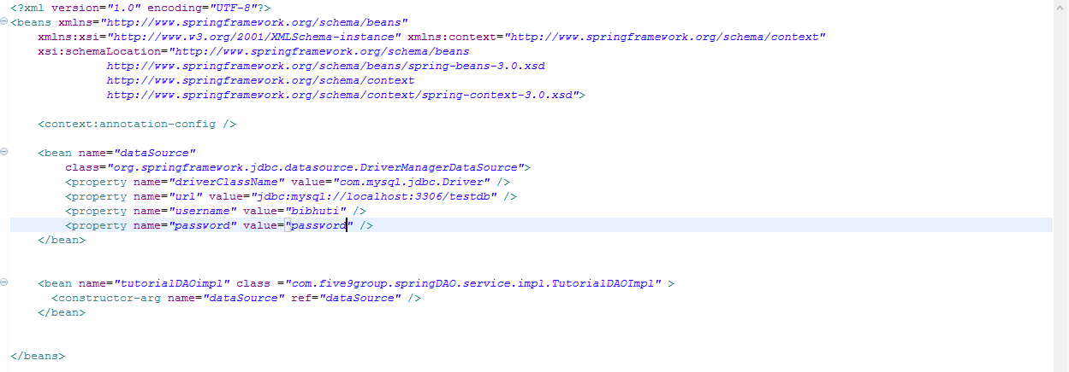
Configuring Data Source and Injecting it.
As simple as creating a bean of class(org.springframework.jdbc.datasource.DriverManagerDataSource) and inject it to our DAO bean as shown below.

Slide 31
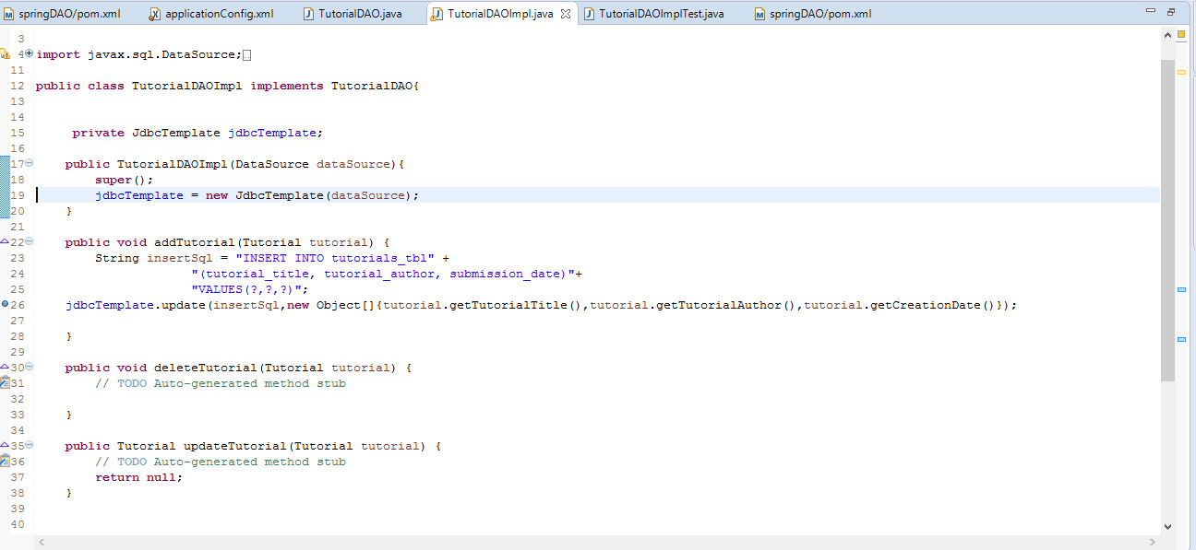
Putting it together and executing
All we do is supply an instance of dataSource to our JdbcTemplate class.
Look at the number of lines of code we didn’t have to write.

Slide 32
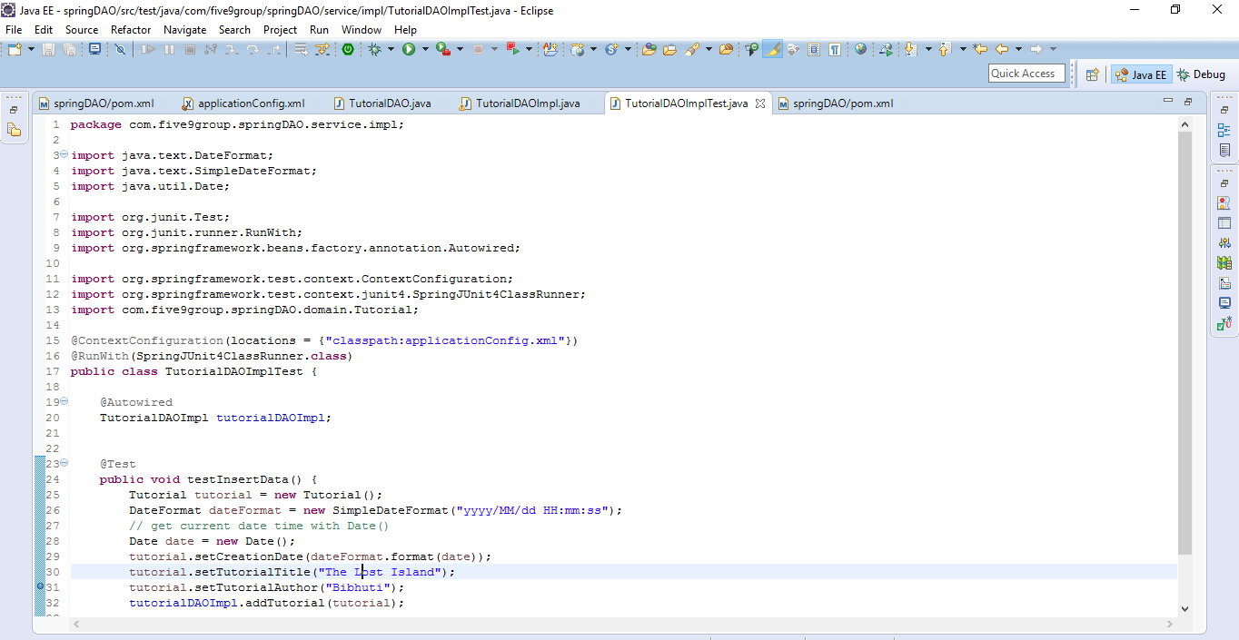
Write a Junit test and run it…

Slide 33
Assignment
Update the code base to include functionalities to
Update the row by Id.
Delete the row by Id.
Also write unit test for them.

Slide 34
Spring Web MVC

Slide 35
Steps for developing a Spring MVC application
Deploy a Dispatcher Servlet(one-time)
Implement a request handler(controller)
Implement the view(s)(jsp,jsf)
Register the controller with DispatcherServlet
Deploy application to any container and test

Slide 36
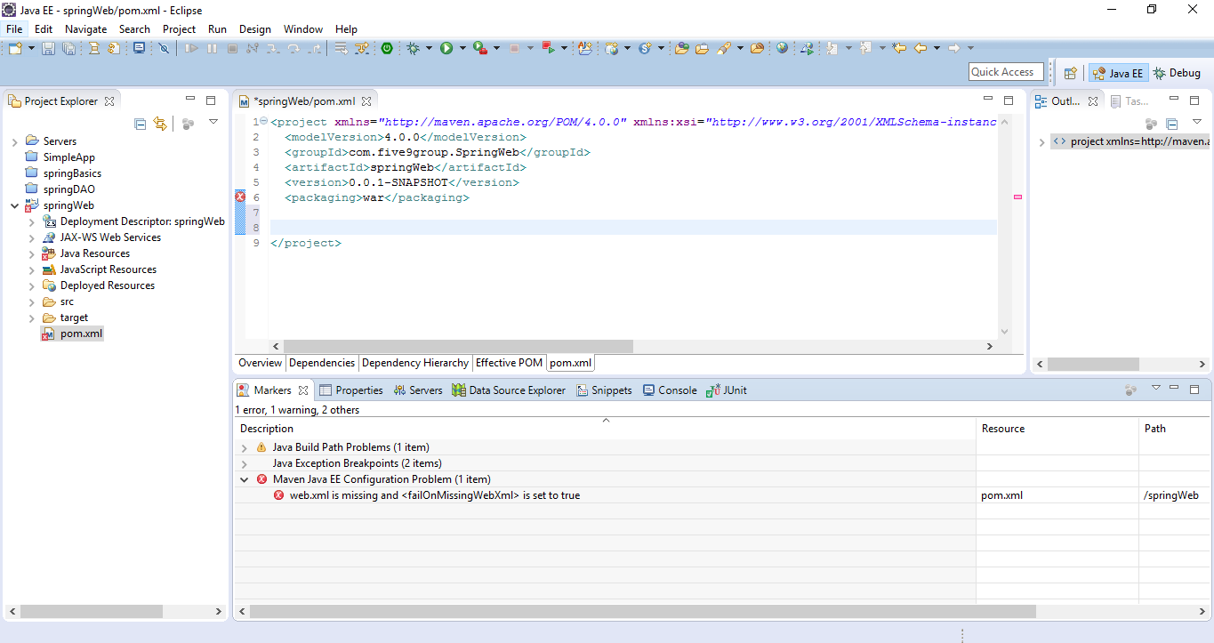
Getting hands dirty ….Create a maven project
Let us start by creating a new maven project.
When you create a maven project for a web application, the packaging should be a war file.
When you create a war packaging structure and there is no web.xml file, then eclipse will complain about it.

Slide 37
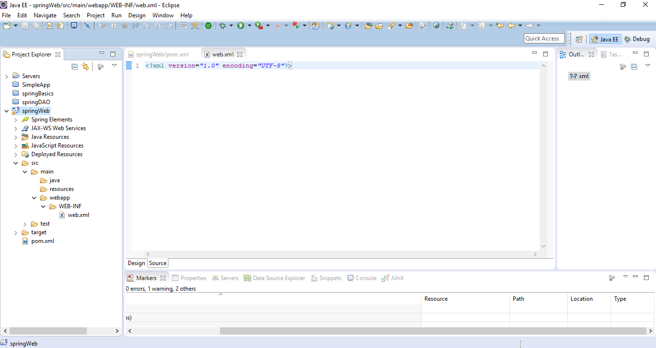
Creating web application folder structure.
A web application should look like this.
Create a WEB-INF folder inside webapp folder.
Add web.xml file inside webapp folder

Slide 38
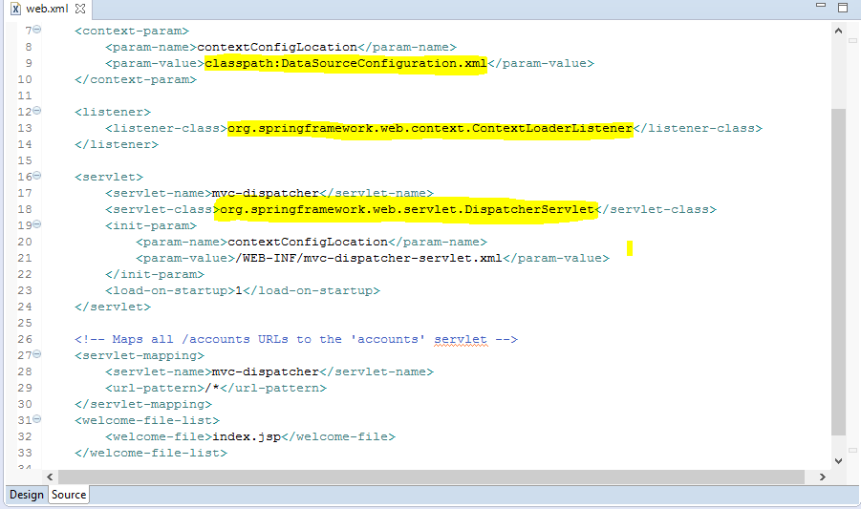
Investigating content inside web.xml file
Spring can be initialized within a webapp by just adding a Spring provided servlet listener.

Slide 39
Dispatcher Servlet
Is defined in web.xml and is core to spring mvc
Dispatcher servlet coordinates all request handling activities
Delegates to web infrastructure beans
Invokes user web components
Users spring for its configuration
Creates separate “servlet” application context
The location of the dispatcher servlet configuration file is defined in web.xml

Slide 40
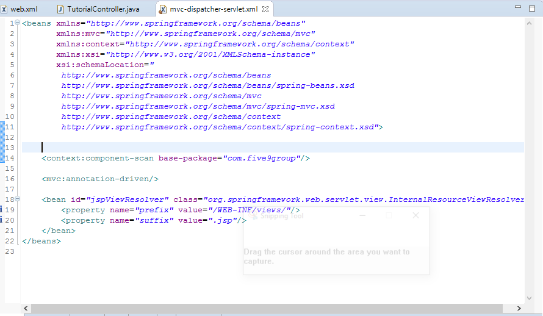
Mvc-dispatcher-servlet.xml
<mvc:annotation-driven/> Tells dispatcher servlet that you are using annotations
<context:component-scan base-package="com.five9group"/>Look for annotations starting from folder structure anything below com.five9group

Slide 41
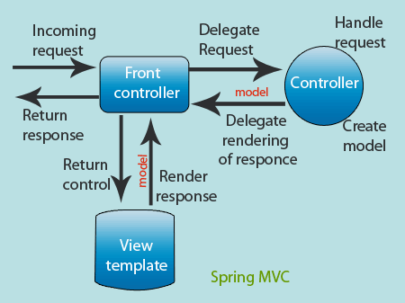
Request Processing Lifecycle

Slide 42
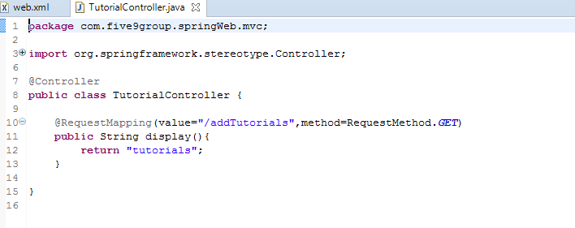
Handlers/Controllers
Handlers are typically called controllers and are usually annotated with @Contoller
@RequestMapping tells spring what method to execute when processing a particular request.
Controllers typically returns a view name
Controllers may return null or void

Slide 43
View Resolvers
The view resolvers are defined in the dispatcher servlet configuration file.
The Dispatcher Servlet delegates to a View resolver to map returned view name to view implementation.
The default view resolver treats the view name as a Web Application-relative file path.
There are different implementations of view resolvers.
org.springframework.web.servlet.view.InternalResourceViewResolver
org.springframework.web.servlet.view.UrlBasedViewResolver

Slide 44
Build and deploy ‘springWeb’ application
Check out the springWeb application from GitHub from the following location.
Run maven command to generate a war file.
Download Tomcat Server from Apache site and extract it to location of your choice.
Configure eclipse to start and stop the server from the IDE.
Deploy the application to the Server.
Start the server and test the url.

Slide 45
Deployed application
When you access http://localhost:8080/springWeb. You should be seeing something like this.

Slide 46
Assignment
Based on the code you updated in Spring Data Access module, develop UI components to update, delete tutorials so that the user can interact with the application.
Also write unit and selenium tests for them.

