Slide 1
Software Configuration Management
April 2016

Slide 2
Modules
Version Control (Git)
Application Build Tools(Maven)
Creating Maven project using eclipse
Running maven goals using eclipse
Configuring Git (local and remote) using eclipse
Pushing the project to remote Git server
Configure workspace to import existing project

Slide 3
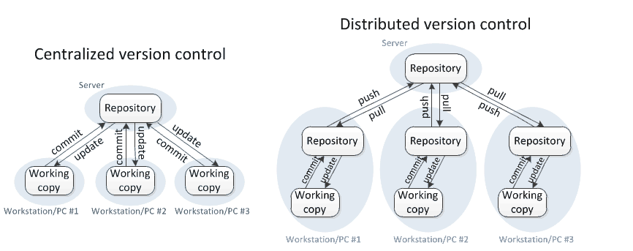
Version Control System
Revision Control and tracks who made what changes and when.
Distributed (Git) and centralized version control(subversion)

Slide 4
Distributed Version Control System (Git/GitHub)
GitHub is a free and open source distributed version control system.
The basic Git workflow goes something like this:
You modify files in your working directory.
You stage the files, adding snapshots of them to your staging area.
You do a commit, which takes the files as they are in the staging area and stores that snapshot permanently to your Git directory.

Slide 5
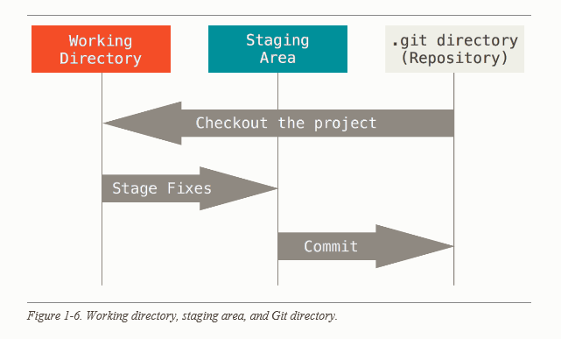
Distributed Version Control System

Slide 6
Terminologies
Trunk: Master copy of a piece of software.
Branch: Copy of trunk, usually a work in Progress.
Merge: Updates made from branch to trunk
Checkout: To create a local working copy from the repository.
Commit :To write or merge the changes made in the working copy back to the repository.
Push/checkin: Update remote repository with changes from the local repository.

Slide 7
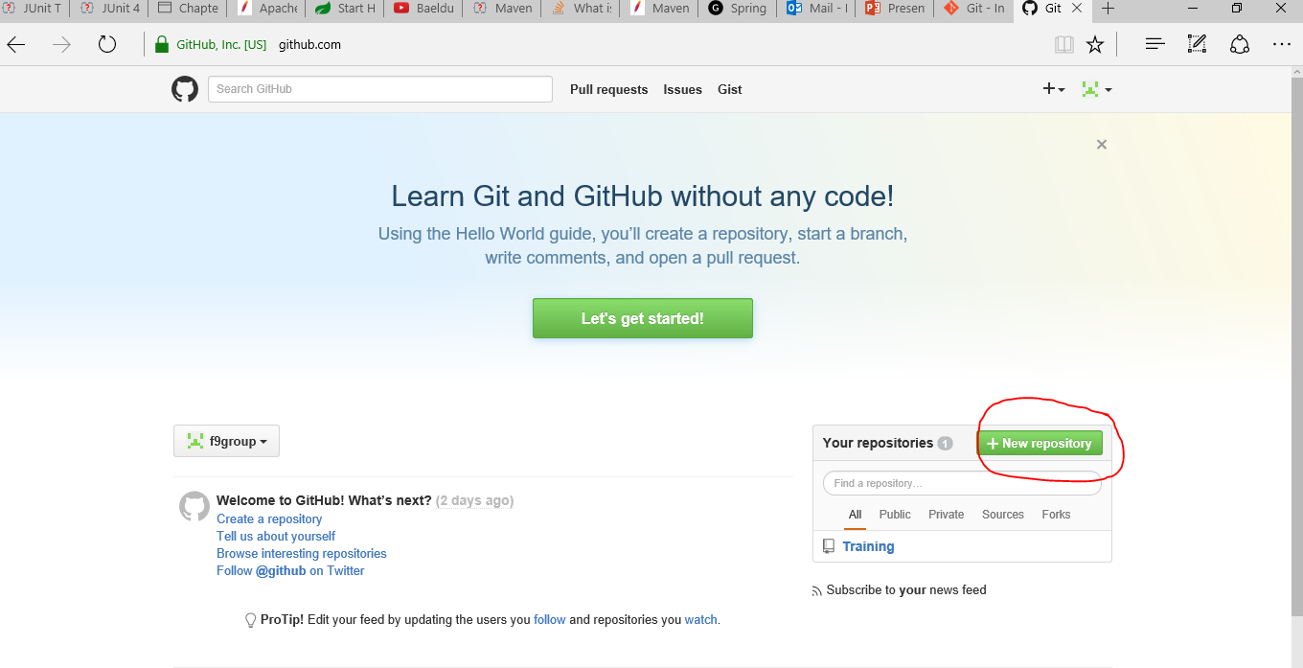
Create an account in GitHub
Lets create a free public account in GitHub by providing necessary details
https://github.com/
Create a repository in github from the home page and call it "workspace".

Slide 8
Application Build Tools
Maven is a build automation tool.
It built using a plugin-based architecture that allows it to make use of any application controllable through standard input.
You will need Java to run Maven.
After you install Maven you can create a maven project using the following command.

Slide 9
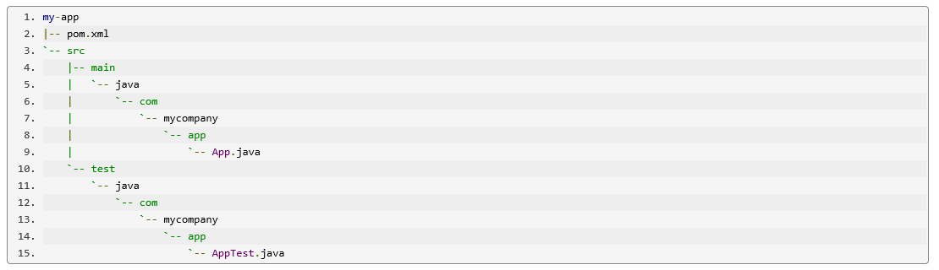
Maven project structure
Every maven project has the following structure.

Slide 10
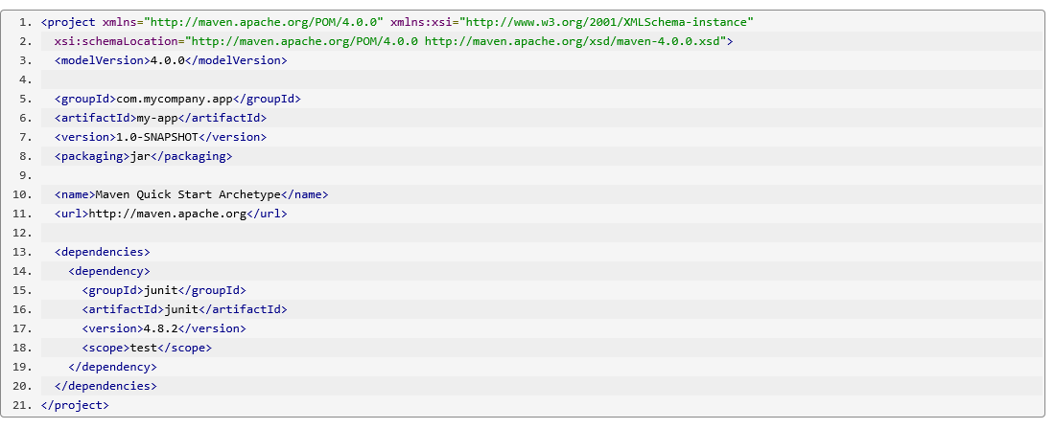
Pom.xml
The pom.xml file is the core of a project's configuration in Maven.
It is a single configuration file that contains the majority of information required to build a project.
A typical file will look some thing like this.

Slide 11
Maven Phases
Following are the most common default lifecycle phases in maven
validate: validate the project is correct and all necessary information is available
compile: compile the source code of the project
test: test the compiled source code using a suitable unit testing framework. These tests should not require the code be packaged or deployed
package: take the compiled code and package it in its distributable format, such as a JAR.
integration-test: process and deploy the package if necessary into an environment where integration tests can be run
verify: run any checks to verify the package is valid and meets quality criteria
install: install the package into the local repository, for use as a dependency in other projects locally
deploy: done in an integration or release environment, copies the final package to the remote repository for sharing with other developers and projects

Slide 12
Configuring Eclipse to use Maven and Git
Download Eclipse IDE for JAVA EE developers https://eclipse.org/downloads/index.php?show_instructions=TRUE
Download eclipse compatible version of JAVA and install JDK and JRE(1.8).
Extract the zip folder to the destination of your choice.
Make a note of where JDK and JRE are installed on your machine.

Slide 13
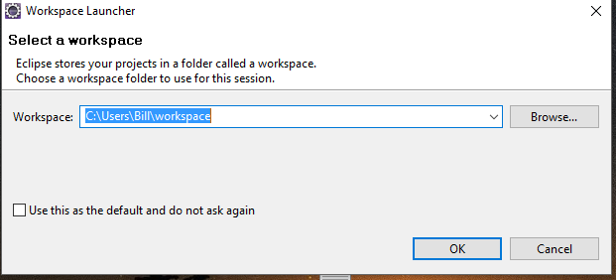
Open eclipse
Tools for Java developers creating Java EE and Web applications, including a Java IDE, tools for Java EE, JPA, JSF, Mylyn, EGit and others
Define a workspace as shown below

Slide 14
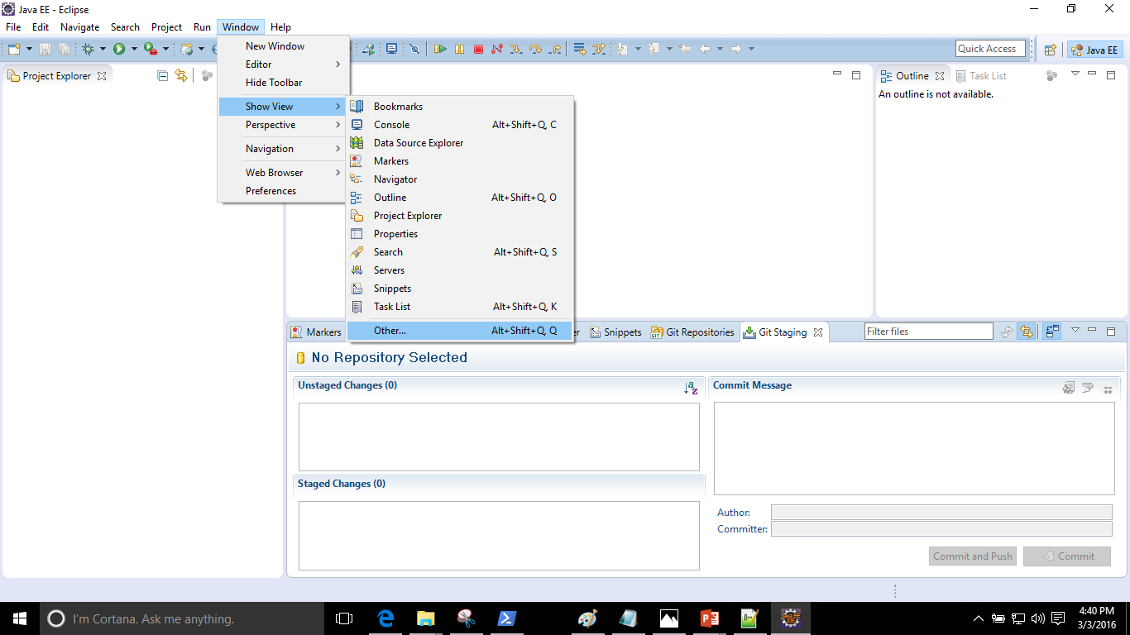
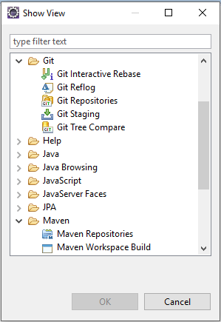
Verify that Maven and Git plugins are available

Slide 15
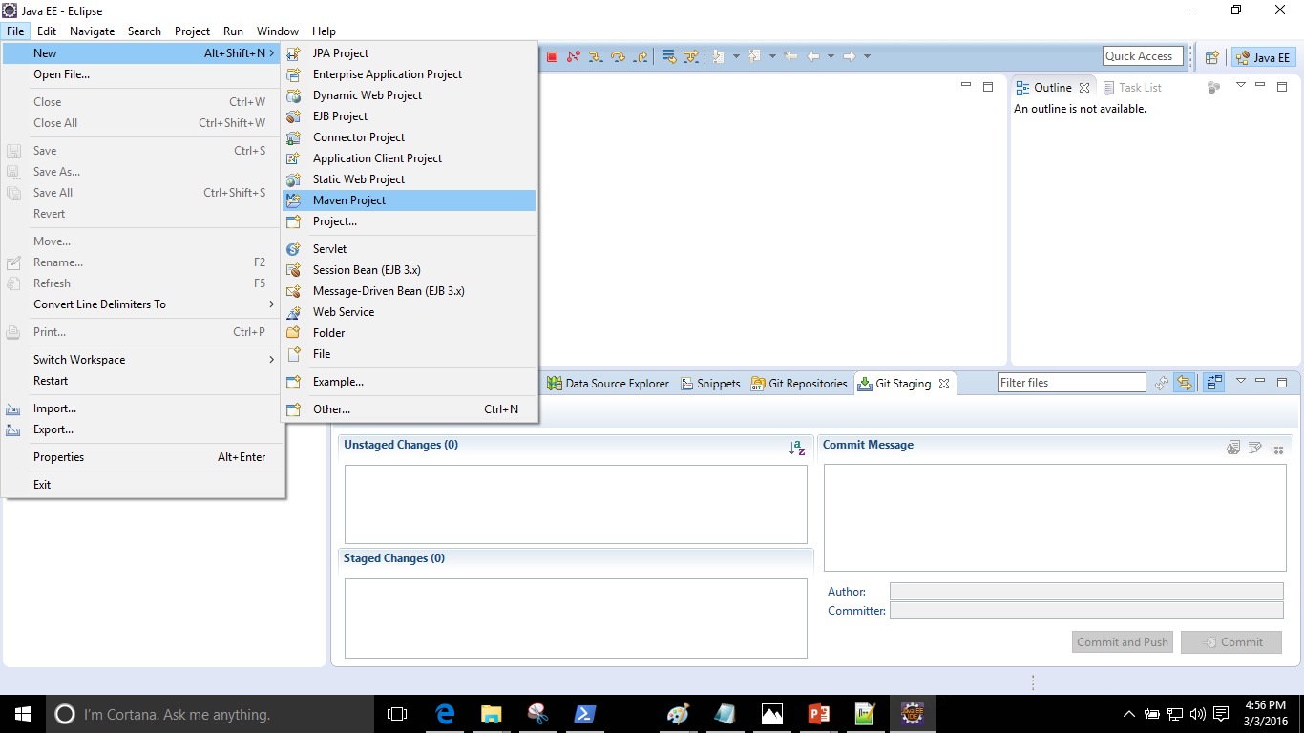
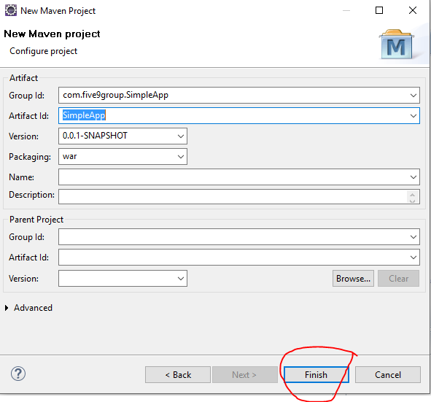
Creating a Maven project in Eclipse

Slide 16
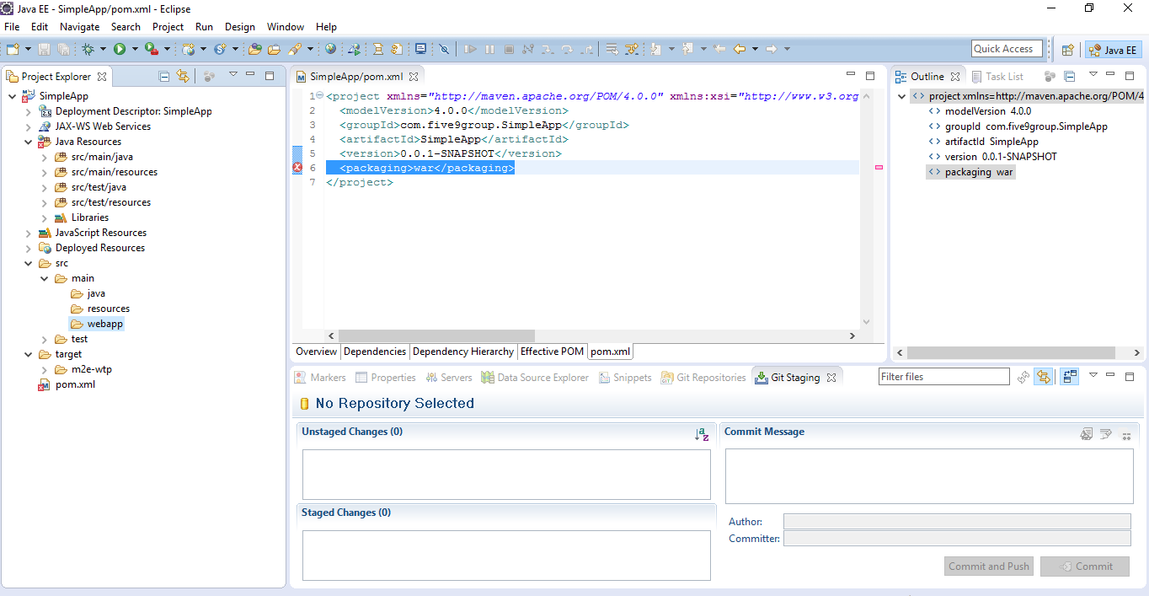
Creating a maven Project in eclipse

Slide 17
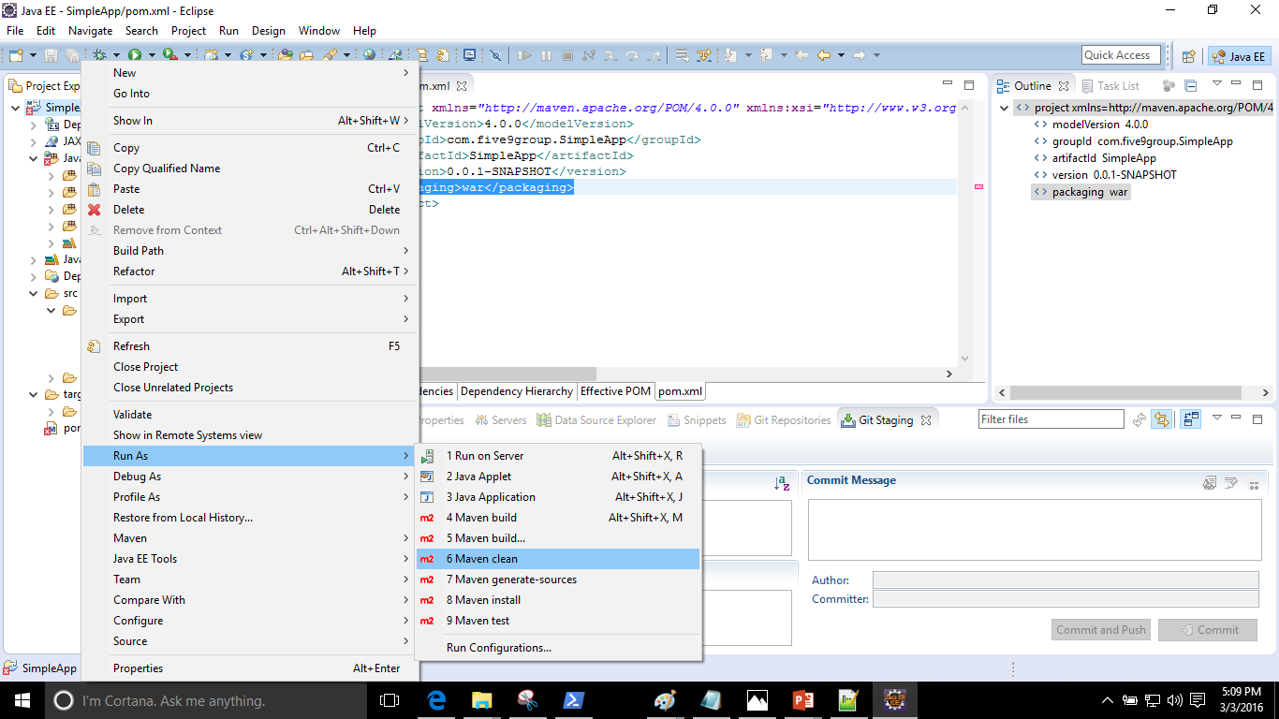
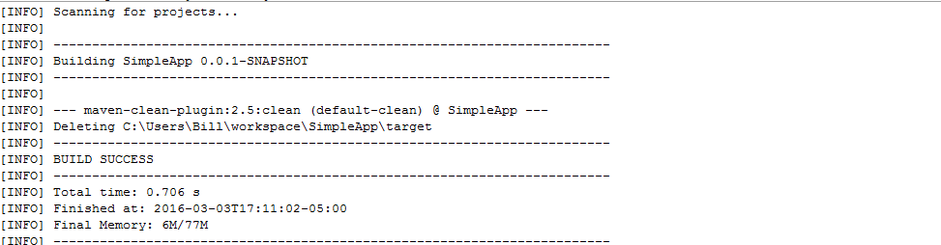
Running Maven Goals for the project

Slide 18
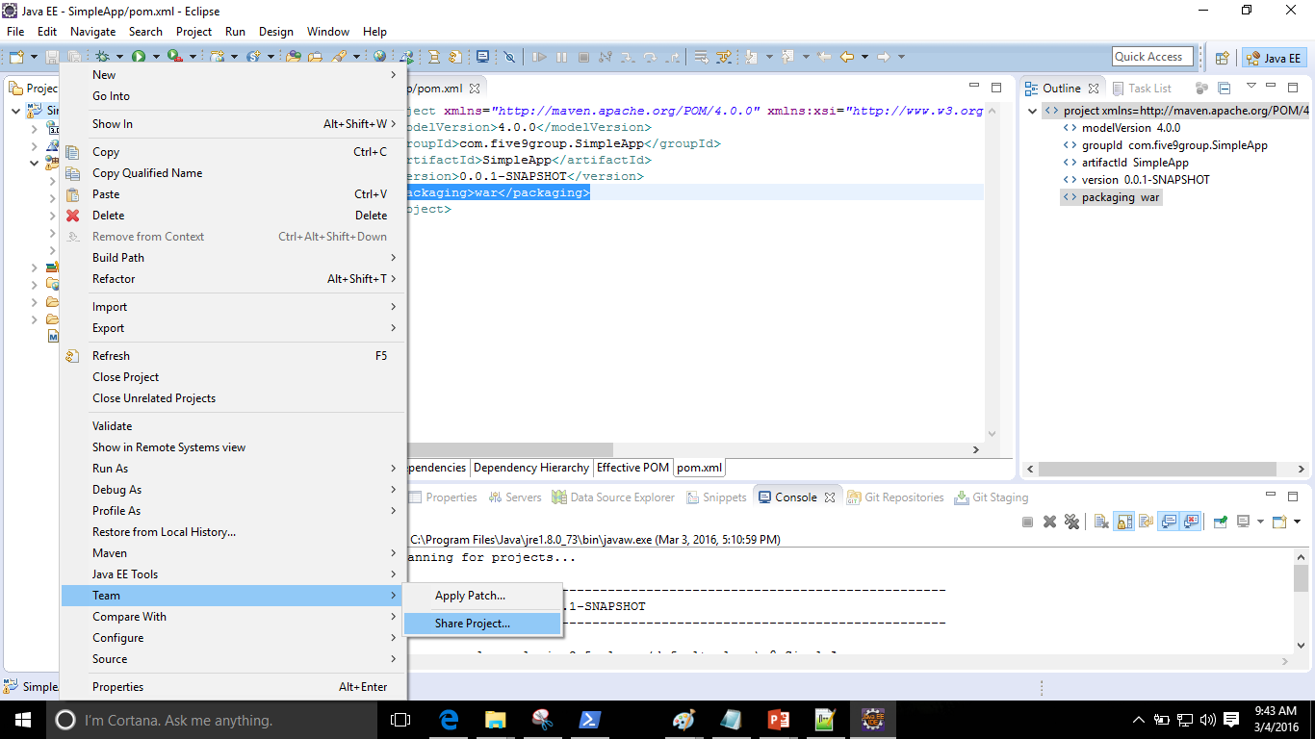
Configuring Local repository
Let us create a local repository

Slide 19
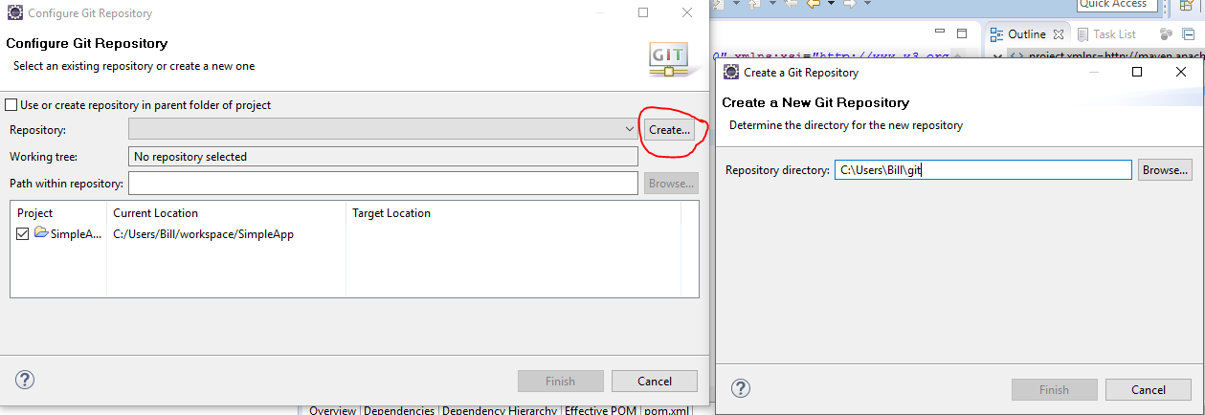
Configuring Local repository
Hit create button and enter the name of the repository you want to create.

Slide 20
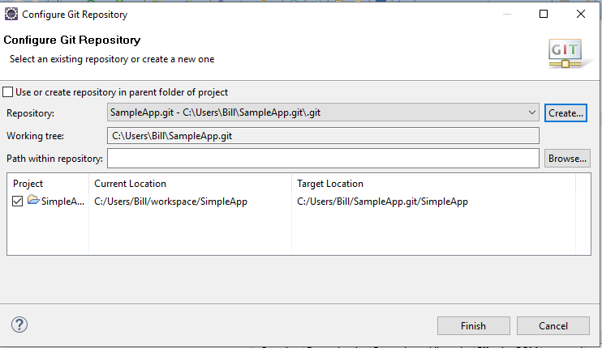
Configuring Local repository

Slide 21
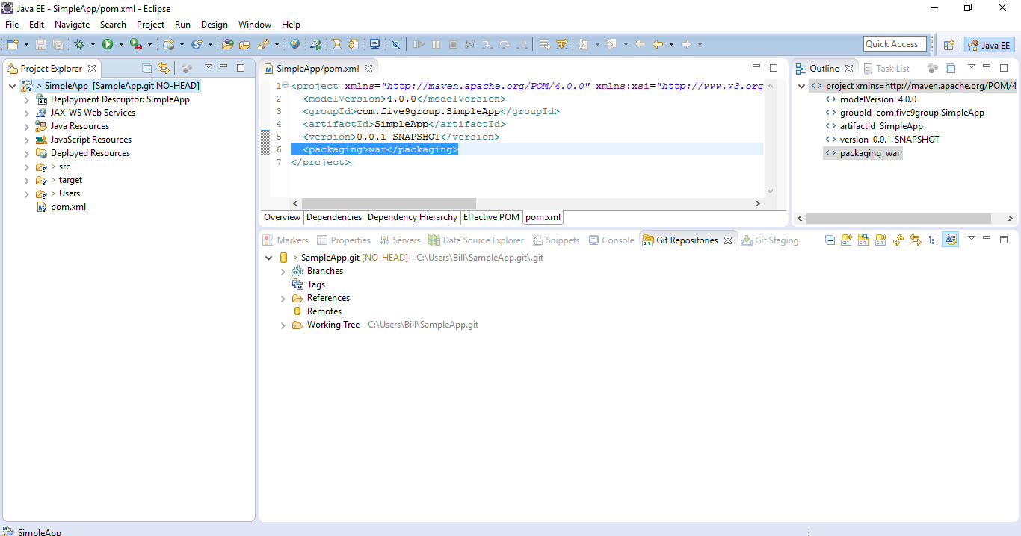
Git Repository view
After you get to Git Repository view you will see something like the snapshot below.
Now you are ready to commit the changes to local repository.

Slide 22
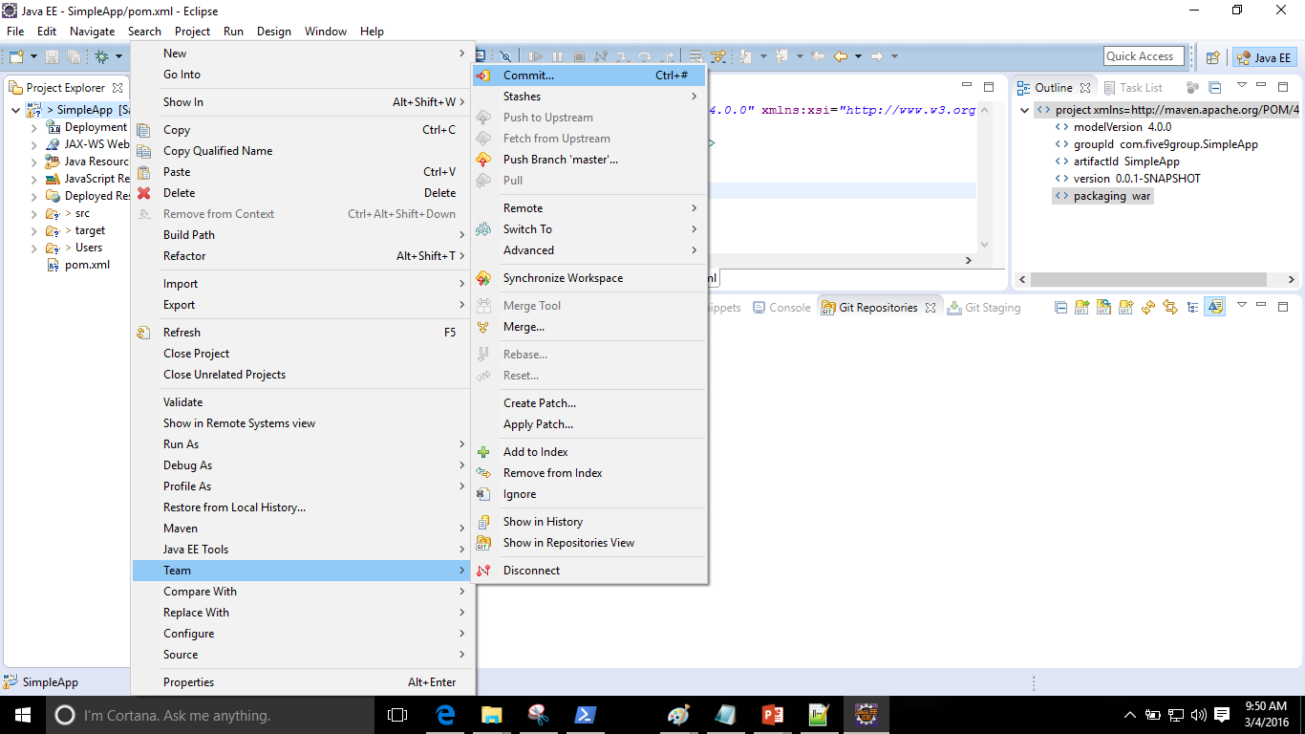
Committing changes to Local Repository
Navigate as shown below to commit the changes

Slide 23
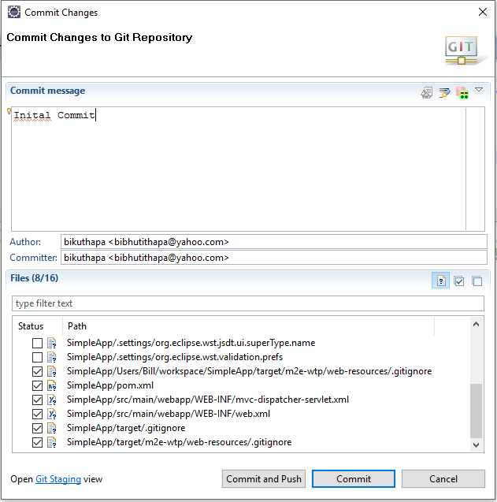
Committing the changes in Local Repository
Git forces you to enter comments before committing.
We have added our files by committing the changes and staged it; waiting it to be pushed.

Slide 24
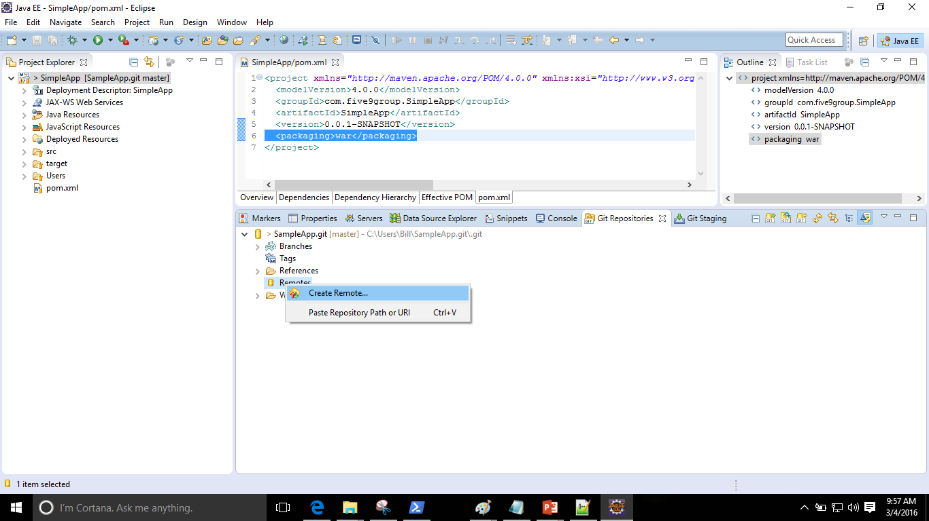
Creating Remote
We are ready to push the project to our workspace repository that we created earlier.

Slide 25
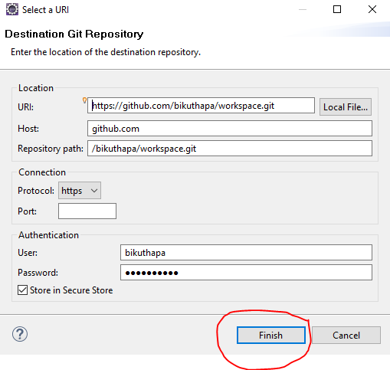
Pointing to our remote server
Specify where your remote server is along with credentials to connect.

Slide 26
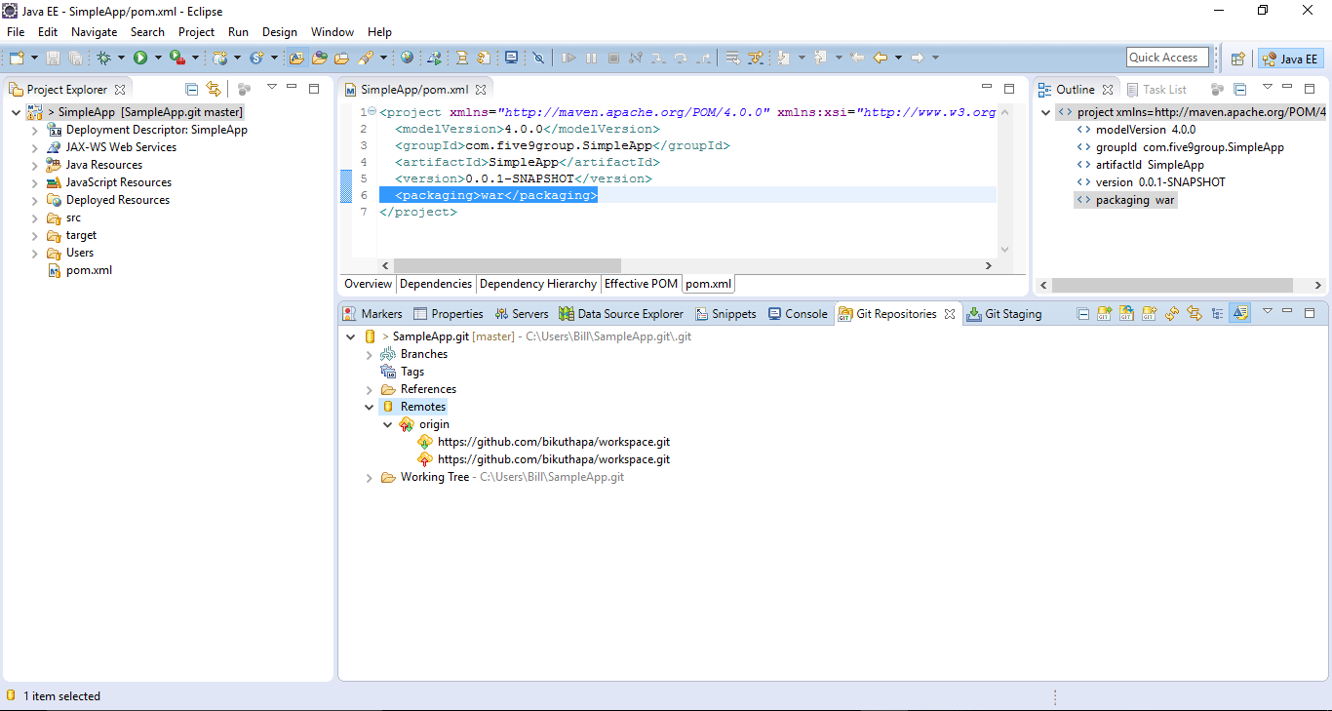
Successful remote creation
If you have successfully configured the remote server, in your repository view, you should see push and pull icons as shown below.

Slide 27
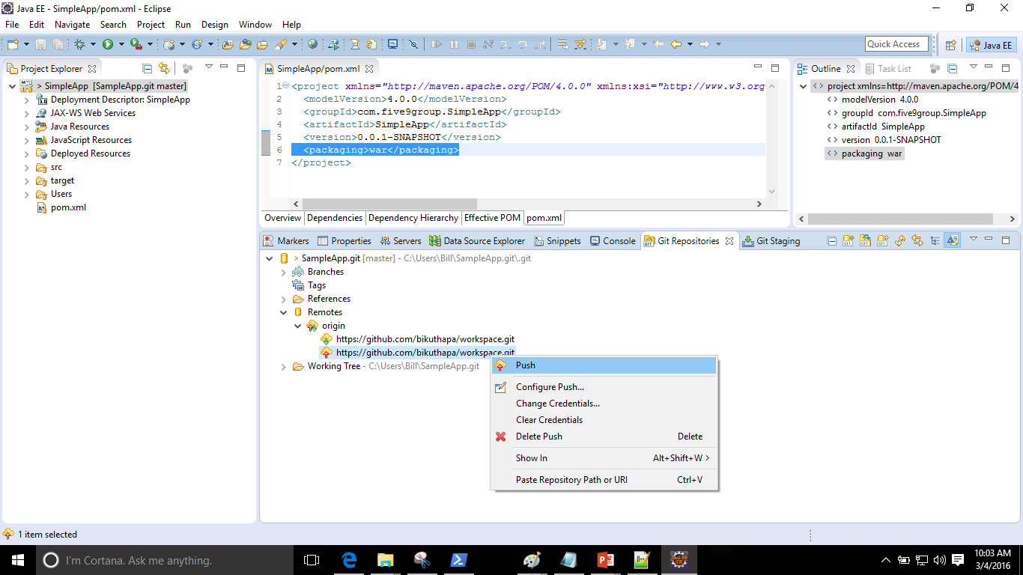
Configuring Push
Once push is configured pull is automatically configured.

Slide 28
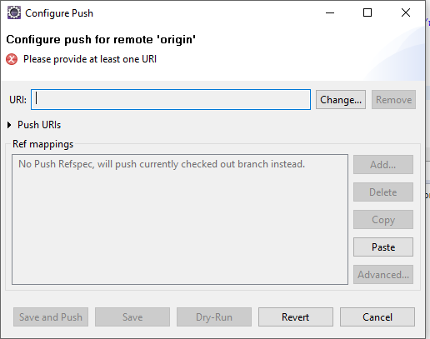
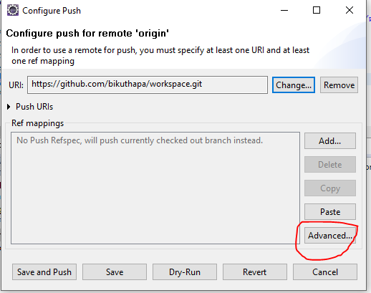
Configuring push cont’d

Slide 29
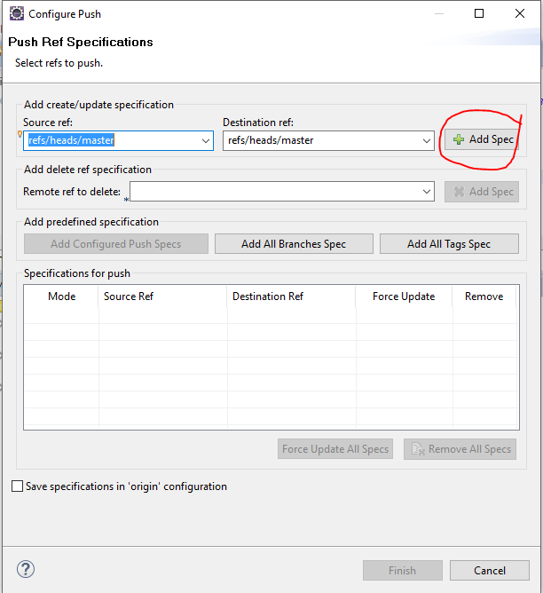
Configuring push cont’d

Slide 30
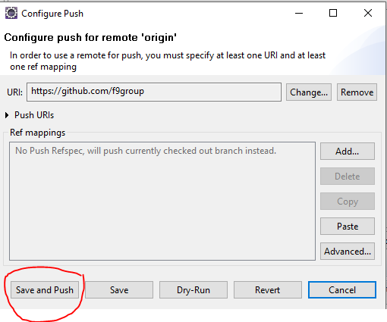
Save the configuration and Push

Slide 31
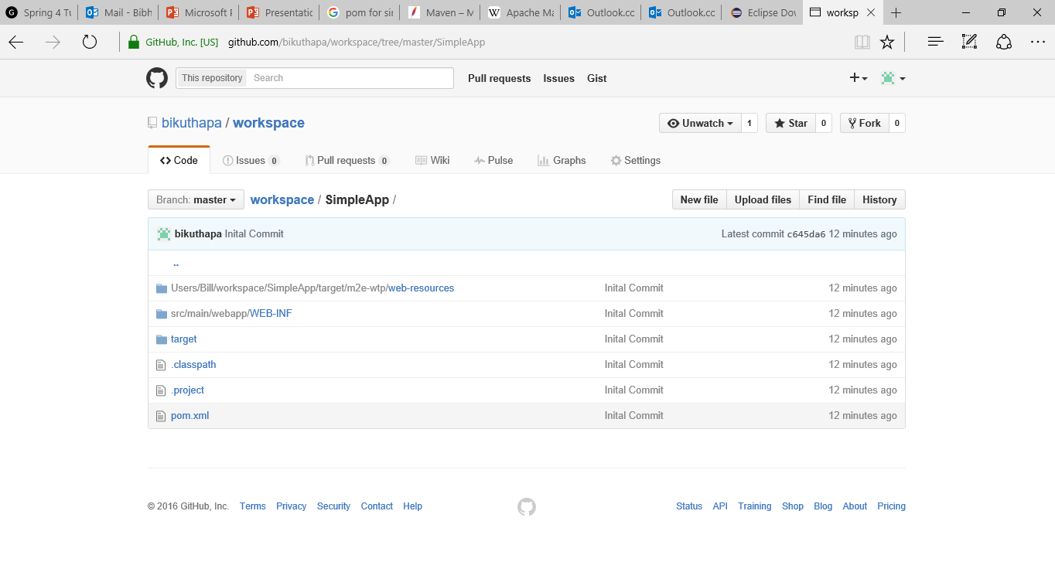
Verify successful push
Login to your remote repository and verify that the content has been pushed.

Slide 32
Assignment
Update some of the files in the project, commit the file and push it to remote server.

Slide 33
Configure workspace to import existing project

Slide 34
Setting up Environment
Open Eclipse,
Create workspace
Clone existing project from remote server
Import the existing project.

Slide 35
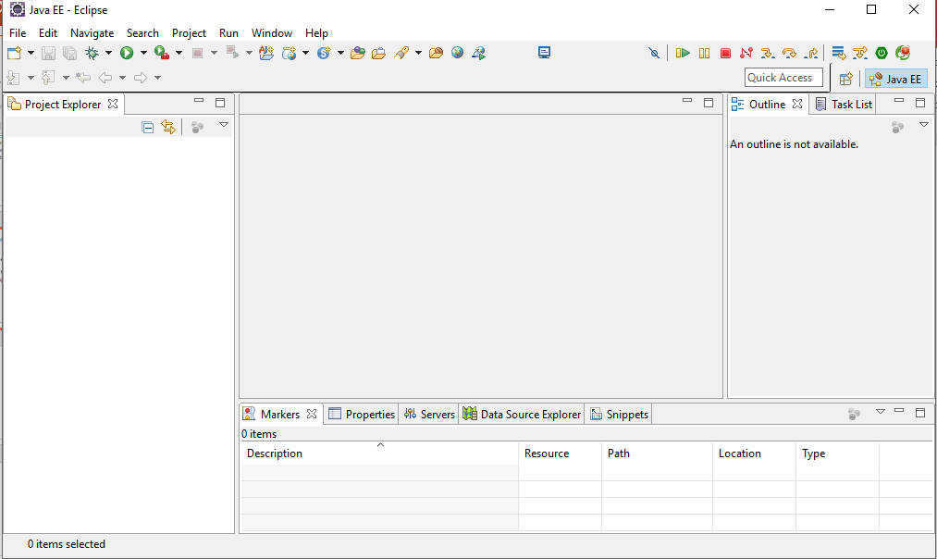
Create Workspace
Specify where you want your workspace and ok.

Slide 36
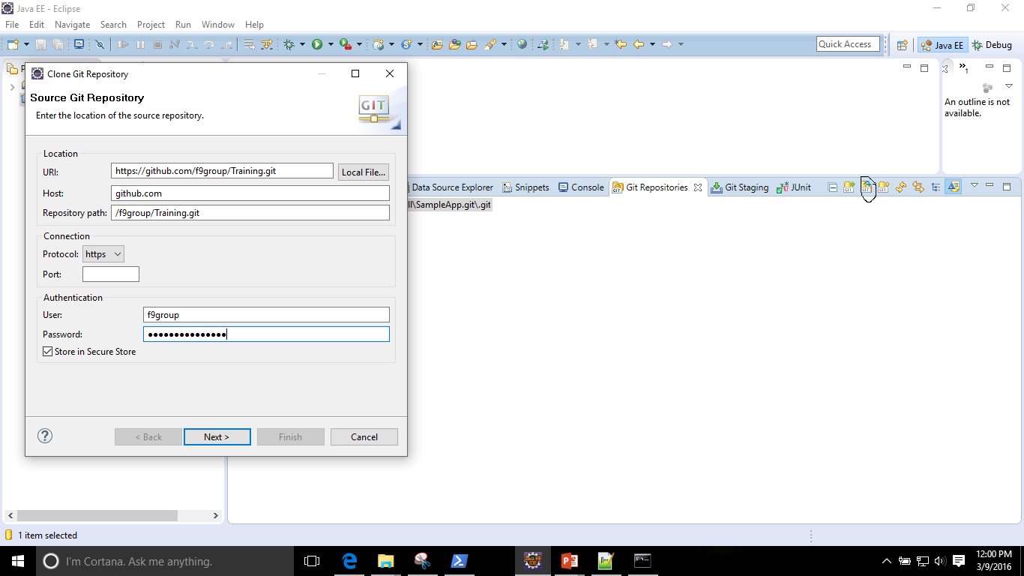
Clone existing project from remote server
A sample Application is already checked in to the remote server. We will fetch that to eclipse by navigating to Repository view →Clone Repository .

Slide 37
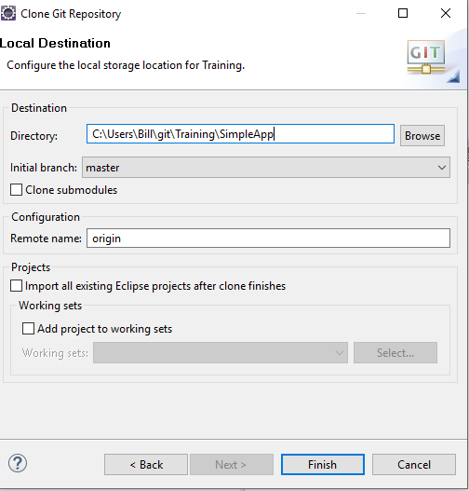
Clone existing project from remote server cont’d
You will need proper credentials to fetch the project.
Select where you want the project in your local drive and then the wizard will navigate you through the process

Slide 38
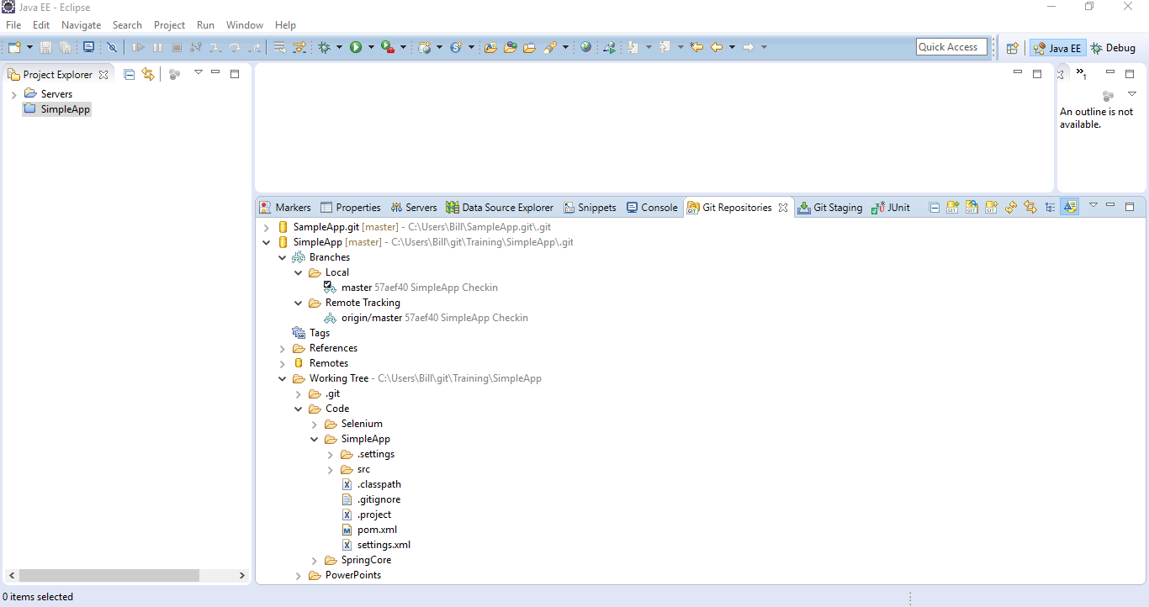
Fetched project
At the end, the repository view will look like this.

Slide 39
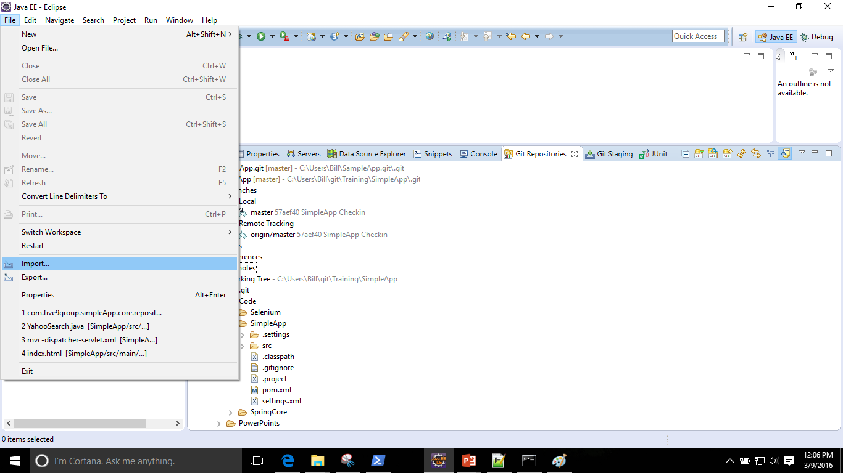
Importing project to your workspace
Next step is to import the project to your workspace

Slide 40
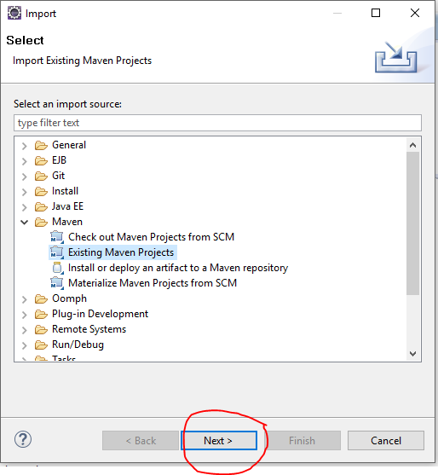
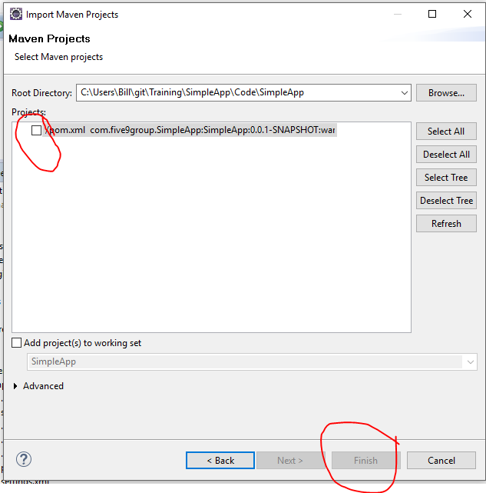
Importing project to your workspace

