Slide 1
Spring Framework
Date

Slide 2
Modules
Introduction to Spring
Spring Bean Configuration
Unit Testing using Mockito framework
Data Access with Spring JDBC Template
Integration Testing
Spring Web MVC
Functional Testing using Selenium web driver
Code Refactoring and Metrics

Slide 3
Introduction and Spring Bean Configuration

Slide 4
Introduction to Spring
The Spring Framework is an open source application framework.
It provides comprehensive infrastructure support for developing Java application
Spring deals with plumbing
Spring Integrates well with other enterprise services
Messaging, Remote Access
Spring makes data access easier to do
Manages Resources, supports all major data access technologies.

Slide 5
Why Spring?
Lightweight and minimally invasive development with POJO
Loose coupling through dependency injection
Declarative programming through aspects
Boilerplate code reduction through templates

Slide 6
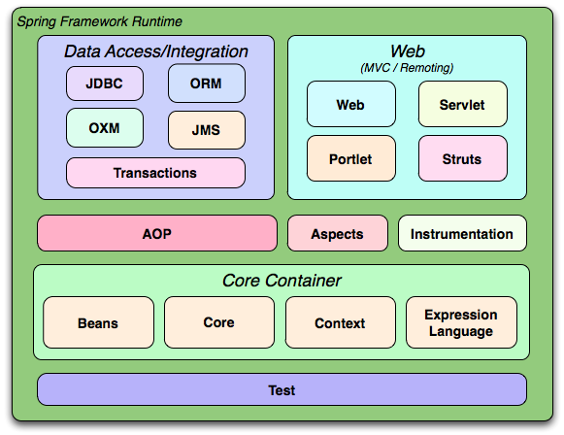
Spring Architecture

Slide 7
Spring core
Beans
Implements beanfactory through factory pattern
Core
It has dependency injection and IOC features
Context
Used for application context
Expression Language
Used for querying and manipulating objects at runtime

Slide 8
Inversion of Control Container(Dependency Injection)
Objects created by the IoC container is called as bean
The container can be configured by
Loading XML file
Writing Java configuration classes
The IoC container is responsible for managing object lifecycle, initializing them and configuring these objects by wiring them together.

Slide 9
Application Context
Spring comes with several flavors of Application Context.
Some of the important classes that implement Application Context are
ClassPathXmlApplicationContext: Defines that your configuration file is within the class path.
FileSystemXmlApplicationContext: Defines where your configuration is located.
XmlWebApplicationContext: Used for web applications

Slide 10
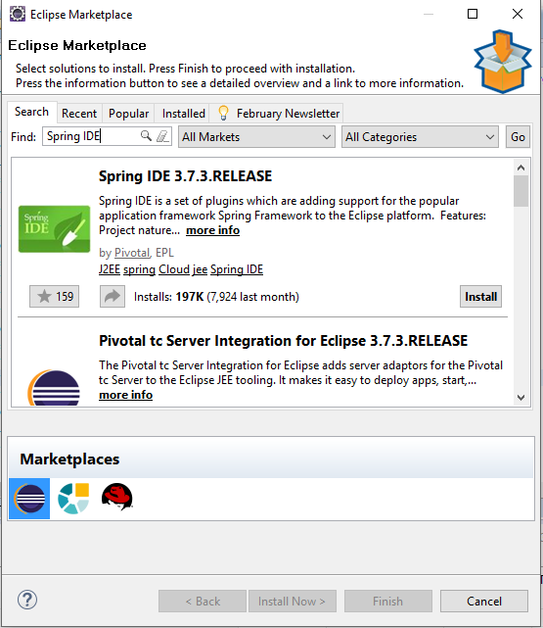
Getting hands dirty
Let us install spring IDE plugin in our workspace
Go to Help → Eclipse Market Place and type Spring IDE
Create a new Maven project.

Slide 11
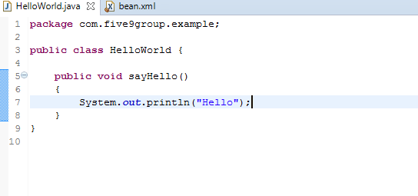
Getting hands dirty
Update pom.xml to include dependency for
spring-core
spring-context
spring-beans
Let’s create a simple Hello world. Create a package with the name
com.five9group.example
Create a class called HelloWorld in the package.

Slide 12
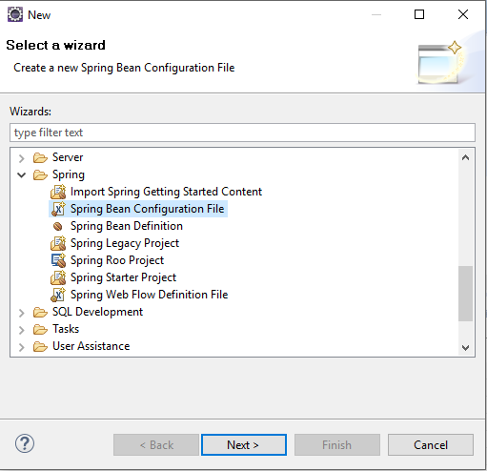
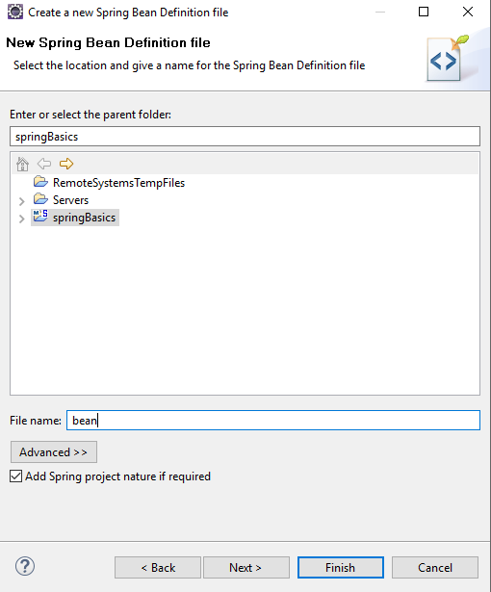
Creating a bean configuration file
Spring IDE can help us create a bean configuration file easily. Here is how…. Right click on the project → New→ Other

Slide 13
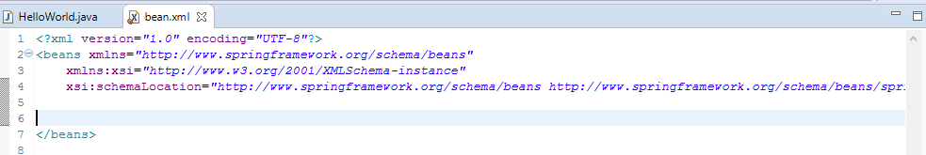
Adding to bean configuration file
An empty bean configuration file will look something like this…
Now let us add a bean definition for the class HelloWorld

Slide 14
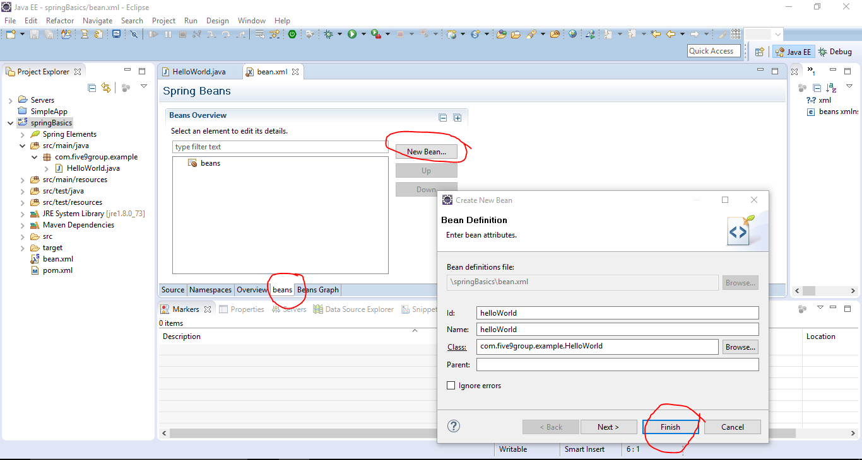
Adding bean definition for the class
Navigate to bean.xml file and add bean definition of HelloWorld class as shown below.

Slide 15
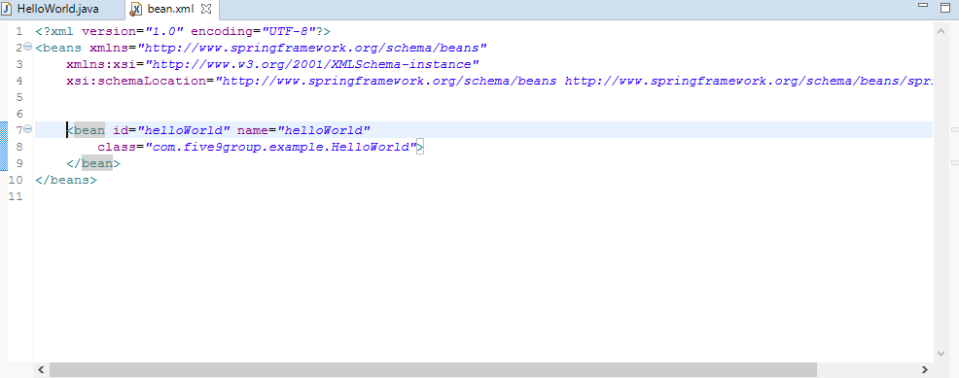
Added bean definition for HelloWorld
Here is the outcome of the bean definition we have just added.

Slide 16
Putting it together…
Let us now create a test class and call the method sayHello.
In the source folder “src/test/java” , create a package
com.five9group.example
Create a test class called TestingHelloWorld
We are now going to:
Create a main method,
Load the bean configuration in Application Context
Use that to invoke the sayHello method in HelloWorld

Slide 17
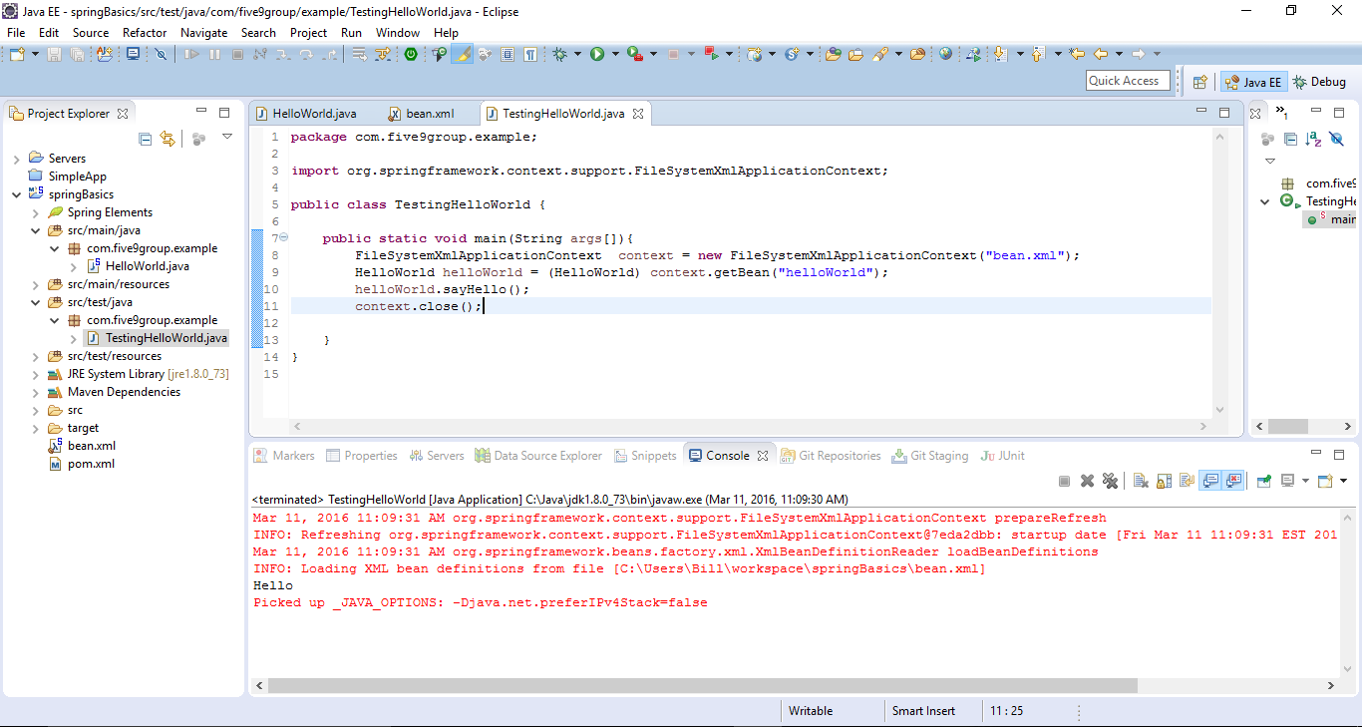
Run it as java application
The container created an instance of HelloWorld class and therefore we didn’t have to use the new keyword.

Slide 18
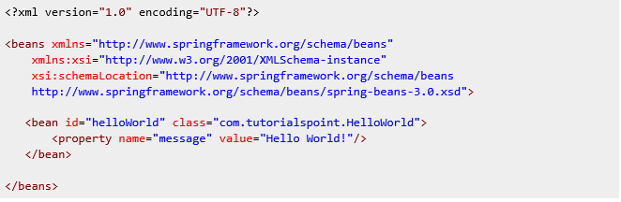
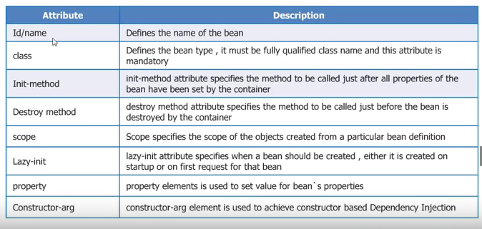
Attributes of a Bean Tag
A bean can have other attributes, the table below shows available attributes

Slide 19
Dependency Injection
Types of dependency injection supported by Spring
Setter injection: In this type of DI the required values are injected using the setter method to a bean.
Constructor injection: In this type of DI the bean is injected through the constructor arguments

Slide 20
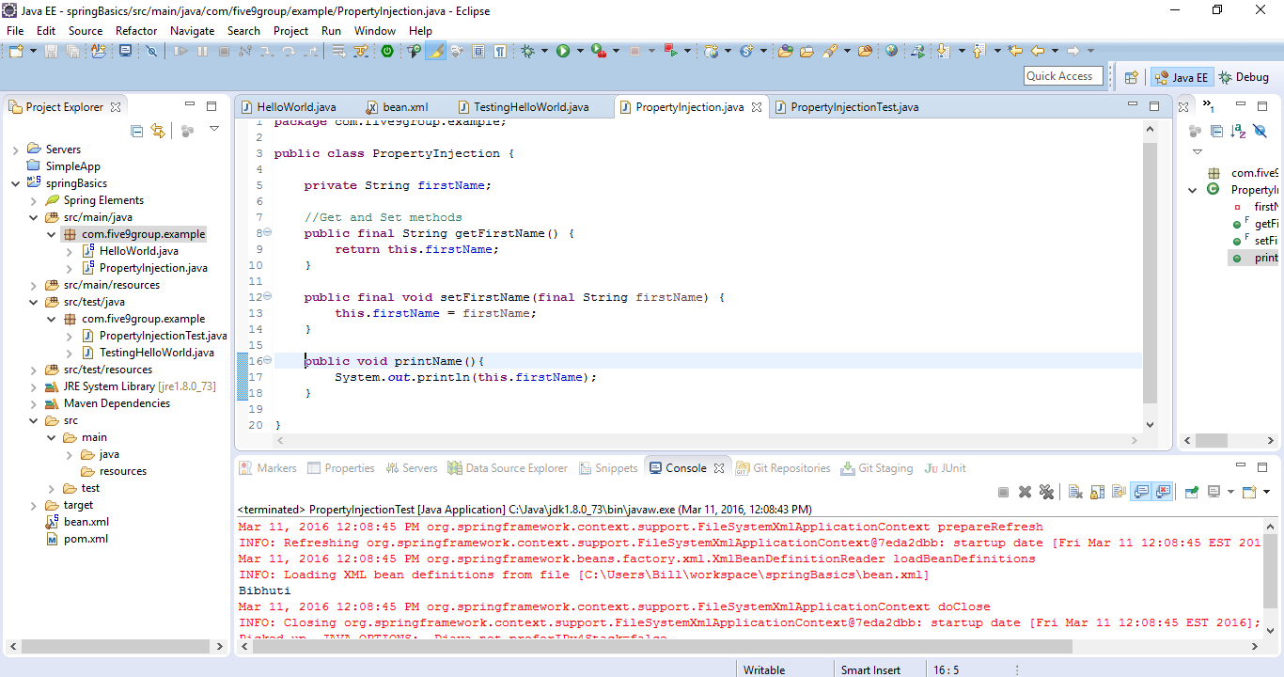
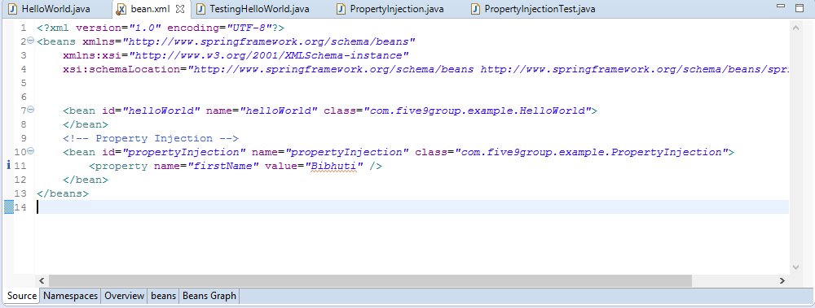
Setter Injection
This is how you inject values to a bean using setter injection

Slide 21
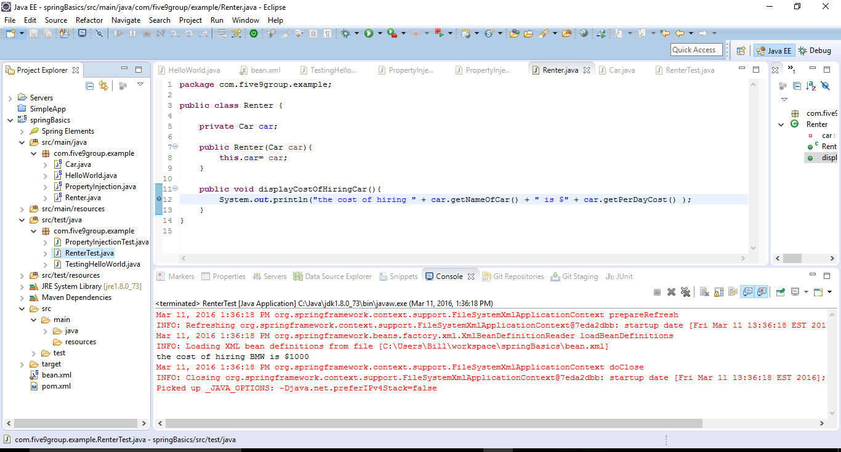
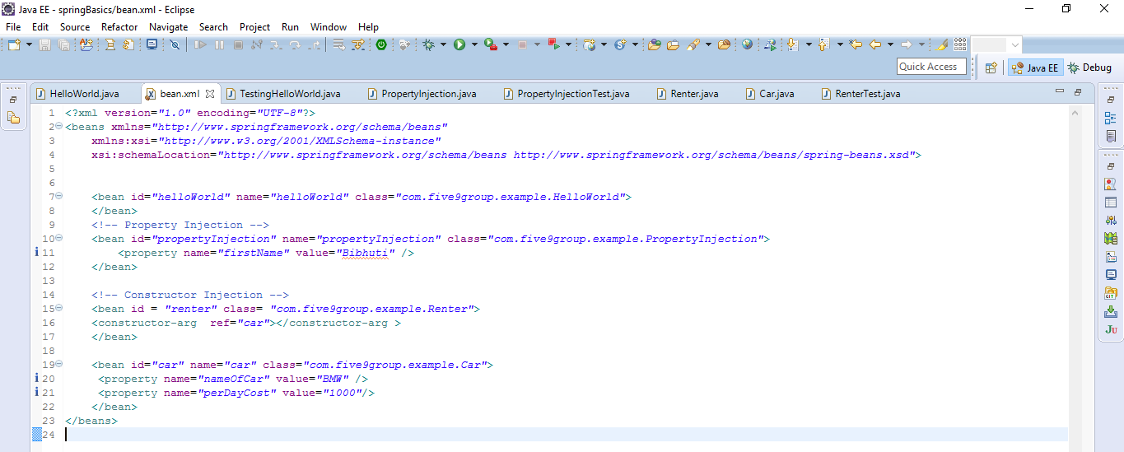
Constructor injection

Slide 22
Assignment
Update the PropertyInjection class to print first and last name.

Slide 23
Unit Testing using mocking framework(mockito)

Slide 24
Unit Testing
Unit Testing
Tests one unit of functionality
Keeps dependencies minimal
Stub or mock out dependencies if needed
Each test exercise a single scenario.

Slide 25
Unit Testing with mocking framework (Mockito): Overview
Use a mocking library to generate a mock object
Record the mock with expectations of how it will be used for a scenario
What methods will be called
What values to return
Exercise the scenario
Verify mock expectations were met.

Slide 26
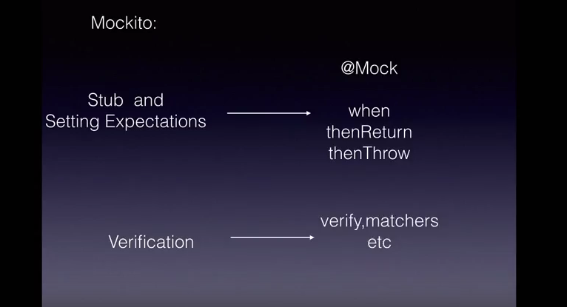
Conceptualize

Slide 27
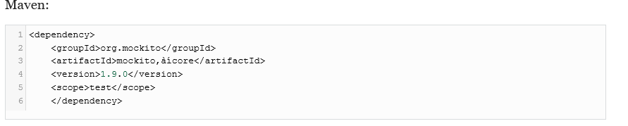

Adding Mockito to the project
You can configure Mockito in maven project just by including the dependency.
You can create a mock object either calling a static method or annotating with @Mock

Slide 28
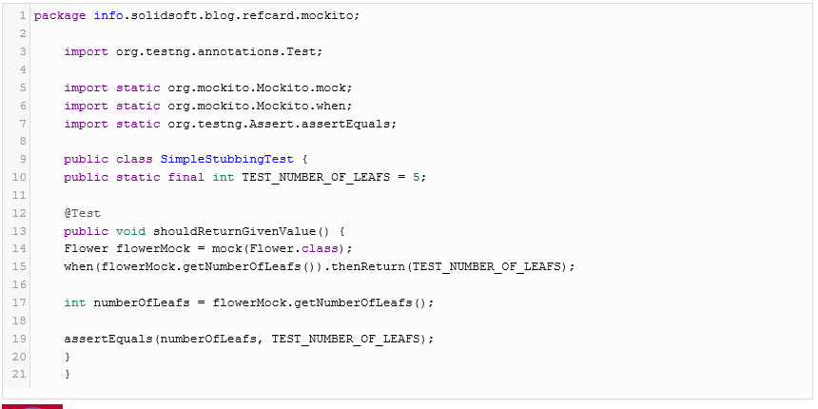
Stubbing Method’s return value
Mockito has the ability to return a given value when a specific method is called.
when(....).thenReturn(....)

Slide 29
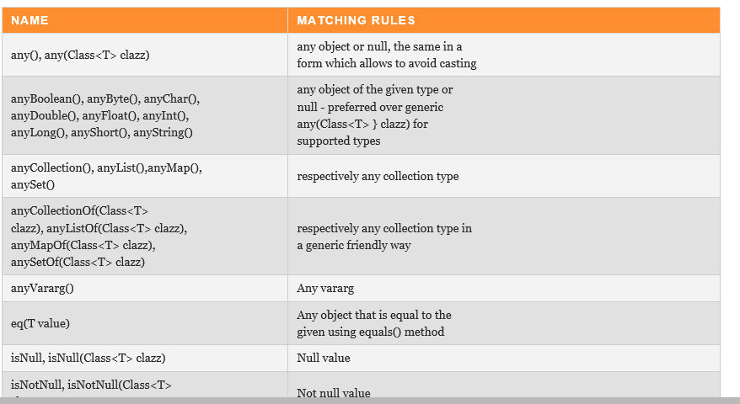
Argument Matching
Mocks can return different values depending on arguments passed into a method.
You can use Mockito’s several methods to define that independent of the input value a certain return value should be returned.

Slide 30
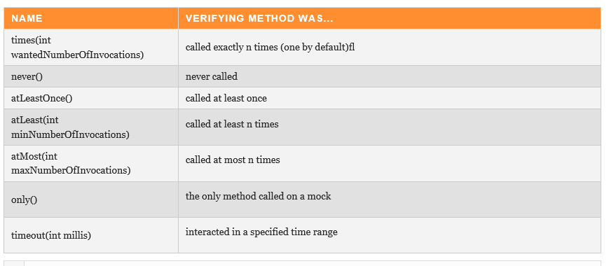
Verifying Behavior
To verify that the specified conditions were met Mockito uses verify method.(Behavior testing)

Slide 31
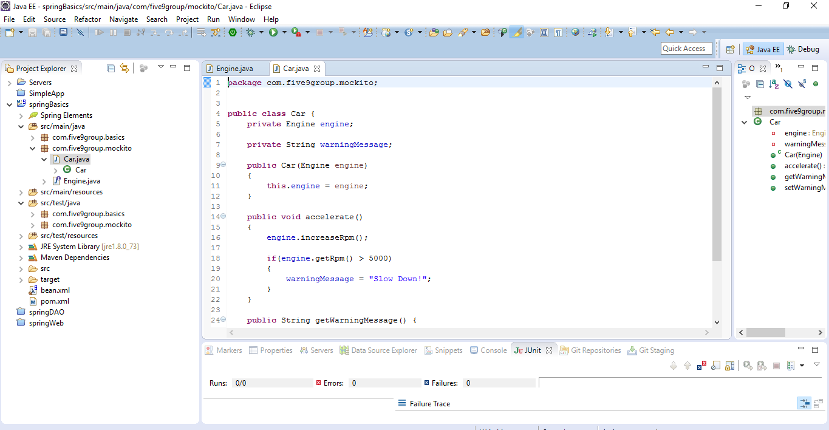
Try it yourself…….
In the springBasics project there is a package com.five9group.mockito.
Write a test for the car class under the package; such that if the revolutions per minute (RPM) > 6000. Slow down ! Warning is printed.

Slide 32
Data Access with Spring JDBC Template

Slide 33
Spring Data Access
Spring makes data access easier because:
It manages resources for you
Provides API helpers
Supports all major data access technologies
Jdbc
Hibernate
JPA
ibatis

Slide 34
Getting hands dirty…
We are going to create database schema called testdb
Create a table called tutorials_tbl, insert data to the table
Use that table as a basis to create our domain class in java.
Define a DAO(Data Access object) or a service
Implement one of DAO’s method to insert data into the tutorials_tbl using Spring JDBC.

Slide 35
Getting the Database Server
Install MySql from the url below.
https://dev.mysql.com/downloads/mysql/
Create a database schema
shell> create database testdb;
Create a user and grant all privileges to that user.
shell> CREATE USER ‘bibhuti'@'localhost' IDENTIFIED BY 'password';
shell>GRANT ALL PRIVILEGES ON * . * TO ‘bibhuti'@'localhost';
Login as the created user:
shell> mysql -u <bibhuti> –p password testdb

Slide 36
Create a table
Create a table in the schema
shell> use testdb;
shell> CREATE TABLE tutorials_tbl(
tutorial_id INT NOT NULL AUTO_INCREMENT,
tutorial_title VARCHAR(100) NOT NULL,
tutorial_author VARCHAR(40) NOT NULL,
tutorial_description VARCHAR(100),
PRIMARY KEY ( tutorial_id ) );

Slide 37
Inserting data in the table
INSERT INTO tutorials_tbl
(tutorial_title, tutorial_author, tutorial_description )
VALUES ("JAVA Tutorial", "Sanjay", “Spring 3.0 Basic example”);
INSERT INTO tutorials_tbl
(tutorial_title, tutorial_author, tutorial_description )
VALUES ("Learn MySQL", "Abdul S", “Spring Security”);
INSERT INTO tutorials_tbl
(tutorial_title, tutorial_author, tutorial_description )
VALUES ("Learn PHP", "John Poul", “Spring by example”);

Slide 38
Spring JDBC
Spring JDBC is the central framework class that manages all the database communication and exception handling
JdbcTemplate class executes SQL queries, update statements and stored procedure calls, performs iteration over ResultSets and extraction of returned parameter values.
Instances of the JdbcTemplate class are threadsafe once configured. So you can configure a single instance of a JdbcTemplate and then safely inject this shared reference into multiple DAOs

Slide 39
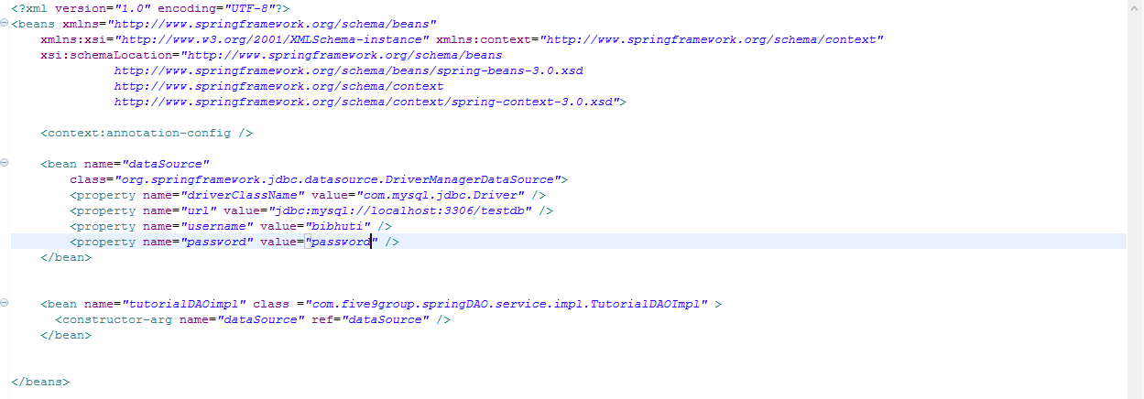
Configuring Data Source and Injecting it.
As simple as creating a bean of class(org.springframework.jdbc.datasource.DriverManagerDataSource) and inject it to our DAO bean as shown below.

Slide 40
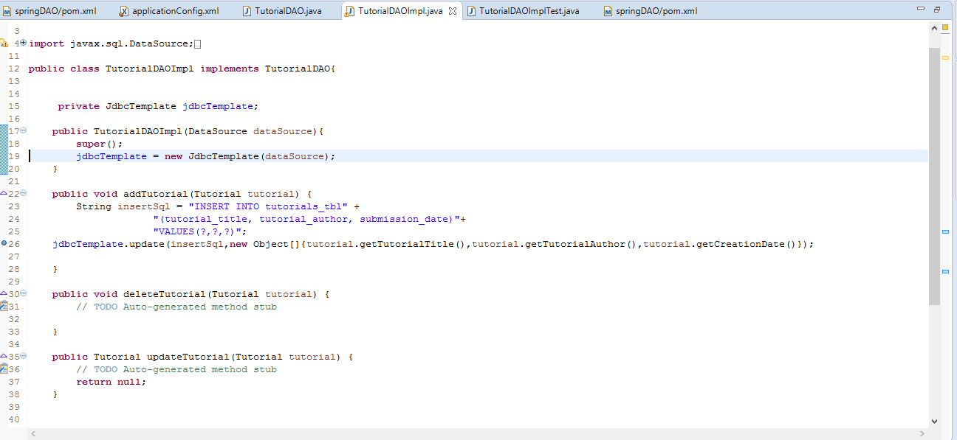
Putting it together and executing
All we do is supply an instance of dataSource to our JdbcTemplate class.
Look at the number of lines of code we didn’t have to write.

Slide 41
Integration Testing using SpringJUnit4Runner class

Slide 42
Advantages of Integration Testing
The code can be tested without deploying to any container.
i.e. you can test everything within eclipse.
You can re-use your configuration file to test in different environments.
i.e. create different configuration file for each environment if the infrastructure is different without having to change an code.

Slide 43
Integration Testing :SpringJUnit4Runner
SpringJUnit4Runner consists of several Junit test support classes.
It uses shared Application Context across test methods.
The tests are annotated with @ContextConfiguration
We can specify the location of our configuration file by specifying the classpath.
We can inject a bean by using @Autowired annotation.

Slide 44
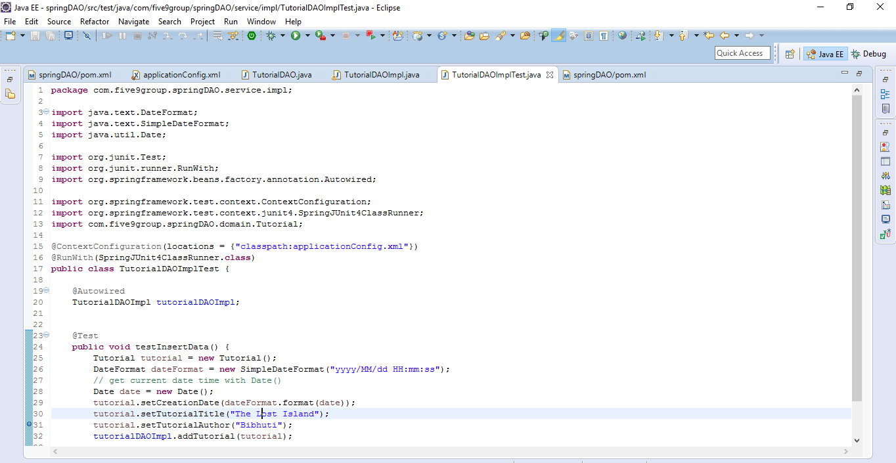
Configurations to run Integration Test

Slide 45
Assignment
Update the code base to include functionalities to
Update the row by Id.
Delete the row by Id.
Also write integration tests for them.

Slide 46
Spring Web MVC

Slide 47
Steps for developing a Spring MVC application
Deploy a Dispatcher Servlet(one-time)
Implement a request handler(controller)
Implement the view(s)(jsp,jsf)
Register the controller with DispatcherServlet
Deploy application to any container and test

Slide 48
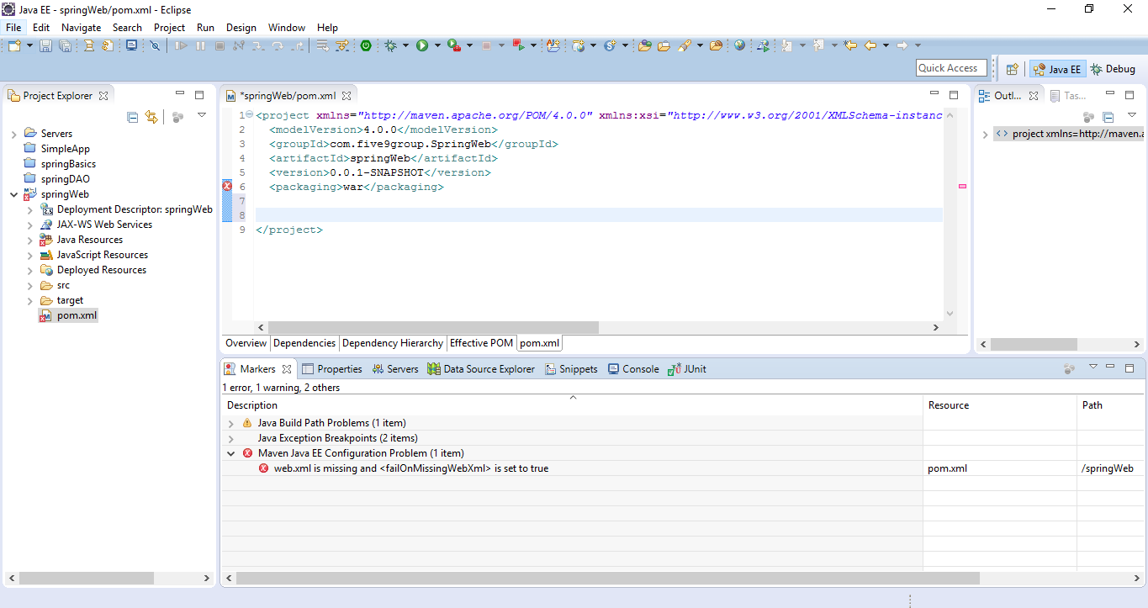
Getting hands dirty ….Create a maven project
Let us start by creating a new maven project.
When you create a maven project for a web application, the packaging should be a war file.
When you create a war packaging structure and there is no web.xml file, then eclipse will complain about it.

Slide 49
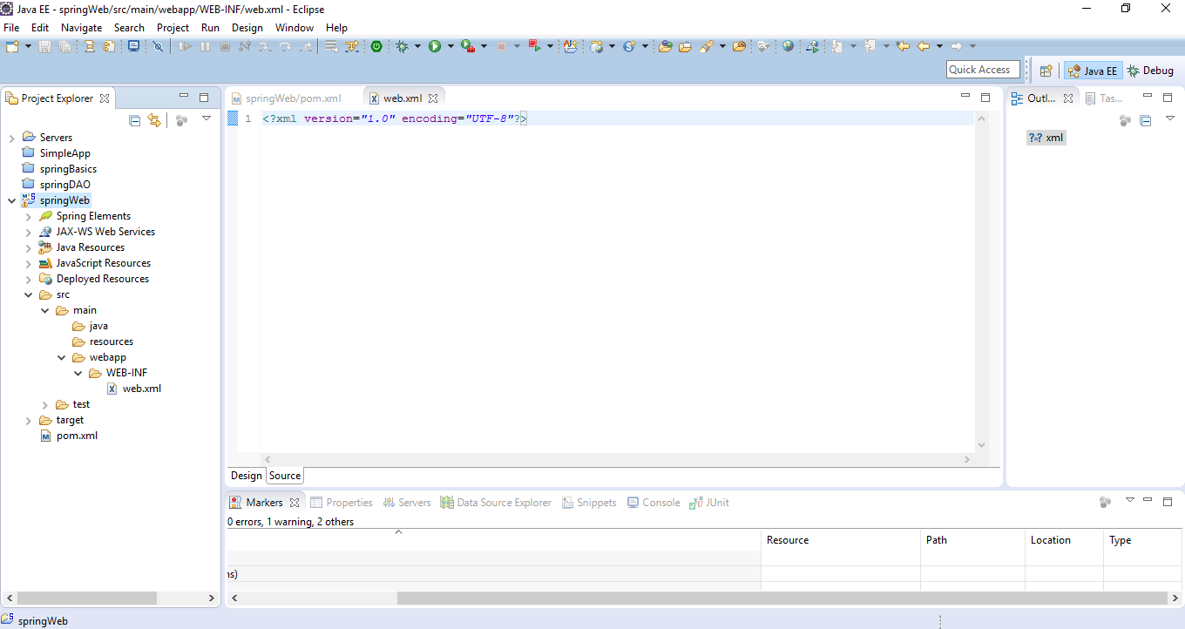
Creating web application folder structure.
A web application should look like this.
Create a WEB-INF folder inside webapp folder.
Add web.xml file inside webapp folder

Slide 50
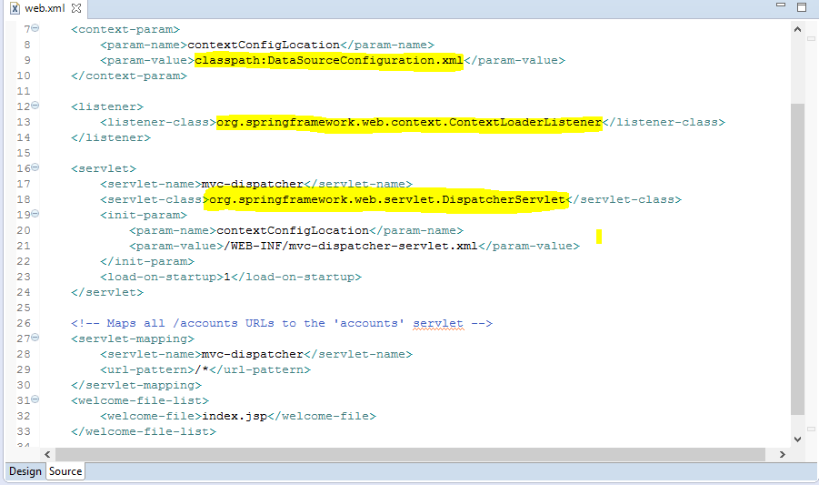
Investigating content inside web.xml file
Spring can be initialized within a webapp by just adding a Spring provided servlet listener.

Slide 51
Dispatcher Servlet
Is defined in web.xml and is core to spring mvc
Dispatcher servlet coordinates all request handling activities
Delegates to web infrastructure beans
Invokes user web components
Users spring for its configuration
Creates separate “servlet” application context
The location of the dispatcher servlet configuration file is defined in web.xml

Slide 52
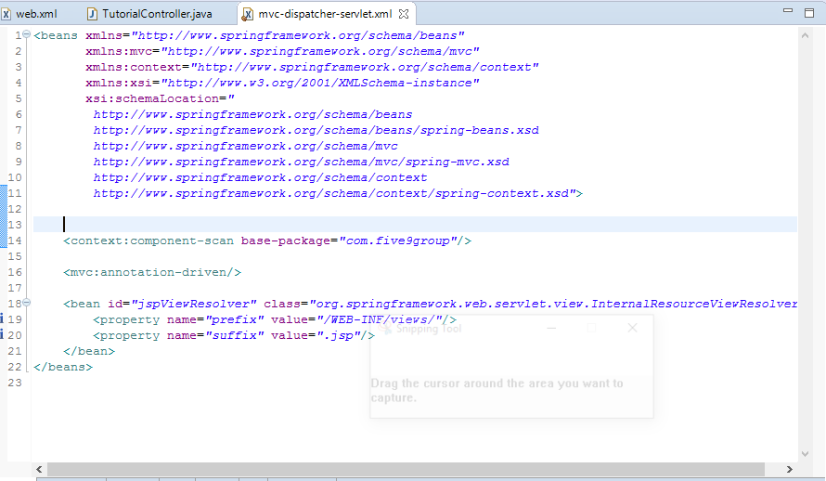
Mvc-dispatcher-servlet.xml
<mvc:annotation-driven/> Tells dispatcher servlet that you are using annotations
<context:component-scan base-package="com.five9group"/>Look for annotations starting from folder structure anything below com.five9group

Slide 53
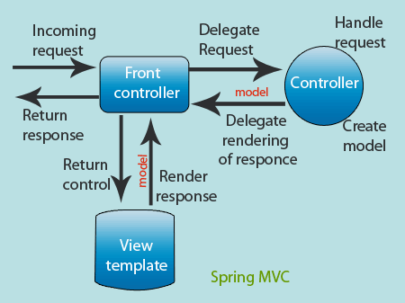
Request Processing Lifecycle

Slide 54
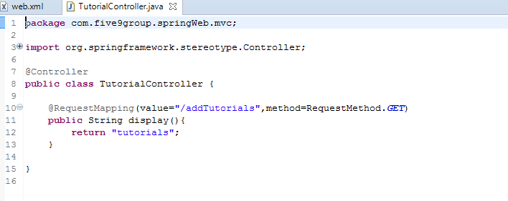
Handlers/Controllers
Handlers are typically called controllers and are usually annotated with @Contoller
@RequestMapping tells spring what method to execute when processing a particular request.
Controllers typically returns a view name
Controllers may return null or void

Slide 55
View Resolvers
The view resolvers are defined in the dispatcher servlet configuration file.
The Dispatcher Servlet delegates to a View resolver to map returned view name to view implementation.
The default view resolver treats the view name as a Web Application-relative file path.
There are different implementations of view resolvers.
org.springframework.web.servlet.view.InternalResourceViewResolver
org.springframework.web.servlet.view.UrlBasedViewResolver

Slide 56
Build and deploy ‘springWeb’ application
Check out the springWeb application from GitHub from the following location.
Run maven command to generate a war file.
Download Tomcat Server from Apache site and extract it to location of your choice.
Configure eclipse to start and stop the server from the IDE.
Deploy the application to the Server.
Start the server and test the url.

Slide 57
Deployed application
When you access http://localhost:8080/springWeb. You should be seeing something like this.

Slide 58
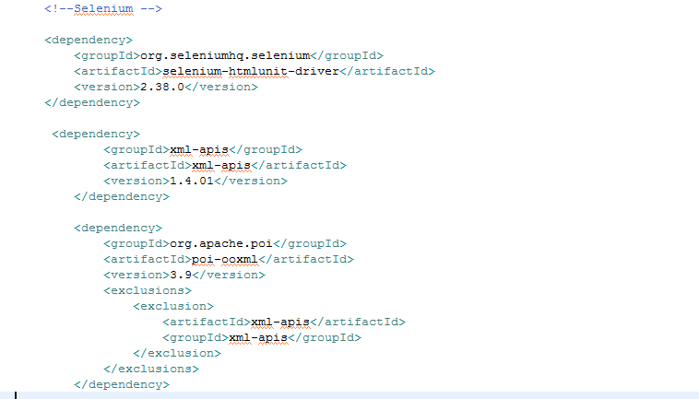
Functional Testing: Selenium
You can configure Selenium in maven project just by including the dependency

Slide 59
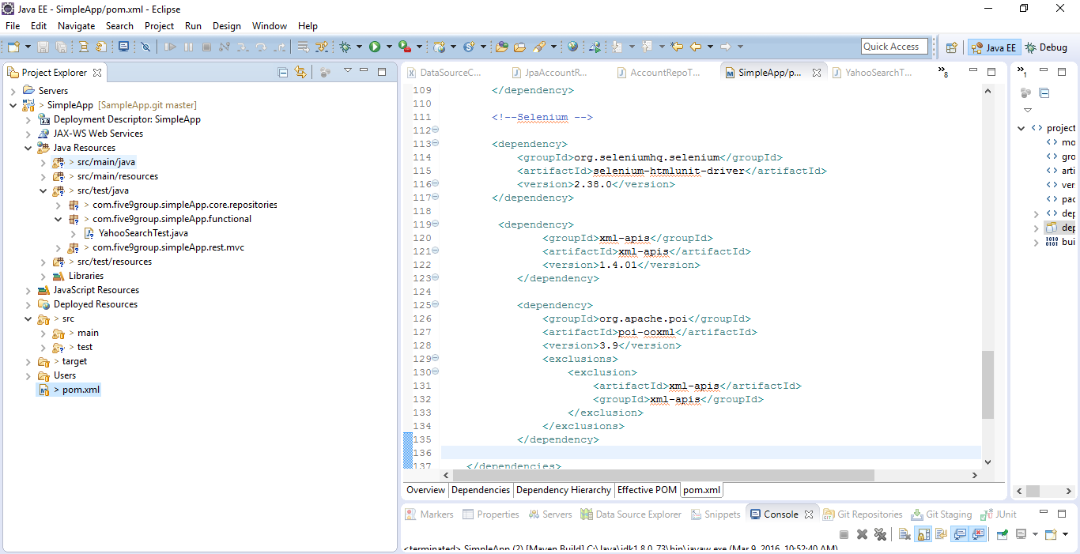
Create package for functional testing
Create a separate package as out lined below and add tests to it.

Slide 60
Selenium core classes
org.openqa.selenium.WebDriver: The main interface to use for testing, which represents an idealised web browser. The methods in this class fall into three categories – Control of the browser itself, Selection of WebElements, Debugging aids
org.openqa.selenium.WebElement: Represents an HTML element. Generally, all interesting operations to do with interacting with a page will be performed through this interface.
org.openqa.selenium.By: Mechanism used to locate elements within a document

Slide 61
Locator techniques to identify html objects
Xpath
ID
ClassName
Name
LinkText
CssSelector
Partial link text

Slide 62
Assignment
Based on the code you updated in Spring Data Access module, develop UI components to update, delete tutorials so that the user can interact with the application.
Also write unit and selenium tests for them.

Slide 63
Code Refactoring and Metrics

Slide 64
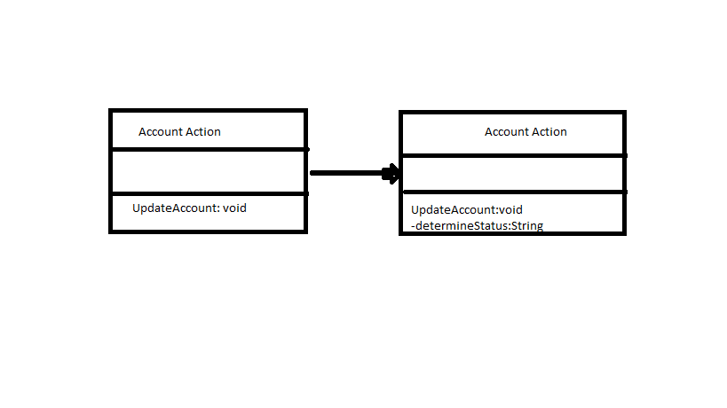
Code Refactoring
The process of cleaning code without changing the underlying functionality to improve the structure of code and reduce complexity.​
The best way to refactor code is to extract method.

Slide 65
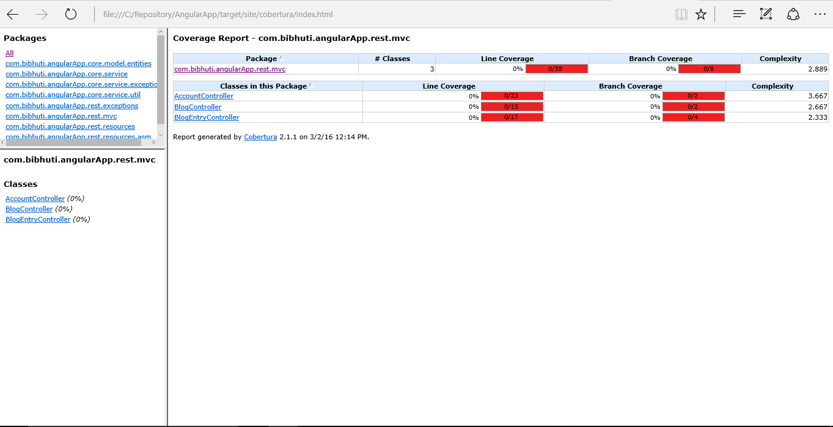
How do you identify code that needs refactoring?
Tools that analyze cyclomatic complexity is good at pointing out code that needs to be refactored.​
Running Cobertura to identify cyclomatic complexity from maven​
Higher the complexity number better it is to refactor code.

Slide 66
Code Metrics
Why measure code attributes​
Complexity ​
Maintainability ​
Risk​
Extensibility​
Waste

Slide 67
Code Metrics Terminology
Cyclomatic Complexity
Duplicate Code Analysis
Circular Dependencies
Code Coverage

Slide 68
Cyclomatic Complexity
Measurement of number of paths through the methods. More the number of paths complexity increases linearly.
Tools used to measure cyclomatic Complexity
PMD
The Eclipse Metrics plug-in
JavaNCSS
Cobertura
To reduce Cyclomatic Complexity we can introduce isolation via refactoring
Break the method into smaller ones
Introduce more classes

Slide 69
Duplicate Code Analysis
Duplicate code with demonstrates poor coding standards and replicate defects
Tools used for Duplicate code analysis
CPD
Resolution for duplicate code issues
Refactor code to extract super class
Extract Methods

Slide 70
Circular Dependencies
Occurs when one part of the code(say X) depends on the other(say Y) and that in turn depends on the first; so you get a dependency like the one below
X <-->Y
This creates compilation and deployment issues.
Tools used to measure circular dependencies
JDepend
Resolution for circular dependencies
Make the code modular by extracting packages.

Slide 71
Code Coverage
Used to determine how much of the code is being tested by coded test.(JUnit, selenium).
Higher the number better is the code coverage
Tools used to measure code coverage.
Cobertura
Running Cobertura via maven command.
mvn cobertura:cobertura

Slide 72
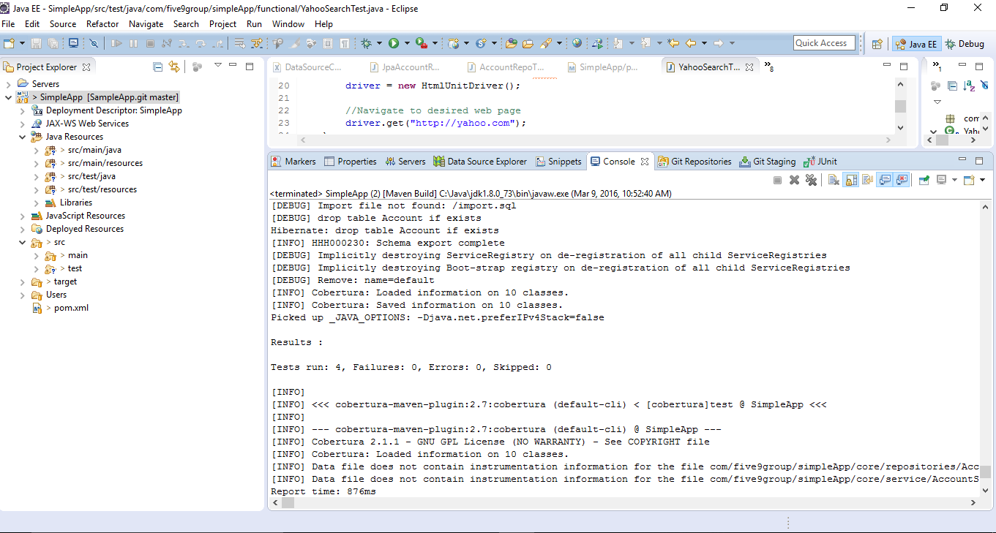
Code Coverage

