Slide 1
Computer Music Representation and Modeling
M. Sc. in Music and Acoustic Engineering
«Need Chords?»
Silvio Attolini
10539533
Davide Marin Pasin
10799610
Federico Ceriola
10786380

Slide 2
What is Need Chords?
“Need Chords?” is a Web app that combines a chords recognition system with a live sharing between the users.
Features:
Chords recognition based on the chromogram algorithm.
Authentication with mail and password.
Live sharing on a public board.
Feedbacks through comments on the board.
S.Attolini
D. Marin Pasin
F. Ceriola
MAE - CMRM

Slide 3






Implementation tools and structure
Front end
Database and Storage
Analysis and Navigation
S.Attolini
D. Marin Pasin
F. Ceriola
MAE - CMRM

Slide 4
Implementation tools and structure
Analysis
Live Sharing
Navigation
S.Attolini
D. Marin Pasin
F. Ceriola
MAE - CMRM

Slide 5
Analysis: the chromagram algorythm
Audio
Chroma representation
Pattern matching
Chord recognition
Audio loading: Librosa
Chroma feature extraction through IIR elliptic filter bank
Pattern matching: modeling of chords and similarity measure
Chord labels, timestamps and visualization of the results
S.Attolini
D. Marin Pasin
F. Ceriola
MAE - CMRM

Slide 6
Feature extraction
Librosa.iirt: time-frequency representation using IIR elliptic filterbank.
Filters centered around MIDI pitches, with bandwidth of a semitone each.
Other methods tested: STFT, CQT.
After extraction: feature normalization (smoothing).
S.Attolini
D. Marin Pasin
F. Ceriola
MAE - CMRM

Slide 7
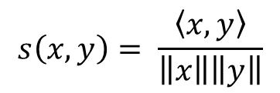
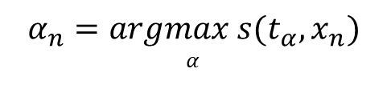
Chord templates and similarity
Modeling of the chords:
Vectors of 12 elements, one for each note
Vectors are binary: idnicate presence of the note in the chord
Only major and minor triads: 24 vectors
Generated by cyclically shifting the C major and C minor vectors
x_{n}: feature vector
t_{α}: chord templates
α_{n}: recognition result
s: similarity measure: inner product of normalized vectors
$$s\left(x,y\right)= \frac{\left\langle x,y\right\rangle }{\left\|x\right\|\left\|y\right\|}$$
$$α_{n}=argmax s(t_{α},x_{n})$$
$$α$$
S.Attolini
D. Marin Pasin
F. Ceriola
MAE - CMRM

Slide 8
Results visualizations and limitations
User is presented with time chord representation of only the most similar chord, together with list of chord and timestamps (for ease of reading).
Limitations and possible improvements:
Only triads: 4 or more voice chords often give issues (tested in separated notebook)
Other similarity measures could be tested
Harmonics and other sound components would require different modeling for chord templates
Machine learning (supervised learning) and statistical models (e.g GMM) could greatly improve the results.
S.Attolini
D. Marin Pasin
F. Ceriola
MAE - CMRM

Slide 9
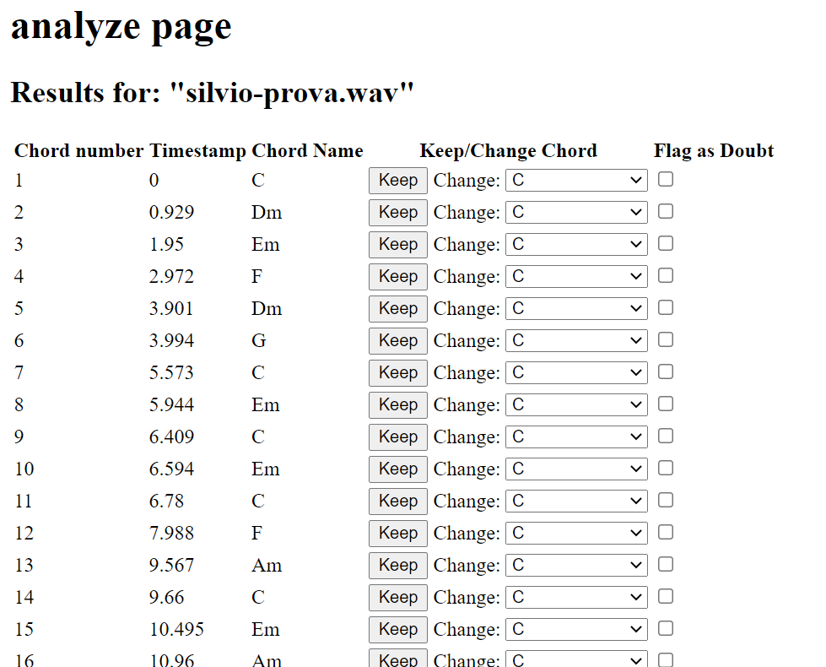
Interactions with proposed results
S.Attolini
D. Marin Pasin
F. Ceriola
MAE - CMRM

Slide 10
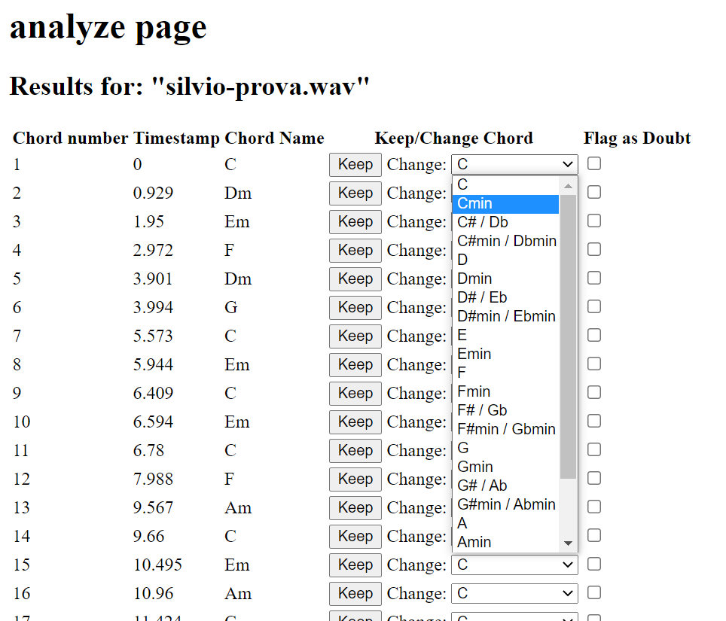
Interactions with proposed results
S.Attolini
D. Marin Pasin
F. Ceriola
MAE - CMRM

Slide 11
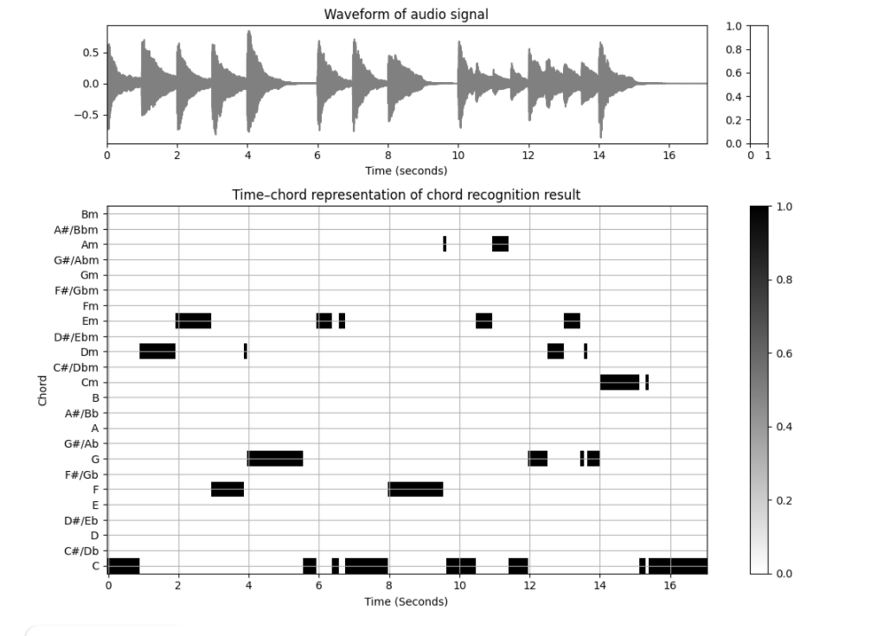
Chromagram example
S.Attolini
D. Marin Pasin
F. Ceriola
MAE - CMRM

Slide 12
Database structure for Live Sharing
Collections:
Documents:
Fields:
UsersID
…
…
Nickname
Profile Img URL
Users
Chords
TimestampsInSeconds
NameOfSongs
Description
UserNick
PostID (auto-generated)
…
…
Posts
Date
PostID
Text
UserNick
CommentsID (auto-generated)
…
…
Comments
S.Attolini
D. Marin Pasin
F. Ceriola
MAE - CMRM

Slide 13
Future Developements
Analysis page: choose which chord is to keep or change.
Machine Learning: the system recognize how much the chord retrieved is far from the most probable answer.
Comment page: based on the machine learning computation results other users can suggest the best answer.
Adapt the app to every device by adding media queries in CSS.
…any suggestions?
S.Attolini
D. Marin Pasin
F. Ceriola
MAE - CMRM

Slide 14

Demo
https://www.youtube.com/watch?v=UCK4Q5L8FPs
S.Attolini
D. Marin Pasin
F. Ceriola
MAE - CMRM

