Slide 1
Recent Architectures of Deep
Convolutional Neural Networks..

Slide 2
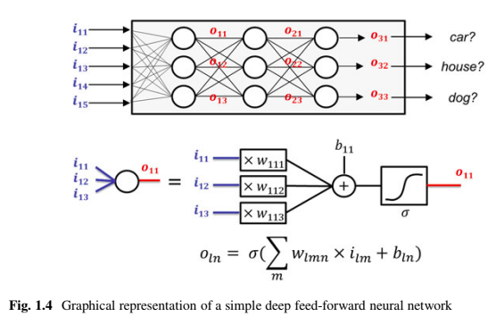
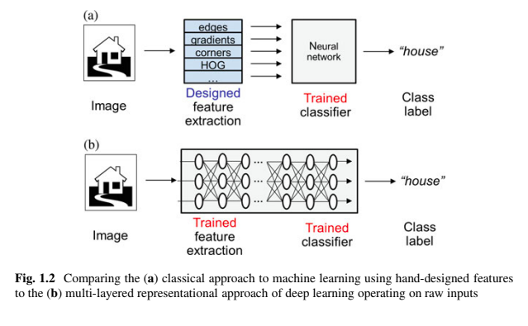


Slide 3
The training algorithm might get stuck in a local minimum or it could converge to the wrong function when it is overfitting.
deeper networks suffer from vanishing gradients (Hochreiter et al. 2001)
In general, the giant networks that might be necessary to learn complex nonlinear functions are infeasible to train sometime.
Universal approximation theorem (Hornik et al. 1989) :
a neural network with 1 hidden layer can approximate any continuous function for inputs within a specific range. If the function jumps around or has large gaps, we won't be able to approximate it.

Slide 4
CNN Literature
1989 to date.
These improvements can be categorized as parameter optimization, regularization, structural reformulation, etc.
main thrust in CNN performance improvement came from the restructuring of processing units and the designing of new blocks.

Slide 5
CNN Literature
Point of focus:
spatial exploitation
Depth
multi-path
Width
feature-map exploitation
channel boosting
attention-based CNNs.

Slide 6
Spatial Exploitation based CNNs
CNNs have a large number of parameters and hyper-parameters, such as weights, biases, number of layers, and processing units (neurons), filter size, stride, activation function, learning rate, etc.
As convolutional operation considers the neighborhood (locality) of input pixels, therefore different levels of correlation can be explored by using different filter sizes.
Different sizes of filters encapsulate different levels of granularity; usually, small size filters extract fine-grained and large size extract coarse-grained information.

Slide 7
LeNet
LeNet was the first CNN architecture, which not only reduced the number of parameters but was able to learn features from raw pixels automatically.
showed state-of-the-art performance on hand digit recognition tasks
ability to classify digits without being affected by small distortions.
LeNet is a feed-forward NN that constitutes of five alternating layers of convolutional and pooling, followed by two fully connected layers
exploited the underlying basis of the image that the neighboring pixels are correlated to each other and feature motifs are distributed across the entire image.
Therefore, convolution with learnable parameters is an effective way to extract similar features at multiple locations with few parameters.
Learning with sharable parameters

Slide 8
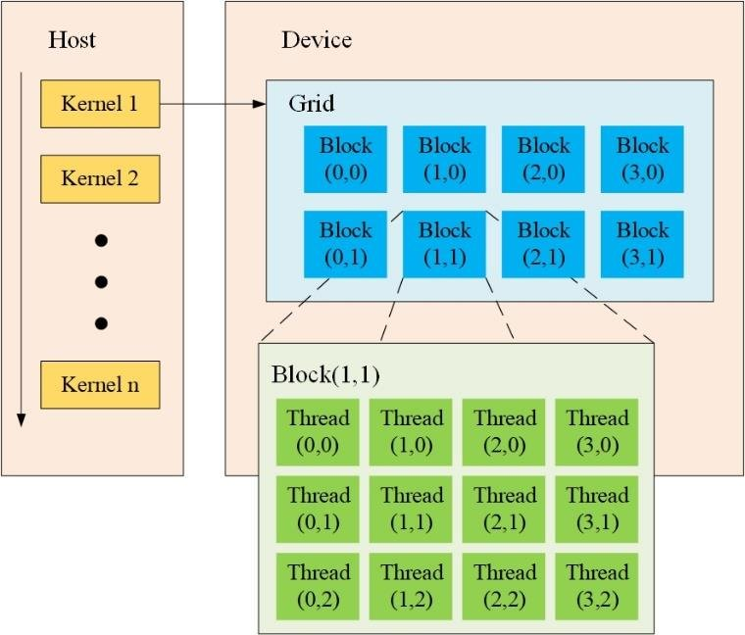
Limitation
GPU was not commonly used to speed up training, and even CPUs were slow
considers each pixel as separate input and applies a transformation on it, which was a substantial computational burden
CNN was limited to hand digit recognition tasks and didn’t perform well to all classes of images.
GPU advantage:
A CPU consists of four to eight CPU cores, while the GPU consists of hundreds of smaller cores.
massively parallel architecture

Slide 9
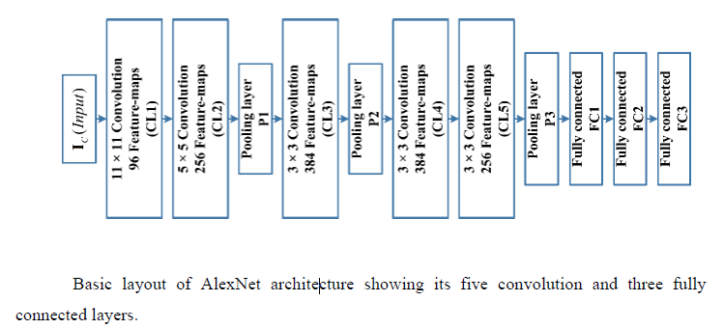
AlexNet
AlexNet is considered as the first deep CNN architecture, which showed groundbreaking results for image classification and recognition tasks
In AlexNet, depth was extended from 5 (LeNet) to 8 layers to make CNN applicable for diverse categories of images.
depth improves generalization for different resolutions of images but, the main drawback associated with an increase in depth is overfitting.

Slide 10
Overfitting:Bias and Variance
Bias is the algorithm’s tendency to consistently learn the wrong thing by not taking into account all the information in the data.
Variance is an error from sensitivity to small fluctuations in the training set
underfitting: High Bias and High Variance
Overfitting occurs if the model or algorithm shows low bias but high variance
Overfitting:
Low Bias but high variance (Less training error and High test error)

Slide 11
AlexNet Features
ReLU was employed as a non-saturating activation function to improve the convergence rate by alleviating the problem of vanishing gradient to some extent .
Overlapping subsampling and local response normalization were also applied to improve the generalization by reducing overfitting.
use of large size filters (11x11 and 5x5) at the initial layers, compared to previously proposed networks.
Due to the efficient learning approach of AlexNet, it has significant importance in the new generation of CNNs and has started a new era of research in the architectural advancements of CNNs.

Slide 12
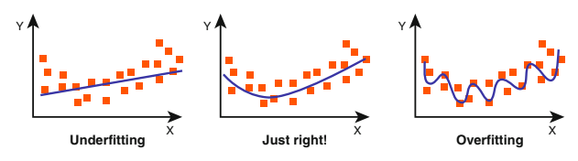
Regularization
A network is overfitting, when it performs well on its training data, but not on new unseen inputs.
Solutions:
Data augmentation : fake data is generated and added to the training set.
not for many other tasks such as natural language processing.
Parameter norm penalties : a penalty is added to the loss function to optimally limit the capacity of a model.
Dropout : some connections are randomly put to zero every iteration.
k-Fold Cross-Validation: Cross-validation is a resampling procedure used to evaluate machine learning models on a limited data sample.

Slide 13
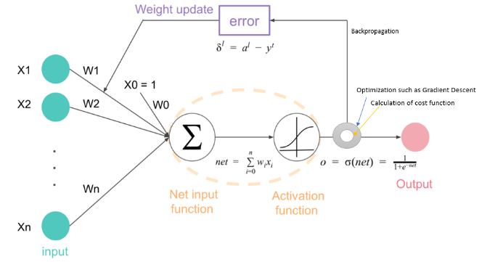
Vanishing Gradient Problem
Deep networks are hard to train because of the notorious vanishing gradient problem — as the gradient is back-propagated to earlier layers, repeated multiplication may make the gradient infinitively small.
As a result, as the network goes deeper, its performance gets saturated or even starts degrading rapidly.

Slide 14
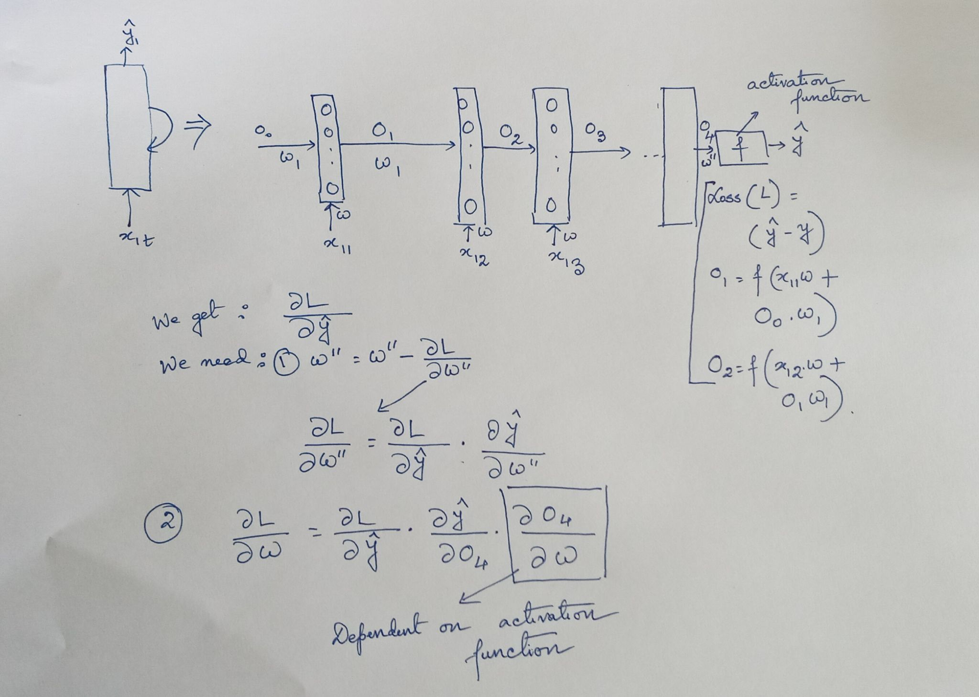
Vanishing Gradient Problem

Slide 15
Other adjustments in AlexNet
use of large size filters (11x11 and 5x5) at the initial layers, compared to previously proposed networks
Due to the efficient learning approach of AlexNet, it has significant importance in the new generation of CNNs and has started a new era of research in the architectural advancements of CNNs.

Slide 16
Choice of filter size*
*In a convolution, a convolution filter slides over all the pixels of the image taking their dot product [linear combination of the pixels weighted by the convolutional filter extracts some kind of feature from the image]
Most of the useful features in an image are usually local and it makes sense to take few local pixels at a time to apply convolutions.
Most of these useful features may be found in more than one place in an image: slide
single kernel all over the image to extract same feature in different parts of the image
Small kernel instead of a fully connected network:
benefit from weight sharing and reduction in computational costs. *https://towardsdatascience.com/deciding-optimal-filter-size-for-cnns-d6f7b56f9363

Slide 17
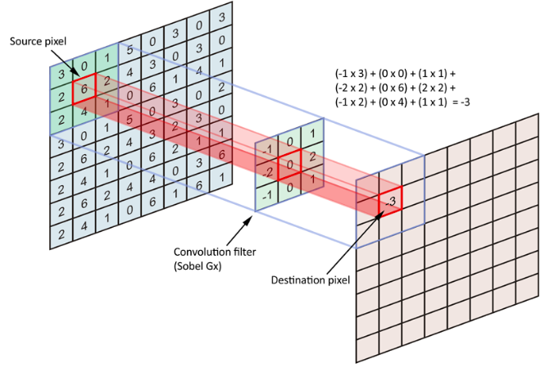
Why smaller size and odd number?
we are trying to encode the pixels in the neighborhood of anchor/source pixel
source pixel is the anchor point at which the kernel is centered and we are encoding all the neighboring pixels, including the anchor/source pixel
.Odd sized kernel is symmetrically shaped (not symmetric in kernel values)
Asymmetric kernels lead to distortion/ errors

Slide 18
ZfNet - 2013
learning mechanism of CNN, before 2013, was based mainly on hit-and-trial, without knowing the exact reason behind the improvement.
In 2013, Zeiler and Fergus proposed an interesting multilayer Deconvolutional NN (DeconvNet), which got famous as ZfNet.
ZfNet was developed to visualize network performance quantitatively. [
The idea of the visualization of network activity was to monitor CNN performance by interpreting neuron’s activation.]
DeconvNet works in the same manner as the forward pass CNN but reverses the order of convolutional and pooling operation.
This reverse mapping projects the output of the convolutional layer back to visually perceptible image patterns, consequently gives the neuron-level interpretation of the internal feature representation learned at each layer.

Slide 19
ZfNet - 2013
idea of feature visualization proposed by ZfNet was experimentally validated on AlexNet using DeconvNet,:
Few observations:
which showed that only a few neurons were active.
In contrast, other neurons were dead (inactive) in the first and second layers of the network.
maximized the learning of CNN by reducing both the filter size and stride to retain the maximum number of features in the first two convolutional layers. This readjustment in CNN topology resulted in performance improvement, which suggested that features visualization can be used for the identification of design shortcomings and for timely adjustment of parameters.

Slide 20
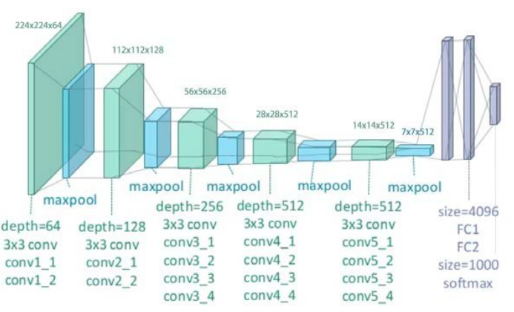
VGG-2015*
The successful use of CNNs in image recognition tasks has accelerated the research in architectural design.
Simonyan et al. proposed a simple and effective design principle for CNN architectures: VGG
modular in layers pattern VGG was made 19 layers deep compared to AlexNet and ZfNet to simulate the relation of depth with the representational capacity of the network
*https://arxiv.org/abs/1409.1556v6

Slide 21
VGG Improvements
ZfNet suggested that small size filters can improve the performance of the CNNs.
Based on these findings, VGG replaced the 11x11 and 5x5 filters with a stack of 3x3 filters layer and experimentally demonstrated that concurrent placement of small size (3x3) filters could induce the effect of the large size filter (5x5 and 7x7).
Soft-Max: Softmax is a mathematical function that converts a vector of numbers into a vector of probabilities [suitable multi-class classification tasks]
For the tuning of the network, max-pooling is placed after the convolutional layer, while padding was performed to maintain the spatial resolution

Slide 22
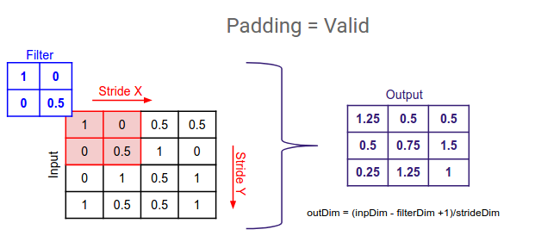
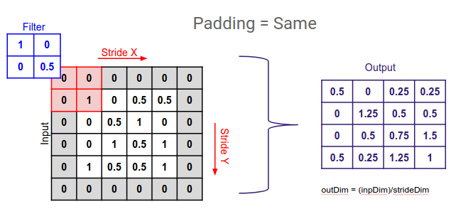
Why Padding is important?
Maintained the dimensions of the input: It's easier to design networks if we preserve the height and width
Without padding, reduction in volume size would reduce too quickly.
Padding actually improves performance by keeping information at the borders.

Slide 23
VGG showed good results both for image classification and localization problems.
VGG was at 2nd place in the 2014-ILSVRC competition but, got fame due to its simplicity, homogenous topology, and increased depth.
The main limitation associated with VGG was the use of 138 million parameters, which make it computationally expensive and difficult to deploy it on low resource systems.
Winner of 2014-ILSVRC competition : GoogleNet

Slide 24
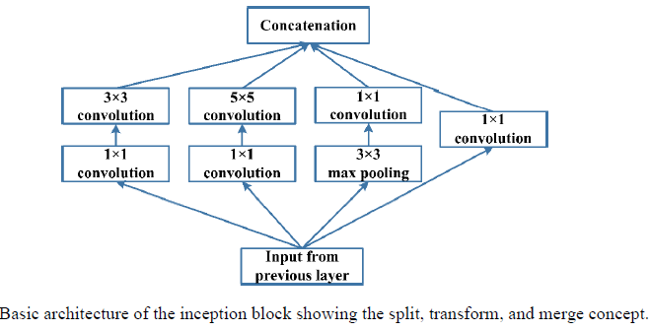
GoogleNet-Inception Block
also known as Inception-V1
objective of the GoogleNet architecture was to achieve high accuracy with a reduced computational cost.
incorporates multi-scale convolutional transformations using split, transform and merge idea.
conventional convolutional layers are replaced in small blocks similar to the idea of substituting each layer with micro NN as proposed in Network in Network (NIN) architecture (Lin et al. 2013).
Inception block encapsulates filters of different sizes (1x1, 3x3, and 5x5)
*https://machinelearningmastery.com/introduction-to-1x1-convolutions-to-reduce-the-complexity-of-convolutional-neural-networks/

Slide 25
Depth based CNN
Deep CNN architectures are based on the assumption that with the increase in depth, the network can better approximate the target function with a number of nonlinear mappings and more enriched feature hierarchies.
Theoretical studies have shown that deep networks can represent certain classes of function more efficiently than shallow architectures
Limitation: Slow training and convergence speed

Slide 26
Highway Networks
In machine learning, a highway network is an approach to optimizing networks and increasing their depth.
Highway Networks are also categorized as multi-path based CNN architectures.
50-layers showed a better convergence [GoogleNet: 22layers]
Highway networks use learned gating mechanisms to regulate information flow, inspired by Long Short-Term Memory (LSTM) recurrent neural networks.
The gating mechanisms allow neural networks to have paths for information to follow across different layers ("information highways").^{[1][2]}
Highway networks have been used as part of text sequence labeling and speech recognition tasks

Slide 27
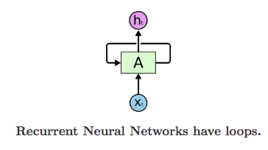
Recurrent Neural Networks
Humans don’t start their thinking from scratch every second.
we understand each word based on your understanding of previous words.
Traditional neural networks can’t d classify what kind of event is happening at every point in a movie. It’s unclear how a traditional neural network could use its reasoning about previous events.
Applications: speech recognition, language modeling, translation, image captioning

Slide 28
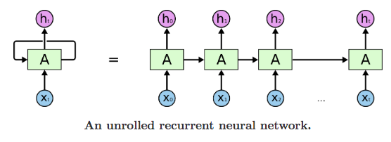
a chunk of neural network, A looks at some input x_t and outputs a value h_t
A loop allows information to be passed from one step of the network to the next.
This chain-like nature reveals that recurrent neural networks are intimately related to sequences and lists.
“I grew up in France… I speak fluent French.” Recent information suggests that the next word is probably the name of a language,
RNNs are absolutely capable of handling such “long-term dependencies

Slide 29
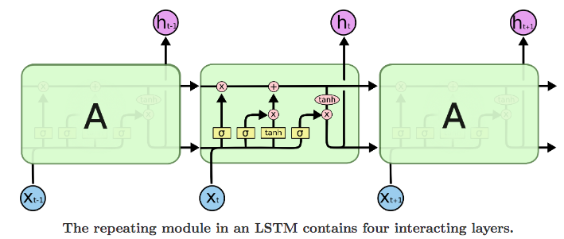
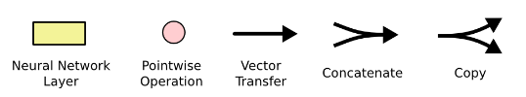
LSTM Networks*
Long Short Term Memory networks – usually just called “LSTMs” – are a special kind of RNN, capable of learning long-term dependencies.
LSTMs are explicitly designed to avoid the long-term dependency problem.
https://colah.github.io/posts/2015-08-Understanding-LSTMs/

Slide 30
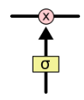
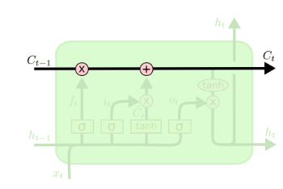
LSTM Networks
Gates are a way to optionally let information through.
-composed out of a sigmoid neural net layer and a pointwise multiplication operation.
sigmoid layer outputs numbers between zero and one, describing how much of each component should be let through. A value of zero means “let nothing through,” while a value of one means “let everything through!”
The key to LSTMs is the cell state.
The LSTM does have the ability to remove or add information to the cell state, carefully regulated by structures called gates.

Slide 31
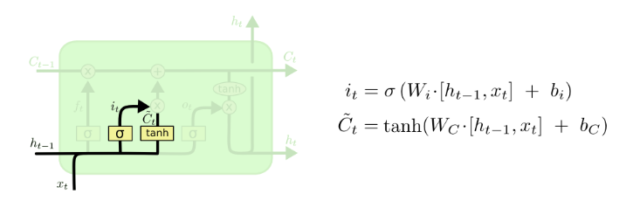
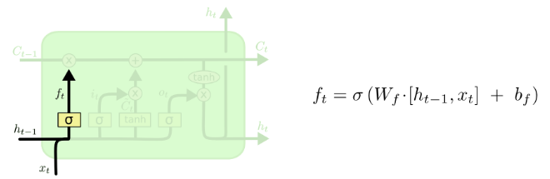
Example
The next step is to decide what new information we’re going to store in the cell state. This has two parts. First, a sigmoid layer called the “input gate layer” decides which values we’ll update. Next, a tanh layer creates a vector of new candidate values, C_t C~t, that could be added to the state.
In the next step, we’ll combine these two to create an update to the state.
‘Tanh’ is the wide variety of sigmoid function
language model trying to predict the next word based on all the previous ones.
It looks at ht−1 and xt and outputs a number between 0 and 1

Slide 32
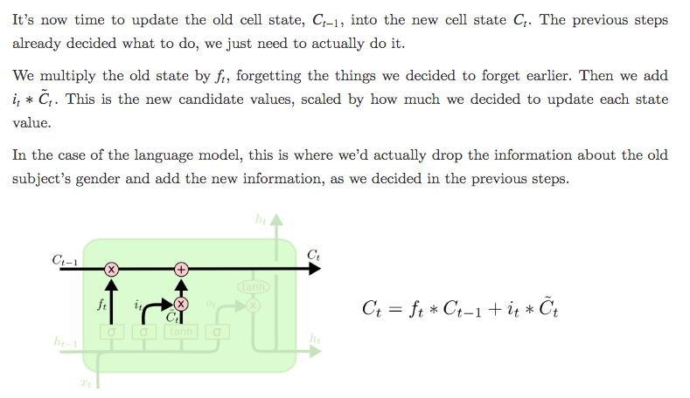
Example

Slide 33
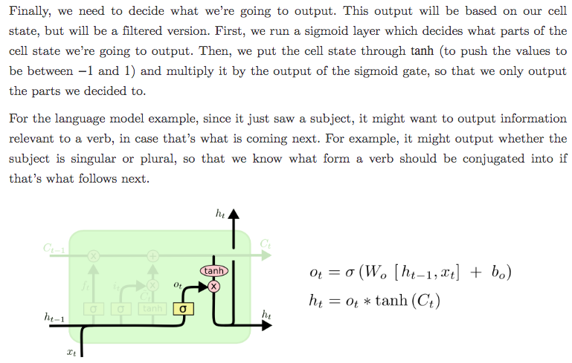
Example

Slide 34
Multi-Path based CNNs
Vanishing gradient problem not only results in higher test error but also higher training error (Pascanu et al. 2012; Dong et al. 2016; Dauphin et al. 2017).
For training deep networks, the concept of multi-path or cross-layer connectivity was proposed (Srivastava et al. 2015a; Larsson et al. 2016; Huang et al. 2017; Kuen et al. 2018).
Multiple paths or shortcut connections can systematically connect one layer to another by skipping some intermediate layers to allow the specialized flow of information across the layers (Mao et al. 2016; Tong et al. 2017).
Cross-layer connectivity partitions the network into several blocks. These paths also try to solve the vanishing gradient problem by making gradient accessible to lower layers.

Slide 35
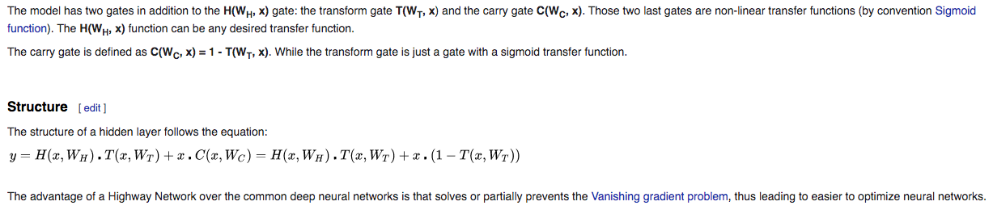
Highway Networks Revisited

Slide 36
ResNet -2015
ResNet can train up to hundreds or even thousands of layers and still achieves compelling performance.
concept of residual learning
placed under the Multi-Path based CNNs
ResNet proposed 152-layers deep CNN, which won the 2015-ILSVRC competition:
20 and 8 times deeper than AlexNet and VGG, respectively,
showed less computational complexity than previously proposed networks (Krizhevsky et al. 2012; Simonyan and Zisserman 2015).
ResNet with 50/101/152 layers has less error on image classification task than 34 layers plain Net.
Moreover, ResNet gained a 28% improvement on the famous image recognition benchmark dataset named COCO (Lin et al. 2014).

Slide 37
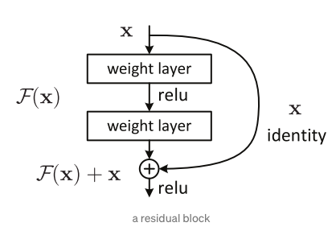
Residual learning*
introducing a so-called “identity shortcut connection” that skips one or more layers.
deeper model should not produce a training error higher than its shallower counterparts.
gradients can flow through the shortcut connections to any other earlier layer unimpededly.

Slide 38
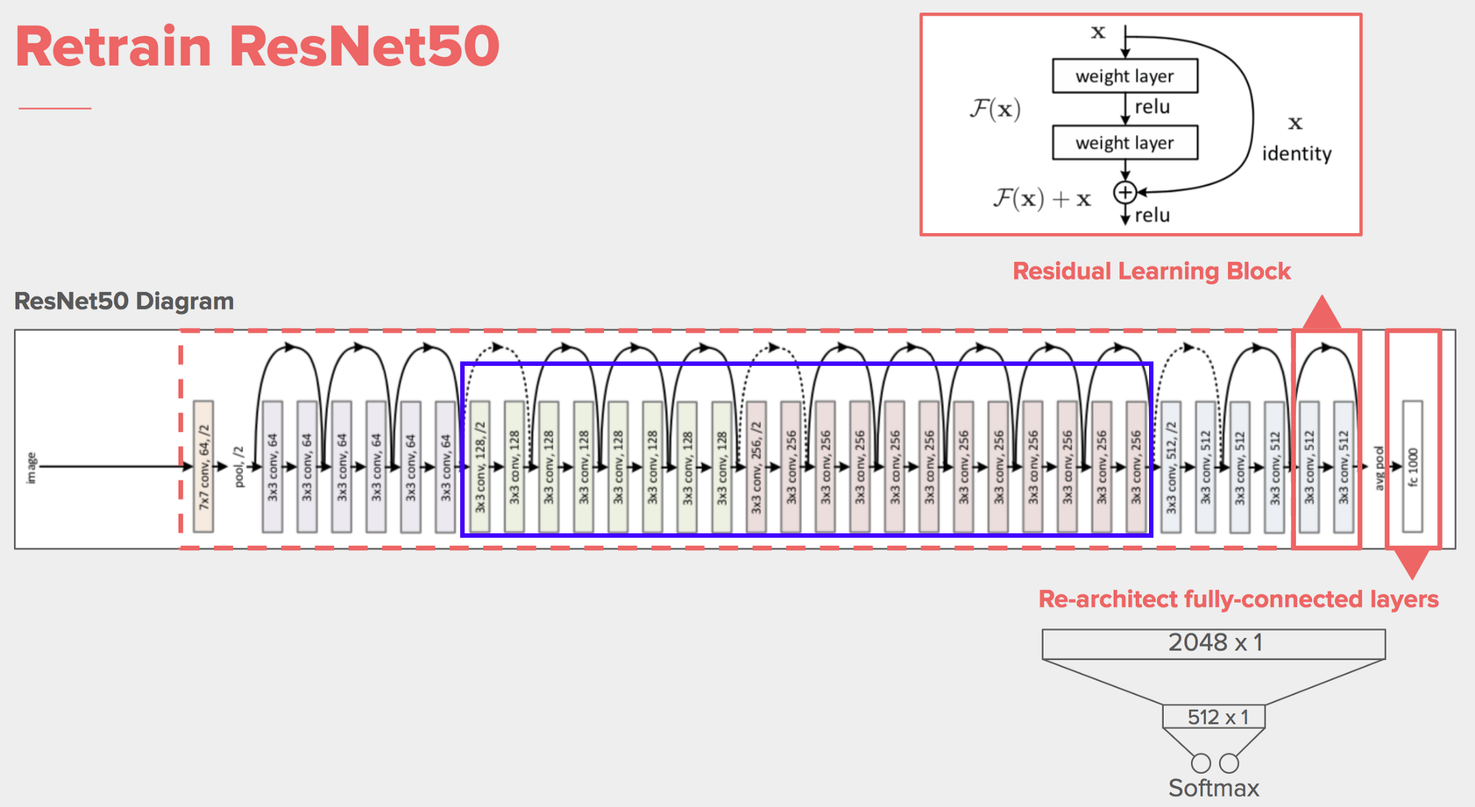
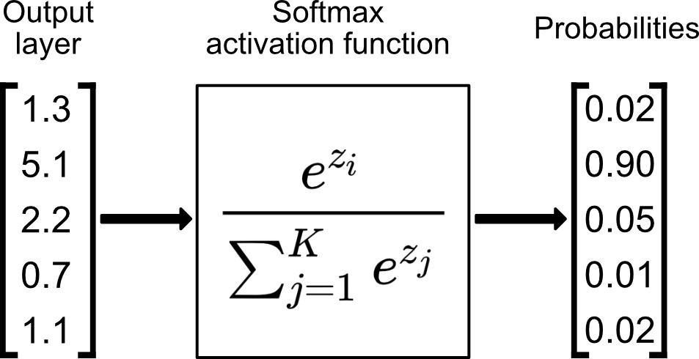

Slide 39
Few Combinations
Inception-V3:
1x1 convolutional operation was used, which maps the input data into 3 or 4 separate spaces that are smaller than the original input space, and then maps all correlations in these smaller 3D spaces, via regular (3x3 or 5x5) convolutions
Inception-ResNet:
combined the power of residual learning and inception block
filter concatenation was replaced by the residual connection.

Slide 40
DenseNet* -2017
Consider a single image x_0 that is passed through a convolutional network:
The network comprises L layers, each of which implements a non-linear transformation H_l(·), where l indexes the layer.
H_l(·) can be a composite function of operations such as Batch Normalization (BN) , rectified linear units (ReLU) , Pooling , or Convolution (Conv).
Advantage of ResNets: gradient can flow directly through the identity function from later layers to the earlier layers.
identity function and the output of H_l are combined by summation, which may impede the information flow in the network.
*https://arxiv.org/pdf/1608.06993v5.pdf

Slide 41
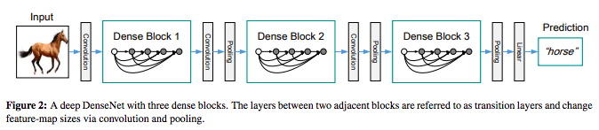
DenseNet
Main Idea: Concatenating feature-maps learned by different layers increases variation in the input of subsequent layers and improves efficiency.
To further improve the information flow between layers: a different connectivity pattern to introduce direct connections from any layer to all subsequent layers.
Figure Ref: *https://arxiv.org/pdf/1608.06993v5.pdf

Slide 42
Width Based CNN
[focus of research shifted from deep and narrow architecture towards thin and wide architectures.]

Slide 43
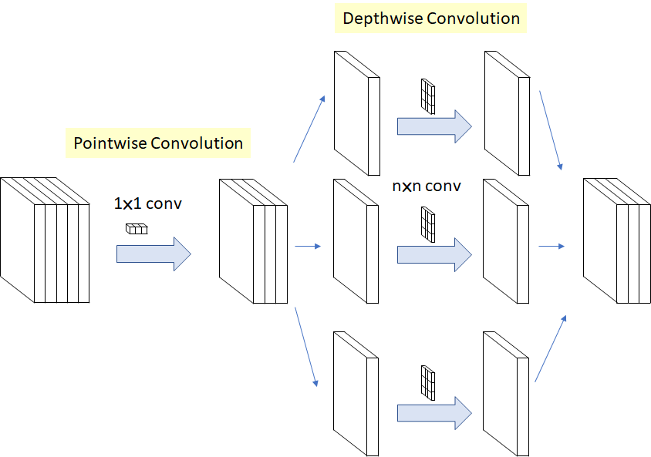
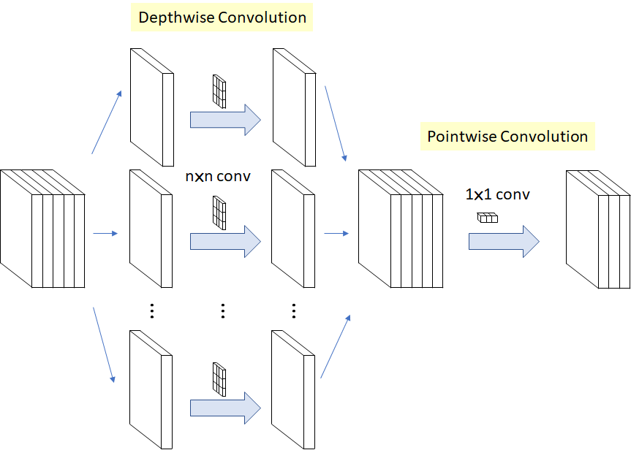
The Modified Depthwise Separable Convolution used as an Inception Module in Xception, so called “extreme” version of Inception module (n=3 here)
Depthwise convolution is the channel-wise n×n spatial convolution. [For 5 channels : 5 n×n spatial convolution.]
Pointwise convolution actually is the 1×1 convolution to change the dimension.

Slide 44
Xception -2016
Useful in Detecting Face Swaps in Videos
Shortcuts between Convolution blocks as in ResNet
Mobilenets, based on Xception (from Google ): SotA in terms of statistical efficiency, require the least amount of weights and computations to achieve a usable accuracy
*https://arxiv.org/pdf/1610.02357.pdf
*https://www.analyticsvidhya.com/blog/2018/04/this-deep-learning-algorithm-detects-face-swaps-videos/
https://www.youtube.com/watch?v=T7o3xvJLuHk

Slide 45
Variations
Attention based CNN
Feature-Map (ChannelFMap) Exploitation based CNNs etc

