Slide 1
fMRI physics and practical data analysis
Peiwu Qin
pwqin@sz.Tsinghua.edu.cn
Office: ipark C2-913

Slide 2
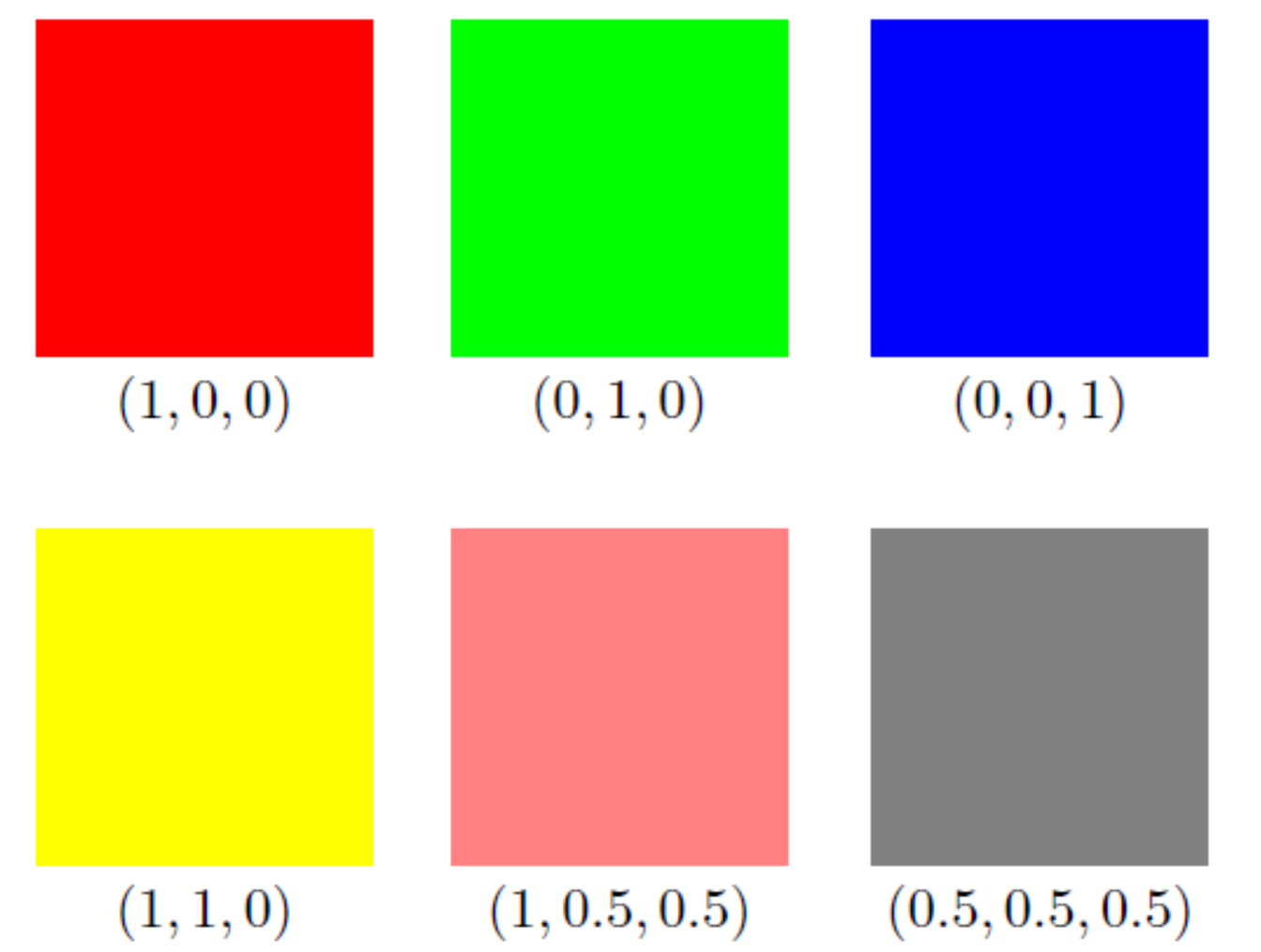
Vector application 2

Slide 3
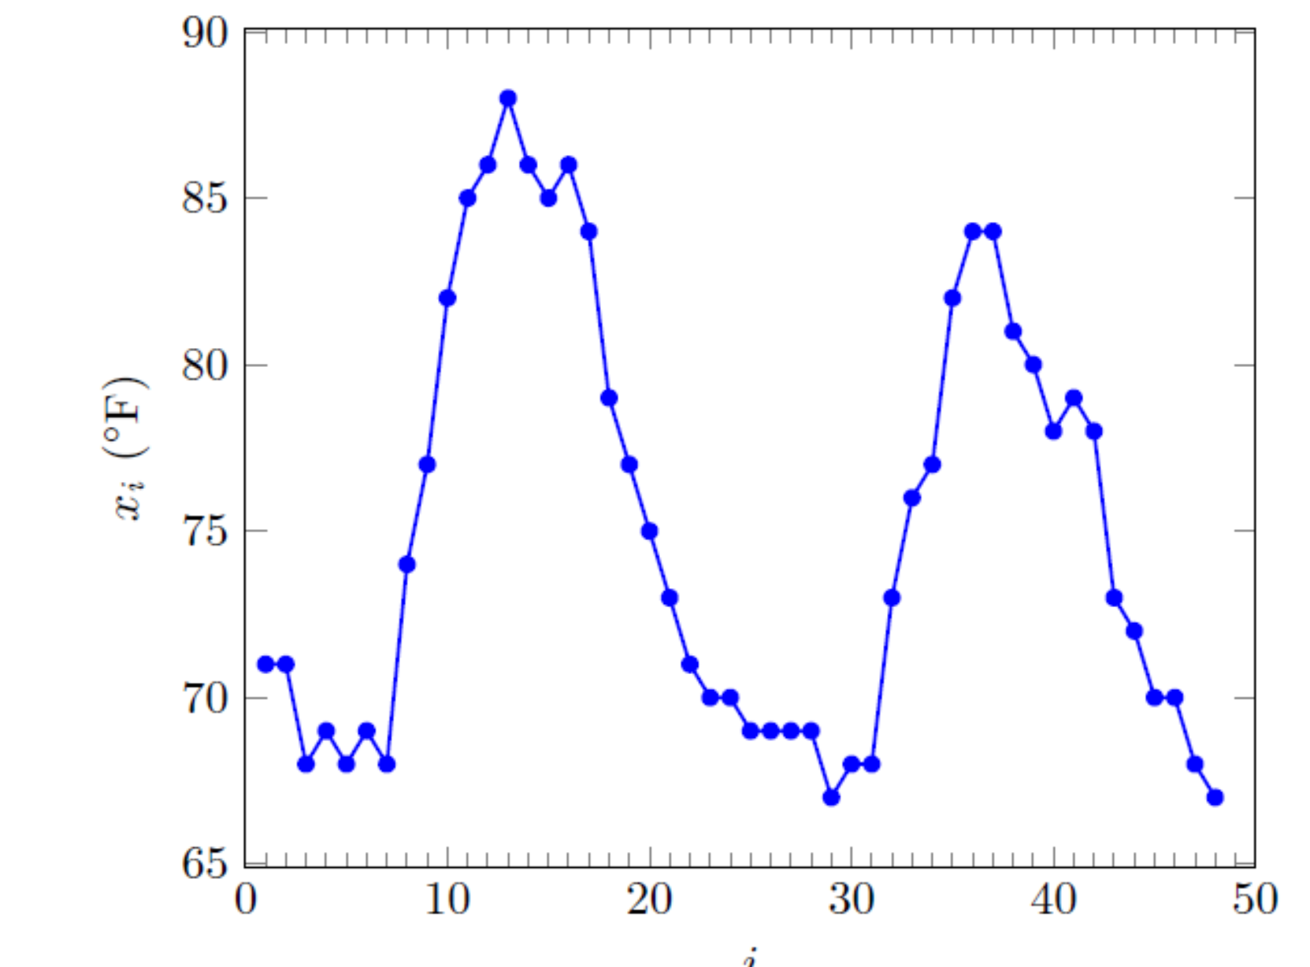
Vector application 2
Figure 1.3 Hourly temperature in downtown Los Angeles on August 5 and 6, 2015 (starting at 12:47AM, ending at 11:47PM).

Slide 4
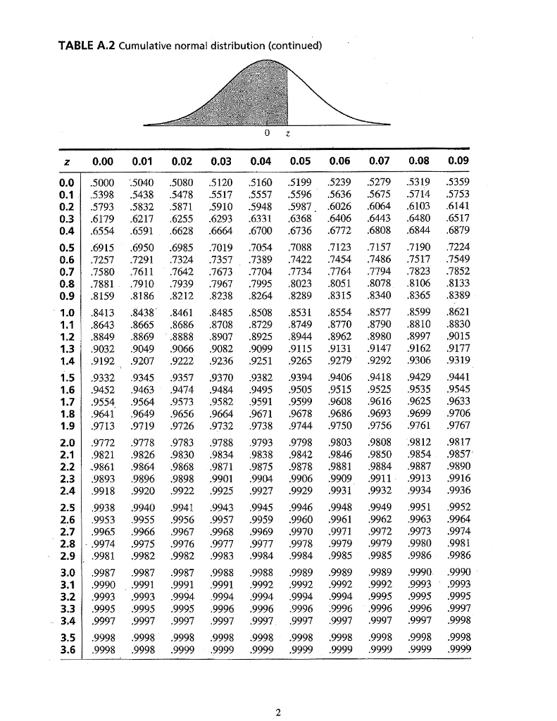

Slide 5
