Slide 1
fMRI physics and practical data analysis
Peiwu Qin
pwqin@sz.Tsinghua.edu.cn
Office: ipark C2-913

Slide 2
Git
Unpleasant person in English slang
Named by Linus Torvalds when he wrote the first version. He described the tool as ‘the stupid content tracker’

Slide 3
Getting started with GIT
• working with a local repository
• synchronising with a remote repository
• setting up a server

Slide 4
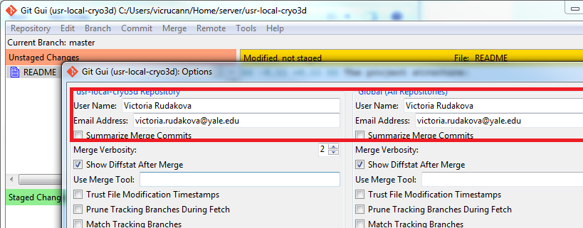
Git config
● Using Git Bash (command line):
$ git config --global user.name "Name Surname"
$ git config --global user.email name.surname@yale.edu
● Using Git GUI:

Slide 5
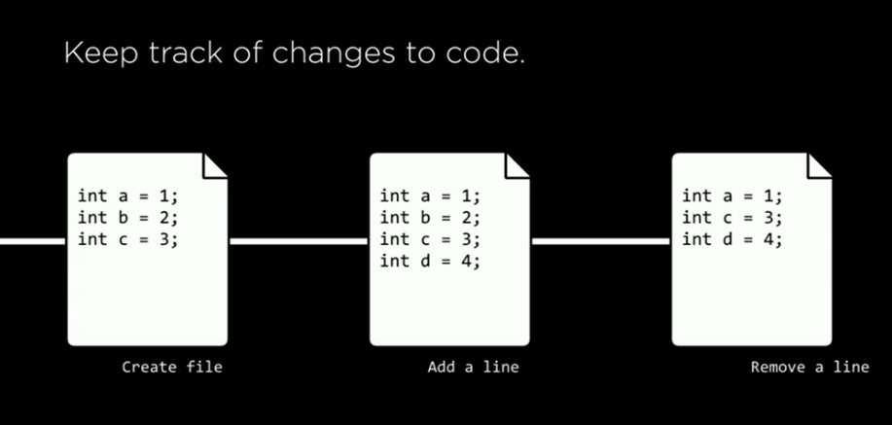
Git: version control

Slide 6
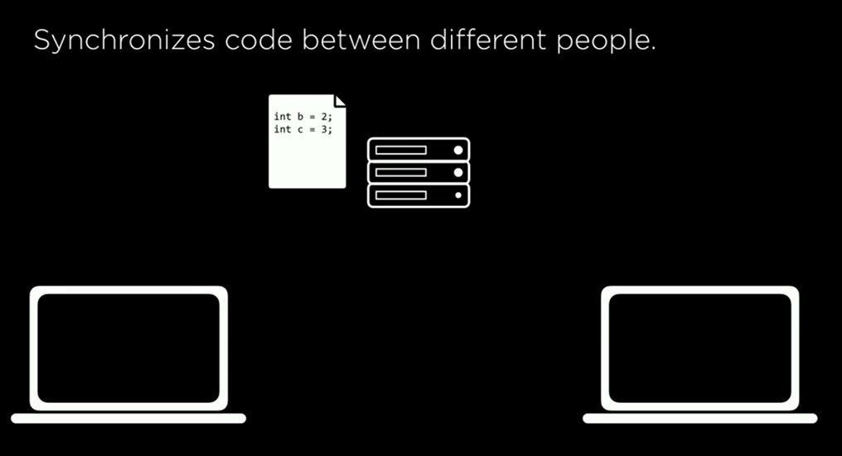
synchronization

Slide 7
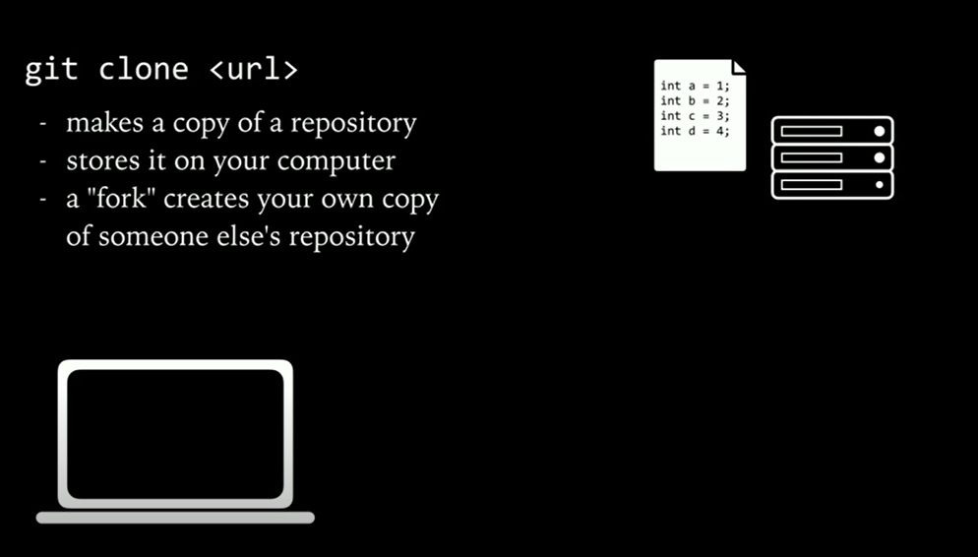
URL: uniform resource locator
Reference to a resource on the internet, a web address

Slide 8
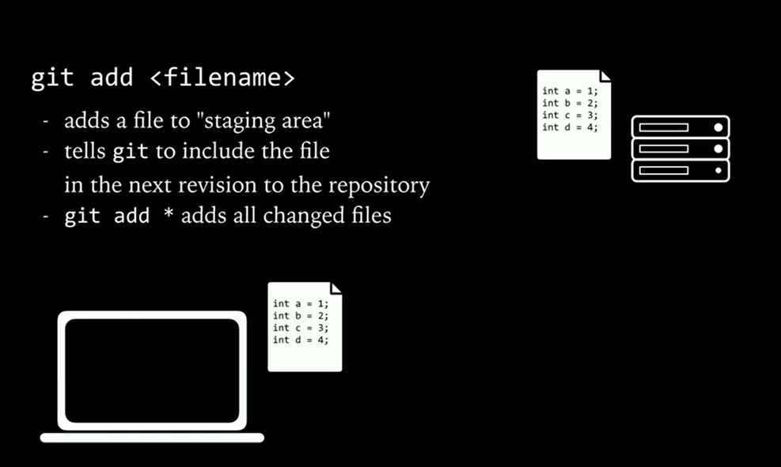

Slide 9
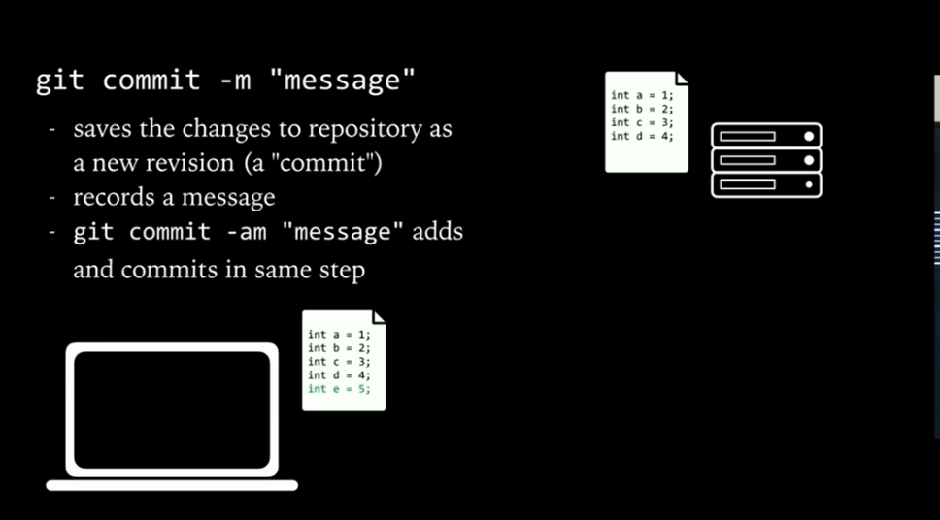

Slide 10
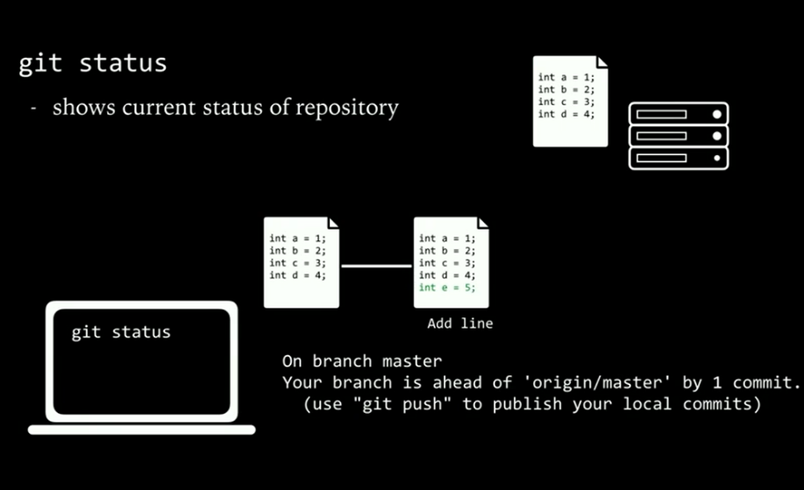
Git status

Slide 11
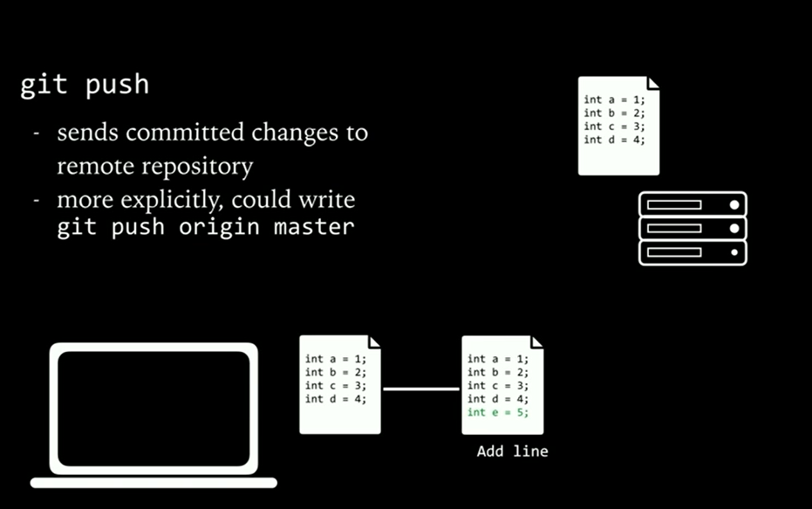

Slide 12
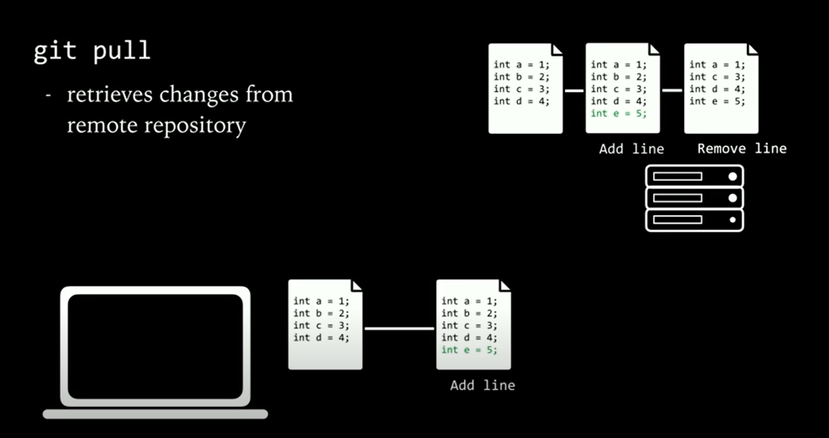
Git pull

Slide 13
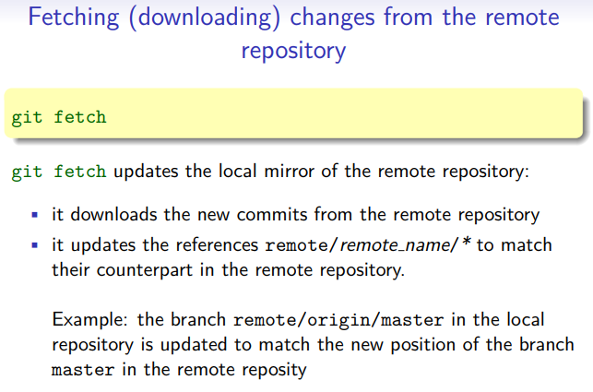

Slide 14
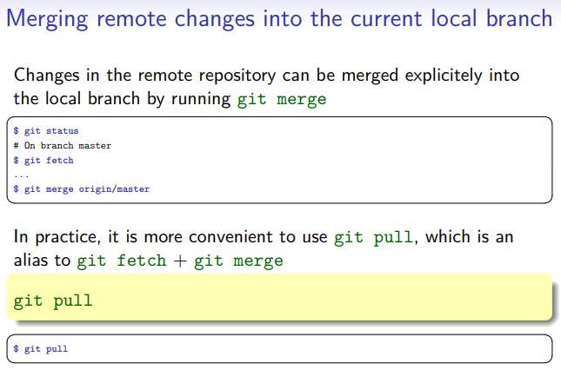

Slide 15
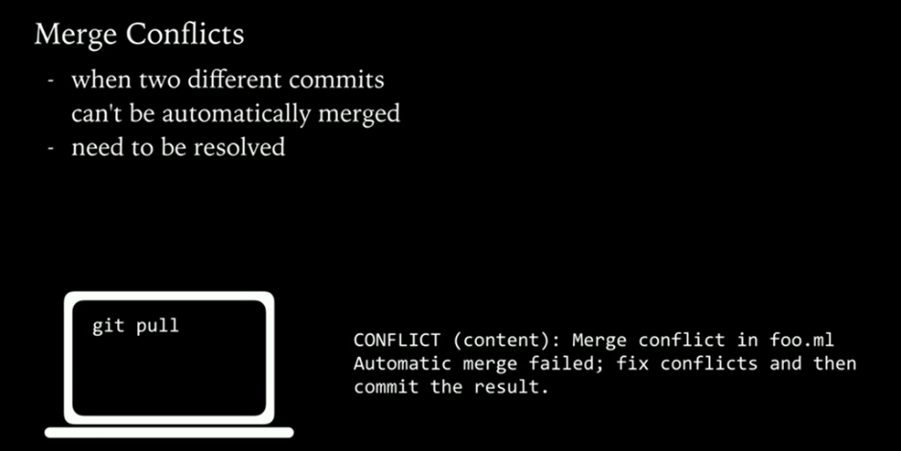
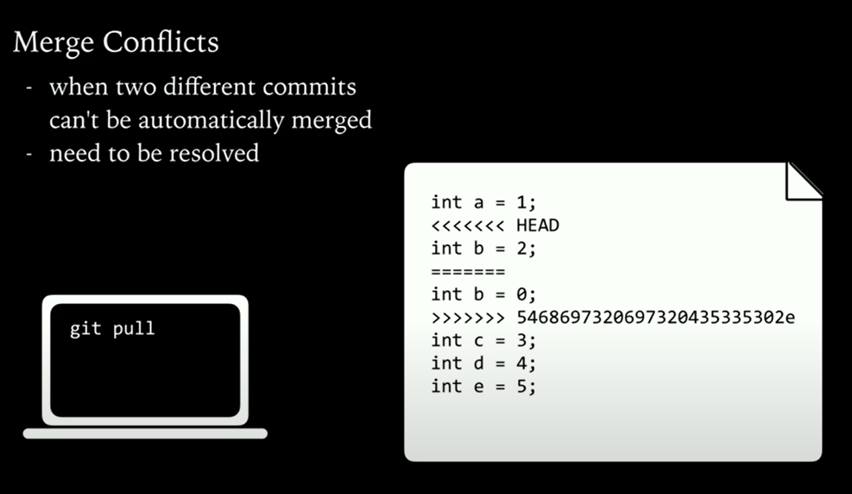

Slide 16
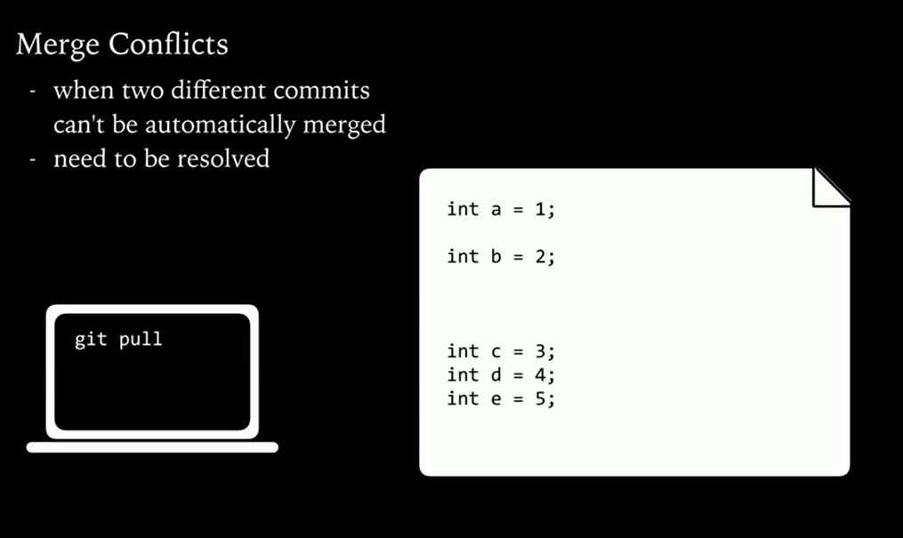

Slide 17
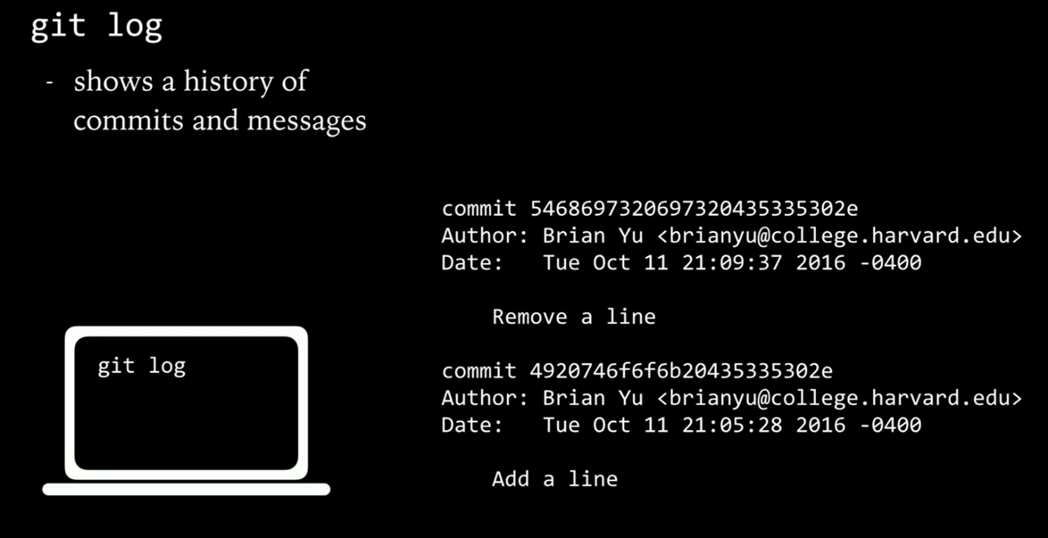

Slide 18
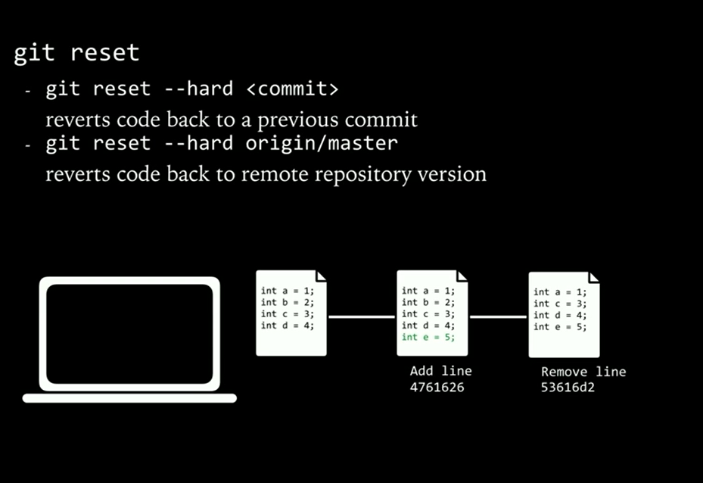
Git reset

Slide 19
Use case 3: branching You may have multiple variants of the same software, materialised as branches, for example:
• a main branch
• a maintainance branch (to provide bugfixes in older releases)
• a development branch (to make disruptive changes)
• a release branch (to freeze code before a new release) VC tools will help you to:
• handle multiple branches concurrently
• merge changes from a branch into another one

Slide 20
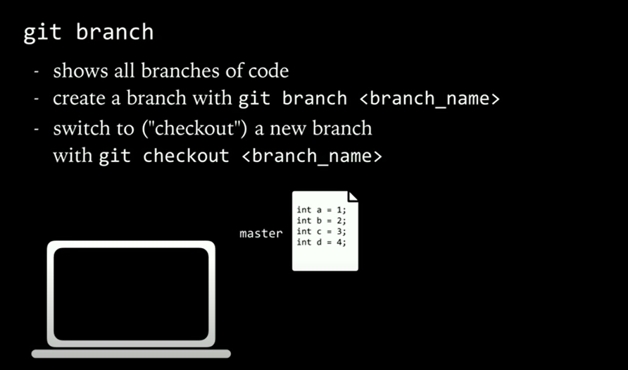
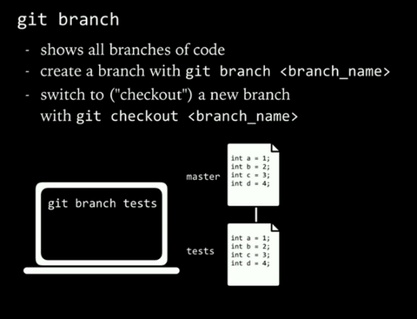

Slide 21
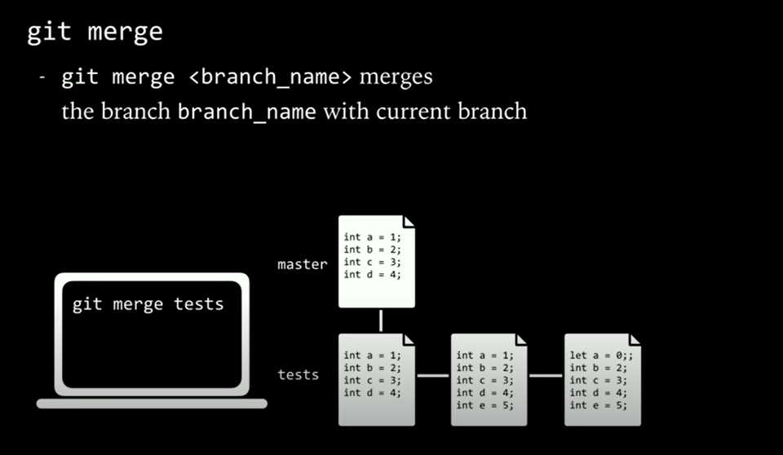

Slide 22
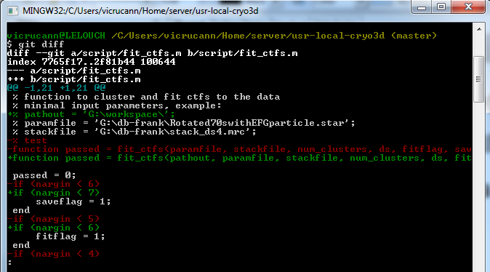
Viewing staged and unstaged changes
$ git diff [what changed but not yet staged]

Slide 23
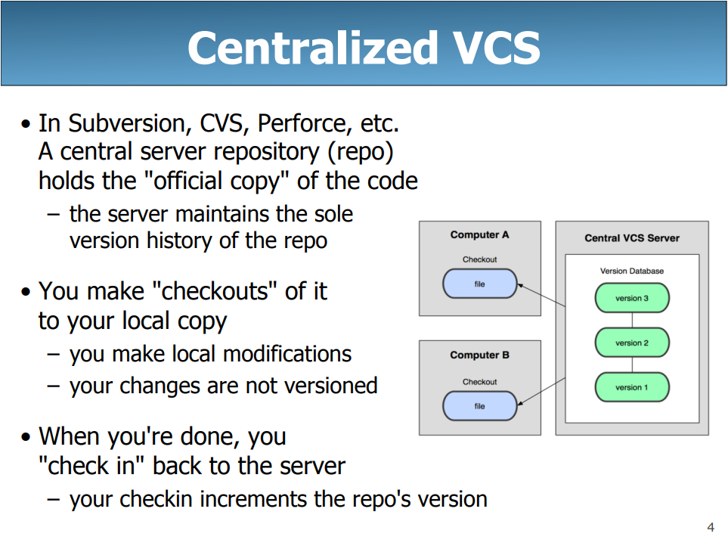

Slide 24
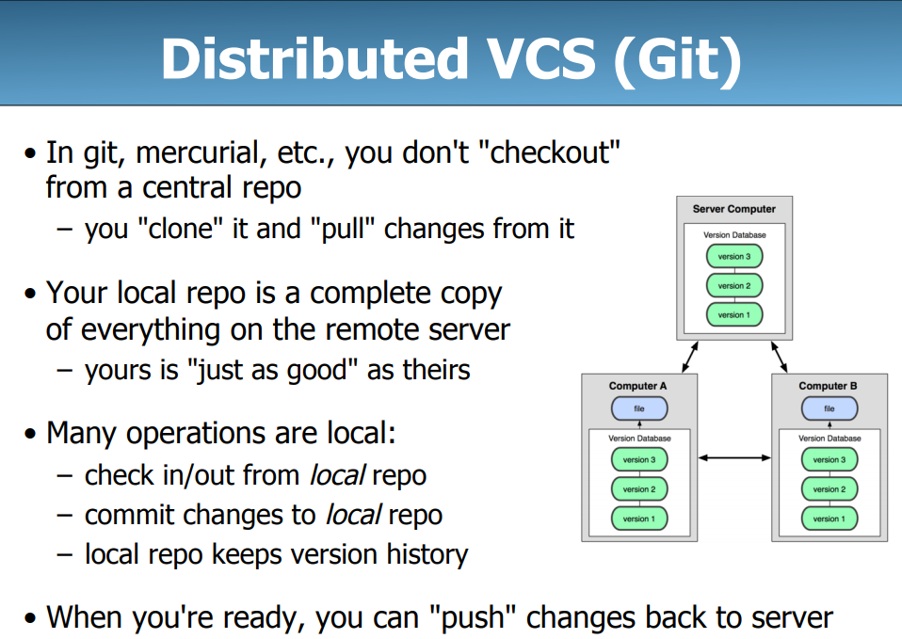

Slide 25
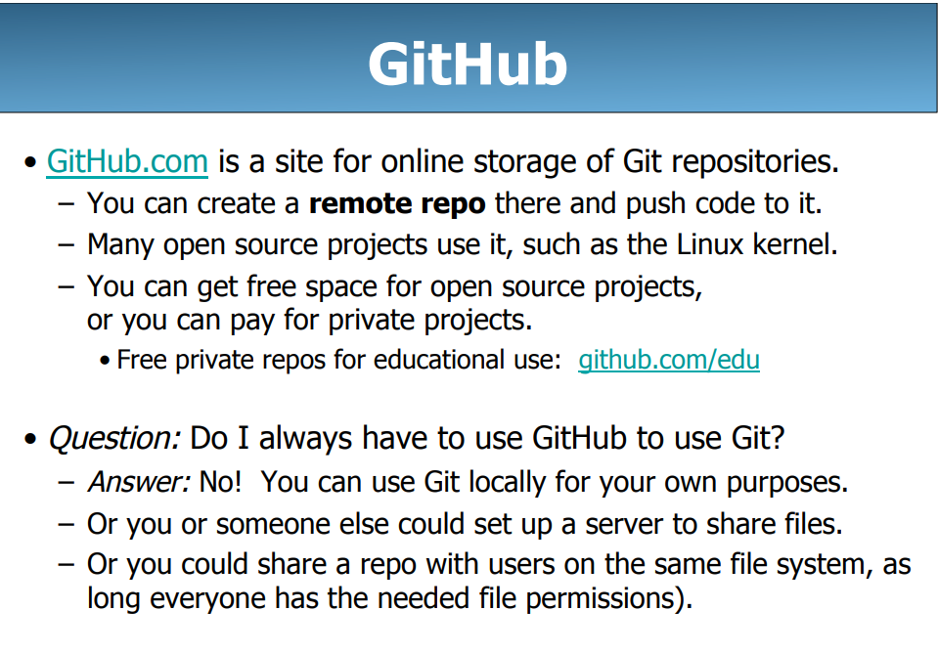

Slide 26
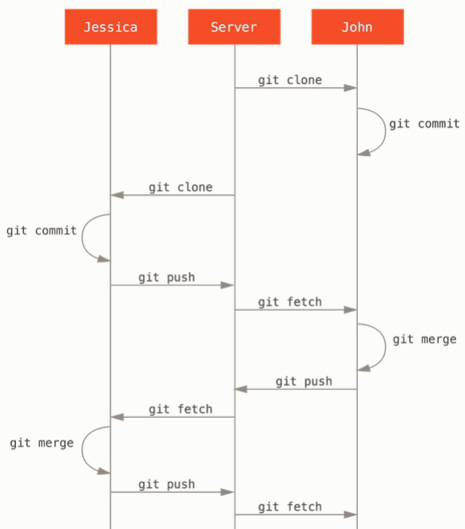

Slide 27
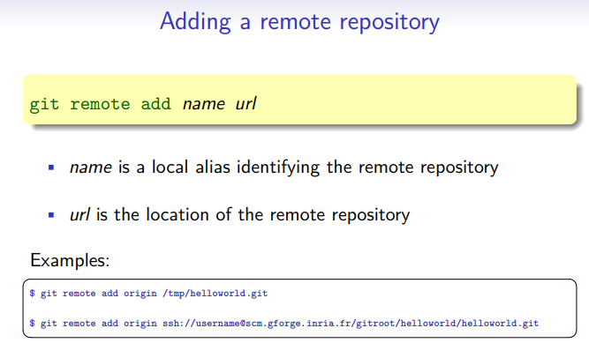

Slide 28
