Slide 1
VCS

Slide 2


FAWAD IQBAL
fawadiqbal.com
@
me@fawadiqbal.com
fawadiqbal@stumail.neu.edu.cn
fwd82
VCS

Slide 3
PROBELMS
Sync your data between your local environment and your remote server
VCS

Slide 4
PROBELMS
2. Keep Track of all your changes.
VCS

Slide 5
PROBELMS
3. Pair Programming / Team Work
VCS

Slide 6
SOLUTION
Version Control System
VCS

Slide 7
VERSION CONTROL SYSTEM
Version Control System (VCS) is for tracking changes in computer files, software development projects,
&
enable them to collaborate on those projects. Using it, the developers can work together on code and separate their tasks.”
VCS
Version Control System

Slide 8
VERSION CONTROL SYSTEM
You can sync your data between your local environment and your remote server
Keep Track of all your changes.
Pair Programming / Team Work
VCS
Version Control System

Slide 9
EXAMPLES OF VCS
Git
Apache Subversion (SVN)
AWS CodeCommit
and a lot more…
VCS
Version Control System

Slide 10

EXAMPLES OF VCS – Git | GitHub
Junio Hamano
The stupid Content Tracker
Global Information Tracker
Git
Linus Torvalds
get
VCS
Version Control System

Slide 11
EXAMPLES OF VCS – Git | GitHub
Git
GitHub
VCS
Version Control System

Slide 12
EXAMPLES OF VCS – Git | GitHub
Chrish Wanstrath
Microsoft
2018
7.6 Billion
GitHub
VCS
Version Control System

Slide 13
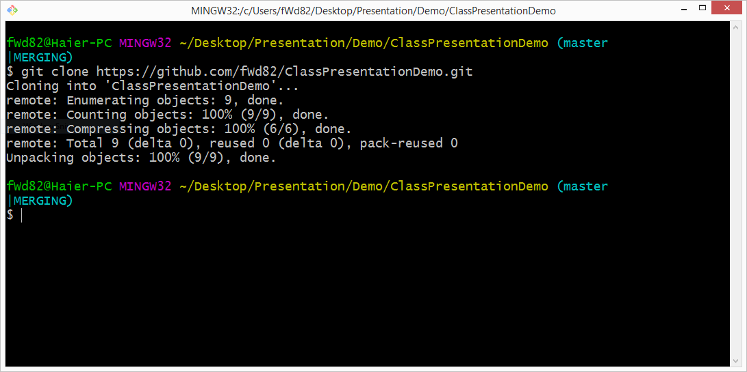
VCS
Version Control System

Slide 14
Some Commands Of Git
$ git init // Initialize local git repo
$ git add <file> // Add file(s) to index
$ git status // Check status of working tree
$ git commit // Commit changes in index
$ git push // Push to remote directory
$ git pull // Pull latest from remote directory
$ git clone // Clone a copy into a new dir
$ touch index.html // Creating text.txt file
VCS
Version Control System

Slide 15
FURTHER STUDY..
Basic Git commands
https://confluence.atlassian.com/bitbucketserver/basic-git-commands-776639767.html
Git Repo
https://github.com/git/git
Git Docs
https://git-scm.com/docs/gittutorial
VCS
Version Control System

Slide 16
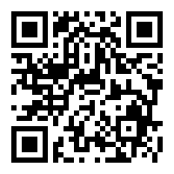
DOWNLOAD..
Download offline version presentation slides:
https://github.com/fWd82/ClassPresentationDemo
VCS
Version Control System

Slide 17
DOUBTS?
Download
Questions, Doubts, Feedback and Critics:
fawadiqbal@stumail.neu.edu.cn
VCS
Version Control System

Slide 18
VCS
Version Control System

