Slide 1
E-commerce website
SDD (Project detailed documentation)

Slide 2
Introduction:
The e-commerce website project is designed to provide a comprehensive online shopping experience for customers while offering efficient management tools for administrators. With a focus on simplicity, usability, and functionality, the website aims to streamline the process of browsing, purchasing, and managing products and orders. By leveraging modern web technologies and intuitive design principles, the platform seeks to cater to the needs of both customers and administrators in a user-friendly manner.

Slide 3
Stakeholders:
Customers: Individuals who visit the e-commerce website to explore products, make purchases, and manage their accounts. Customers are the primary users of the platform, and their satisfaction and engagement are paramount for its success.
Admins: Authorized personnel responsible for managing the e-commerce website, including inventory management, order processing, customer support, and website administration. Admins have access to backend functionalities and tools to oversee and maintain the platform's operations.
These two stakeholder groups are fundamental to the operation and success of the e-commerce website project. While customers drive the demand and usage of the platform through their shopping activities, administrators play a crucial role in ensuring the smooth operation and maintenance of the website's backend infrastructure. Effective collaboration between customers and administrators is essential for delivering a seamless online shopping experience and achieving the goals of the project.

Slide 4
Scope :
The e-commerce website project aims to establish a robust online platform tailored for facilitating commercial transactions between sellers and buyers. Its primary purpose is to provide a seamless and intuitive shopping experience while offering efficient management tools for sellers. The project's objectives include:
Comprehensive Product Catalog: Develop a user-friendly interface for browsing and purchasing a wide range of products across various categories and subcategories.
User Account Management: Implement registration, login, and profile management features to enable personalized shopping experiences and order tracking for users.
Secure Payment Processing: Integrate secure payment gateways to facilitate smooth and secure transactions, ensuring customer trust and confidence.
Order Management: Develop an order processing system that allows users to manage their orders, track shipments, and handle returns or exchanges efficiently.
Seller Dashboard: Provide sellers with a dedicated dashboard to manage their product listings, inventory, pricing, and order fulfillment processes.
Responsive Design: Ensure compatibility with multiple devices and screen sizes to accommodate the growing trend of mobile shopping.

Slide 5
System Overview:
General Description:
Our e-commerce software system is a robust online platform designed to facilitate buying and selling goods and services over the internet. It provides a virtual marketplace where businesses and consumers can interact, browse products, make purchases, and manage transactions seamlessly. With intuitive features and secure functionalities, our e-commerce software aims to enhance the online shopping experience for users worldwide.
Functional Requirements:
1- User Registration and Authentication:
a) Users shall be able to create accounts with unique usernames and passwords.
b) Users shall be able to log in securely to access their accounts.
2- Product Browsing and Search:
a) Users shall be able to browse products by category.
b) Users shall be able to search for products using keywords.
c) The website shall display product details, including images, descriptions, prices, and availability.

Slide 6
3- Shopping Cart and Checkout:
a) Users shall be able to add products to a shopping cart.
b) Users shall be able to view and edit the contents of their shopping cart.
c) Users shall be able to proceed to checkout to complete their purchases.
d) The checkout process shall include entering shipping and billing information.
e) Users shall receive confirmation emails after successful purchases.
4- Payment Processing:
a) The website shall support various payment methods such as credit/debit cards and cash.
b) Payment transactions shall be secure and encrypted.
c) Users shall receive payment confirmation upon successful transactions.
5- Order Management:
a) Users shall be able to view their order history and track the status of their orders.
b) Admins shall be able to manage orders, including processing, shipping, and canceling orders.

Slide 7
Non-Functional Requirements :
1- Security:
a) User data shall be encrypted using AES-256 encryption.
b) The website shall implement measures to prevent common security threats
c) SSL encryption shall be used to protect data transmission.
2- Scalability:
a) The website's functionality shall be designed to evolve and expand without compromising performance.
b) Scalability considerations shall encompass both hardware and software aspects.
3- Maintainability:
a) The website's architecture and design shall facilitate easy maintenance and updates.
b)Proactive measures shall be taken to address potential future issues and keep the system up-to-date.
4- Usability:
a) The user interface shall be intuitive and easy to navigate.
b) It shall be responsive and compatible with various devices and screen sizes.

Slide 8
Architectural Design:
High-level Architectural Overview:
The e-commerce website's architecture is designed to be scalable, modular, and resilient, ensuring optimal performance and reliability. At a high level, the system comprises the following components:
Presentation Layer: This layer handles the user interface and interaction with customers and administrators. It includes components such as web pages, UI controllers, and client-side scripts responsible for rendering dynamic content and facilitating user interactions.
Application Layer: The application layer contains the business logic and core functionalities of the e-commerce platform. It processes user requests, orchestrates data flow, and enforces business rules. Key components include service classes, domain models, and application logic modules.
Data Access Layer: This layer is responsible for interacting with the underlying data storage systems, such as databases or external APIs. It includes components such as data access objects (DAOs), repositories, and data mapping frameworks that facilitate CRUD (Create, Read, Update, Delete) operations and data retrieval.
Integration Layer: The integration layer facilitates communication with external systems, services, and third-party APIs. It handles tasks such as payment processing, shipping logistics, and integration with external data sources. Components in this layer include adapters, connectors, and service gateways.

Slide 9
Design Patterns and Principles:
The e-commerce website architecture follows several design patterns and principles to promote maintainability, extensibility, and scalability:
Model-View-Controller (MVC): The application is structured based on the MVC pattern, separating concerns between the model (business logic and data), view (presentation layer), and controller (application logic).
Dependency Injection (DI): Dependency injection is used to manage component dependencies and promote loose coupling between modules, facilitating easier testing and maintenance.
Service-Oriented Architecture (SOA): The system is designed using a service-oriented architecture approach, where functionalities are encapsulated into modular, independent services that communicate via well-defined interfaces.
Microservices: The architecture may employ a microservices approach, decomposing the system into smaller, independently deployable services that can be developed, deployed, and scaled independently, promoting flexibility and resilience.

Slide 10
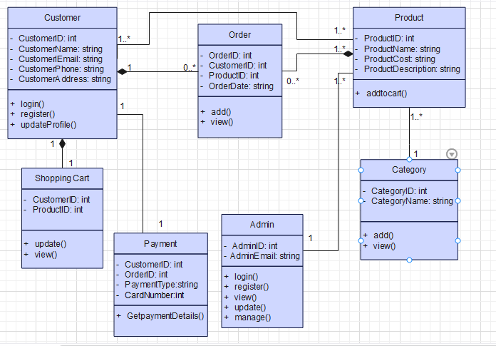
Detailed Design:
Class Diagram:

Slide 11
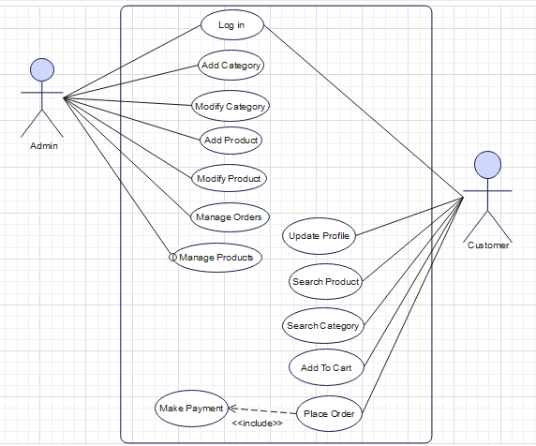
Use Case Diagram:

Slide 12
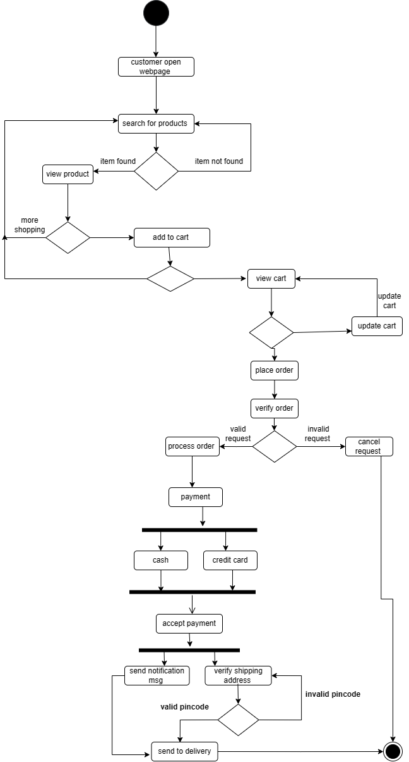
Activity Diagram:

Slide 13
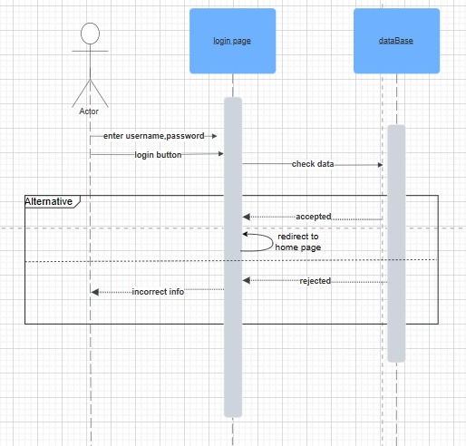
Sequence Diagram:

Slide 14
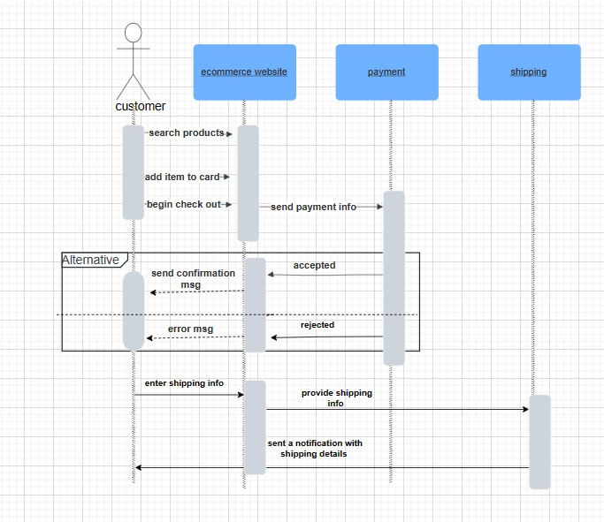

Slide 15
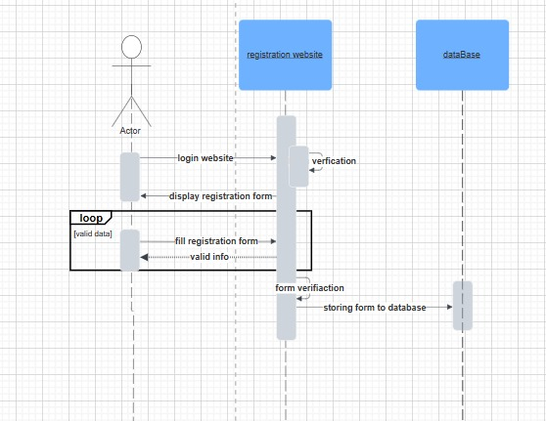

Slide 16
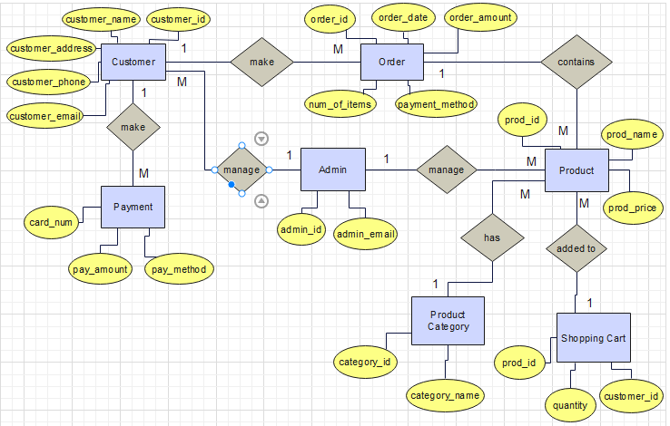
ERD :

Slide 17
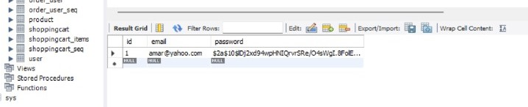
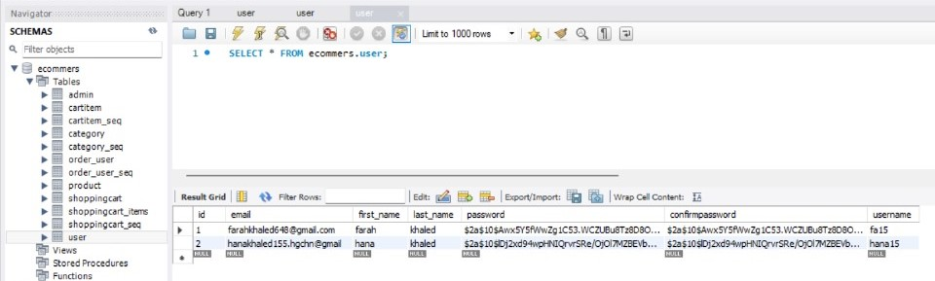
Database Design:
Admin:
User:

Slide 18
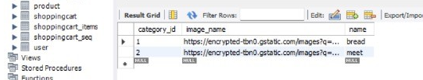
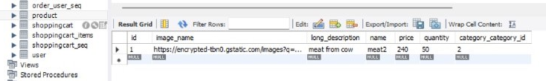
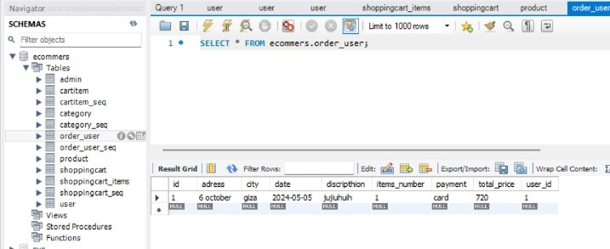
Category:
Product:
Order:

Slide 19
OCL:
context Customer && Admin :
--Signup Constraints
pre: self.password.matches(^(?=.[A-Za-z])(?=.\\d)[A-Za-z\\d]{6,32}$)
pre: self.phoneNumber.matches('^01[0125][0-9]{8}$')
pre: self.password = self.confirmPassword
pre: self.email.matches('^[a-zA-Z0-9._%+-]+@[a-zA-Z0-9.-]+\\.[a-zA-Z]{2,}$')
pre: User.allInstances()->forAll(u | u <> self implies u.email <> self.email)
post: self.add
--Login Constraints
inv: self.lookupUser(self.email) <> null && self.password = self.lookupUser(self.email).password
pre: self.email.matches('^[a-zA-Z0-9._%+-]+@[a-zA-Z0-9.-]+\\.[a-zA-Z]{2,}$')
post: self.isAuthenticated

Slide 20
--forget password Constraints
inv: self.lookupUser(self.email) <> null
pre: self.enteredVerificationCode = self.sentVerificationCode
pre: self.newPassword.matches('[A-Z][a-zA-Z]{3,8}’)
post: self.passwordChanged
--Helper operation to look up the user based on email
def: lookupUser(email: String) :
User = User.allInstances()->select(u | u.email = email)->asOrderedSet()->first()
context Cart
--add product Constraints
inv: self.isAuthenticated
pre: self.inventory.productQuantity >= 0
post: self.cartModified

Slide 21
context Payment
--Payment Constraints
inv: self.customer.isAuthenticated
pre: self.cart.products->notEmpty()
self.phoneNumber.matches('01[0125][0-9]{8}') && self.city.notEmpty()&&self.details.notEmpty()
pre: if self.method = 'Visa' then
self.cardName.notEmpty() && self.isCardValid(self.expirationDate) self.cardNumber.matches('[0-9]{16}') &&
else
true -- Cash payment (no additional checks)
endif
post: self.orderPlaced
post: self.inventory.productQuantity = self.inventory.productQuantity@pre + self.cart.addedQuantity - self.cart.removedQuantity

Slide 22
--Helper operation to check if the card expiration date is valid
def: isCardValid(expirationDate: String) : Boolean =
let currentMonth: Integer = Integer::parseInt(currentDate.substring(5, 6)) in
--(currentDate format YYYY/MM/DD in JAVA , expirationDate format MM/YY “input from user”)
let currentYear: Integer = Integer::parseInt(currentDate.substring(2, 3)) in
let cardMonth: Integer = Integer::parseInt(expirationDate.substring(0, 1)) in
let cardYear: Integer = Integer::parseInt(expirationDate.substring(3,4)) in
cardYear >= currentYear && cardMonth >= currentMonth
--in keyword establishes that the operation is relevant only when dealing with instances of payment context
context Admin
inv: self.Admin.isAuthenticated
post: self.Admin.manageProduct = True && self.Admin.manageCategories = True && self.Admin.customer = True

Slide 23
Conclusion:
In conclusion, this Software Design Document (SDD) serves as a detailed blueprint for the development and implementation of our e-commerce website. Through comprehensive analysis and planning, we have outlined the key components, functionalities, and design principles that will shape the final product.
The scope and context section provided insights into the purpose of the e-commerce website and its alignment with business objectives. By understanding the industry landscape, target market, and competitive factors, we have established a solid foundation for the project.
The architectural design section delved into the high-level structure of the system, detailing the components, technology stack, and design patterns employed. This ensures scalability, maintainability, and performance optimization of the website.
Detailed design specifications, including class diagrams, sequence diagrams, and database schema, provide a clear understanding of how the system operates at a granular level. These specifications guide the development process and facilitate effective communication among team members.
Error handling and recovery strategies are crucial for maintaining system reliability and data integrity. By identifying potential errors, implementing robust error handling mechanisms, and defining recovery procedures, we mitigate risks and ensure smooth operation under varying conditions.

