Slide 1
ECO346 | DATA VISUALIZATION TECHNIQUES FOR ECONOMISTS
1/4
Visualizing Annual Earnings
by Age
PSLM sample • Sindh Urban • Ages 15–64
REGISTRATION NUMBER
VARIANT SPECIFICATION
FA24-BEDS-003
Sindh Urban • Weighted analysis using household weights

Slide 2
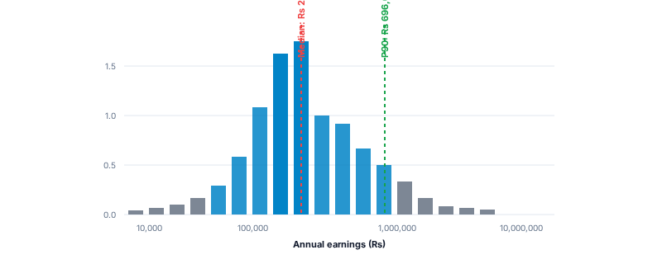
Q2 • EARNINGS DISTRIBUTION
Annual earnings are strongly spread out
2/4
Positive annual earners • Sindh Urban • Ages 15–64
Most Earners Receive Less Than the Highest-Earning Group
2,644
WEIGHTED MEDIAN
Rs 264,000
WEIGHTED P90
Rs 696,000
P90 / P10 RATIO
5.8×
P10 = Rs 120,000
KEY FINDING
Earnings inequality is substantial in urban Sindh.
Source: PSLM 2019–20 | Sindh urban earners, ages 15–64, positive earnings | Weighted by hhweight | 2 earners outside histogram range
Source: PSLM subset. Weighted quantiles use household weight (hhweight).
ECO346 • Data Visualization Assignment • Sindh Urban

Slide 3
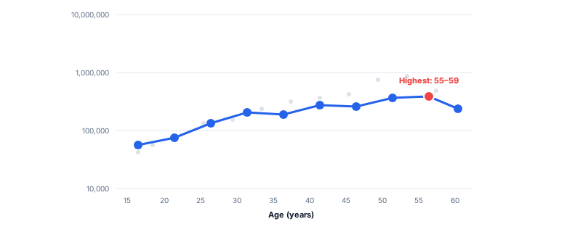
Q3 • AGE AND EARNINGS
Weighted mean earnings generally rise with age
3/4
Band means use household weights; age bands are five years wide
PEAK EARNINGS AGE BAND
Weighted Mean Earnings Peak at Ages 55–59
Ages 55–59
Weighted Mean: Rs 542,400
SELECTED AGE-BAND RESULTS
Age band | n | Weighted mean
25–29 | 398 | Rs 303,153.9
45–49 | 250 | Rs 431,696.7
55–59 | 157 | Rs 542,400.0
60–64 | 72 | Rs 414,262.5
Key insight: The weighted mean complements the median by showing how higher earnings influence the overall average.
PSLM 2019–20 | Sindh urban earners, ages 15–64, with positive annual earnings | Weighted by household weight | Hollow markers indicate age bands with fewer than 30 earners
Source: PSLM 2019–20 subset microdata.
ECO346 • Data Visualization Assignment • Sindh Urban

Slide 4


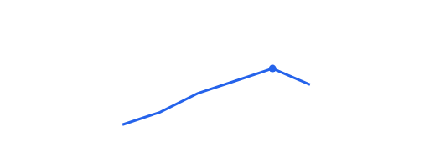
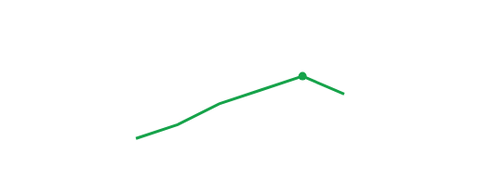
Q4 • REPRODUCIBILITY AND VALIDATION
Cross-Validation between R and Python Pipelines
4/4
R Pipeline Output
R / ggplot2
Python Pipeline Output
Python / matplotlib
Both R and Python produced identical weighted mean annual earnings of Rs 303,153.9 for the 25–29 age group.
PSLM 2019–20 Microdata Analysis • Sindh Urban
ECO346 • Data Visualization Assignment • Sindh Urban

