Slide 1
ECO346 | DATA VISUALIZATION TECHNIQUES FOR ECONOMISTS
Visualizing Annual Earnings
by Age
PSLM sample • Sindh Urban • Ages 15–64
REGISTRATION NUMBER
FA24-BEDS-011
Variant: Sindh Urban • Weighted analysis using household weights
1/4

Slide 2
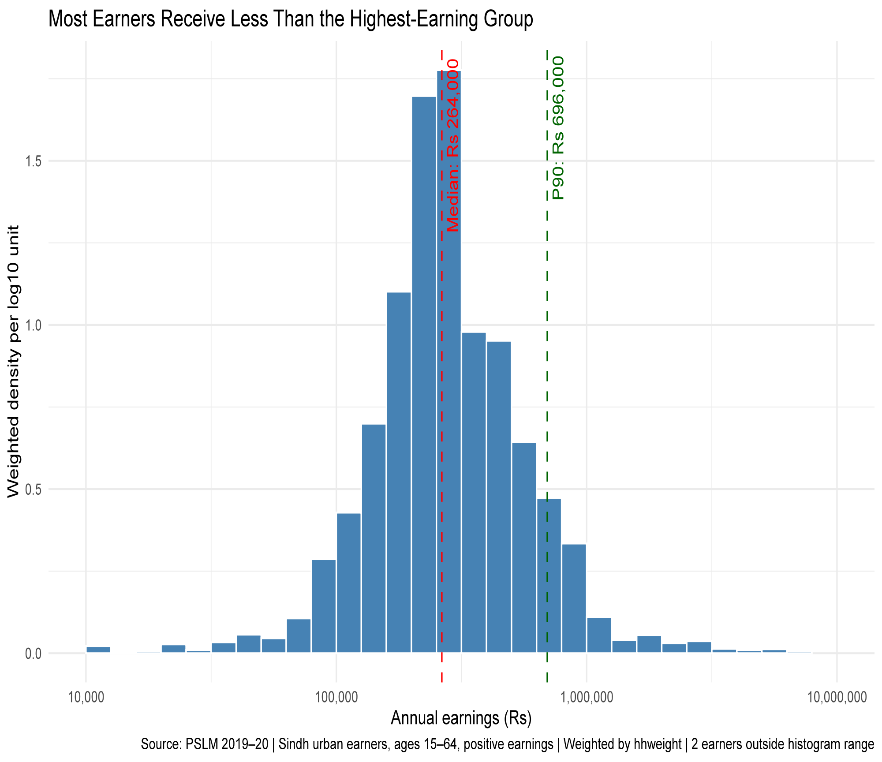
Q2 • EARNINGS DISTRIBUTION
Annual earnings are strongly spread out
Positive annual earners • Sindh Urban • Ages 15–64
VALID EARNERS
WEIGHTED MEDIAN
2,644
Rs 264,000
After sample and missing-value filters
WEIGHTED P90
P90 / P10
5.8×
Rs 696,000
P10 = Rs 120,000
Key finding: the 90th-percentile earner receives about 5.8 times the 10th-percentile earner. The weighted median (Rs 264,000) is slightly above the unweighted median (Rs 252,000).
Source: PSLM subset. Weighted quantiles use household weight (hhweight).
ECO346 • Data Visualization Assignment • Sindh Urban
2/4

Slide 3
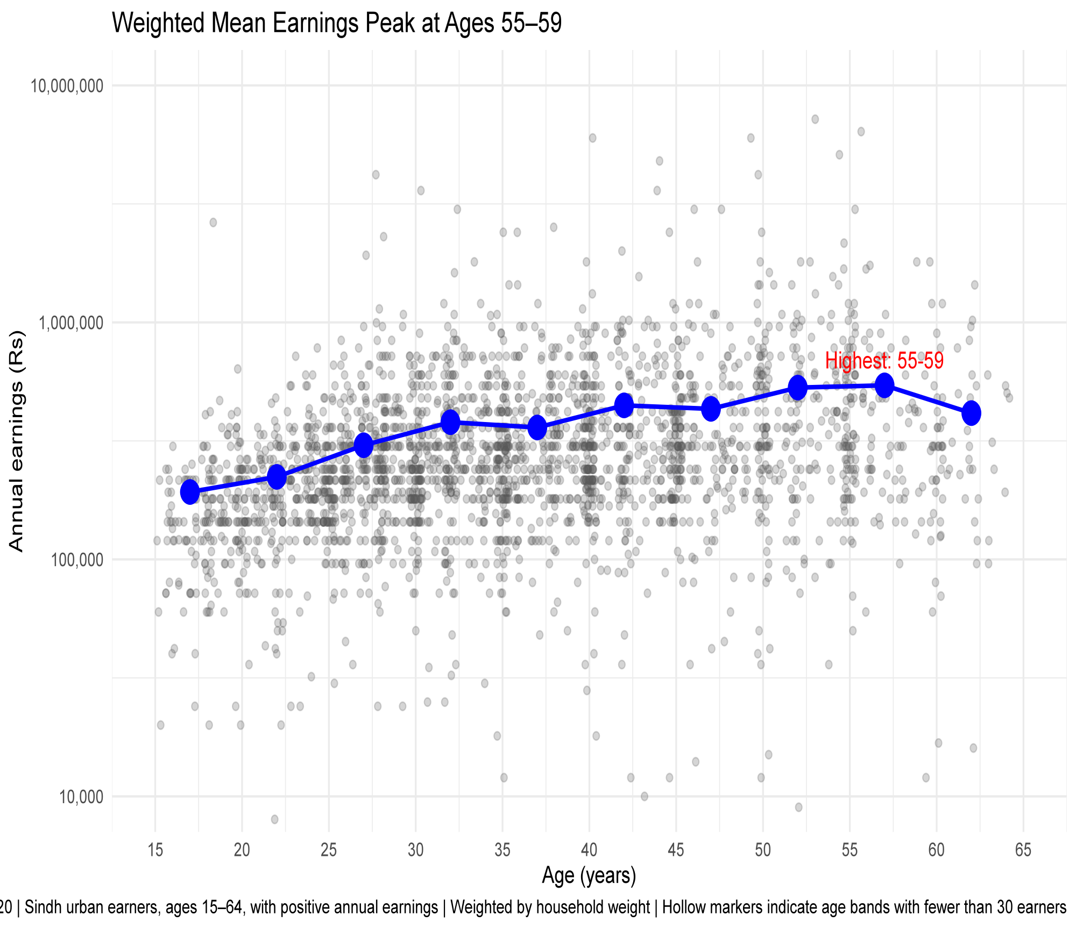
Q3 • AGE AND EARNINGS
Weighted mean earnings generally rise with age
Band means use household weights; age bands are five years wide
Weighted mean by age band (Rs)
Selected age-band results
Age band | n | Weighted mean
25–29 | 398 | Rs 303,153.9
45–49 | 250 | Rs 431,696.7
55–59 | 157 | Rs 542,400.0
60–64 | 72 | Rs 414,262.5
Interpretation: earnings do not increase smoothly at every age band. The pattern is consistent with experience-related earnings growth, but the cross-sectional data cannot prove that individuals’ earnings rise as they age.
15–19 25–29 35–39 45–49 55–59 60–64
Peak band: ages 55–59, with weighted mean annual earnings of Rs 542,400.
ECO346 • Data Visualization Assignment • Sindh Urban
3/4

Slide 4
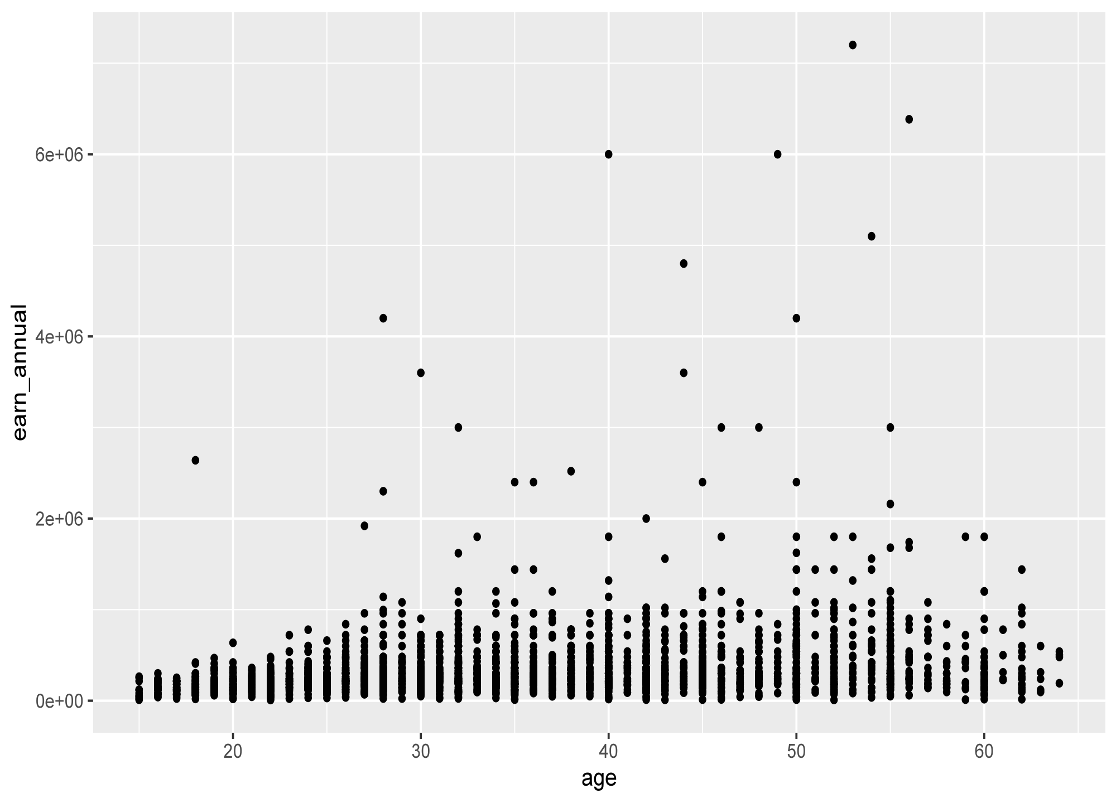
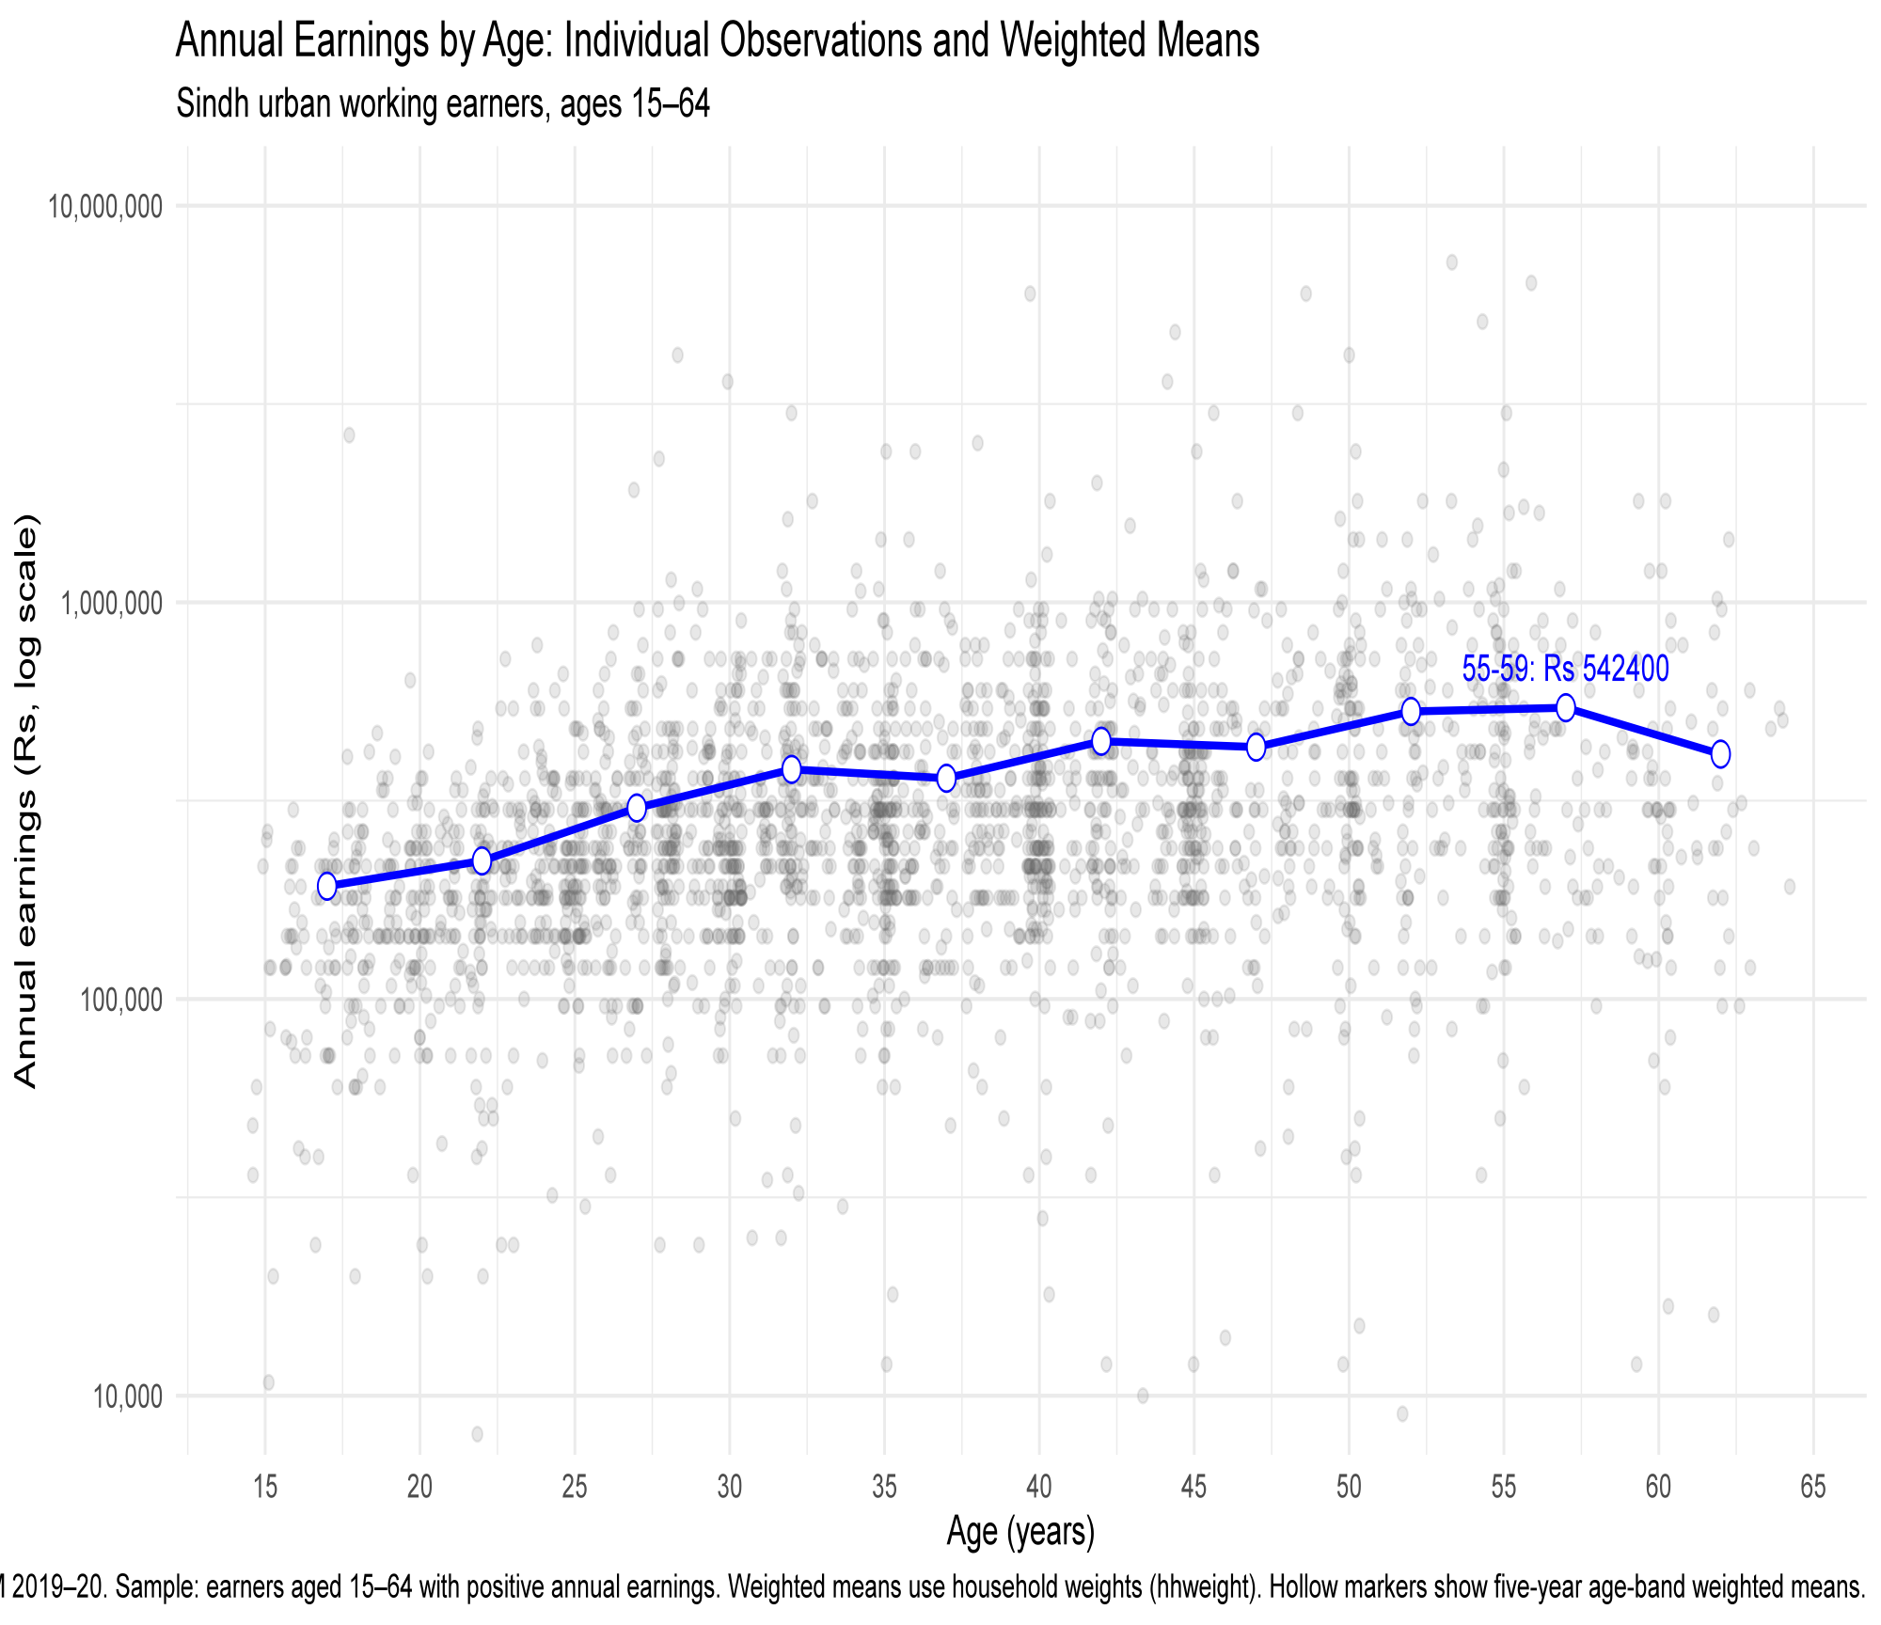
Q4 • DESIGN AND REPRODUCIBILITY
Redesign makes the age pattern easier to read
DEFAULT
REDESIGN
Raw points only
ansparency + log scale + weighted means
Default Graph
Raw data points show individual observations.
Points overlap, making the pattern difficult to see.
Age-wise differences are less clear.
Redesign graph
Transparency reduces the visual effect of overlapping points.
Log scale makes the earnings distribution easier to compare.
Weighted mean markers highlight differences across age groups.
ECO346 • Data Visualization Assignment • Sindh Urban
4/4

Slide 5
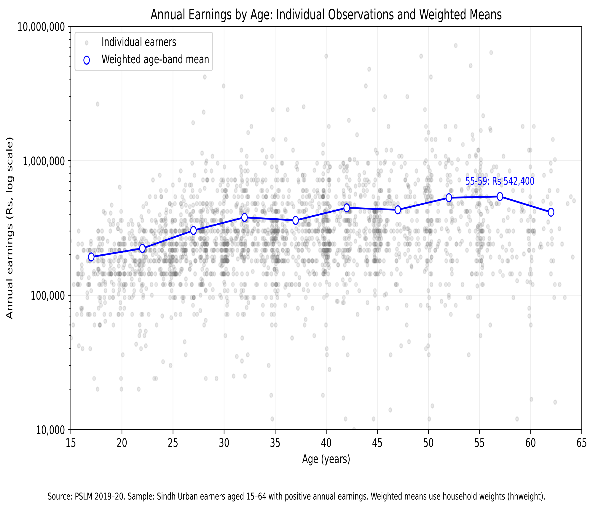
Q5 • Reproducibility and Validation
R
Python
Reproducibility: Obtaining the same results
again using the same data and code.
Validation: Checking the correctness of calculations
by comparing the results.
Cross-check: The results from R and Python were
compared.
Finding: The weighted mean annual earnings for the
25–29 age group were Rs. 303,153.9.
ECO346 • Data Visualization Assignment • Sindh Urban

