Slide 1
Earnings in Punjab's urban workforce
How annual earnings are distributed, and how they change with age
Variant 1 — Punjab urban
FA24-BEDS-033 · Section A
PSLM 2019-20 person file linked to household file by hhid
3,768 earners aged 15-64 with earn_annual > 0, weighted by hhweight

Slide 2
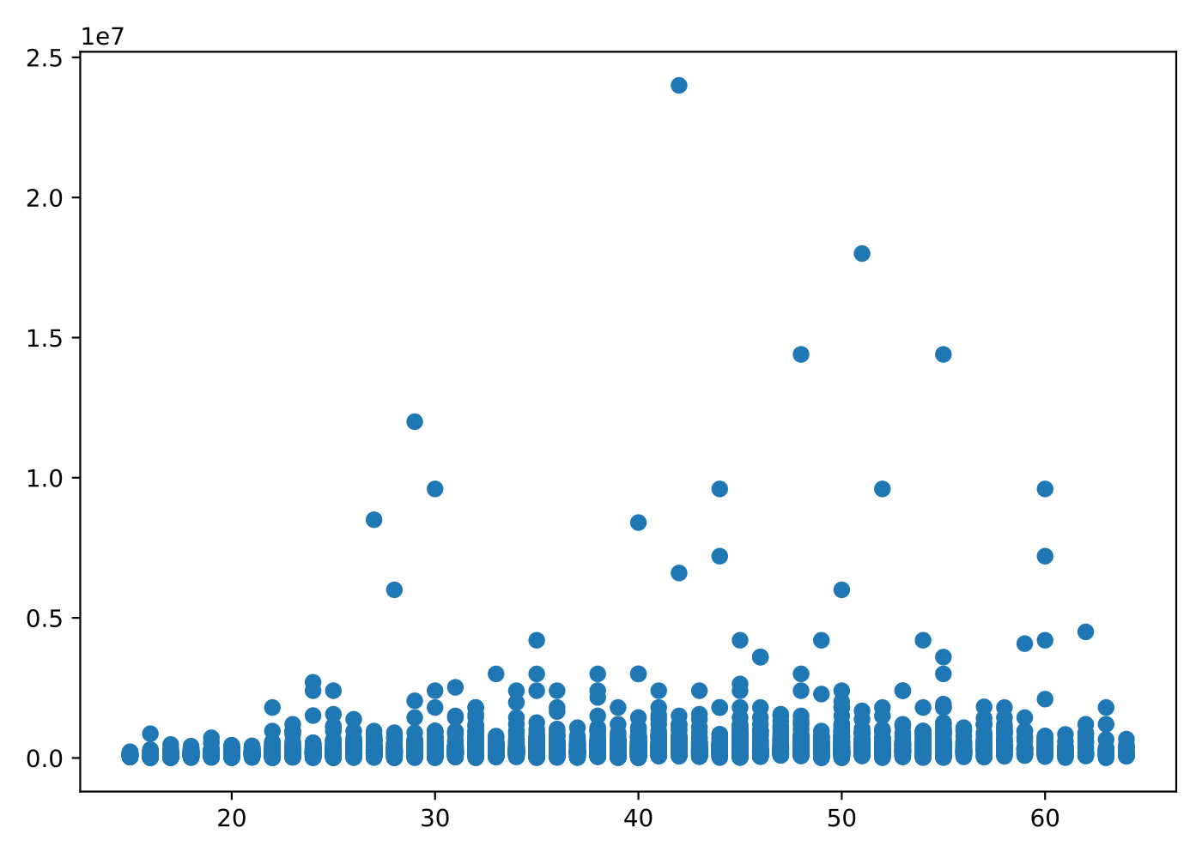
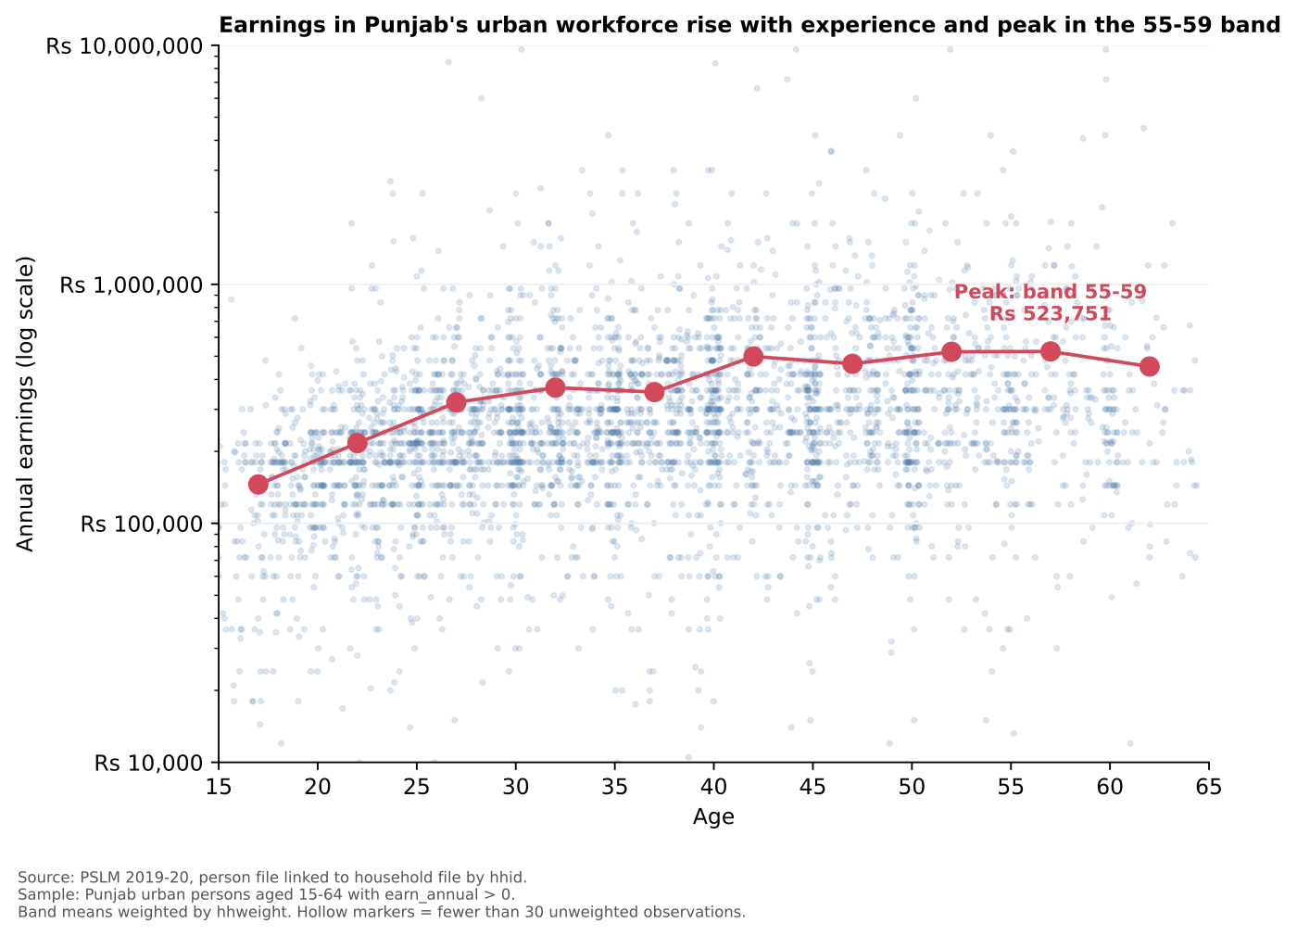
The makeover: default vs redesign
Default — ggplot(data, aes(age, earn_annual)) + geom_point()
Redesign — figures/relationship.svg
Three changes: log y-axis across the full earnings range · semi-transparent jittered points for density · weighted band means at midpoints joined by a line (hollow = thin band). Principles: perceptual ranking of channels · overplotting · conditional means + data-ink.

Slide 3
Earnings peak late: the 55-59 band earns 3.6x the youngest band
Peak band (weighted mean)
55-59
Rs 523,751
Youngest band (15-19)
Rs 145,444
3.6x gap to peak
25-29 vs 45-49
+45%
Rs 320,776 → Rs 465,073
Cross-section only: this curve mixes age with cohort and selection effects, so it is not evidence that an individual's earnings will follow this path over time.

Slide 4
Reproducibility & cross-check
Scripts (run in order, no internet needed)
R vs Python cross-check — band 25-29
scripts/01_default.R → figures/default.svg
scripts/02_distribution.R → figures/distribution.svg
scripts/03_relationship.R → figures/relationship.svg + band_table.csv
scripts/04_relationship_py.py → figures/relationship_py.svg
R: Rs 320,776
Python: Rs 320,776
Agree to the rupee ✓
What differed in Python's defaults
matplotlib defaults to a linear y-axis, larger opaque markers, no jitter. I set a log y-axis with FixedLocator ticks at 10^4-10^7 formatted as 'Rs ...', alpha = 0.15 small markers, and uniform(-0.4, 0.4) horizontal jitter to match ggplot.
Weighted quantile
Sort by x · cumulate shares of hhweight · take the smallest x whose cumulative share reaches p. R's built-in quantile() uses a different definition and will not match the answer key.
Repository: github.com/<username>/ECO346-A1-FA24-BEDS-033

