Slide 1
ECO346 · ASSIGNMENT 1 · FA24-BEDS-037
How earnings are spread, and how they change with age, in urban Khyber Pakhtunkhwa
My variant: 37 = 4 × 8 + 5 → variant 5 → KP urban
Data: PSLM 2019–20 person file, merged with the household file by hhid
Sample: 678 earners aged 15–64 with annual earnings above zero
Weights: every statistic weighted by hhweight
Rs 240,000
5.44×
55–59
weighted median
90th / 10th percentile
age band with highest mean
ECO346 Assignment 1 · FA24-BEDS-037 · 1/4

Slide 2
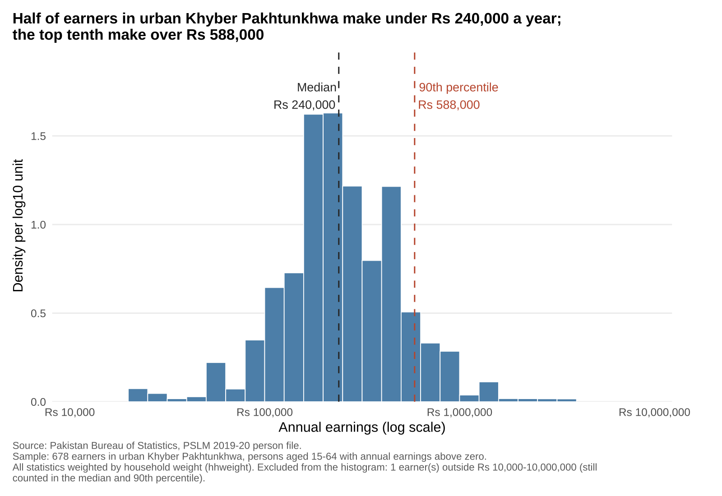
Q2 · THE DISTRIBUTION
Half of earners make under Rs 240,000 a year
Weighted histogram on a log scale, 0.1-wide bins from Rs 10,000 to Rs 10 million.
Top tenth earn over Rs 588,000: 5.44 times the bottom tenth (Rs 108,000).
Weighted and unweighted medians are both Rs 240,000: about 5% of earners report exactly Rs 20,000 a month, so both cross 50% inside that heap.
1 earner (Rs 5,000) falls outside the plotted range.
ECO346 Assignment 1 · FA24-BEDS-037 · 2/4

Slide 3
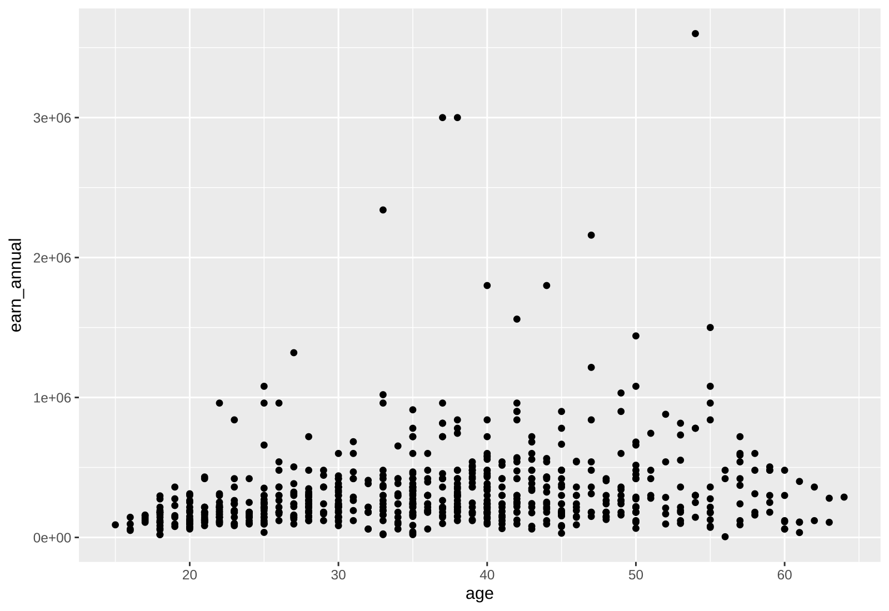
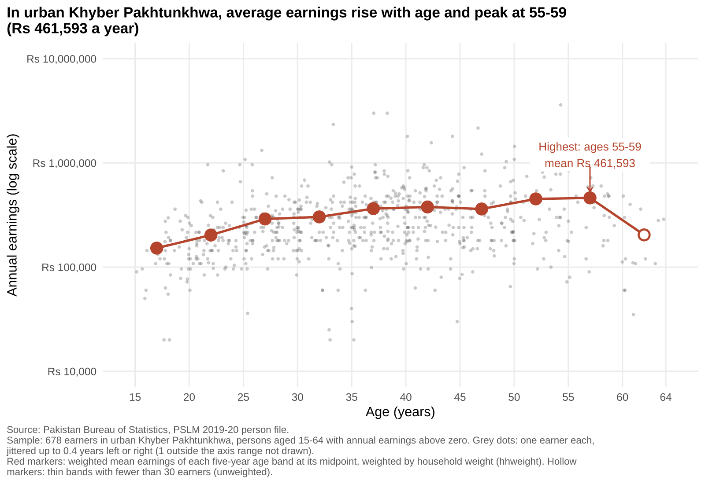
Q4 · THE MAKEOVER
From R's default to a figure that answers the question
BEFORE: ggplot() + geom_point()
AFTER: redesign (Q3)
Log scale spreads incomes out · Transparency + jitter fix overplotting · Weighted band means show the trend · Less ink, finding in the title
ECO346 Assignment 1 · FA24-BEDS-037 · 3/4

Slide 4
Q3 · THE FINDING THAT MATTERS MOST
Average earnings triple from the teens to the late fifties
Weighted mean rises from Rs 152,102 (15–19) to Rs 461,593 (55–59).
Steepest gains come early: Rs 289,679 by 25–29, then a plateau near Rs 360,000–377,000 in the 35–49 bands.
60–64 drops, but rests on only 15 earners (hollow marker = thin band).
Caution: one cross-section mixes age with cohort, so this is not one person's career path.
ECO346 Assignment 1 · FA24-BEDS-037 · 4/4

