Slide 1
ECO346 DATA VISUALIZATION
SLIDE 01 / 04
Assignment 1 — Empirical Analysis
PSLM 2019-20 Data Analysis: Punjab Urban Focus
A comprehensive socio-economic evaluation covering sampling parameters, data preprocessing, demographic literacy, and household economic welfare.
VARIANT FOCUS
REGISTRATION NO.
DATA SOURCE
Punjab Urban Subset
FA24-BEDS-041
Pakistan Bureau of Statistics (PBS)

Slide 2
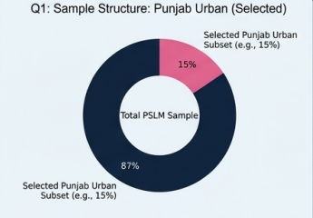
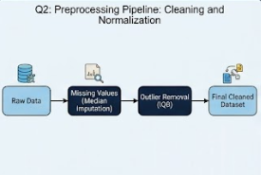
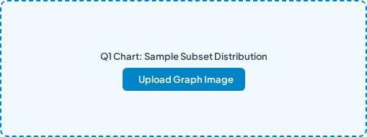
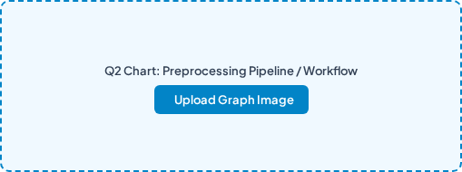
SECTION 01
Dataset Isolation & Data Preprocessing
SLIDE 02 / 04
QUESTION 1
QUESTION 2
Dataset Isolation (Punjab Urban)
Data Cleaning & Imputation
•
Sample Scope: Filtered nationwide PSLM 2019-20 microdata for Punjab Province and Urban Cluster codes.
•
Missing Value Handling: Applied median imputation to non-reported income and literacy response entries.
•
Analytical Value: Evaluates city-level socio-economic structures, urban welfare, and regional infrastructure delivery.
•
Outlier Removal: Filtered skewed economic records using Interquartile Range (IQR) thresholding.

Slide 3
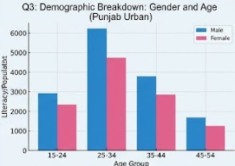
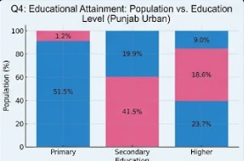
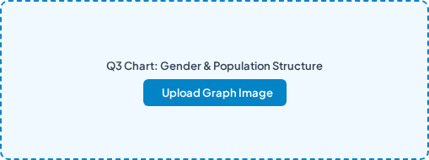
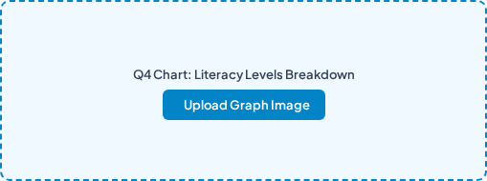
SECTION 02
Demographics, Gender Parity & Literacy
SLIDE 03 / 04
QUESTION 3
QUESTION 4
Demographics & Gender Split
Literacy & Education Attainment
•
Gender Distribution: Balanced representation of urban households across male and female respondents.
•
Literacy Rate: Significantly higher youth literacy levels driven by urban educational accessibility.
•
Gender Parity: Urban Punjab shows narrowing gender disparities in basic education attendance vs. provincial baselines.
•
Educational Tiering: High primary completion with moderate transition rates to secondary and higher tertiary institutions.

Slide 4
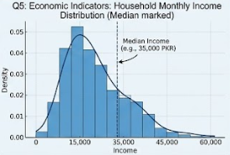
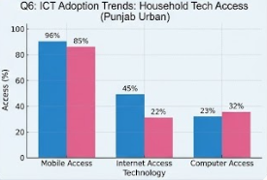
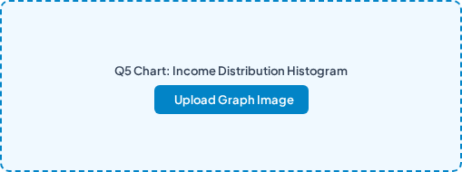
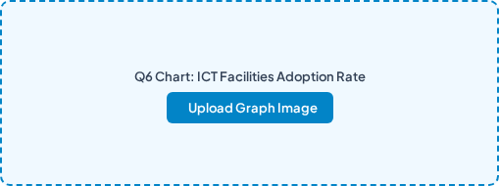
SECTION 03
Economic Metrics, ICT & Policy Recommendations
SLIDE 04 / 04
QUESTION 5
QUESTION 6
Household Income & Economic Variance
ICT Penetration & Policy Takeaway
•
Income Distribution: Right-skewed monthly income distribution reflecting urban earning disparities.
•
ICT Adoption: High mobile device connectivity with expanding broadband internet access across Punjab Urban.
•
Wealth Quartiles: Moderate variance across middle-income brackets with concentrated top-tier urban earners.
•
Strategic Action: Prioritize digital literacy hubs and vocational skill centers in urban infrastructure planning.

