Slide 1
ECO346 Assignment 1
Data Visualization Techniques for Economists
Meesam Rizvi | FA24-BEDS-071
Variant 7: Urban Balochistan, Pakistan
PSLM 2019–20 • Positive annual earnings • Ages 15–64

Slide 2
Default plot vs redesigned figure
Q4 → Q3 redesign
Default: raw age and annual earnings scatter; little guidance for the viewer.
Redesign: labeled axes, log earnings scale, age-band weighted means, thin-group markers, and a highest-mean annotation.
Design goal: preserve individual observations while making the group pattern easier to interpret.

Slide 3
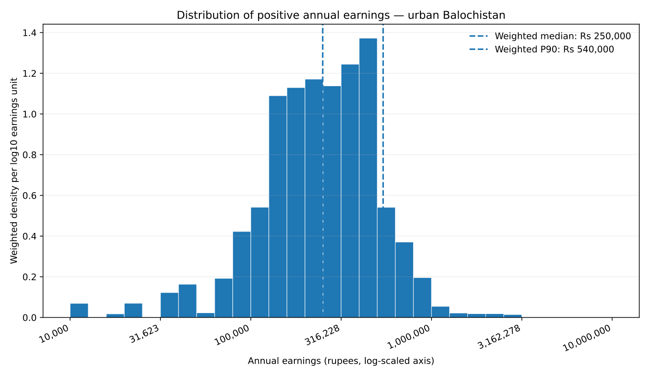
Earnings distribution

Slide 4
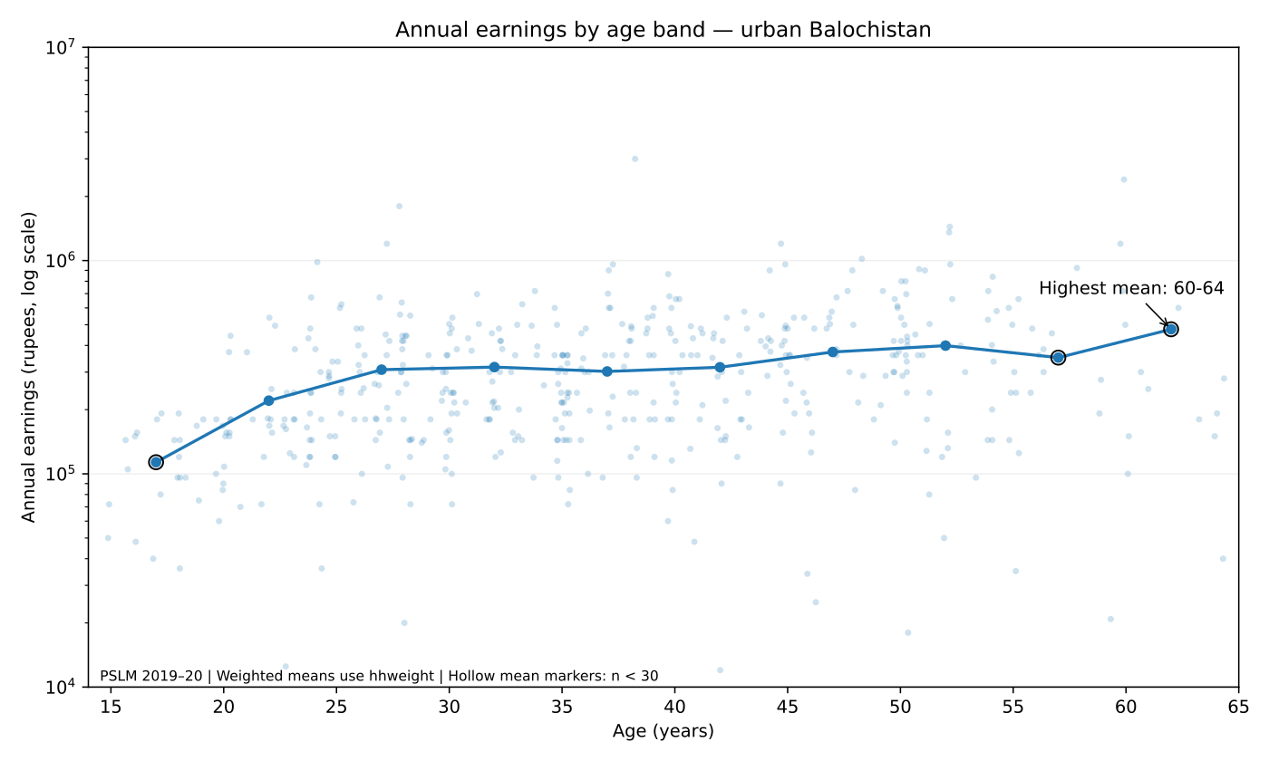
Most important finding

