Slide 1
Schooling costs and literacy in rural Khyber Pakhtunkhwa
Uswah Zahid · FA24-BED-076 · Section B
Variant 4 = rural KP (76 = 9 × 8 + 4)
19,896
13,200
4,912
persons in rural KP
aged 10–64, literacy recorded
students with spending > 0
PSLM 2019–20 · every statistic weighted by household weight (hhweight)
Notes:
TALKING POINTS (about 45 seconds). Say these in your own words.
- My variant is 4: my registration number ends in 76, and 76 = 9 x 8 + 4. Variant 4 is rural Khyber Pakhtunkhwa.
- Data: PSLM 2019-20. The person file has no weight, province or area, so I joined the household file by household ID (hhid) and kept rural KP: 19,896 persons.
- Two samples: for literacy, people aged 10 to 64 with a recorded literacy value (13,200). For spending, students with spending above zero (4,912).
- Every statistic is weighted by household weight: it says how many households each sampled household represents.

Slide 2
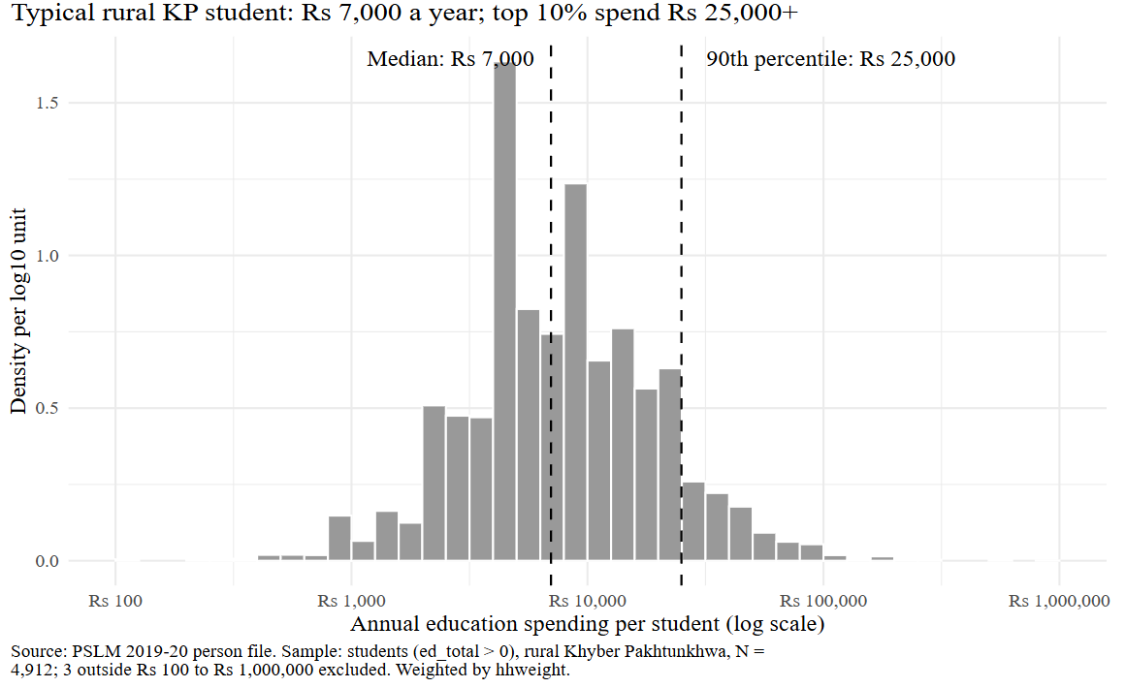
The typical student costs Rs 7,000 a year; the top tenth Rs 25,000+
Rs 7,000
weighted and unweighted median
Rs 2,500
10th percentile (weighted)
Rs 25,000
90th percentile (weighted)
10.00
ratio p90 / p10
Notes:
TALKING POINTS (about 1 minute).
- The figure shows annual education spending per student on a log scale. Spending is very skewed, so on a log axis each step is ten times more, not the same number of rupees.
- Bars are density per log10 unit, weighted by household weight. The two dashed lines are the weighted median, Rs 7,000, and the weighted 90th percentile, Rs 25,000.
- The 10th percentile is Rs 2,500, so the ratio p90/p10 is 10.00: spending at the 90th percentile is ten times the 10th.
- The weighted and unweighted medians are both Rs 7,000. The weights shift the cumulative shares only a little, not enough to move where the 50% mark falls.
- Three students outside Rs 100 to Rs 1,000,000 are excluded from the histogram.

Slide 3
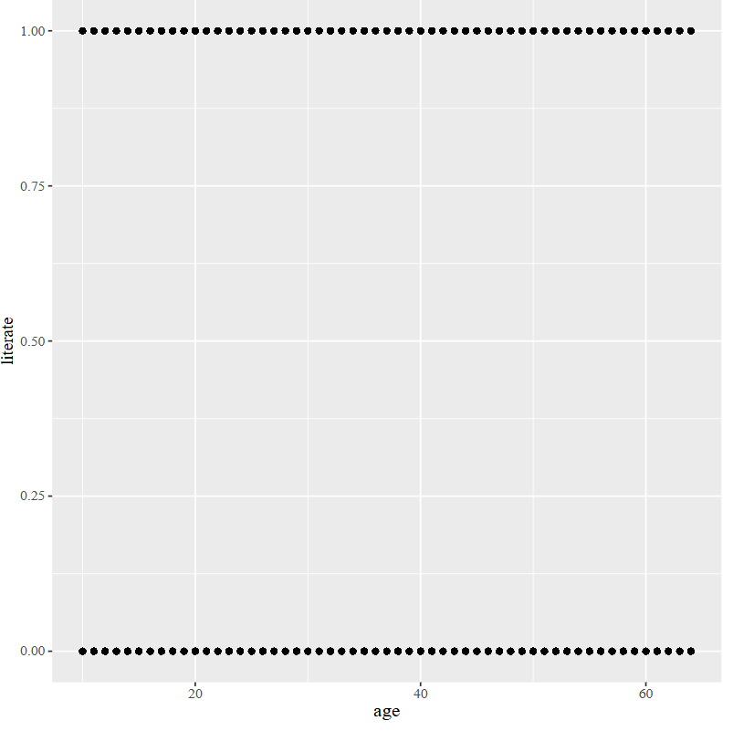
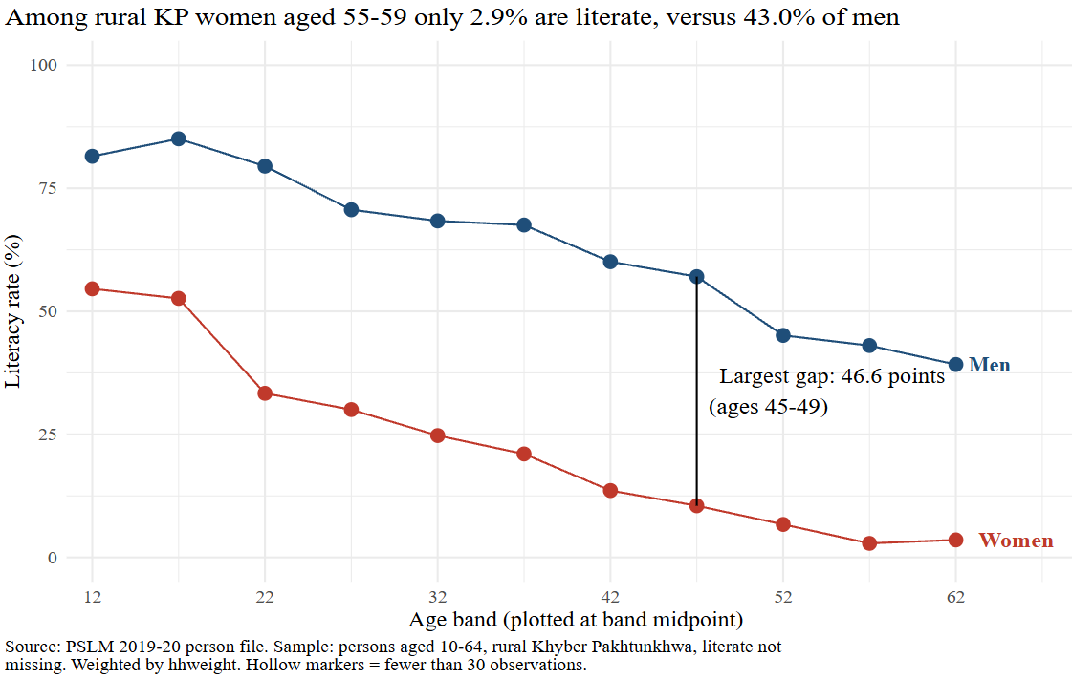
Makeover: from overlapping dots to weighted rates by age band
R default: ggplot + geom_point()
Redesign: weighted literacy rate by age band
Overplotting → weighted conditional means
Position on a common scale (perceptual ranking of channels)
Direct labels, less ink (data-ink)
Notes:
TALKING POINTS (about 1 to 1.5 minutes).
- Left is R's default: literate against age with geom_point. Literate is only 0 or 1, so thousands of people sit on top of each other in two rows. That is overplotting: I cannot see how many people are in each row, or any trend.
- Right is my redesign: the weighted literacy rate for each five-year age band and sex, which is a conditional mean.
- Changes and principles: (1) conditional means fix overplotting; (2) a common 0-100 scale lets readers compare by position, the most accurate channel in the perceptual ranking of channels; (3) direct labels instead of a legend; (4) less clutter, following data-ink; (5) a title that states the finding and an annotation of the largest gap.
- What the default shows that my redesign hides: the individual observations and exact ages.

Slide 4
At ages 55–59, 2.9% of rural KP women are literate versus 43.0% of men
2.9%
43.0%
46.6
of women aged 55–59
of men aged 55–59
points: largest gap,
at ages 45–49
What it cannot tell us: the figure compares different people at one time, so age and cohort effects can’t be separated. Older women may be less literate because of the schooling available when they were young.
Notes:
TALKING POINTS (about 1 minute).
- The finding I think matters most: among people aged 55 to 59 in rural KP, only 2.9% of women are literate, compared with 43.0% of men.
- Women are below men in every age band. The largest gap is 46.6 percentage points, at ages 45 to 49. Among 15 to 19 year olds the rates are 52.6% for women and 85.1% for men, a smaller gap (32.5 points) but still large.
- Limit: the figure compares different people at one point in time, so I cannot separate an age effect from a cohort effect. Older women may be less literate because of the schooling available when they were young. It also does not show causes.
- Close: thank you, I am happy to take questions.

