Slide 1
Education spending and literacy in rural Punjab
ECO346 Assignment 1 | FA24-BEDS-088 | PSLM 2019–20
Variant 0 = Punjab rural (88 = 11 × 8 + 0)
35,925
24,630
9,173
persons in the variant
aged 10–64 with literacy data
students with spending > 0
Notes:
Variant: last two digits 88; 88 = 11 x 8 + 0, so variant 0 = Punjab rural (prov_code 2, urban_rural 1). I attach hhweight, prov_code and urban_rural from the household file by hhid. 35,925 persons in the variant; 24,630 are aged 10-64 with a non-missing literate value; 9,173 have ed_total > 0 (students). Every statistic is weighted by hhweight.

Slide 2
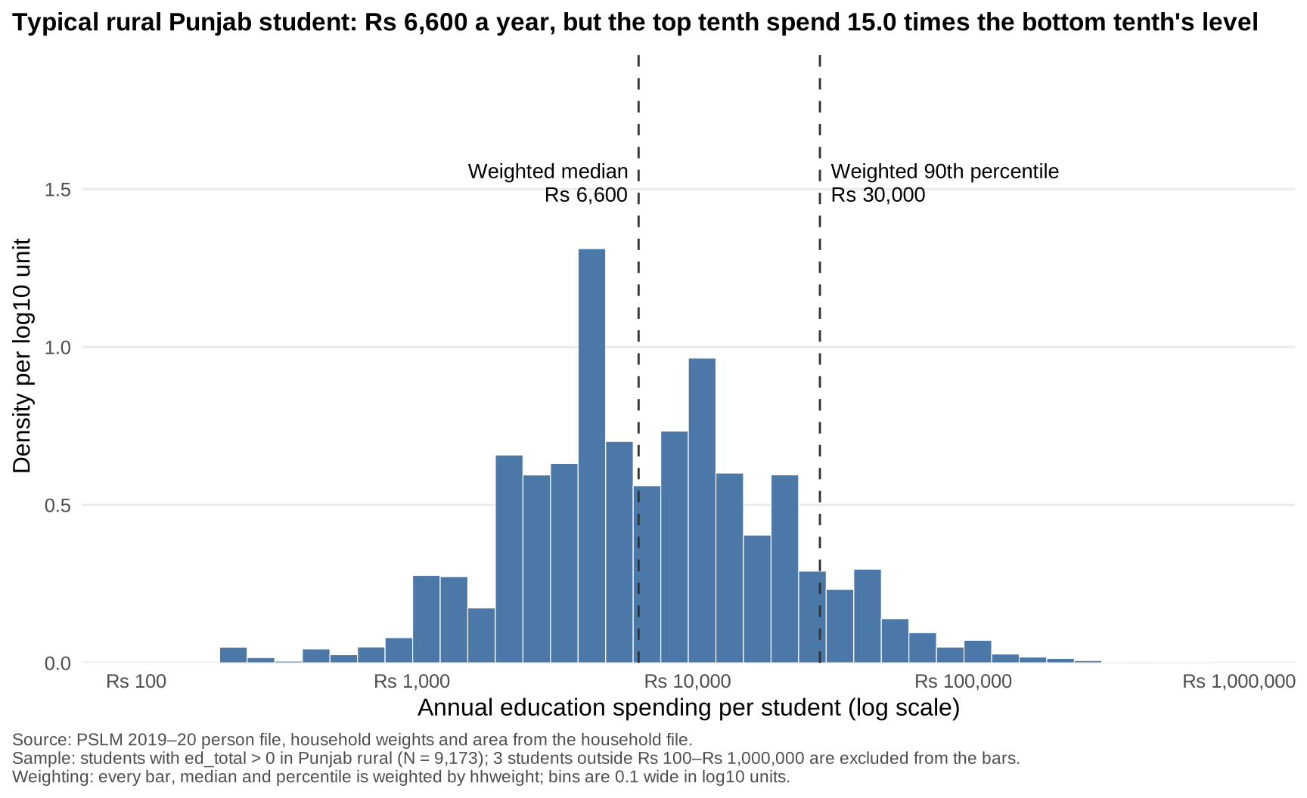
Half of students cost under Rs 6,600 a year; the top tenth, over Rs 30,000
Rs 6,600
weighted median (unweighted Rs 7,000)
Rs 30,000
weighted 90th percentile
15.00×
90th ÷ 10th percentile (Rs 2,000)
Notes:
Weighted histogram on a log10 scale, bins 0.1 wide from Rs 100 to Rs 1,000,000, density per log10 unit. 9,173 students; 3 outside the range (1 below Rs 100, 2 above Rs 1,000,000). Weighted median Rs 6,600 vs unweighted Rs 7,000: the weighted cumulative share reaches 50.1% at Rs 6,600 (unweighted: 49.1%, so the unweighted 50% mark falls on the heap at Rs 7,000). 10th percentile Rs 2,000, 90th Rs 30,000, ratio 15.00.

Slide 3
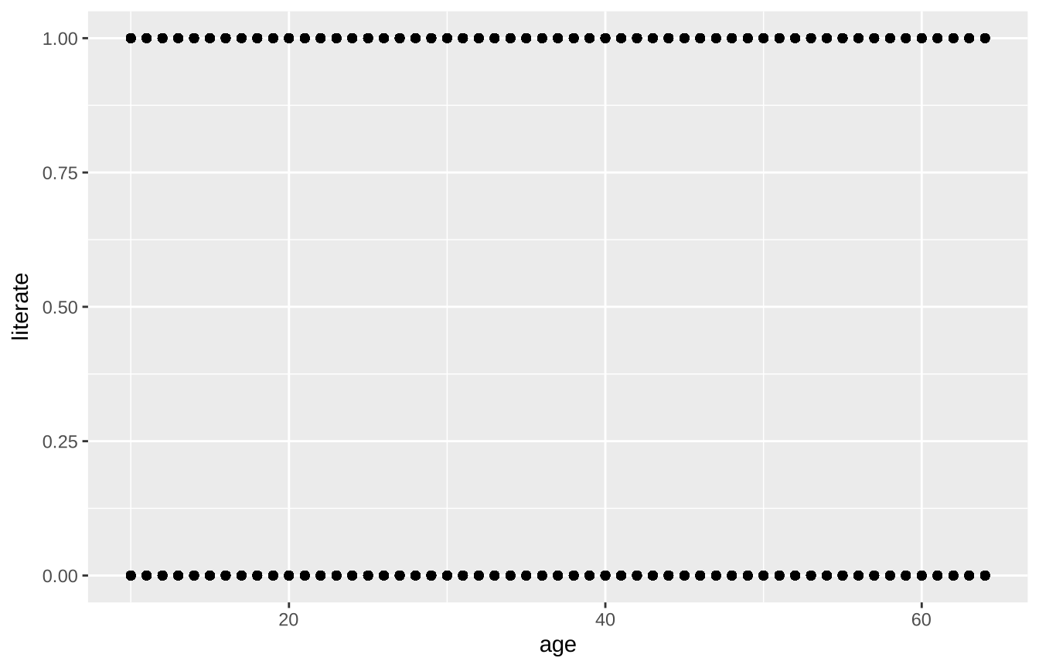
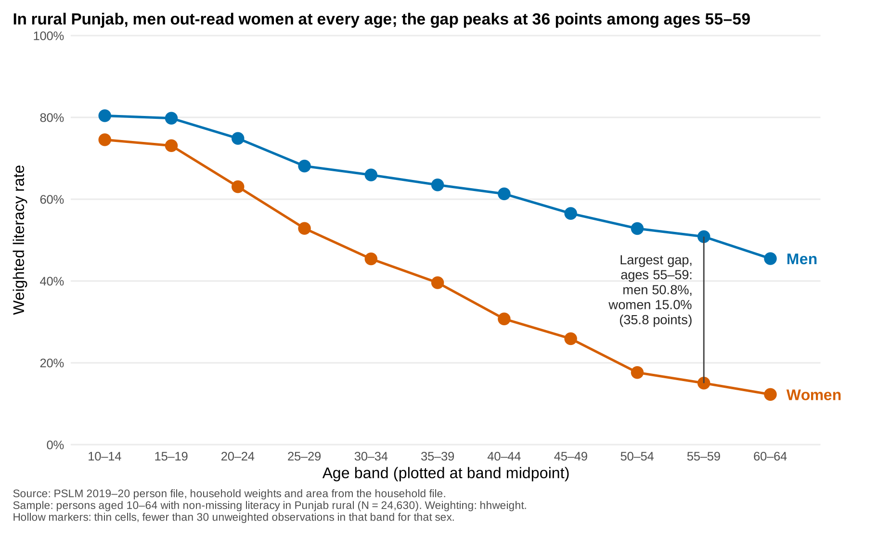
The makeover: from 24,630 overplotted dots to eleven comparable means
Before: R default, geom_point()
After: weighted means by age band
Conditional means · common-scale position · direct labels, no legend · hhweight · finding as title
Notes:
Default: 24,630 binary points stacked in two rows, unweighted, one grey panel; you cannot read a rate off it. Redesign: conditional means (weighted rate per five-year band), position on a common scale, women and men labeled directly, no legend, less non-data ink, finding in the title, hollow markers for thin cells (none here: smallest cell has 412 persons). What the default shows that the redesign hides: individual single-year ages and that the outcome is binary.

Slide 4
Women read far less than men in rural Punjab, and the gap grows with age
Ages 15–19
Ages 55–59
73.1% women
79.8% men
15.0% women
50.8% men
Gap between men and women: 6.7 points at 15–19, 35.8 points at 55–59
A one-time survey compares cohorts; it cannot say whether any one woman lost literacy or why the older cohorts lacked access.
Notes:
Weighted literacy rates, rural Punjab, aged 10-64. Women 73.1% vs men 79.8% at 15-19; women 15.0% vs men 50.8% at 55-59. Largest gap is at 55-59, 35.8 points. Cross-section: this mixes age and cohort; it cannot tell us why women were excluded (access, norms, costs).

