Slide 1
Earnings in urban Sindh: distribution and age profile
ECO346 Assignment 1 · FA24-BEDS-0XX · Section A
Variant 3 = Sindh urban (prov_code 3, urban_rural 2)
PSLM 2019-20 · earners aged 15-64 with earnings > 0 · n = 2,644 · weighted by hhweight
Median Rs 264,000 · 90th percentile Rs 696,000 · P90/P10 = 5.80

Slide 2
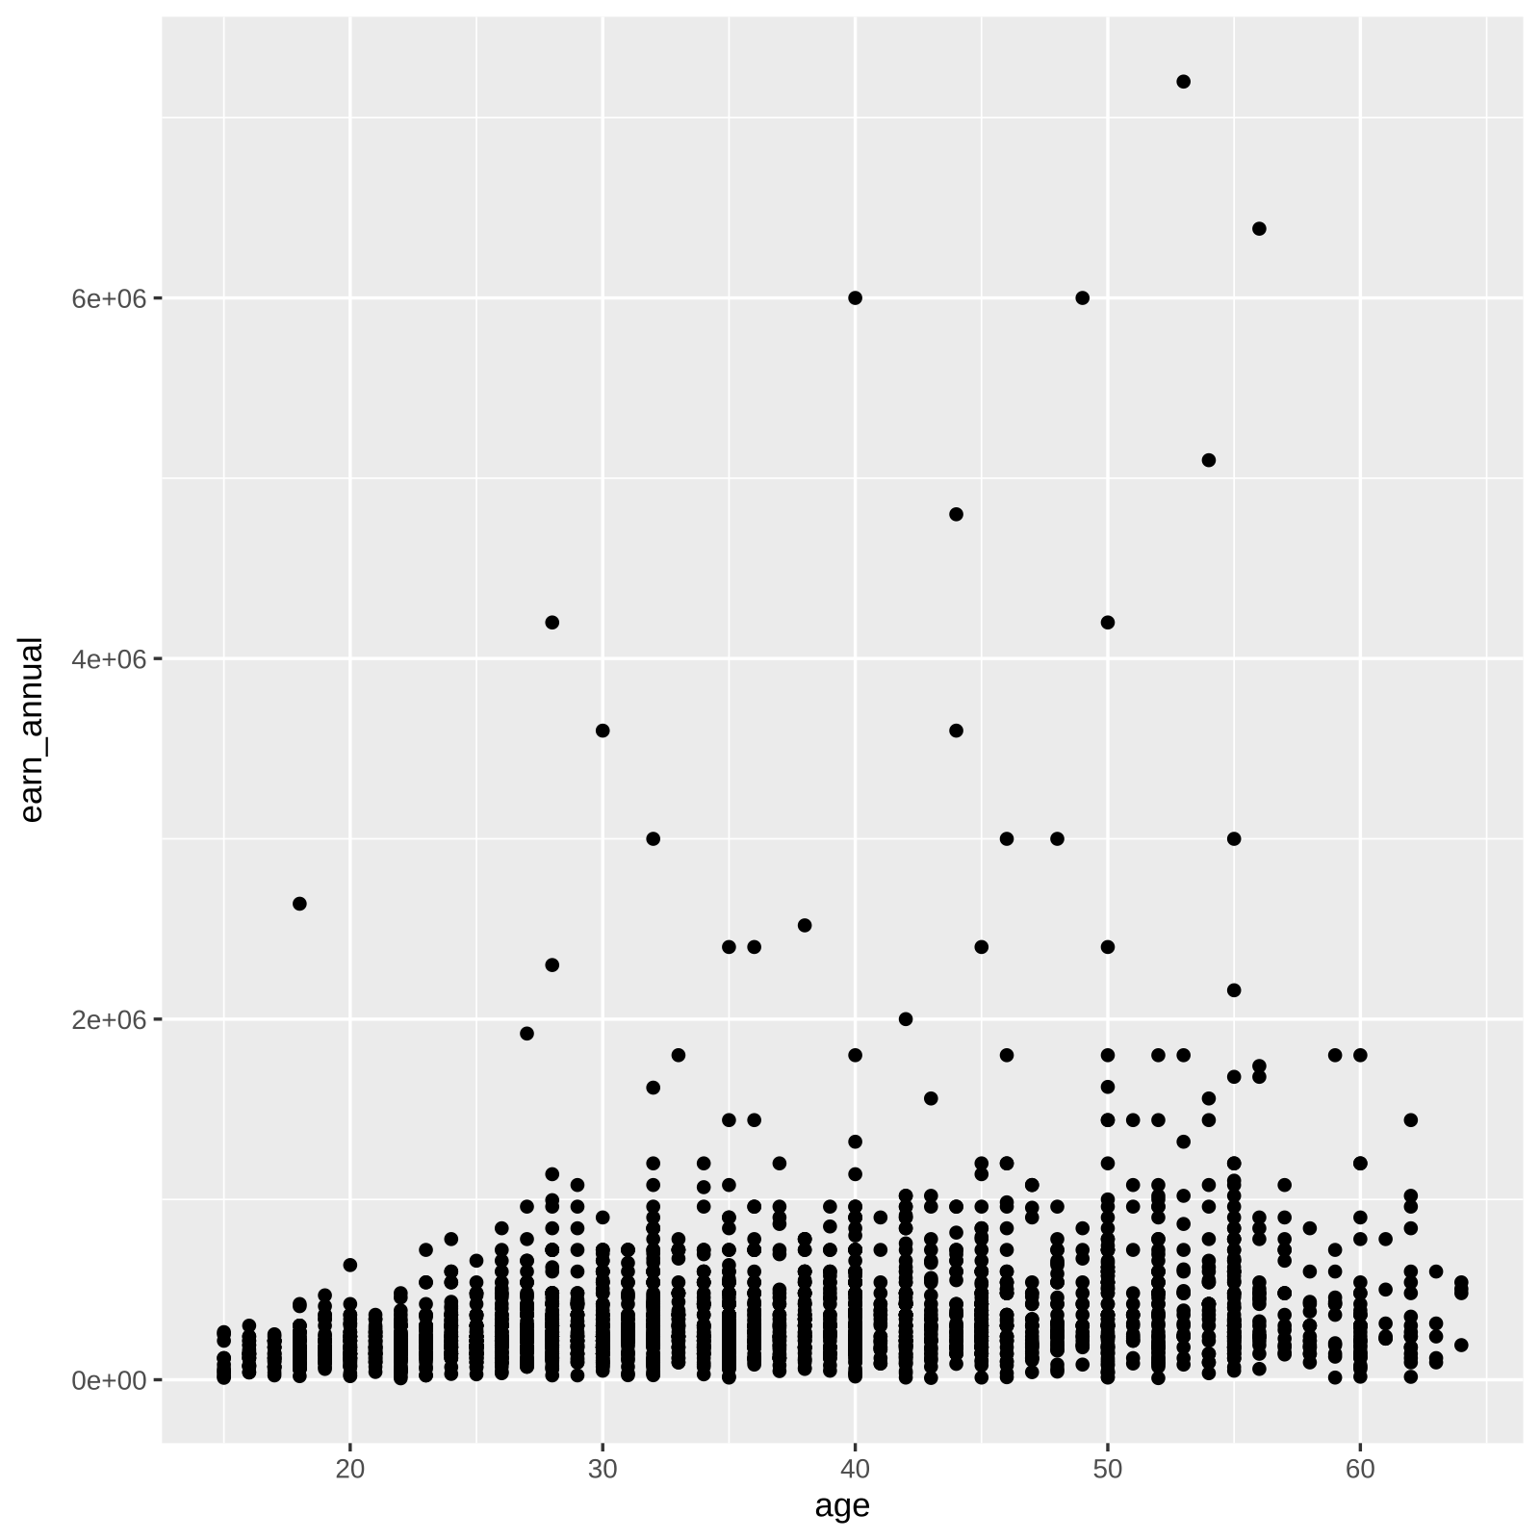
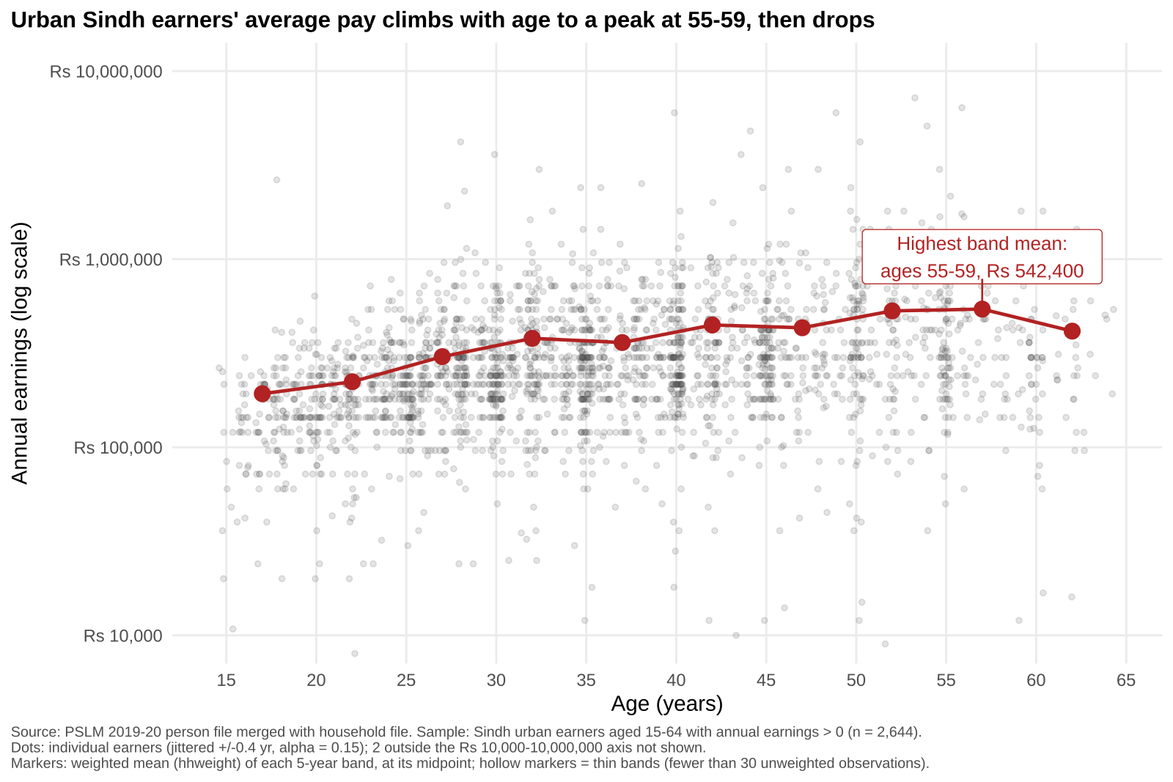
The makeover: R's default vs. the redesign
Changes: log scale in rupees · jitter + transparency (overplotting) · weighted band means (conditional means) · direct annotation and finding title · less non-data ink

Slide 3
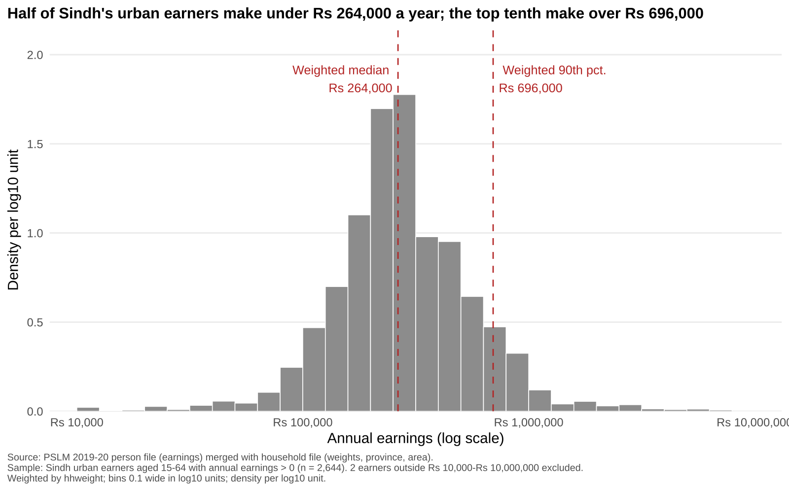
Half of urban Sindh earners make under Rs 264,000; the top tenth over Rs 696,000
P90/P10 = 5.80
Weighted median is above the unweighted (Rs 252,000)

Slide 4
Most important finding: pay rises with age, peaking at 55-59
25-29: Rs 303,154 · 45-49: Rs 431,697 · 55-59: Rs 542,400 (peak) · 60-64: Rs 414,262
Huge spread at every age: age explains little of who earns what.
Limit: one cross-section, so age and cohort effects are mixed.

