Slide 1

Name Ibrahim Khalid
Reg No Fa24-Bed-100
Variant 4 (KP Rural)
Assignment No 2
Notes:
Every band has at least 400 observations per sex. A single cross-section cannot separate cohort effects from ageing.

Slide 2
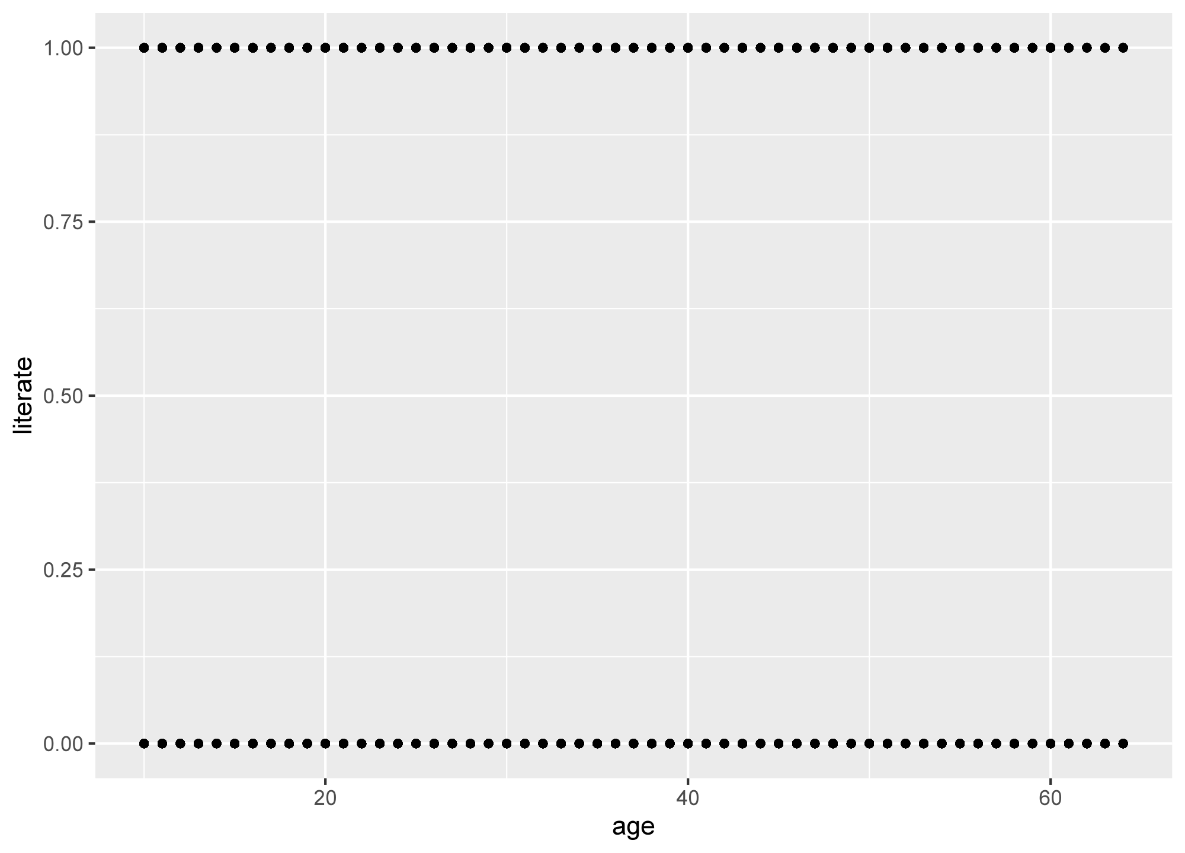
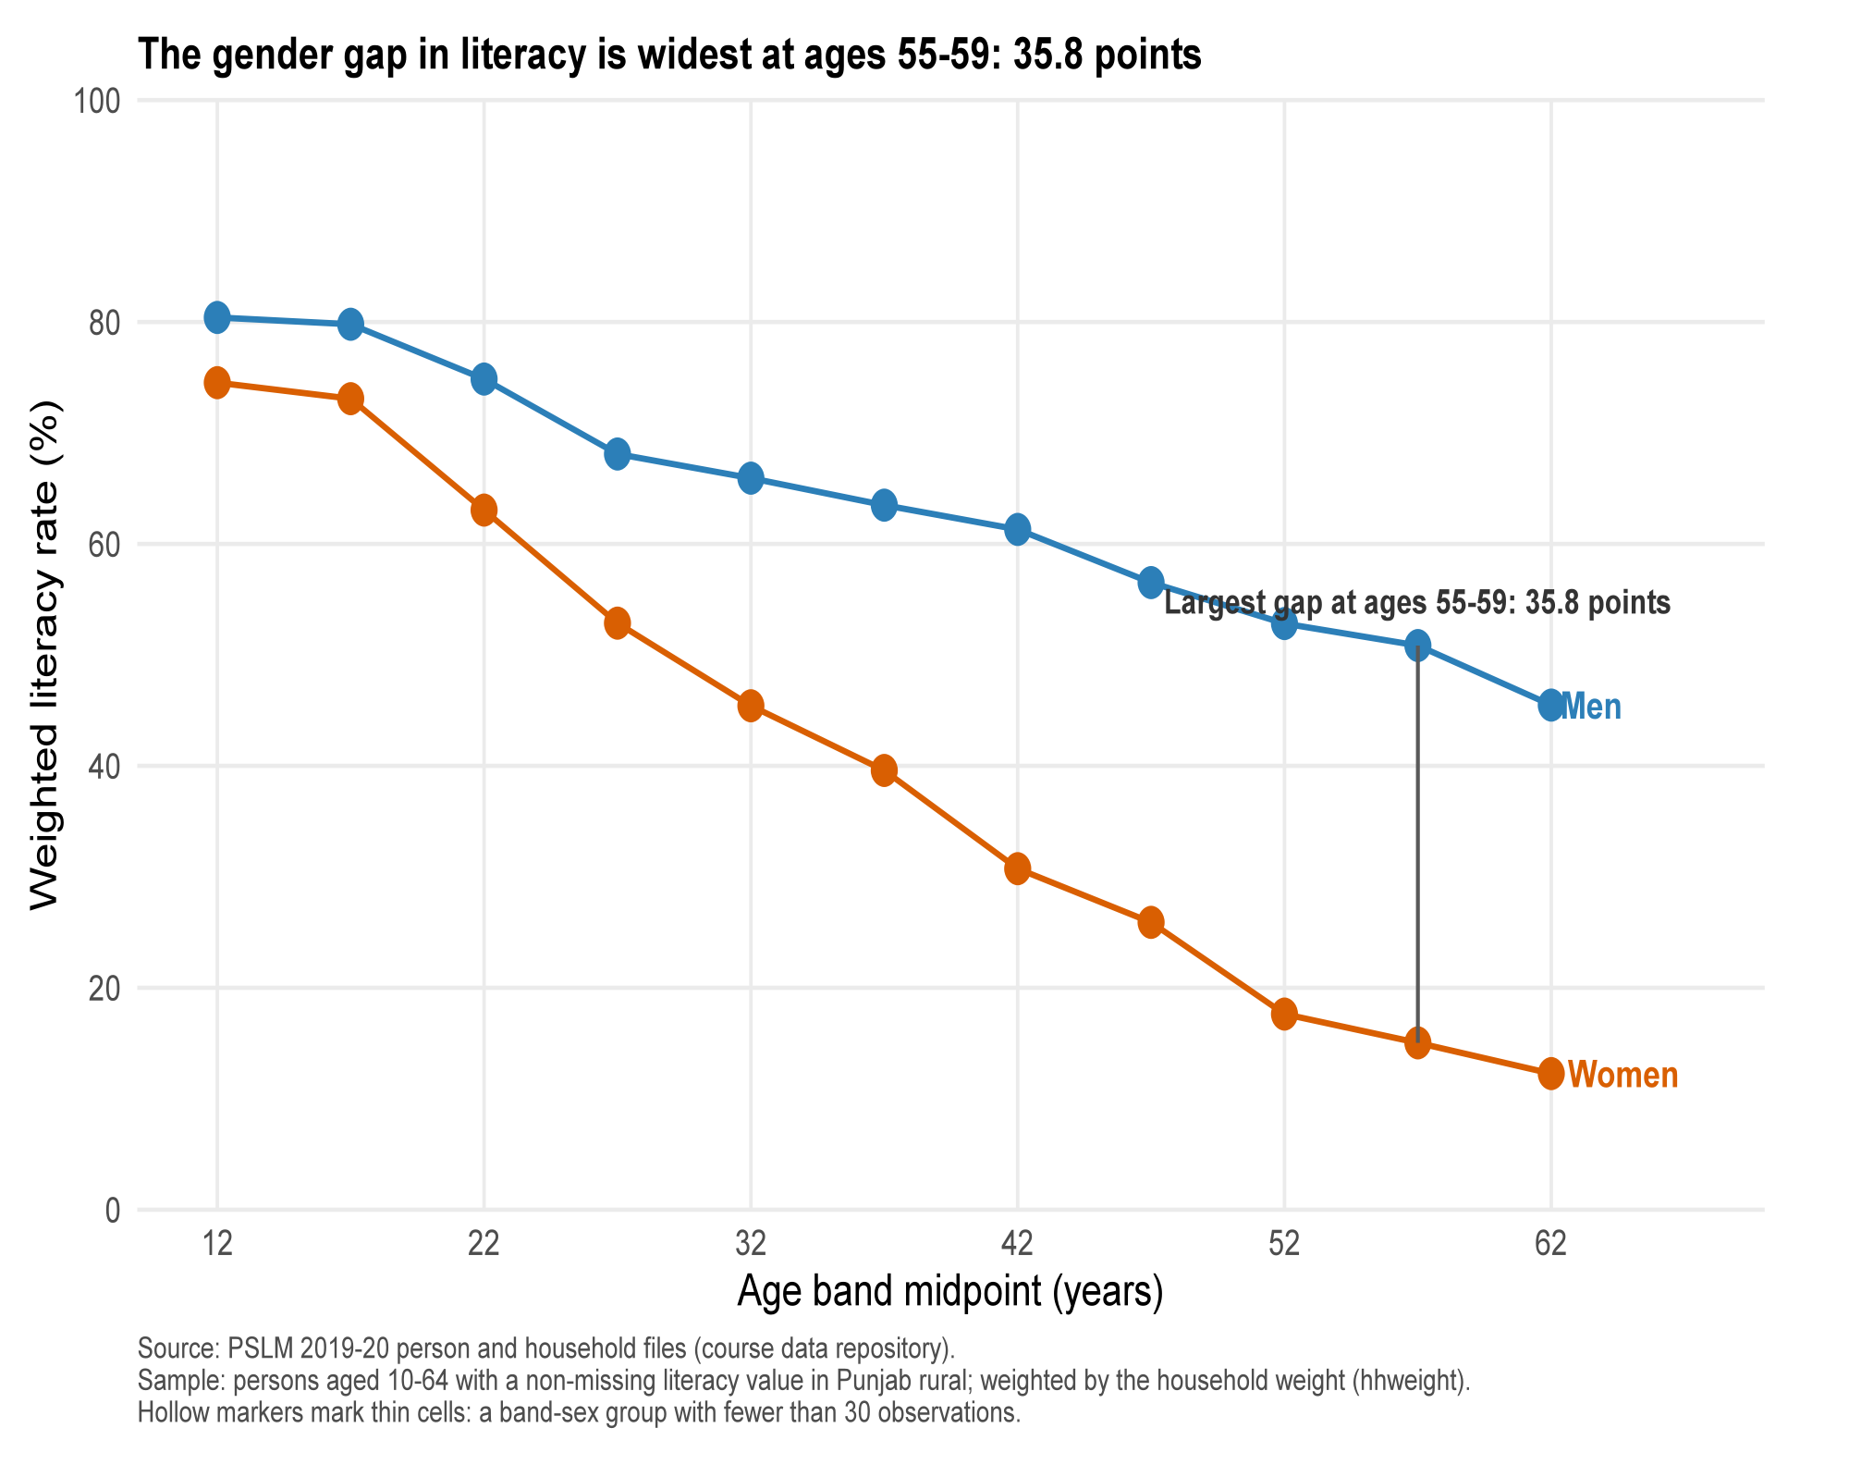
Default
Redesign
Notes:
Every band has at least 400 observations per sex. A single cross-section cannot separate cohort effects from ageing.

Slide 3
Education & Literacy in Rural Punjab
PSLM 2019-20 | Punjab, rural | Weighted by household weight
9,170
Rs 6,600
35.8 pts
students analysed (spending Rs 100 - Rs 1,000,000)
weighted median annual spending per student
largest male-female literacy gap, ages 55-59
Three questions: how much do families spend on schooling, how does literacy change with age, and how well does the redesigned chart hold up?
Notes:
Overview of the three findings. Data: PSLM 2019-20 person and household files, Punjab rural subset.

Slide 4
Education spending is strongly right-skewed
15x
90th percentile vs 10th (Rs 30,000 vs Rs 2,000)
217 vs 209
mean weight below vs above the unweighted median
Weighting pulls the median down from Rs 7,000 to Rs 6,600: lower-spending households represent slightly more of rural Punjab. 3 of 9,173 students fell outside the Rs 100 - Rs 1,000,000 range.
Notes:
Quantiles use the assignment definition: smallest value where cumulative weight share reaches q.

Slide 5
The makeover, and a Python cross-check
1
Conditional means replace the raw 0/1 scatter, fixing overplotting.
R vs Python: women aged 15-19
73.1%
73.1%
2
Position carries age and literacy; colour only marks sex.
R (ggplot2)
Python (matplotlib)
An automated test confirmed all counts and all 11 age-band rates match. The one visual difference, default axis padding, was fixed with identical limits (age 9-70, rate 0-100) and breaks in both scripts.
3
Direct end labels replace the legend, cutting non-data ink.
Trade-off: the default scatter shows the raw spread and the discreteness of the 0/1 outcome, which the summary hides.
Notes:
Redesign principles: overplotting, perceptual ranking of channels, data-ink ratio.

