Slide 1
Education spending and literacy in rural Sindh
Sarah Tashfeen
FA24-BEDS-102 · ECO346 Data Visualization Techniques for Economists
My variant: 2 = Sindh, rural
02 ÷ 8 leaves remainder 2 · PSLM 2019–20, weighted by household weight · 1,440 students, 7,171 persons aged 10–64

Slide 2
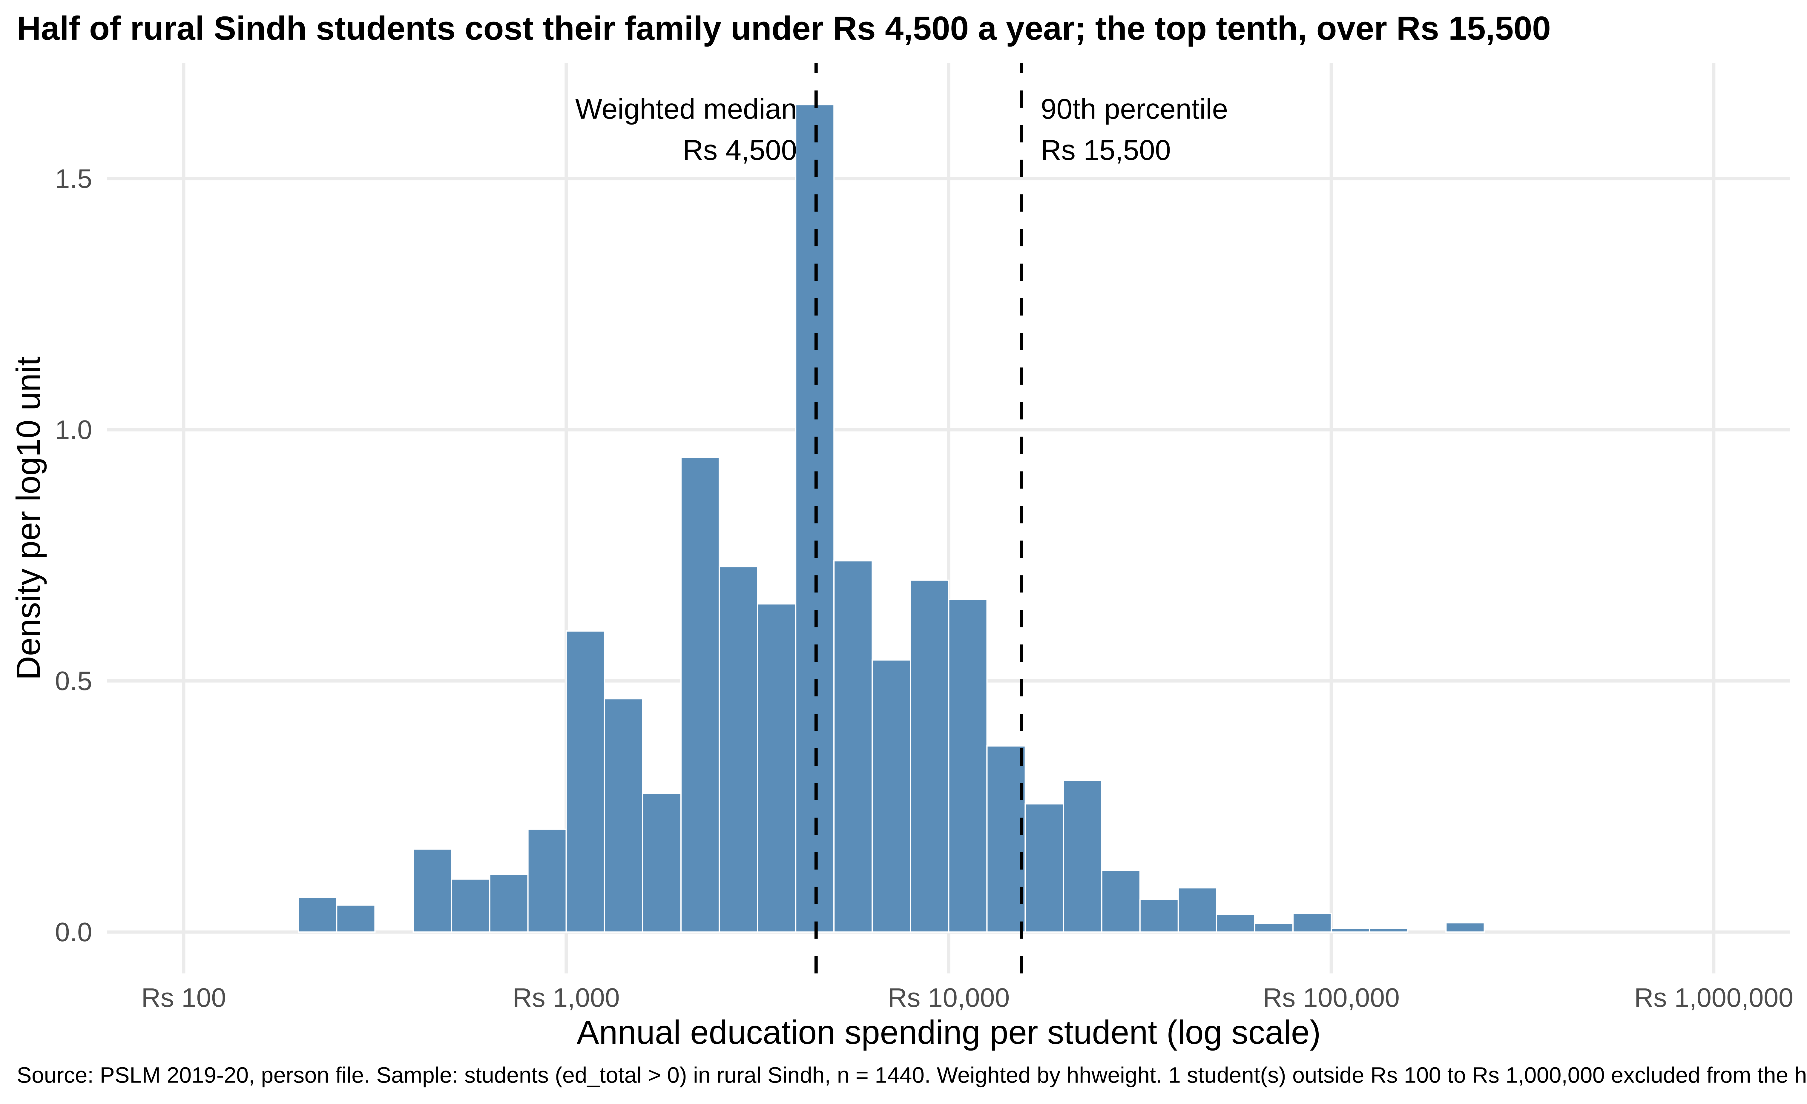
Half of rural Sindh students cost families under Rs 4,500 a year; the top tenth, over Rs 15,500
Rs 4,500
weighted median (unweighted: Rs 4,295)
Rs 15,500
weighted 90th percentile
15.5×
ratio of 90th to 10th percentile (Rs 1,000)
Log scale: spending runs from Rs 100 to Rs 1,000,000
Source: PSLM 2019–20; students (ed_total > 0), rural Sindh, n = 1,440; weighted by hhweight. 1 student below Rs 100 excluded from the histogram.

Slide 3
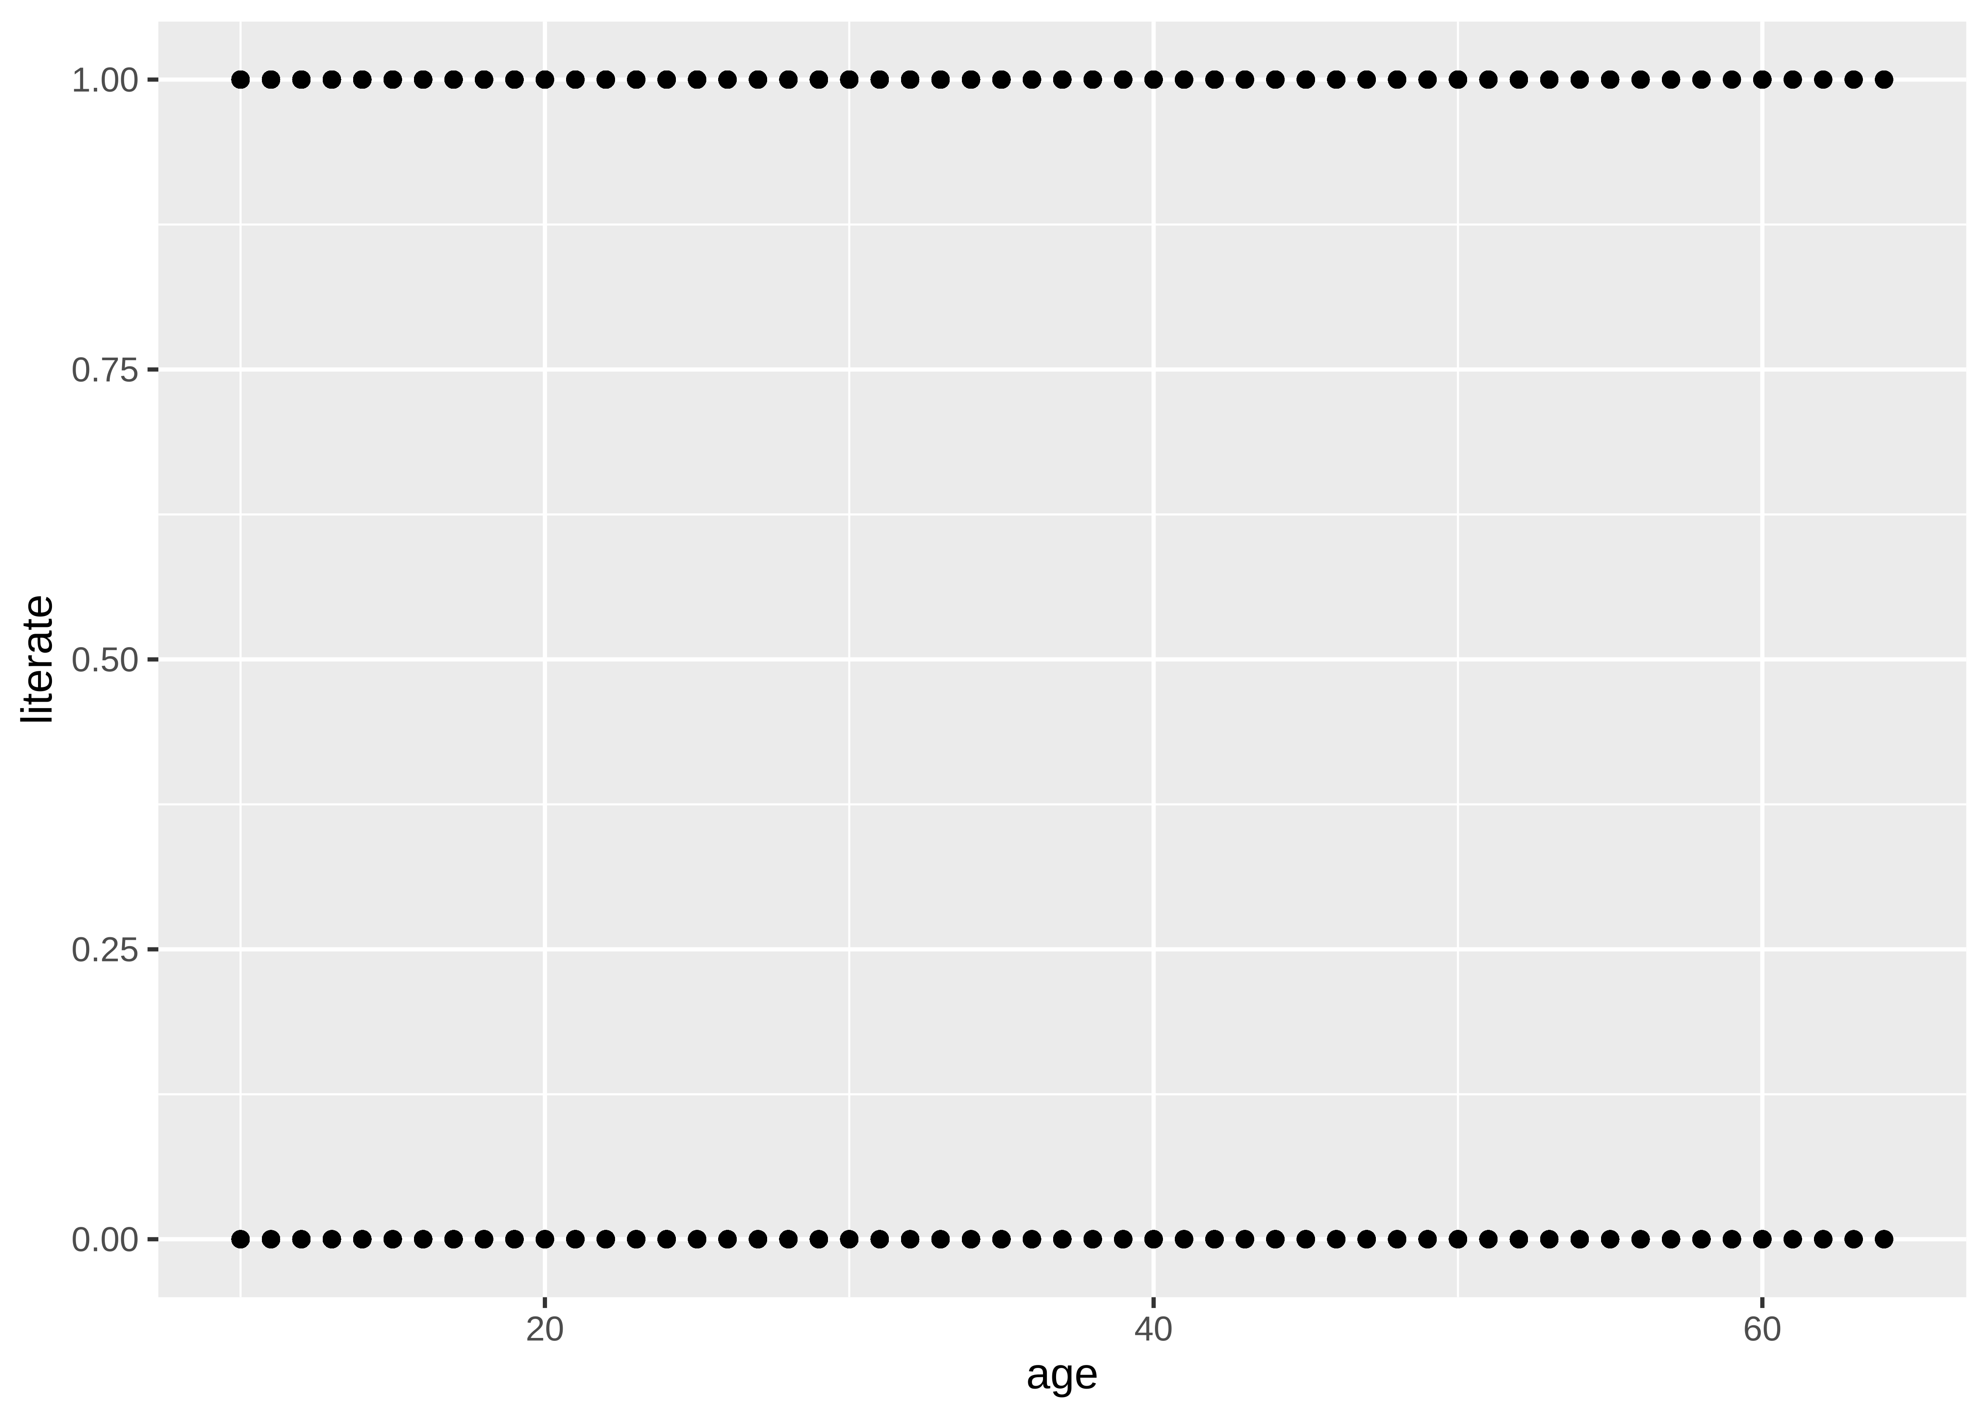
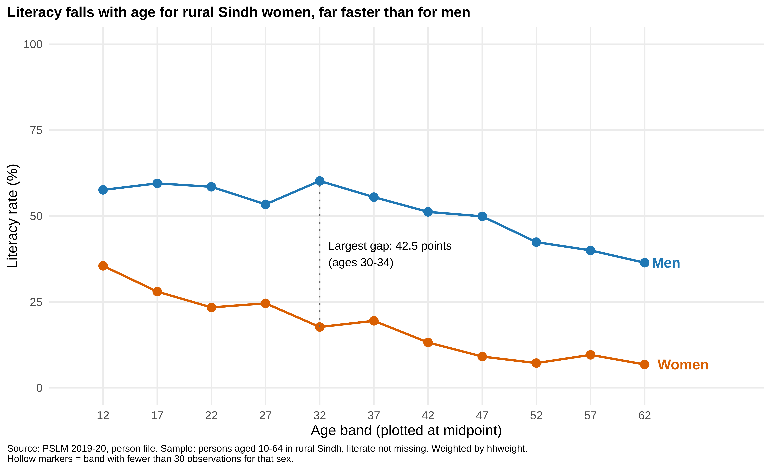
Makeover: from 7,171 overlapping dots to two labelled lines of average literacy
Default (R, untouched)
Redesign
Conditional means by age band: read by position on a common scale
Women and men direct-labelled, no legend (data–ink)
Default hides nothing of the 0/1 data but overplots; redesign hides single years of age

Slide 4
Main finding: rural Sindh women are far less literate than men at every age
Ages 15–19
Ages 55–59
Largest gap: ages 30–34, 42.5 points (men 60.2%, women 17.7%)
Younger women read more than older women, but still trail young men by about 30 points
Cannot tell us: this compares cohorts at one date, not how any person changed, or why
28.0%
women
59.5%
men
9.6%
women
40.0%
men
Source: PSLM 2019–20; persons aged 10–64, rural Sindh; weighted by hhweight. R and Python band tables agree (women 15–19: 28.0% in both).

