Slide 1



Business Insights from Sales Data End-to-End Sales Data Analysis using
Data Cleaning
Data Processing
Data Modeling , Visualization

Slide 2
Step1 : Business Questions
What is the total sales revenue before and after tax?
Which package types generate the highest sales and quantity sold?
Which customer locations generate the highest sales, orders, and customer count?
How has total sales changed year over year?
Which states generate the highest sales and customer concentration?
How do sales and order volumes differ between salespersons and non-sales employees?
Which are the top 5 customer locations in terms of total transactions from 2013 to 2016, and how has their activity trended over these years?
How are customers distributed across different package types in terms of number of unique customers?

Slide 3
Step2 : General Dataset Overview
This section provides a general view of the dataset structure and key attributes used in the analysis.
Fact_Sales
Sale_ID (PK)
City_Key
CustomerKey
InvoiceDate_Key
DeliveryDate_Key
Salesperson_Key
Quantity
Unit_Price
Total_Excluding_Tax
Tax
Tax_Amount
Total_Including_ Tax
Dim_Customer
CustomerID (PK)
Customer_Name
Location
Category
Buying_Group
Primary_Contact
Postal_Code
Credit_Limit
Dim_City
CityID (PK)
City
State_Province
Country
Sales_Territory
Latest_Recorded_Population
Dim_Employee
Employee_ID (PK)
WWI_Employee_ID
EmployeeName
Is_Salesperson
Lineage_Key
Dim_Date
Date (PK)
Calendar_Month
Calendar_Year
Fiscal_Month_Number
Fiscal_Year
ISO_Week_Number

Slide 4
Step3 : Data Cleaning Process
Duplicate Records
Removed duplicate records based on the ID
Data Types
Checked and corrected column data types to ensure data consistency
Missing Values
Checked for missing values using the Data Profiling feature in Power Query
Foreign Key Validation
Checked the Customer Key in the Sales table against the Customer Key in the Customer table and removed records that did not have matching values to ensure data integrity using SQL Queries

Slide 5
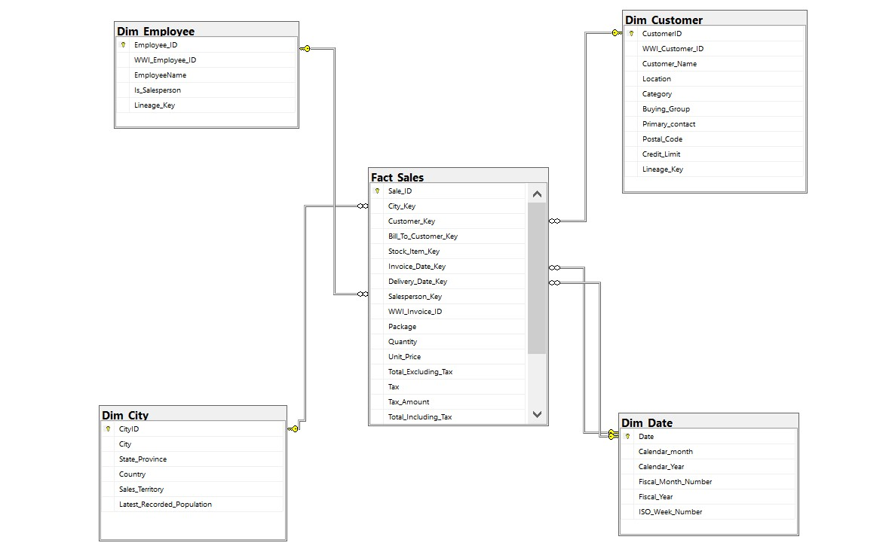
Step4 : Database Design
[Entity Relationship Diagram For Sales Data]

Slide 6
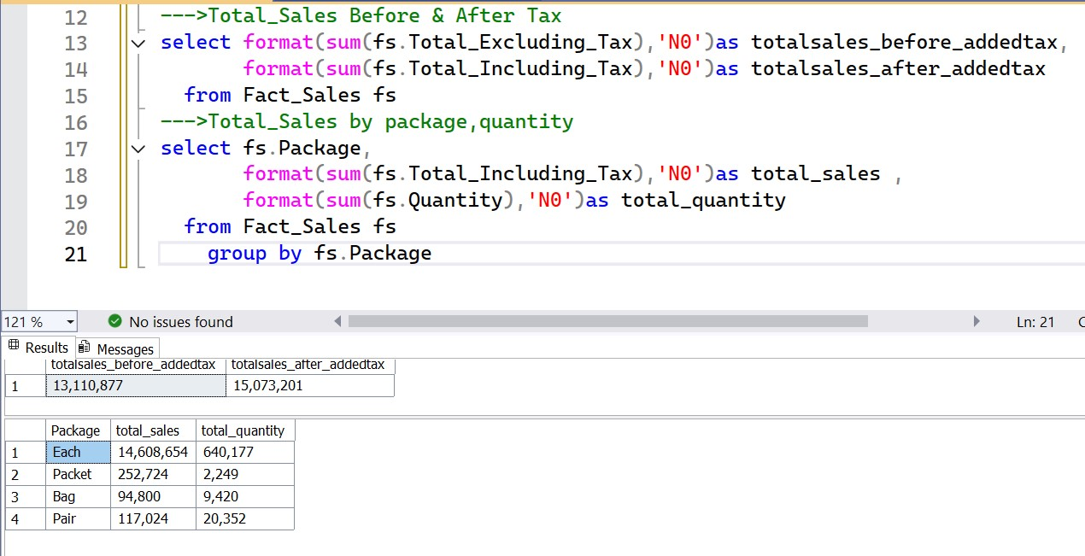
Step5 :Business Insights Extraction Using SQL Queries
After-tax revenue exceeds pre-tax revenue by 2M, showing the tax contribution to total sales.
The results show that “Each” is the highest contributing package type in terms of sales and quantity, while “Bag” represents the lowest contribution, helping identify product demand patterns.

Slide 7
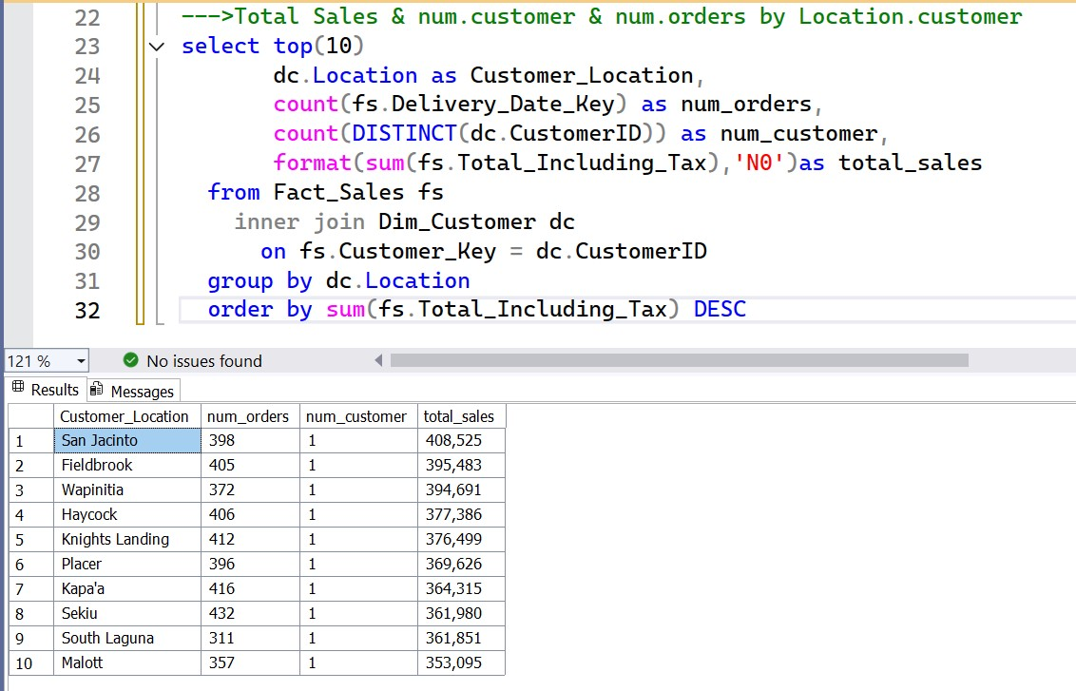
Among the top 10 customer locations, “San Jacinto” generates the highest total sales, while “Mallot” has the lowest contribution. This helps identify key high-performing and low-performing markets.

Slide 8
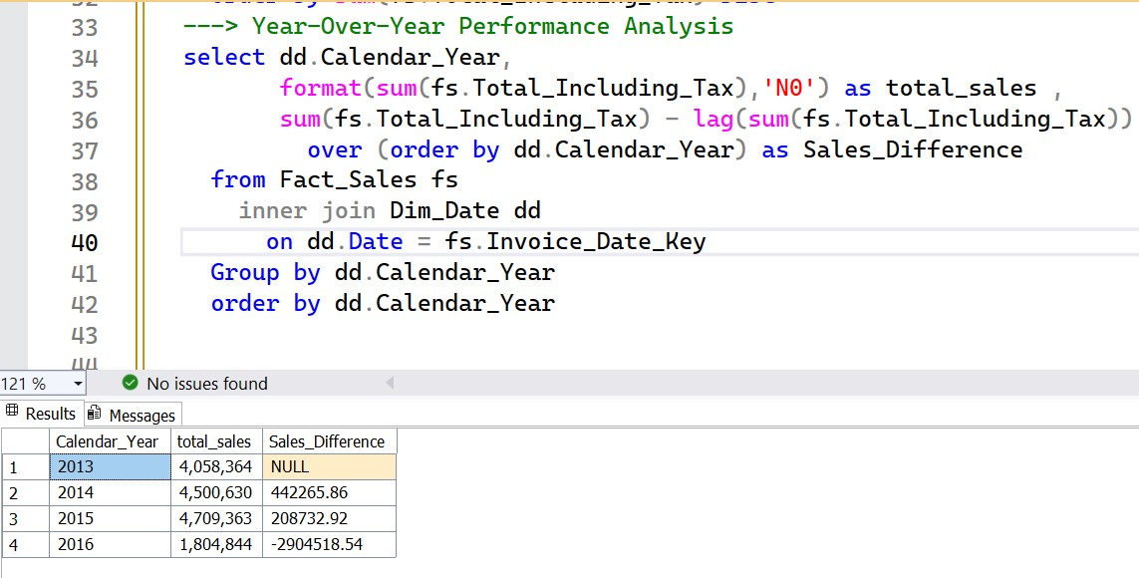
After steady growth from 2013–2015, total sales plunged in 2016, losing three-quarters of revenue. This suggests a critical market or operational issue that needs attention.

Slide 9
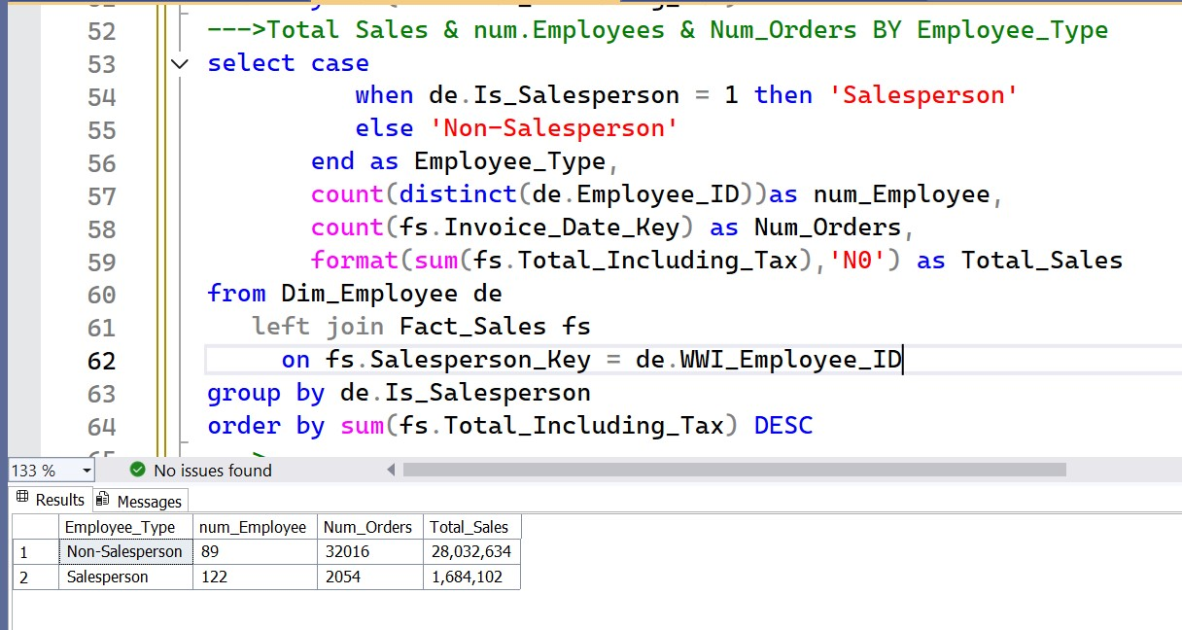
Some sales are recorded under non-sales employees, indicating that transactions can occur without direct sales representative involvement through alternative or automated channels.

Slide 10
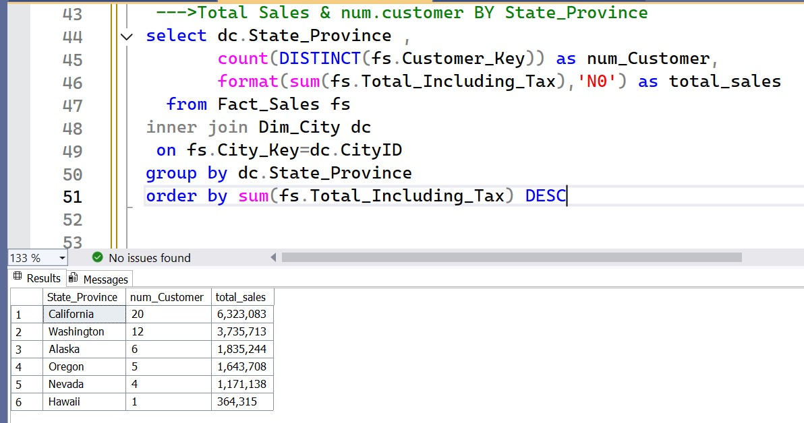
California represents the most profitable region, while Hawaii shows minimal contribution to revenue and customer volume, suggesting opportunities for market expansion or improvement.

Slide 11
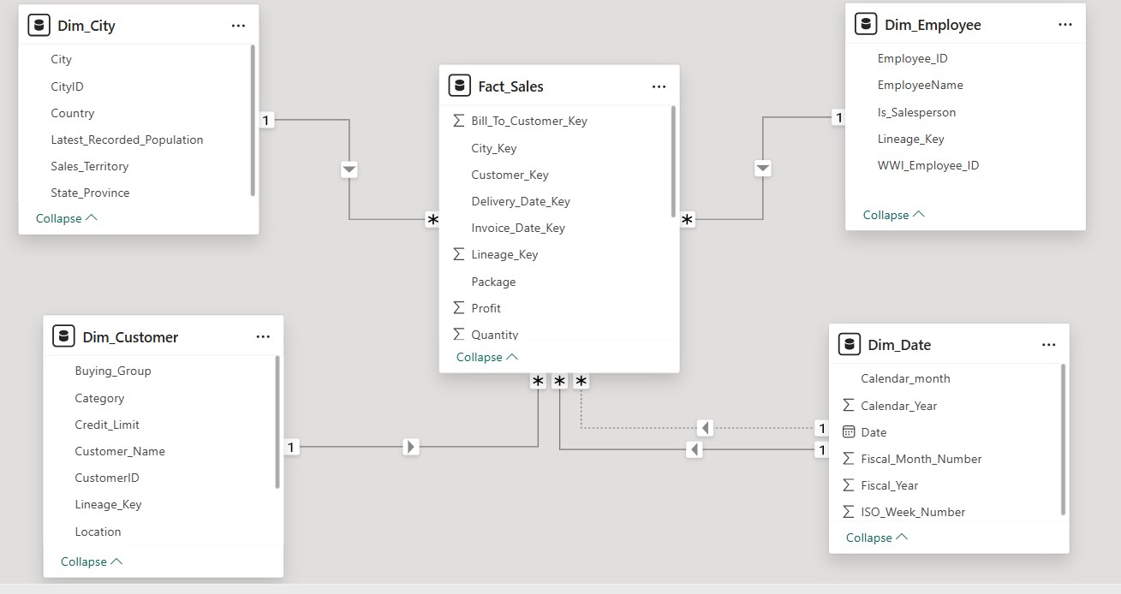
Step6 :Data Modeling

Slide 12
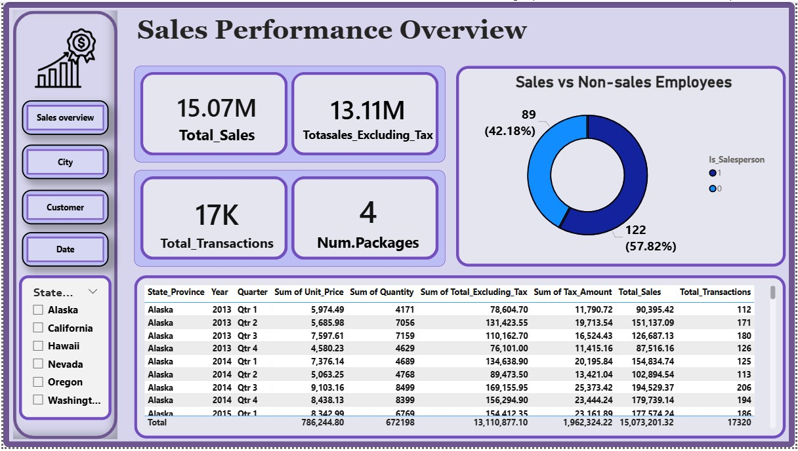

Slide 13
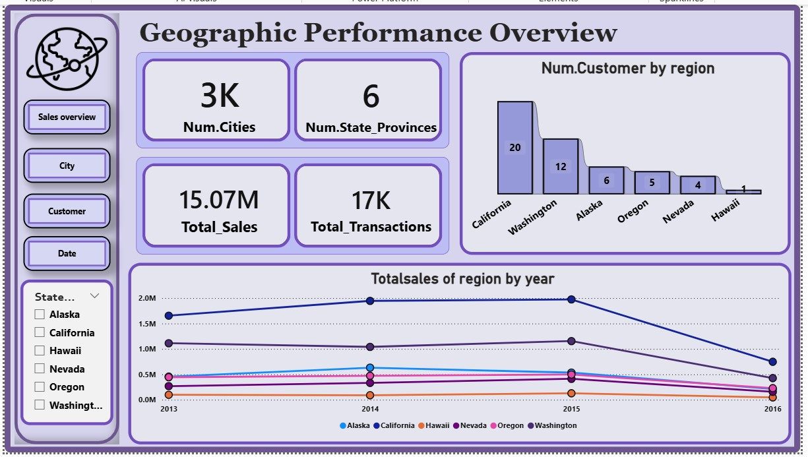

Slide 14
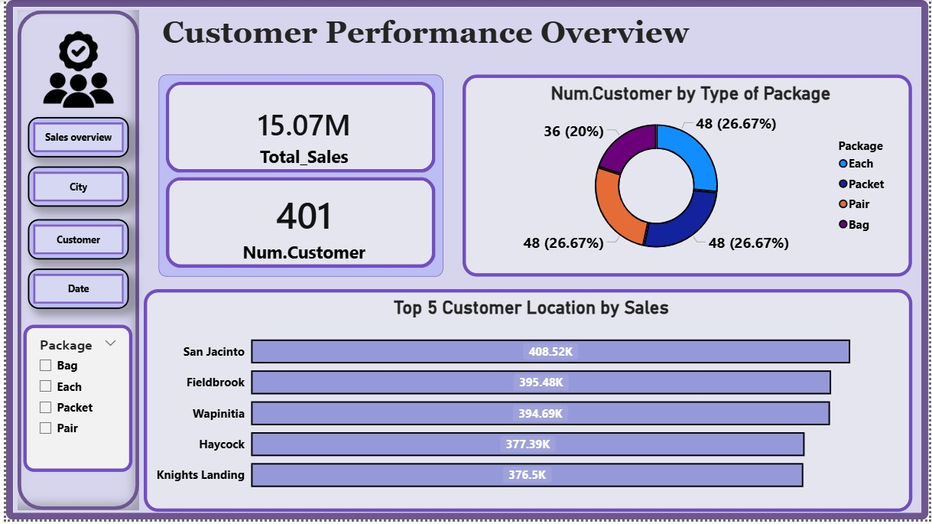

Slide 15
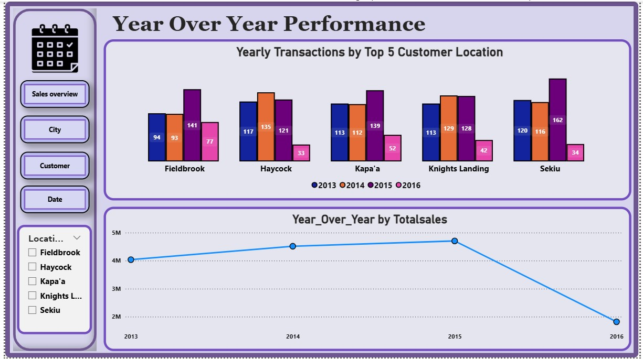

Slide 16
Final Step : Summery and some suggestions
A-Summery
Top Customer Location:
California has the highest number
of customers.
Sales Trend in California:
Sales increased from 2013 to 2015,
then dropped significantly in 2016.
Company-wide Sales:
The highest total sales occurred
in 2015, while the lowest were in
2016.
B-Suggestions
Focus on California:
Since California has the highest number of customers and showed strong sales growth until 2015, the company should consider targeted marketing campaigns or promotions in this region to retain and increase customer engagement.
Analyze 2016 Sales Drop:
Investigate the sharp decline in sales in 2016, particularly in California, to identify potential causes (market changes, competition, supply issues) and implement corrective actions.

