Slide 1
Array Level Steady State Detection for ZFS Storage Servers
A Case Study
Ryan McKenzie
iXsystems

Slide 2
Agenda
Problem Statement
Previous Work
Proposed Solution
Implementation
Results

Slide 3
Problem Statement
Performance Engineers want data to be:
  Repeatable – won’t vary on test order/time
  Applicable – accurate reflection of how the system should perform under the given load
Storage systems and their components/layers are complex.
Test time is very limited compared to customer run time

Slide 4
Problem Statement
Goals:
  Steady State Detection (this talk)
    To prevent measurement in a volatile state
  Preconditioning (next year’s talk?)
    To induce an appropriate steady state on the storage array under test as quickly as possible

Slide 5
Previous Work
Array level steady state detection can be viewed as multiple layers of single device SSD steady state detection…
  SNIA has a widely accepted and applied solution for that problem

Slide 6
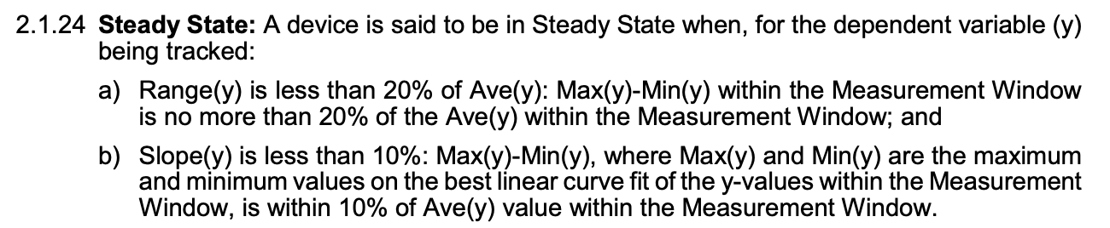
  Solid State Storage (SSS)
  Performance Test Specification (PTS)
From v2.01 (Feb. 2018)
https://www.snia.org/sites/default/files/technical_work/PTS/SSS_PTS_2.0.1.pdf

Slide 7
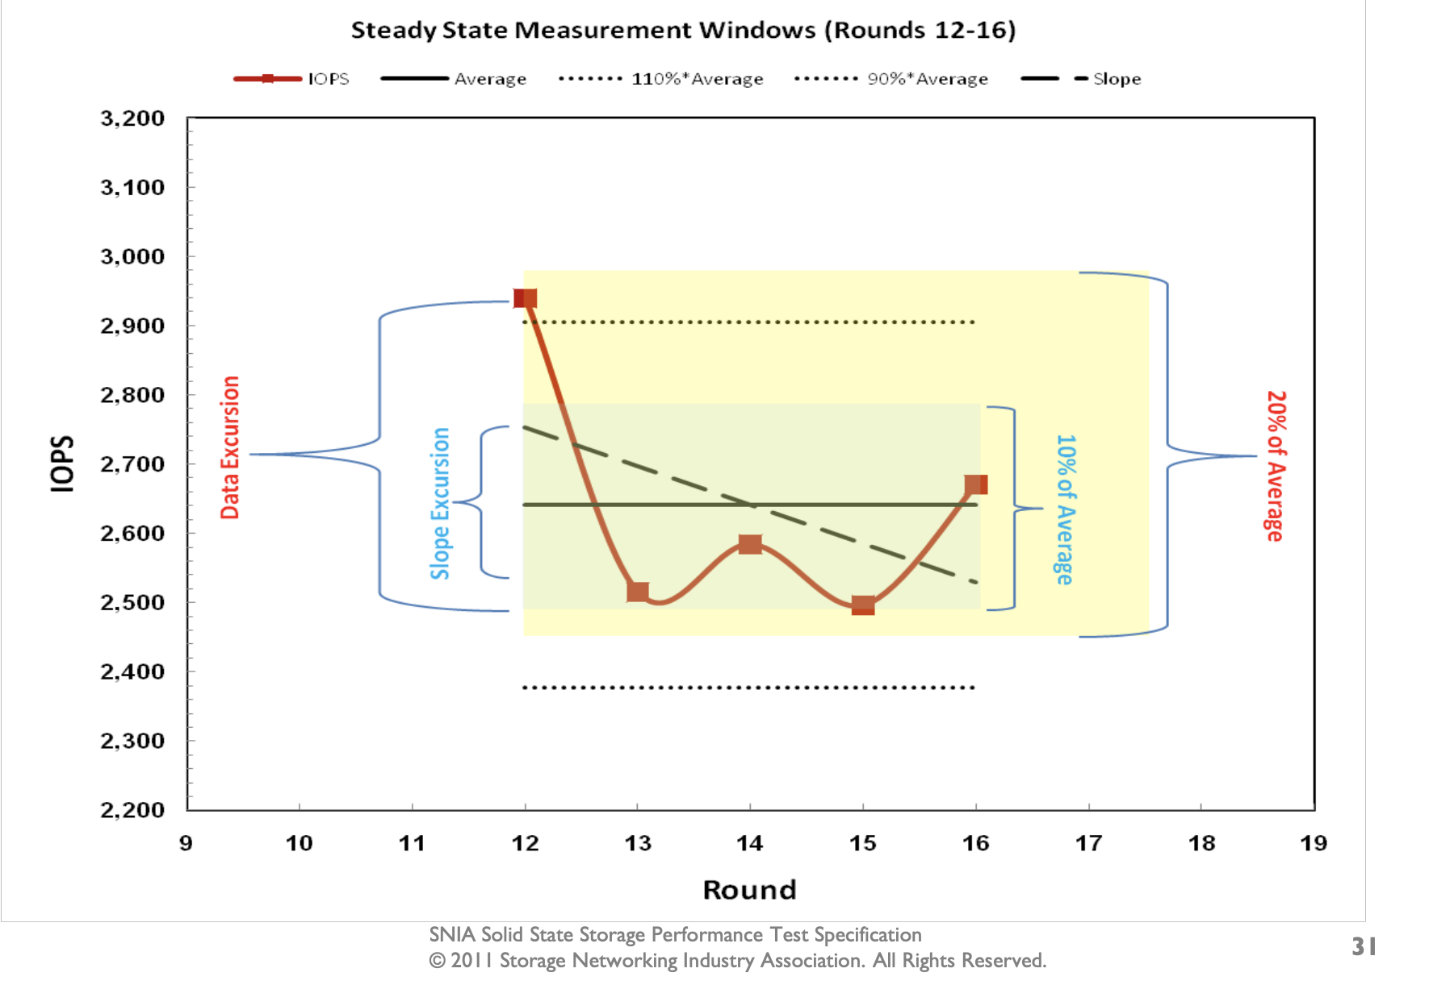
  SNIA Solid State Storage Performance Test Specification (Easen Ho, 2011)
https://www.snia.org/sites/default/files/HoEasen_SNIA_Solid_State_Storage_Per_Test_1_0.pdf

Slide 8
Proposed Solution
Select multiple metrics to gather from a ZFS storage server under load
Subject each metric to the SNIA steady state determination of range and slope

Slide 9
Proposed Solution: Metrics
ARC Metrics
  ARC size
  ARC MRU/MFU makeup
  ARC data/metadata makeup
  ARC hit ratio

Slide 10
Proposed Solution: Metrics
L2ARC Metrics (if applicable)
  L2ARC size
  L2ARC write rate
  L2ARC hit ratio

Slide 11
Proposed Solution: Metrics
ZFS Metrics
  Pool performance (OPS)
  Pool performance (bandwidth)
  Pool Performance (avg op latency)

Slide 12
Proposed Solution: Metrics
All metrics must “do no harm” if collection fails
  Decided failure state is “steady”
All non-performance metrics are normalized to a percentage
  i.e. ARC size is expressed as
  blocks in ARC / max blocks in ARC

Slide 13
Proposed Solution: Challenges
Workload Matters!
  Read/Write Mix
  Active Dataset Size (vs. ARC and L2ARC)
Some metrics may never reach a steady state!
Long and slow warming of L2ARC
  Slope may show as “steady” but performance still not at peak.

Slide 14
Proposed Solution: Heuristics
In such a complex system, it will be very difficult to satisfy all chosen metrics at once…
  Heuristic is to declare system is in steady state if some number of metrics satisfied
Even if metrics are satisfied, are we still warming the caches?
  If so, we continue to wait…

Slide 15
Implementation

Slide 16
Implementation: Metrics
ARC size
  kstat.zfs.misc.arcstats.size / kstat.zfs.misc.arcstats.c_max
ARC MRU/MFU makeup
  arcMRU/(arcMRU+arcMFU)
  arcMRU = kstat.zfs.misc.arcstats.mru_size
  arcMFU = kstat.zfs.misc.arcstats.mfu_size

Slide 17
Implementation: Metrics
ARC data/metadata makeup
  arcDATA/(arcDATA+arcMETA)
  arcDATA = kstat.zfs.misc.arcstats.data_size
  arcMETA = kstat.zfs.misc.arcstats.metadata_size
ARC hit ratio
  arcHITS/(arcHITS+arcMISS)
  arcHITS = kstat.zfs.misc.arcstats.hits
  arcMISS = kstat.zfs.misc.arcstats.misses

Slide 18
Implementation: Metrics
L2ARC size
  kstat.zfs.misc.arcstats.l2_asize / L2CAP
  L2CAP = sum( cache device capacities from “diskinfo” )
L2ARC write rate
  L2writes / vfs.zfs.l2arc_write_max
  L2writes = kstat.zfs.misc.arcstats.l2_write_bytes this interval – last interval
  NOTE: this value can be > 100% due to boost
    In my testing I have set write max == write boost

Slide 19
Proposed Solution: Metrics
L2ARC hit ratio
  l2arcHITS/(l2arcHITS+l2arcMISS)
  l2arcHITS = kstat.zfs.misc.arcstats.l2_hits
  l2arcMISS = kstat.zfs.misc.arcstats.l2_misses

Slide 20
Proposed Solution: Metrics
ZFS Metrics
  Pool performance (OPS)
  Pool performance (bandwidth)
  Pool Performance (avg op latency)

Slide 21
Implementation: Engine
A python Thread class instance
  Upon creation thread will preload constants like L2ARC capacity, ARC max, etc…
  When started, thread will spend a tunable amount of time loading metrics
  When steady state is decalred, can signal benchmark to begin measurement
  Can be stopped early using Thread event

Slide 22
Implementation: Engine
Collect all metrics every INTERVAL seconds
  Default 15s, tunable
Once WINDOW of intervals is collected, begin calculating range and slope for steady state
  Default 20 intervals, tunable
  Recommend window at least as long as benchmark measurement period

Slide 23
Implementation: Heuristics
If 7 of the current 10 metrics are satisfied, we declare system to be in steady state
  Tunable
In testing, we have the luxury of knowing:
  Active dataset size
  Caches were clear before this test
If metrics are satisfied, we still wait until at least 85% of the ADS is ”in cache”
  Assuming we have 10% or more cache free space available

Slide 24
Results

Slide 25
Solution Under Test
FreeBSD+OpenZFS based storage server
  512G main memory
  4x 1.6TB NVMe drives as L2ARC
    Enterprise-grade dual port PCIeG3
  142 2TB SAS HDDs in 71 mirror vdevs
  1x 100GbE NIC (optical QSFP+)
  Tested with various iSCSI, NFSv3, and SMB workloads

Slide 31
Conclusions
Reduction in test time for deliverables
  Test Engineer Time
  System Time
Better Repeatability
Better Baselines/Comparability
Still room for Improvement!

Slide 32
Future Work: Metrics
A better way to collect pool op latency
Avg. device busy for different pool device classes
  i.e. data, SLOG, cache, fusion

Slide 33
Thank You!

Slide 34
References
Solid State Storage (SSS) Performance Test Specification (PTS) - V2.01
  www.snia.org/sites/default/files/technical_work/PTS/SSS_PTS_2.0.1.pdf
SNIA Solid State Storage Performance Test Specification (Easen Ho, 2011)
  www.snia.org/sites/default/files/HoEasen_SNIA_Solid_State_Storage_Per_Test_1_0.pdf
“ARC: A Self-Tuning, Low Overhead Replacement Cache”
  Nimrod Megiddo and Dharmendra S. Modha
  2nd USENIX Conference on File Storage Technologies (2003)
  www.usenix.org/conference/fast-03/arc-self-tuning-low-overhead-replacement-cache
“Activity of the ZFS ARC”, Brendan Gregg’s Blog (January 9, 2012)
  dtrace.org/blogs/brendan/2012/01/09/activity-of-the-zfs-arc/
“ZFS L2ARC”, Brendan Gregg’s Blog (July 22, 2008)
  www.brendangregg.com/blog/2008-07-22/zfs-l2arc.html

Slide 35
Please take a moment to rate this session.
Your feedback matters to us.

Slide 36
Subhead
  Example 1
  Example 2
Subhead

Slide 39
Bullet one
  Bullet two
    Bullet 3
      Bullet 4

